Slide 1
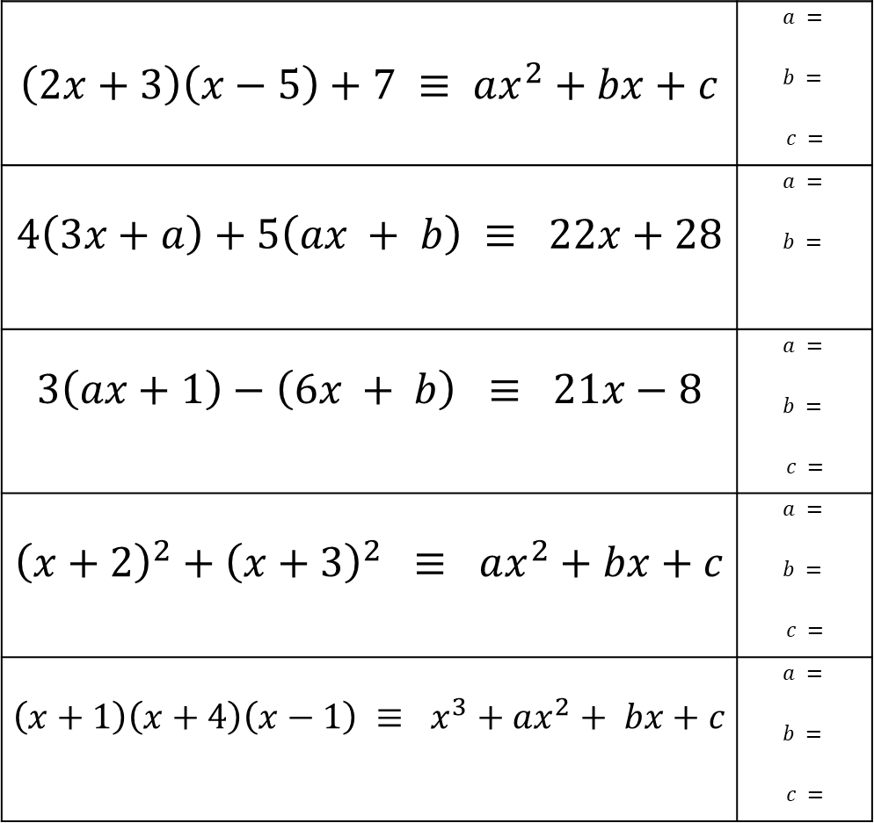
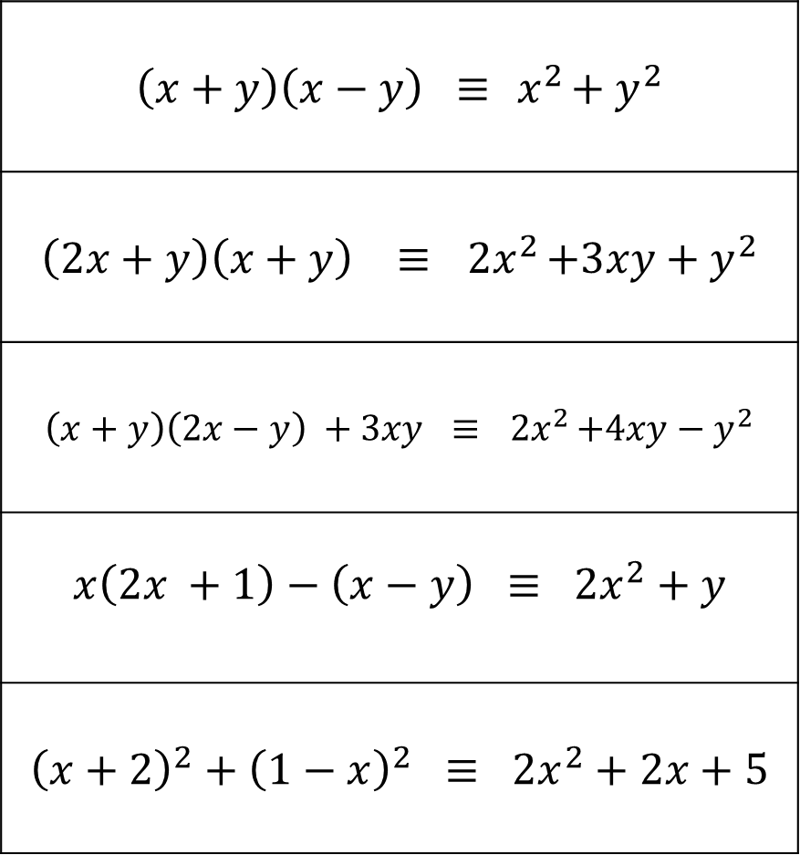
Show that the following Identities are true.
Find the missing numbers of these Identities
$$\left(x+y\right)\left(x−y\right) ≡{ x}^{2}+{ y}^{2}$$
$$\left(2x+y\right)\left(x+y\right) ≡{ 2x}^{2}+3xy+y^{2}$$
$$\left(x+y\right)\left(2x−y\right) +3xy ≡{ 2x}^{2}+4xy−y^{2}$$
$$x\left(2x +1\right)−\left(x−y\right) ≡ 2x^{2}+y$$
$${\left(x+2\right)}^{2}+{\left(1−x\right)}^{2} ≡ 2x^{2}+2x+5$$
$$\left(2x+3\right)\left(x−5\right)+7 ≡ ax^{2}+bx+c$$ | $$a =$$ $$b =$$ $$c =$$
$$4\left(3x+a\right)+5\left(ax + b\right) ≡ 22x+28$$ | $$a =$$ $$b =$$
$$3\left(ax+1\right)−\left(6x + b\right) ≡ 21x−8$$ | $$a =$$ $$b =$$ $$c =$$
$${\left(x+2\right)}^{2}+{\left(x+3\right)}^{2} ≡ ax^{2}+bx+c$$ | $$a =$$ $$b =$$ $$c =$$
$$\left(x+1\right)\left(x+4\right)\left(x−1\right) ≡ x^{3}+ax^{2}+ bx+c$$ | $$a =$$ $$b =$$ $$c =$$

Slide 2
ANSWERS

Slide 3
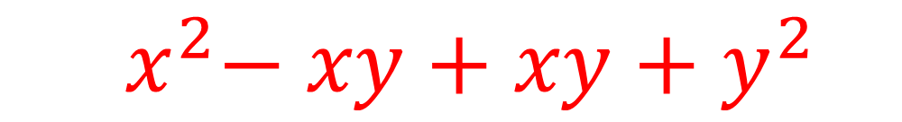
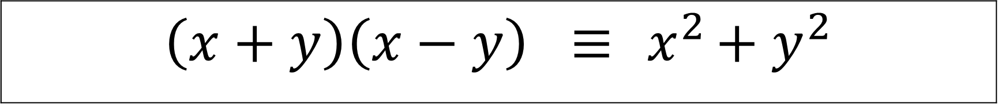

Show that the following Identities are true.
$$\left(x+y\right)\left(x−y\right) ≡{ x}^{2}+{ y}^{2}$$
$${ x}^{2}− xy+xy+{ y}^{2}$$
$${ x}^{2}+{ y}^{2}$$

Slide 4
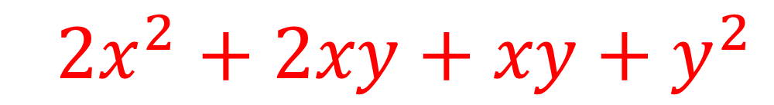
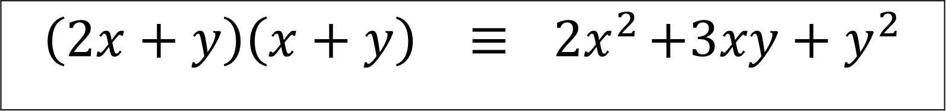

Show that the following Identities are true.
$$\left(2x+y\right)\left(x+y\right) ≡{ 2x}^{2}+3xy+y^{2}$$
$${ 2x}^{2} + 2xy+xy+{ y}^{2}$$
$${ 2x}^{2} + 3xy+y^{2}$$

Slide 5
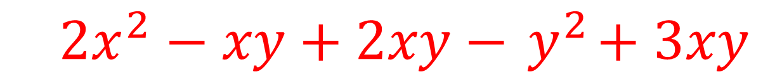
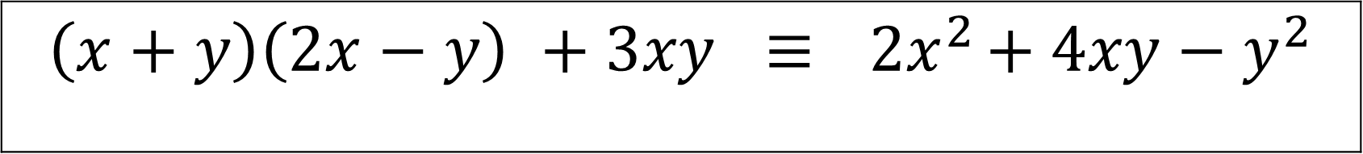

Show that the following Identities are true.
$$\left(x+y\right)\left(2x−y\right) +3xy ≡{ 2x}^{2}+ 4xy−y^{2}$$
$${ 2x}^{2} − xy+2xy−{ y}^{2}+ 3xy$$
$${ 2x}^{2} + 4xy−y^{2}$$

Slide 6

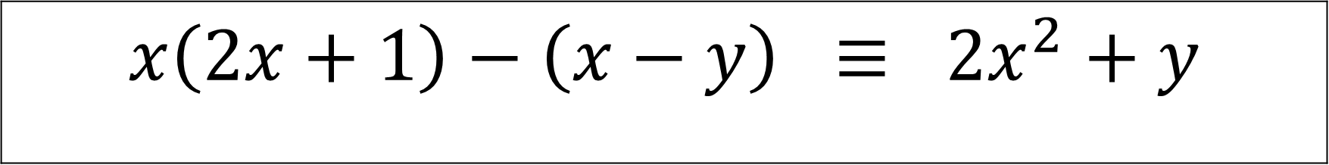

Show that the following Identities are true.
$$x\left(2x+1\right)−\left(x−y\right) ≡ 2x^{2}+y$$
$${ 2x}^{2} + x−x+y$$
$${ 2x}^{2} + y$$

Slide 7
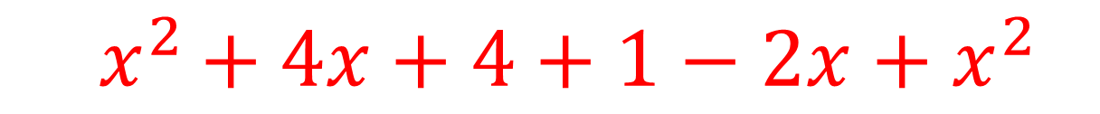
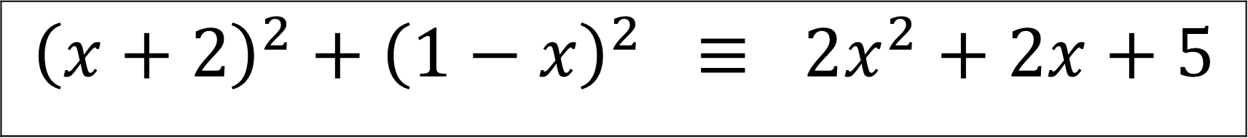

Show that the following Identities are true.
$${\left(x+2\right)}^{2}+{\left(1−x\right)}^{2} ≡ 2x^{2}+2x+5$$
$${ x}^{2 }+ 4x+4+{1−2x+x}^{2}$$
$$2x^{2}+2x+5$$

Slide 8

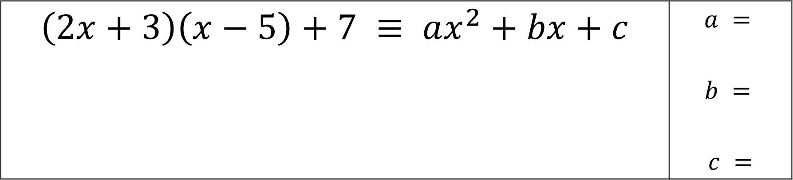

Find the missing numbers of these Identities
$$\left(2x+3\right)\left(x−5\right)+7 ≡ ax^{2}+bx+c$$ | $$a =$$ $$b =$$ $$c =$$
$${ 2x}^{2} −10x+3x−15+7$$
a = 2
b = -7
c = -8
$${ 2x}^{2} − 7x−8$$

Slide 9

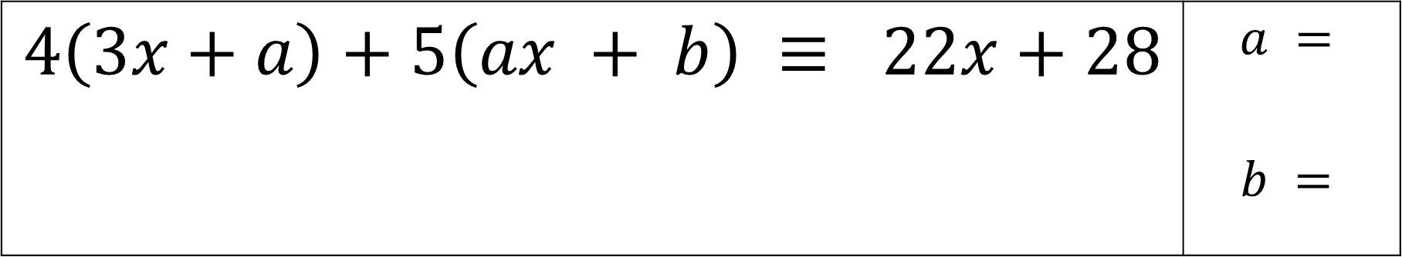

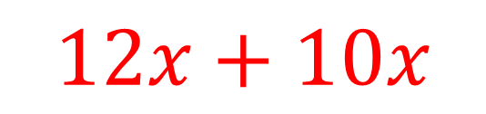
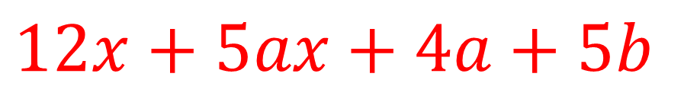
Find the missing numbers of these Identities
$$4\left(3x+a\right)+5\left(ax + b\right) ≡ 22x+28$$ | $$a =$$ $$b =$$
$$12x+4a+5ax+5b$$
$$12x+5ax+4a+5b$$
a = 2
b = 4
$$12x+10x$$
$$+ 8+5b$$

Slide 10

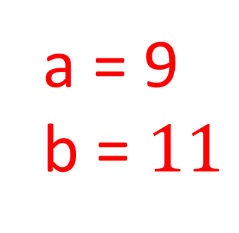
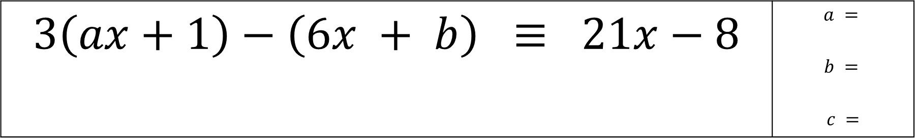
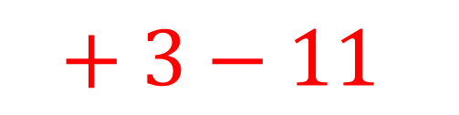
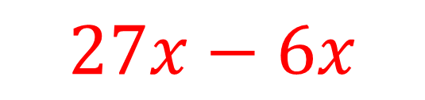
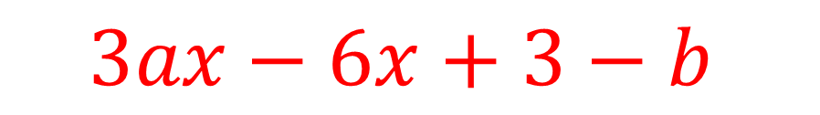
Find the missing numbers of these Identities
$$3\left(ax+1\right)−\left(6x + b\right) ≡ 21x−8$$ | $$a =$$ $$b =$$ $$c =$$
$$3ax+3−6x−b$$
$$3ax−6x+3−b$$
a = 9
b = $11$
$$27x−6x$$
$$+ 3−11$$

Slide 11
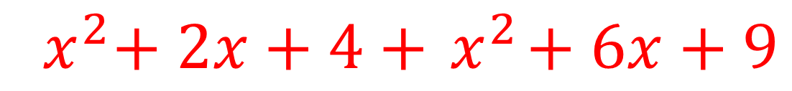
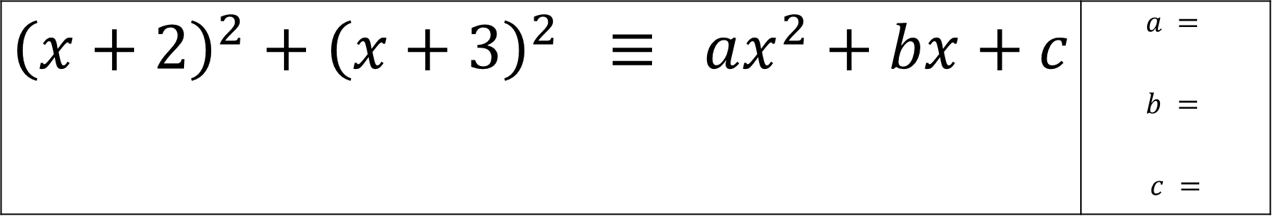
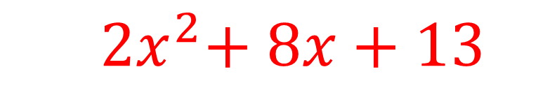
Find the missing numbers of these Identities
$${\left(x+2\right)}^{2}+{\left(x+3\right)}^{2} ≡ ax^{2}+bx+c$$ | $$a =$$ $$b =$$ $$c =$$
$${ x}^{2}+ 2x+4+{ x}^{2}+ 6x+9$$
a = 2
b = 8
c = 13
$${ 2x}^{2}+ 8x+13$$

Slide 12

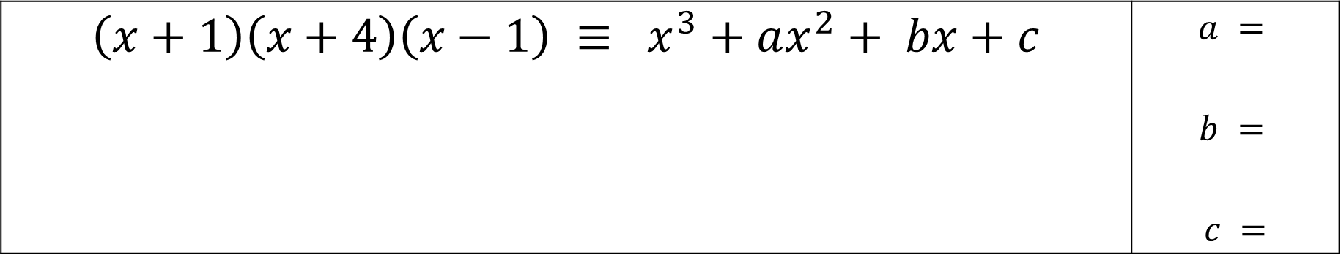

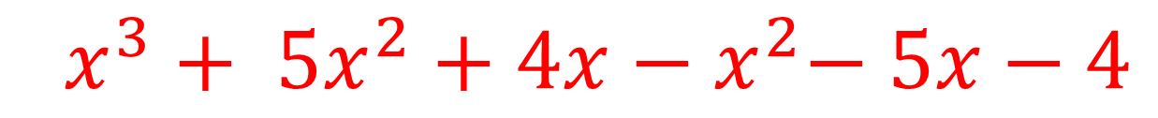
Find the missing numbers of these Identities
$$\left(x+1\right)\left(x+4\right)\left(x−1\right) ≡ x^{3}+ax^{2}+ bx+c$$ | $$a =$$ $$b =$$ $$c =$$
$${ (x}^{2}+ 5x+4)(x−1)$$
a = 4
b = -1
c = -4
$${ x^{3}+ 5x^{2}+4x−x}^{2}− 5x−4$$
$$x^{3}+4x^{2}−x−4$$

