Slide 1

Junior Challenge 5
GOLD

Slide 2
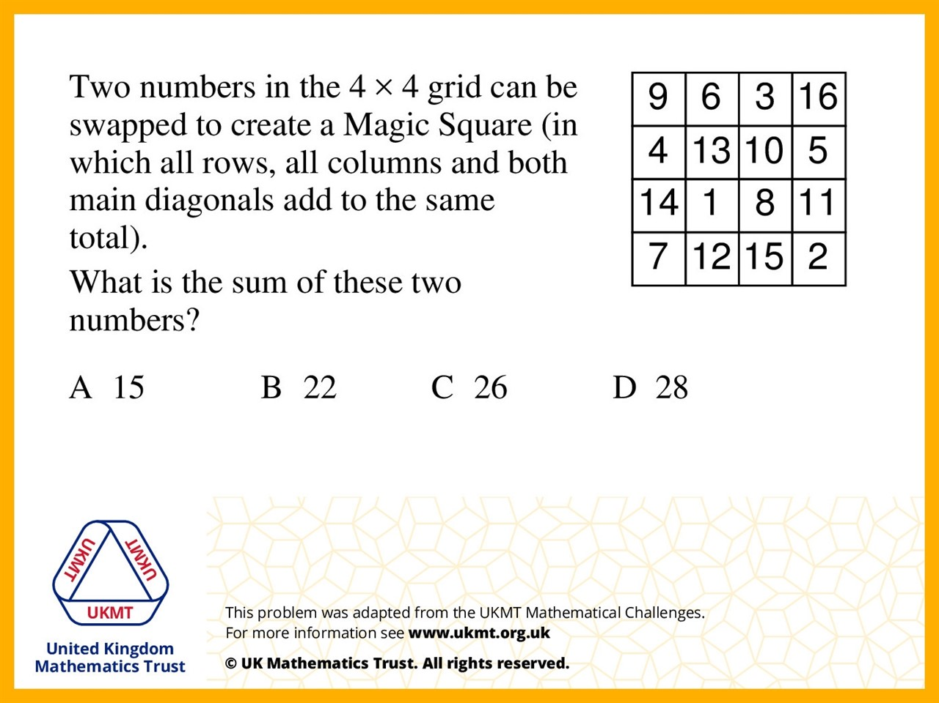
Q1.
13 and 15 need to swap so all the rows and columns and diagonals sum to 34

Slide 3
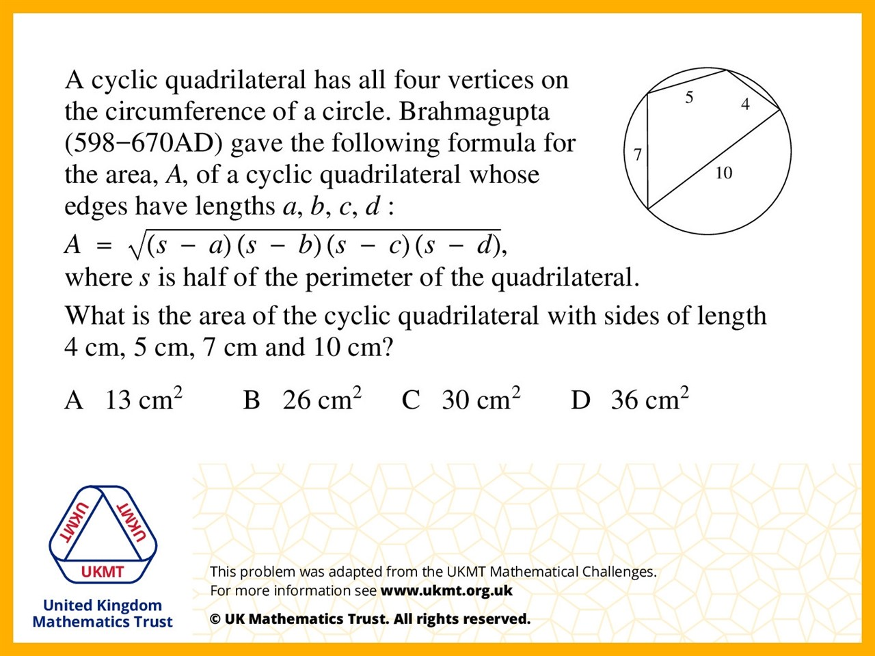
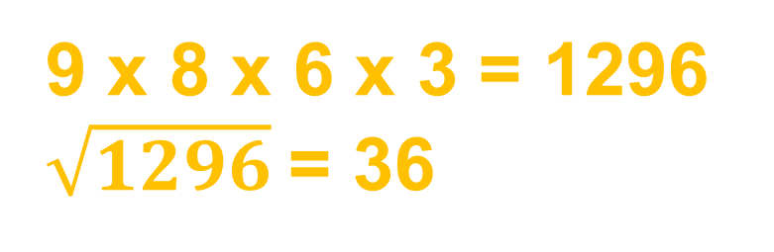
Q2.
9 x 8 x 6 x 3 = 1296
$\sqrt{1296}$= 36

Slide 4
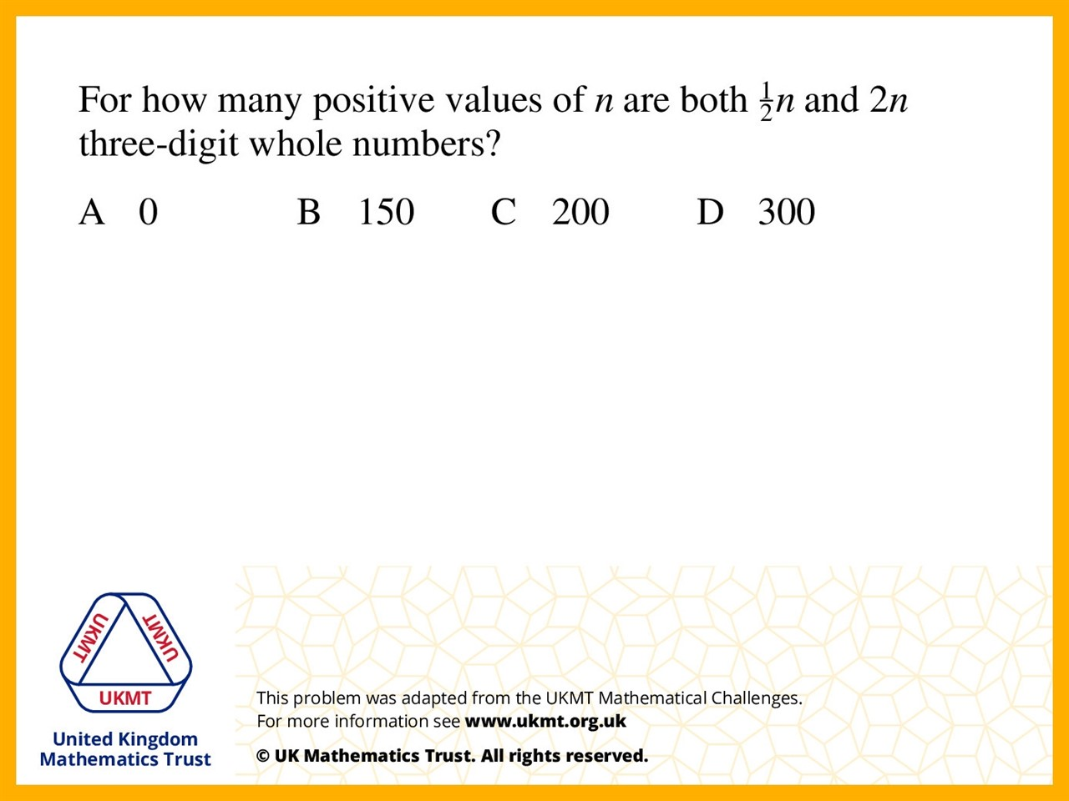
Q3.
It has to be more than 200
and less than 500 to get a number that is 3 digits.
Divide 300 by 2 because it can only be even numbers as it said whole numbers only.

Slide 5
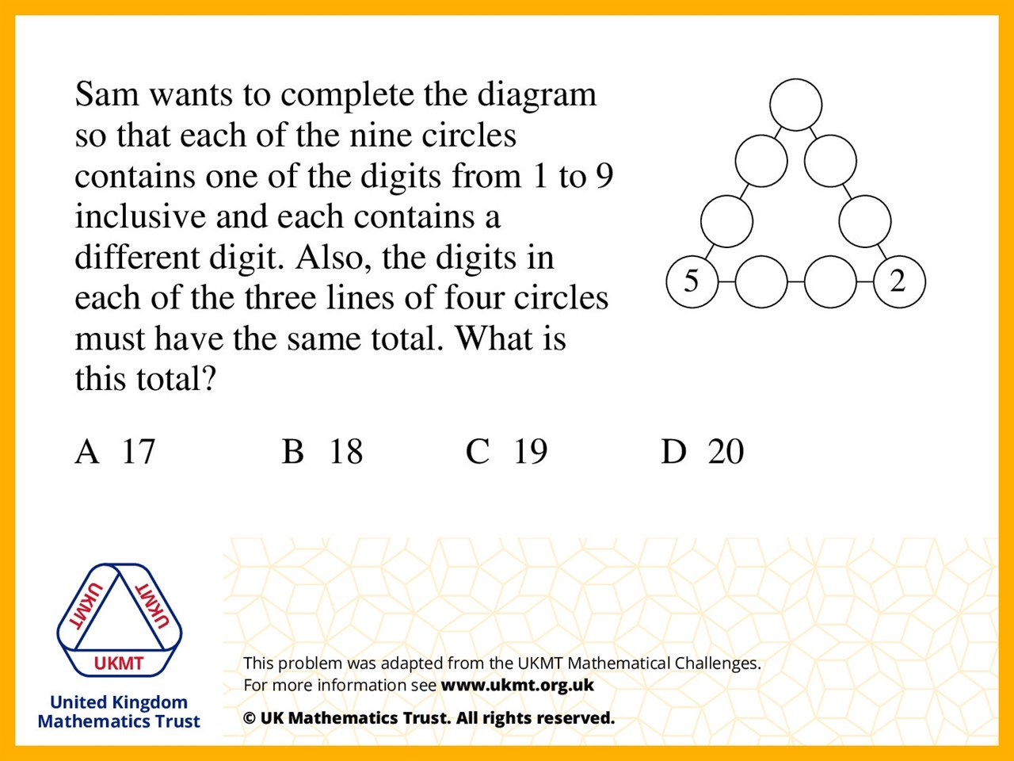
Q4.
Clockwise from the top
8, 1, 9, 2, 7, 6, 5, 4, 3

Slide 6
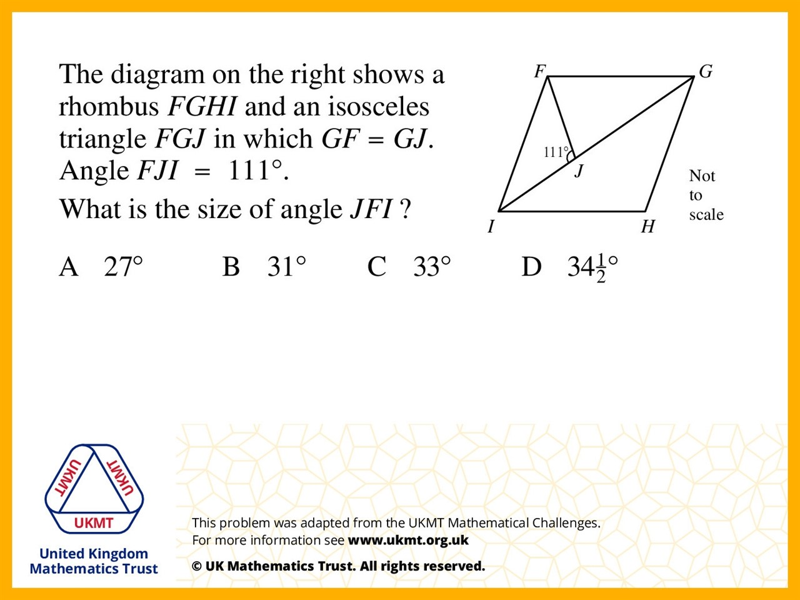
Q5.
FJG = 180 – 111 = 69
69 x 2 = 138
JGF and FIJ = 180 –138 = 42
JFI = 180 – 111 – 42 = 27

