Slide 1
Trigonometry and Modelling
a sin x + b cos x
Modelling
Chapter 7
(Part 6 of 6)

Slide 2
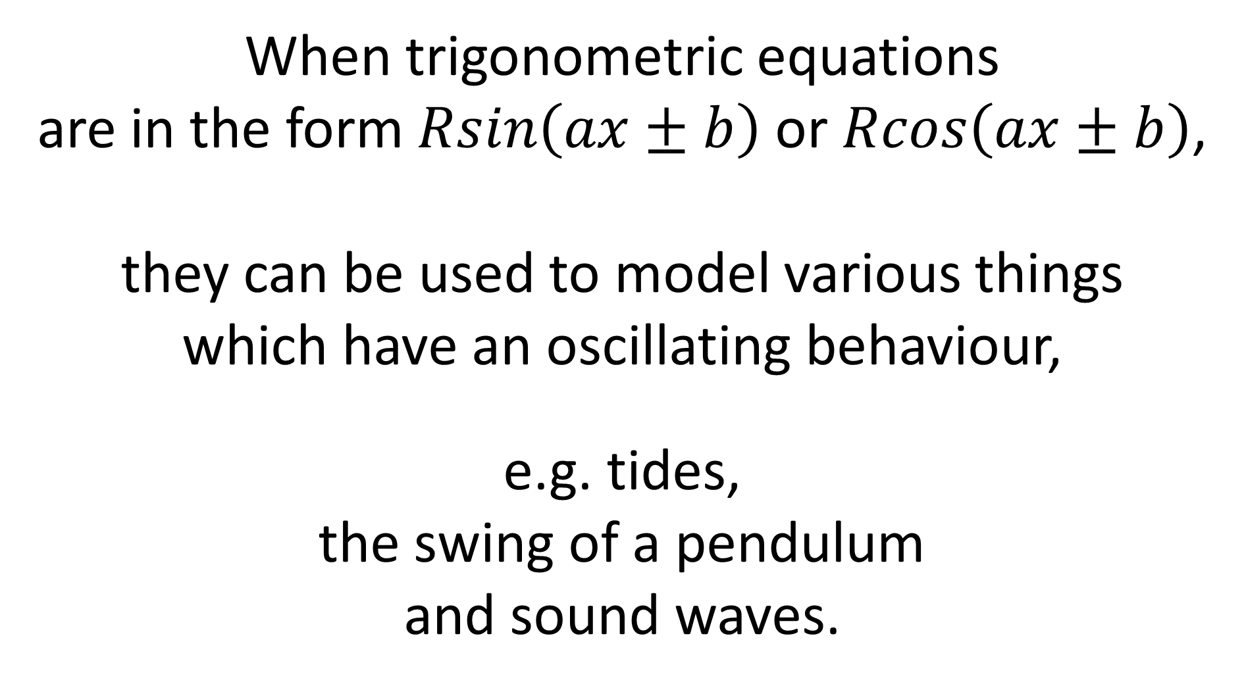
When trigonometric equations
are in the form $Rsin\left(ax±b\right)$ or $Rcos\left(ax±b\right)$,
they can be used to model various things
which have an oscillating behaviour,
e.g. tides,
the swing of a pendulum
and sound waves.

Slide 3
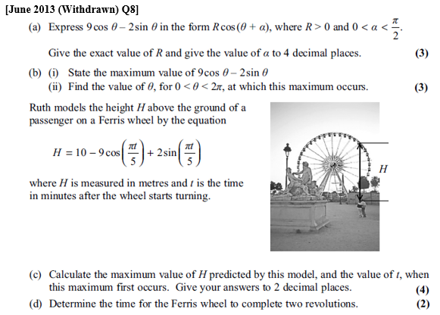

Slide 4
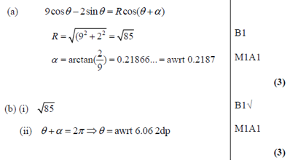

Slide 6
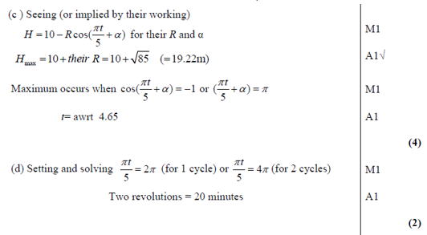

Slide 8
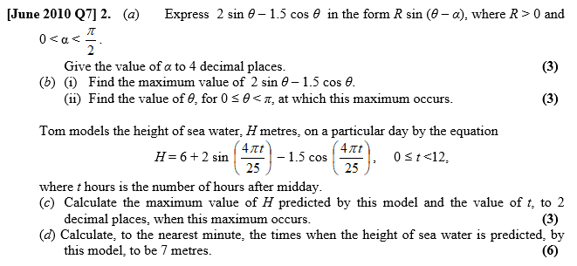

Slide 9
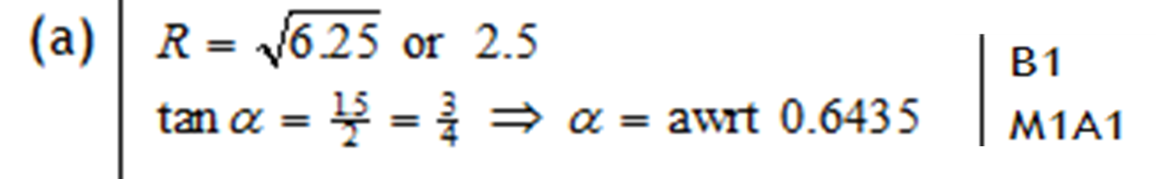

Slide 10
