Slide 1


Save Santa
Escape Room
Share the link with you students.
https://1drv.ms/u/s!Aj4WP89uhvbzgd5aMQgIjJ1pqN5Z2w?e=JtlpKx

Slide 2
It is the night before Christmas and the evil Grinch has sneaked into Santa’s house and
put locks on all the doors!
Can you release him in time for Christmas?!

Slide 3
Instructions
Find the code in each room and use it to
unlock the next room.
I recommend writing down your answers
as you progress.
Always use CAPITAL LETTERS
for passwords.
Now go and free Santa!

Slide 4
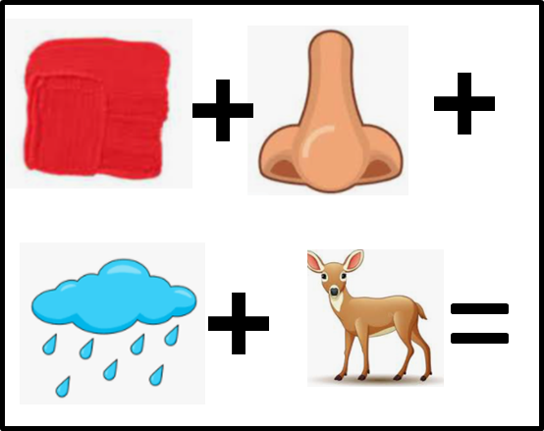
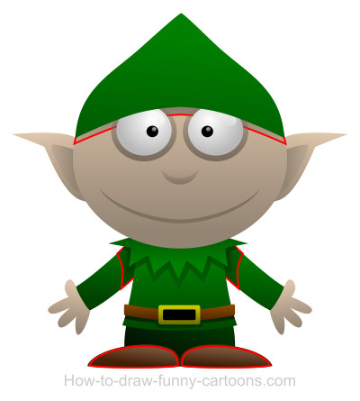
Santa has trained his elves to only let people through the front door when given the magic word.
Use the picture equation to work it out.
Notes:
RUDOLPH

Slide 5

You have made it into Santa’s living room.
50
25
2
5
5
Above is the prime factor Christmas tree for 50. Construct a prime factor Christmas tree for 360 and write your numbers in descending order
Notes:
533222

Slide 6
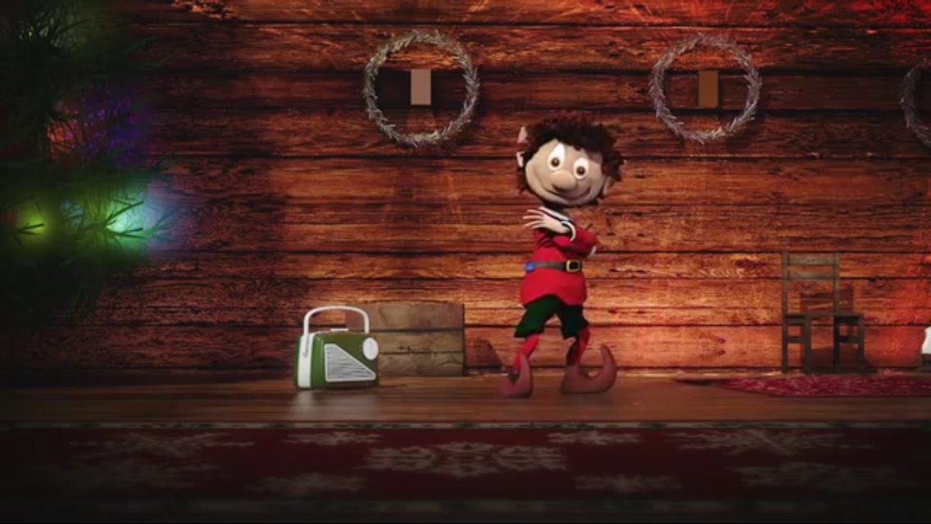
You are now in Santa’s grotto.
50 cm
Dorabella the Elf says he will help you if you tell him the height of the tree.
80 cm
100 cm
120 cm
150 cm
180 cm
80 cm
80 cm
Notes:
310

Slide 7
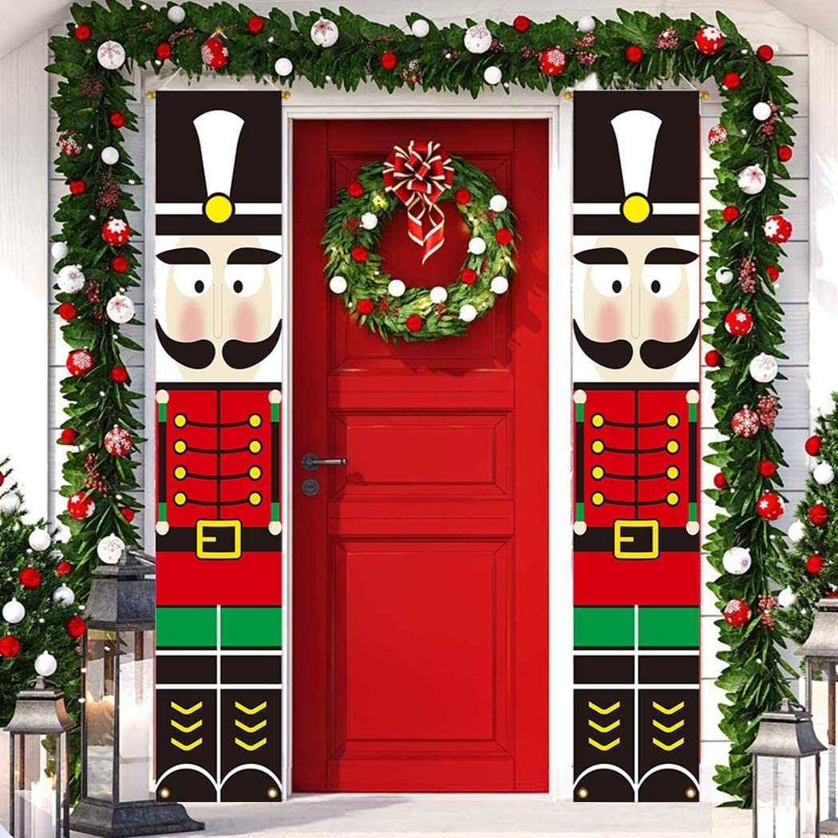
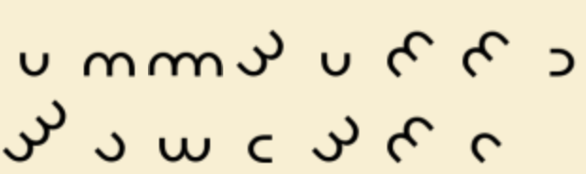
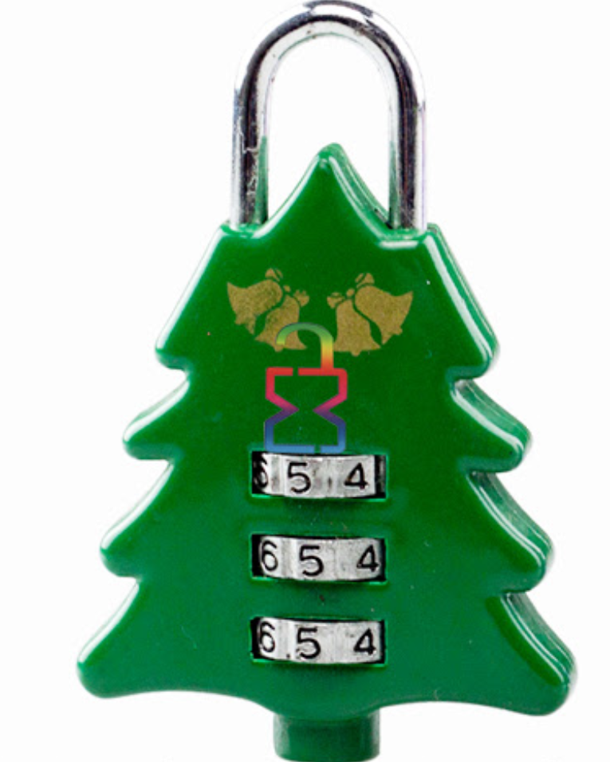
Dorabella Cypher
Break the code. The Elf realises that the code on the door was his favourite type of code of all. So much so that he was named after it.
Notes:
The code says THIRTEENSQUARED
Password is: 169
You may need to direct students to google search “dorabella cypher” if they don’t get it from the clues.

Slide 8
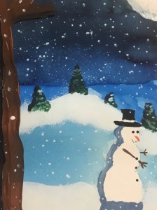
8cm
You find yourself in the courtyard
12cm
The code for the hallway is the total area of the snowman rounded to the nearest cm
7cm
3cm
6cm
56cm
22cm
14cm
Notes:
911

Slide 9
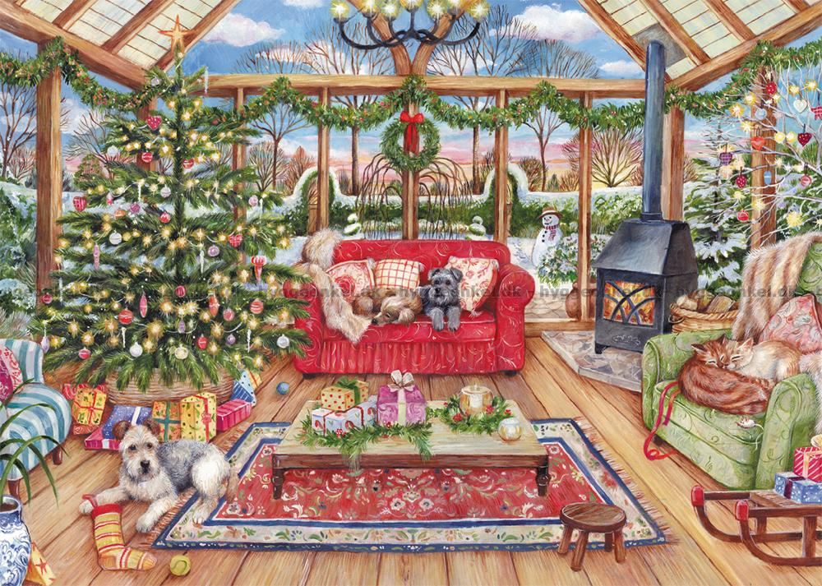
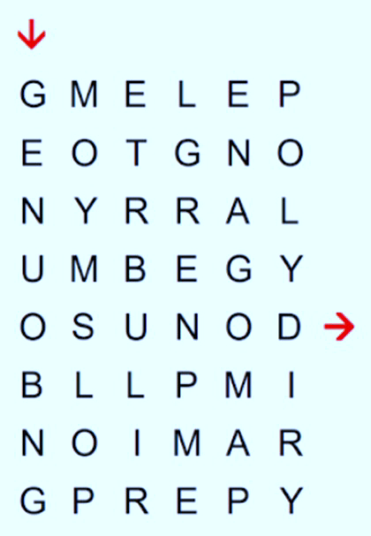
Santa’s Conservatory
Can you get through the maze by just following maths words? No diagonals!
The code for the next door is the first letter of each word
Notes:
GEOMETRY NUMBER ANGLE POLYGON PLUS OBLONG PRIME PYRAMID
GNAPPOPP

Slide 10
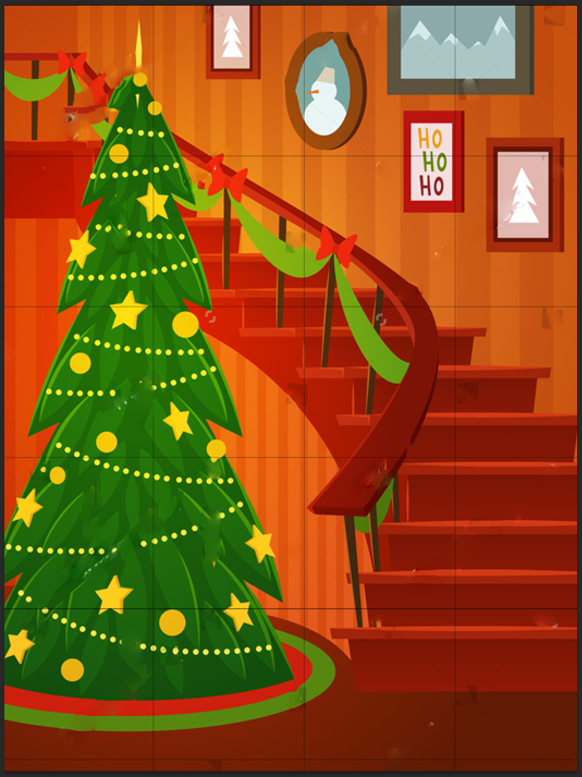


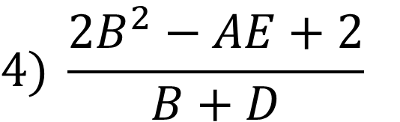


Deck the Halls
A = number of steps
B = number of stars
C = number of baubles
D = number of carrots
E = negative number of “Ho”s
$$1) AB−CD$$
$$2) A−5E$$
$$3) 4E^{2}+D$$
$$4) \frac{2B^{2}−AE+2}{B+D}$$
$$5) \sqrt{4\left(A+B\right)+E}$$
Notes:
Students may need to be told that they just write the answers out. No Space.
98 27 37 20 9

Slide 11
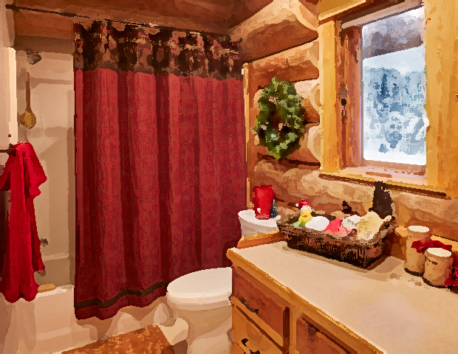
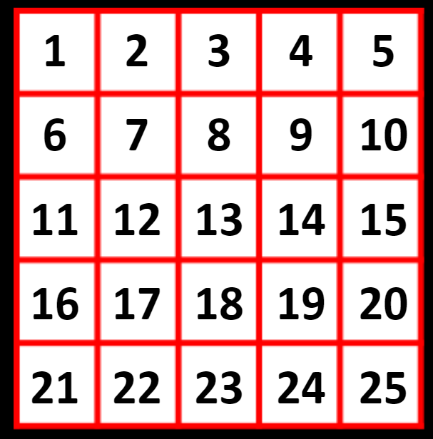
Santa’s Bathroom
Cross out:
Numbers 1 less than a multiple of 5
Prime numbers
Factors of 120
Square numbers
What numbers are left over?
Notes:
182122

Slide 12
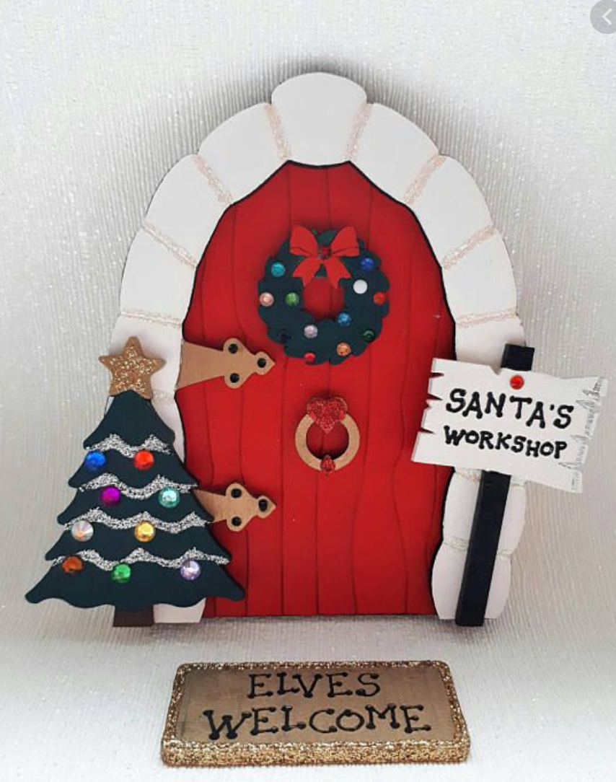
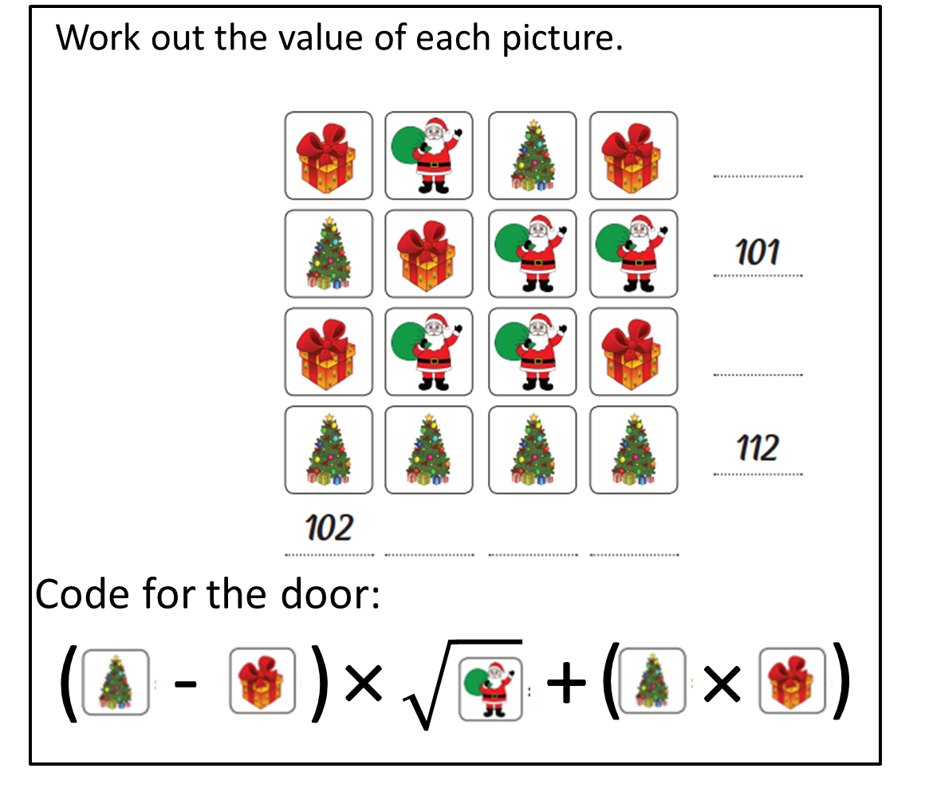
You have arrived at the door to Santa’s bedroom!
Bedroom
Notes:
669

Slide 13
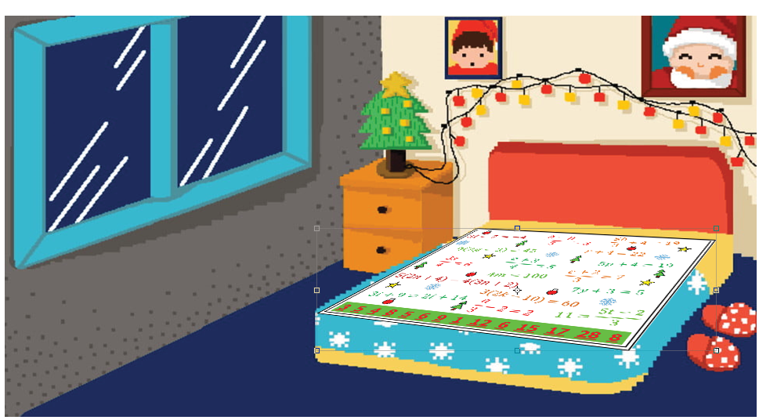

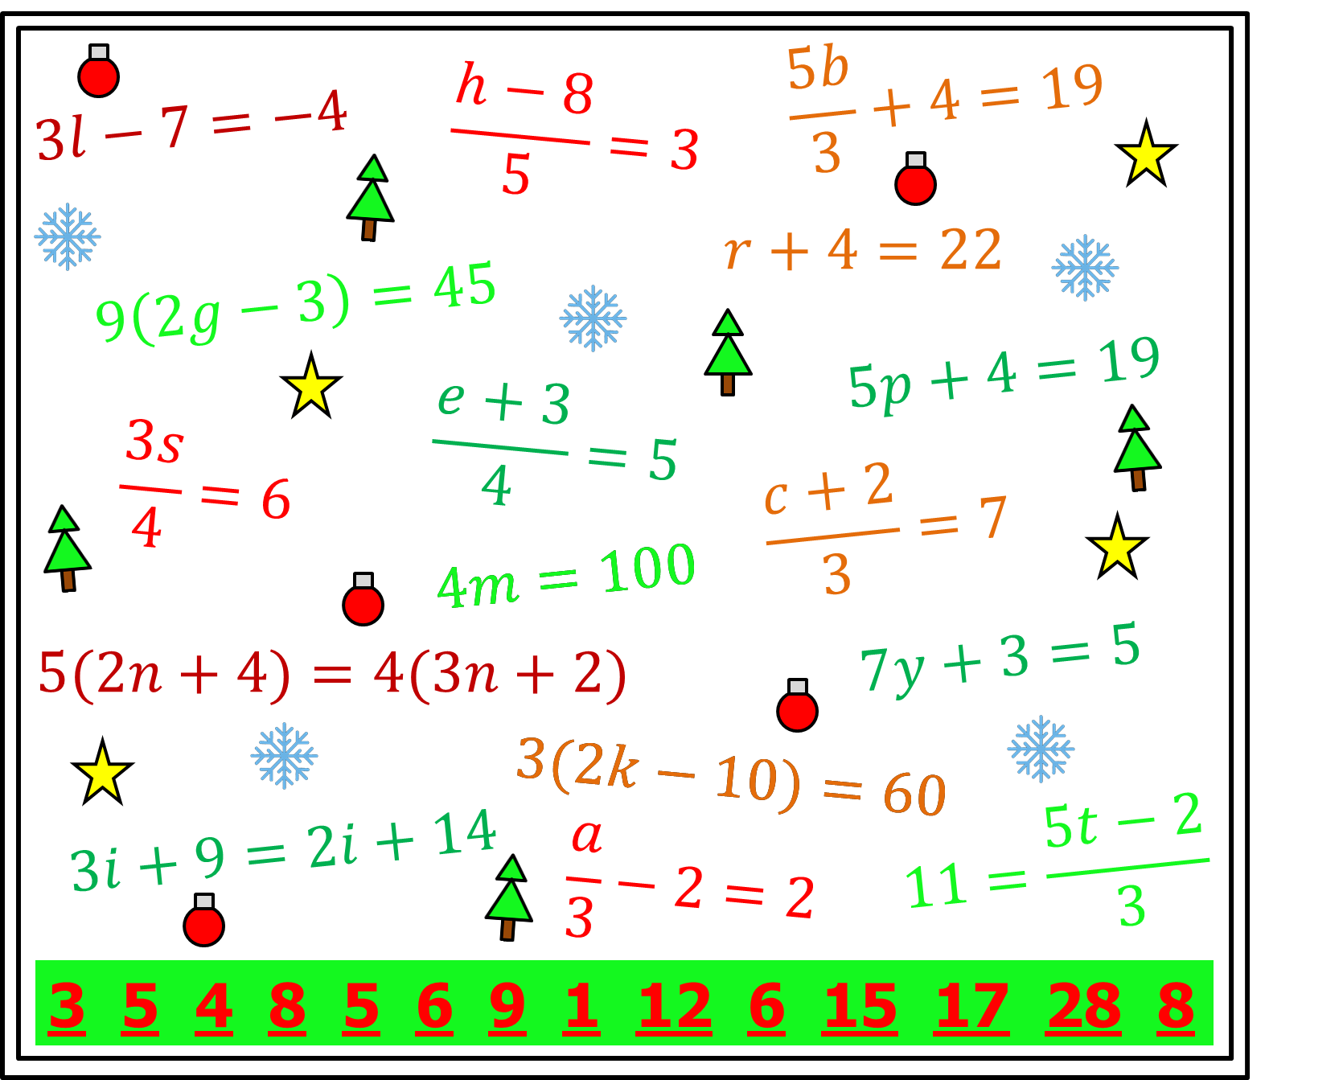
You make it into the bedroom but Santa is nowhere to be seen!? You call out to him and hear a faint “hello” coming from the wardrobe. He is too scared and has locked himself inside. He won’t come out unless you say the secret phrase and prove that you are not the Grinch! Maybe there is a clue on Santa’s duvet?
Notes:
PIGSINBLANKETS

Slide 14
Notes:
Pigs in Blankets

Slide 15
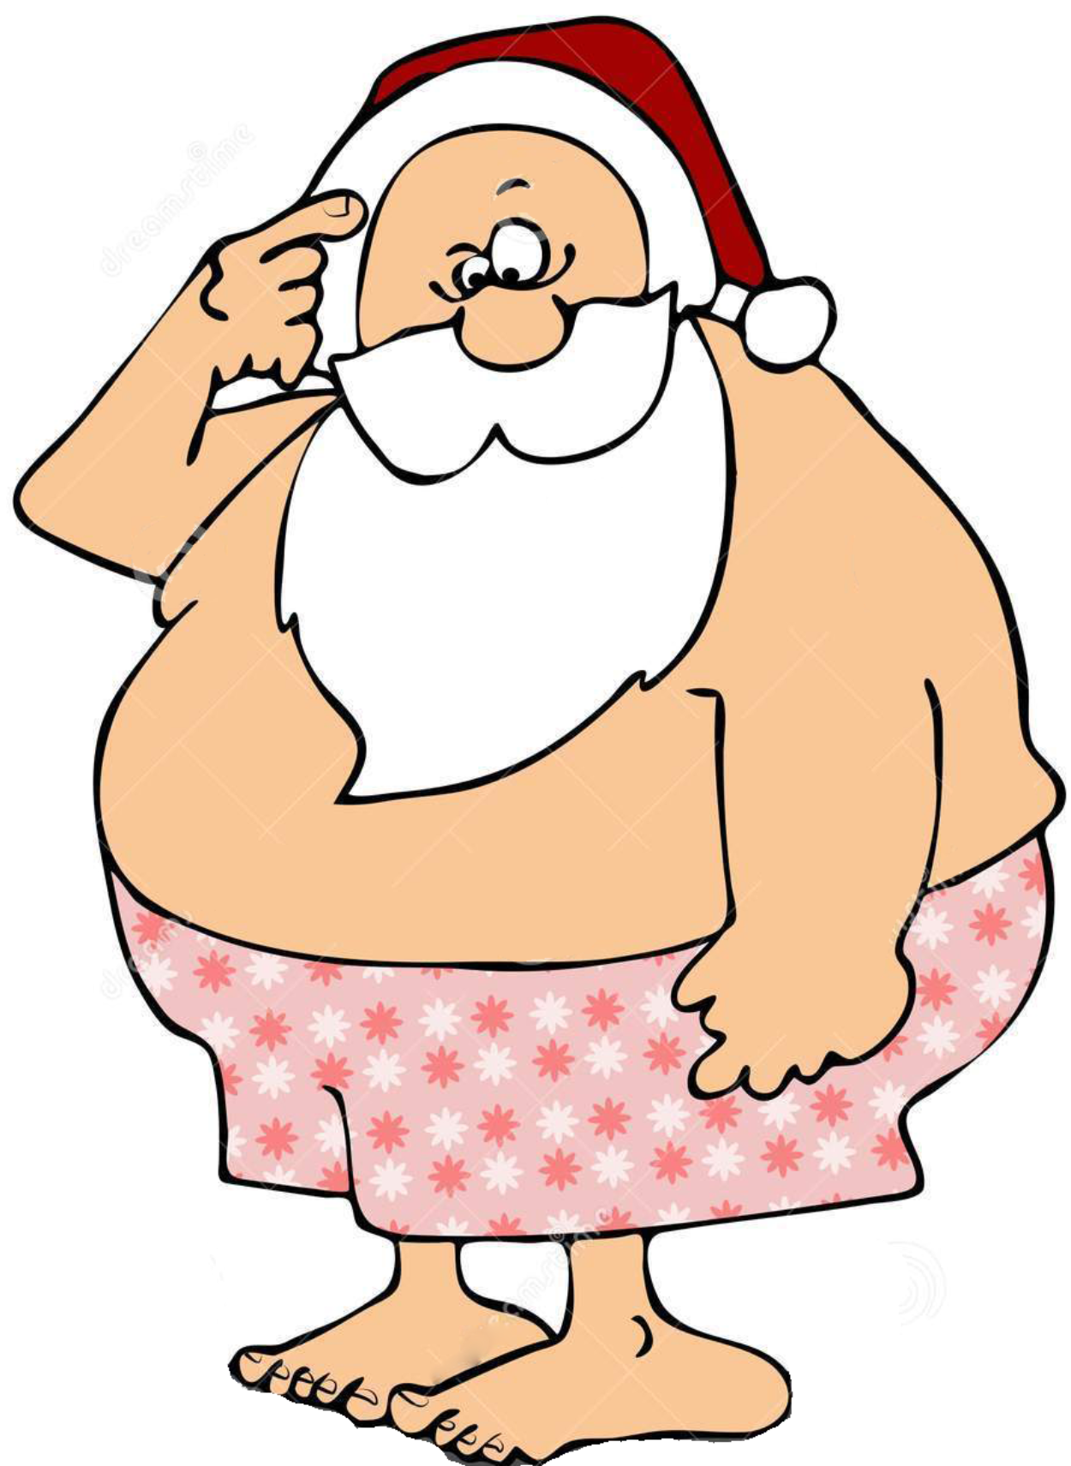


You freed Santa!! Christmas is saved!

