Slide 1
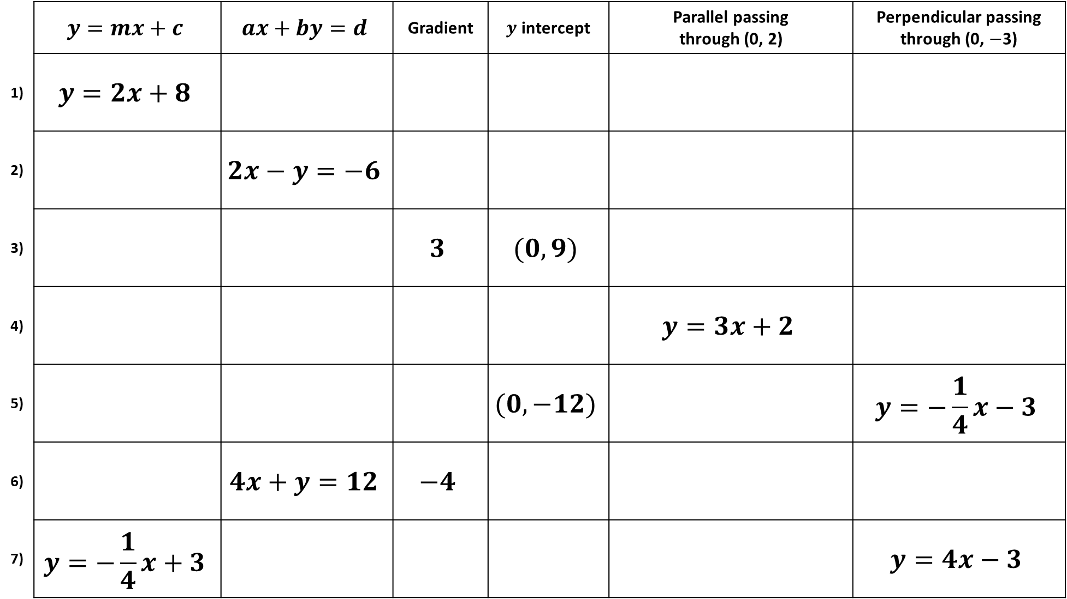
 | $$y=mx+c$$ | $$ax+by=d$$ | Gradient | $y$ intercept | Parallel passing through (0, 2) | Perpendicular passing through (0, $−$3)
1) | $$y=2x+8$$
2) |  | $$2x−y=−6$$
3) |  |  | $$3$$ | $$(0, 9)$$
4) |  |  |  |  | $$y=3x+2$$
5) |  |  |  | $$(0, −12)$$ |  | $$y=−\frac{1}{4}x−3$$
6) |  | $$4x+y=12$$ | $$−4$$
7) | $$y=−\frac{1}{4}x+3$$ |  |  |  |  | $$y=4x−3$$

Slide 2
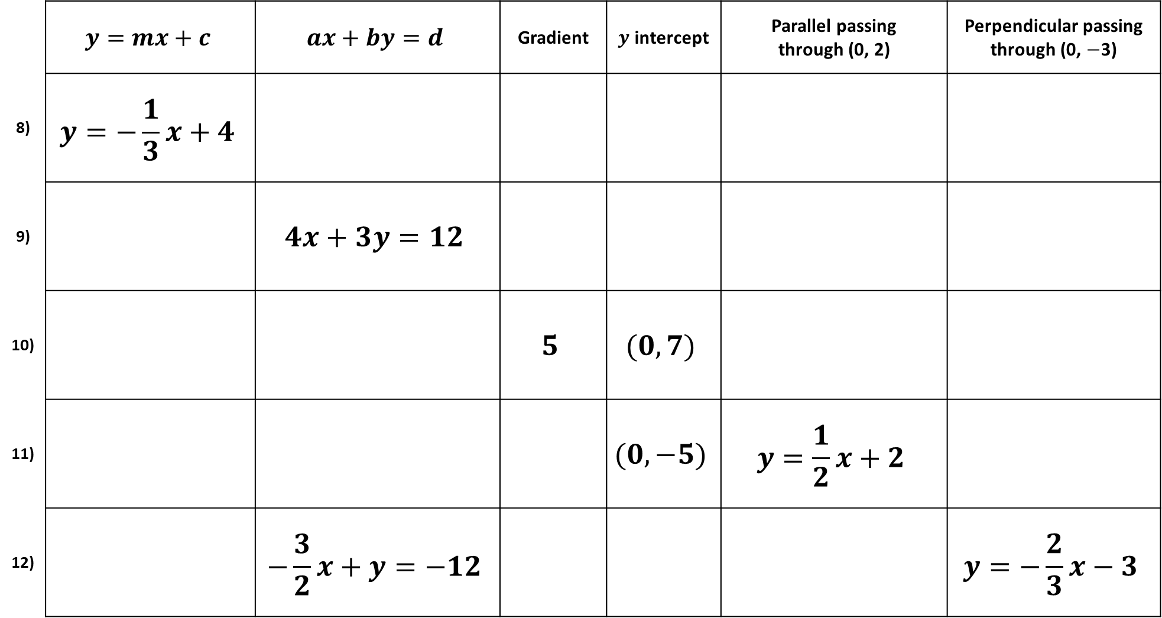
 | $$y=mx+c$$ | $$ax+by=d$$ | Gradient | $y$ intercept | Parallel passing through (0, 2) | Perpendicular passing through (0, $−$3)
8) | $$y=−\frac{1}{3}x+4$$
9) |  | $$4x+3y=12$$
10) |  |  | $$5$$ | $$(0, 7)$$
11) |  |  |  | $$(0, −5)$$ | $$y=\frac{1}{2}x+2$$
12) |  | $$−\frac{3}{2}x+y=−12$$ |  |  |  | $$y=−\frac{2}{3}x−3$$

Slide 3
ANSWERS

Slide 4
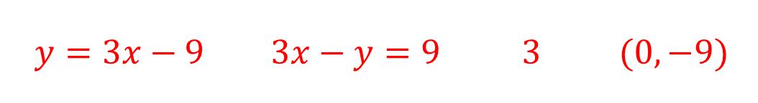
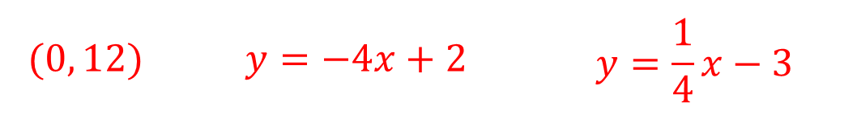
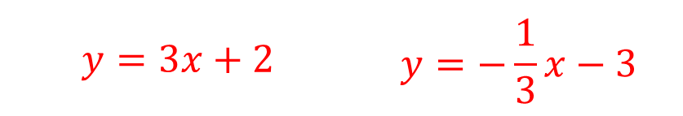

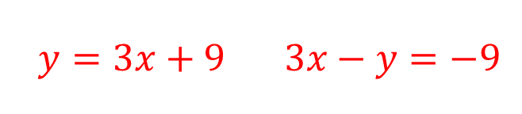

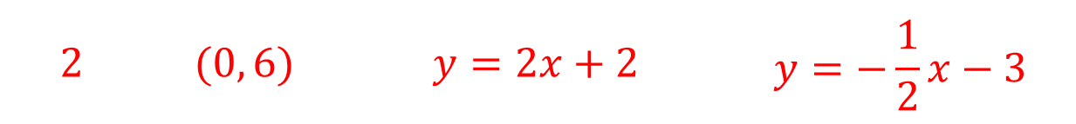
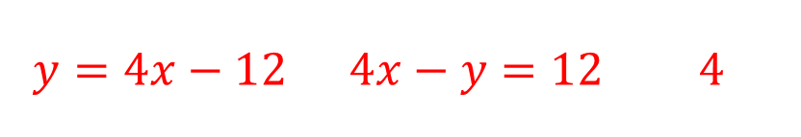

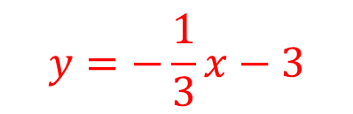
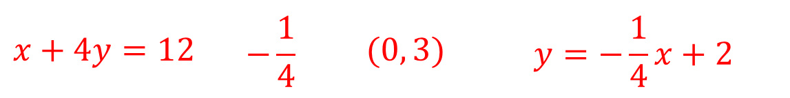
 | $$y=mx+c$$ | $$ax+by=d$$ | Gradient | $y$ intercept | Parallel passing through (0, 2) | Perpendicular passing through (0, $−$3)
1) | $$y=2x+8$$
2) |  | $$2x−y=−6$$
3) |  |  | $$3$$ | $$(0, 9)$$
4) |  |  |  |  | $$y=3x+2$$
5) |  |  |  | $$(0, −12)$$ |  | $$y=−\frac{1}{4}x−3$$
6) |  | $$4x+y=12$$ | $$−4$$
7) | $$y=−\frac{1}{4}x+3$$ |  |  |  |  | $$y=4x−3$$
$$2x−y=−8$$ | $$2$$ | $$(0, 8)$$ | $$y=2x+2$$ | $$y=−\frac{1}{2}x−3$$
$$2$$ | $$(0, 6)$$ | $$y=2x+2$$ | $$y=−\frac{1}{2}x−3$$
$$y=2x+6$$
$$y=3x+9$$ | $$3x−y=−9$$
$$y=3x+2$$ | $$y=−\frac{1}{3}x−3$$
$$y=3x−9$$ | $$3x−y=9$$ | $$3$$ | $$(0, −9)$$
$$y=−\frac{1}{3}x−3$$
$$y=4x−12$$ | $$4x−y=12$$ | $$4$$
$$y=4x+2$$
$$(0, 12)$$ | $$y=−4x+2$$ | $$y=\frac{1}{4}x−3$$
$$y=−4x+12$$
$$x+4y=12$$ | $$−\frac{1}{4}$$ | $$(0, 3)$$ | $$y=−\frac{1}{4}x+2$$

Slide 5
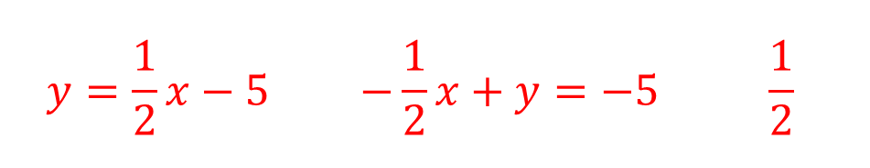
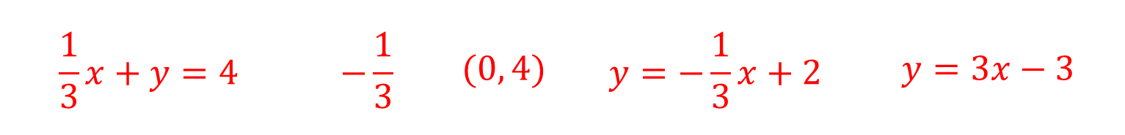
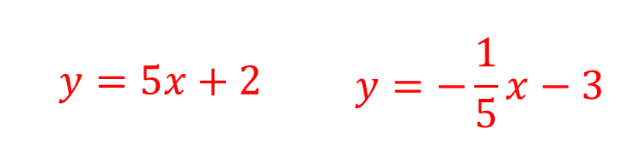
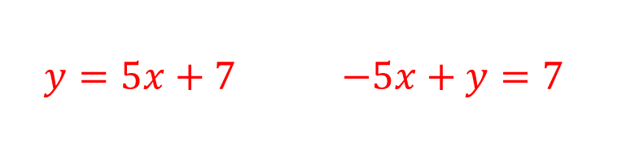
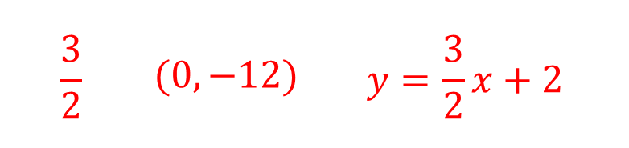
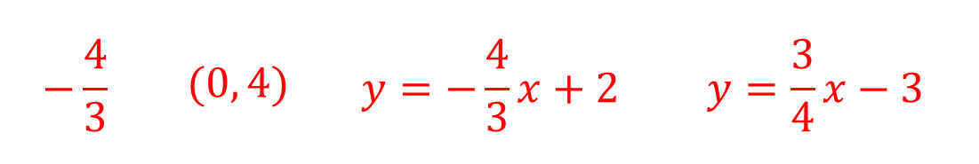
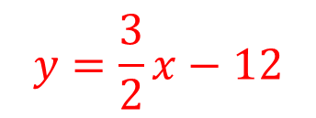
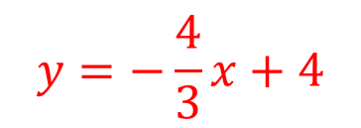

 | $$y=mx+c$$ | $$ax+by=d$$ | Gradient | $y$ intercept | Parallel passing through (0, 2) | Perpendicular passing through (0, $−$3)
8) | $$y=−\frac{1}{3}x+4$$
9) |  | $$4x+3y=12$$
10) |  |  | $$5$$ | $$(0, 7)$$
11) |  |  |  | $$(0, −5)$$ | $$y=\frac{1}{2}x+2$$
12) |  | $$−\frac{3}{2}x+y=−12$$ |  |  |  | $$y=−\frac{2}{3}x−3$$
$$\frac{1}{3}x+y=4$$ | $$−\frac{1}{3}$$ | $$(0, 4)$$ | $$y=−\frac{1}{3}x+2$$ | $$y=3x−3$$
$$y=−\frac{4}{3}x+4$$
$$−\frac{4}{3}$$ | $$(0, 4)$$ | $$y=−\frac{4}{3}x+2$$ | $$y=\frac{3}{4}x−3$$
$$y=5x+7$$ | $$−5x+y=7$$
$$y=5x+2$$ | $$y=−\frac{1}{5}x−3$$
$$y=\frac{1}{2}x−5$$ | $$−\frac{1}{2}x+y=−5$$ | $$\frac{1}{2}$$
$$y=−2x−3$$
$$\frac{3}{2}$$ | $$(0, −12)$$ | $$y=\frac{3}{2}x+2$$
$$y=\frac{3}{2}x−12$$

