Slide 1
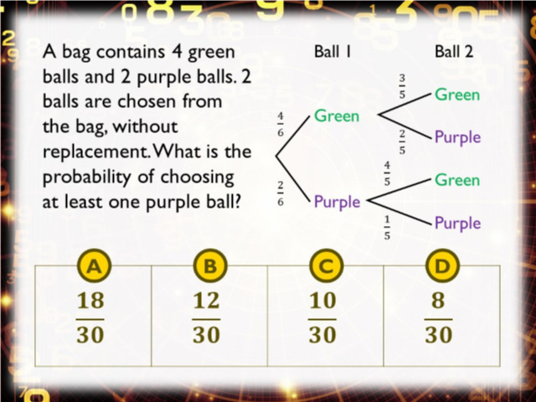
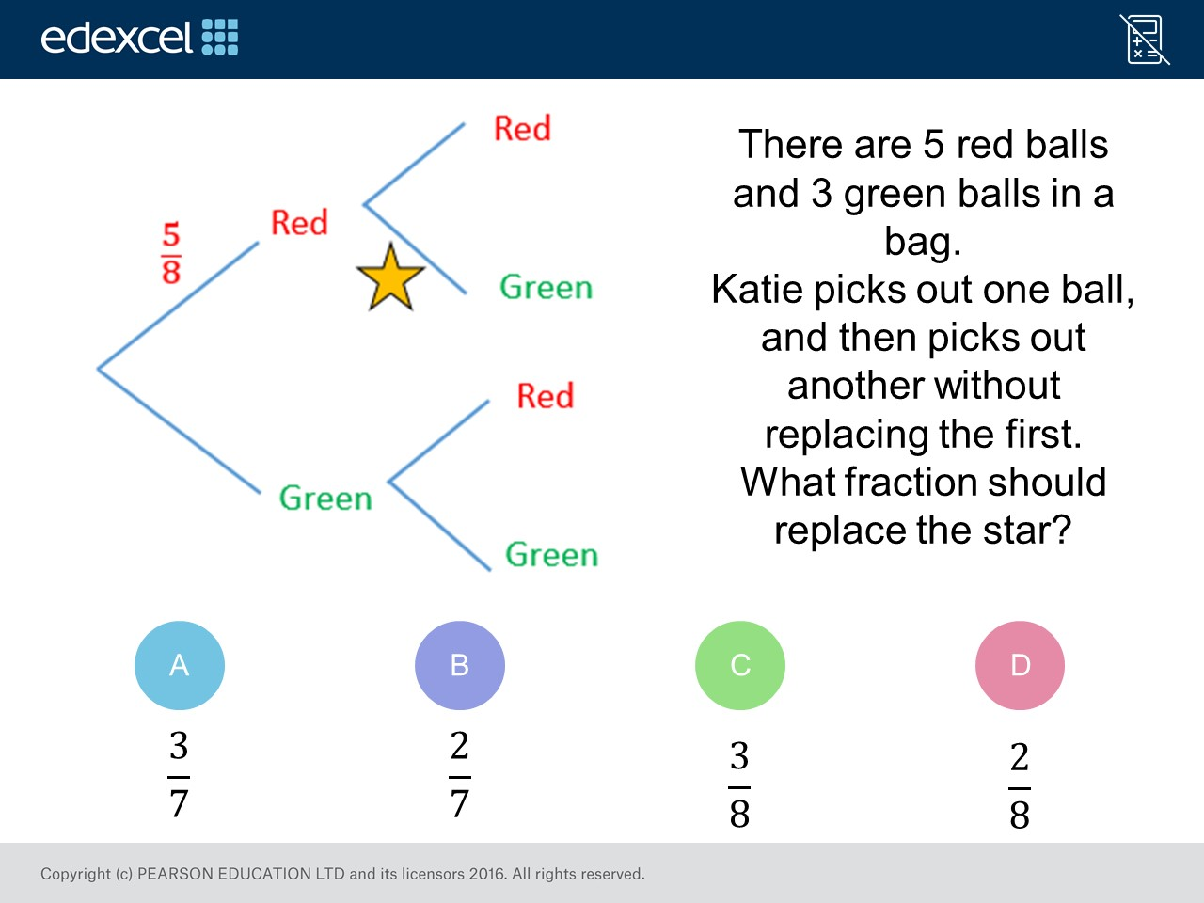
Worst answered question?
Most common wrong answer?

Slide 2
ANSWERS

Slide 3
Worst answered question?

Slide 4

C
They forget the total should be reduced by 1.

Slide 5
D
They calculated P(GP) and did not realise they needed
to include
P(PG) and P(PP)

