Slide 1
What is the percentage of profit and loss?
1) Investment 400dhs
Return 450dhs
2) Investment 400dhs
Return 350dhs
3) Investment 400dhs
Return 300dhs
4) Investment 400dhs
Return 500dhs
5) Investment 400dhs
Return 400dhs
6) Investment 800dhs
Return 900dhs
7) Investment 800dhs
Return 700dhs
8) Investment 800dhs
Return 600dhs
9) Investment 800dhs
Return 1000dhs
10) Investment 800dhs
Return 800dhs

Slide 2
What is the percentage of profit and loss?
1) Investment 200dhs
Return 150dhs
2) Investment 200dhs
Return 100dhs
3) Investment 200dhs
Return 50dhs
4) Investment 200dhs
Return 250dhs
5) Investment 200dhs
Return 300dhs
6) Investment 200dhs
Return 400dhs
7) Investment 200dhs
Return 0dhs
8) Investment 200dhs
Return 200dhs
9) Investment 200dhs
Return 800dhs
10) Investment 200dhs
Return 1600dhs

Slide 3
ANSWERS

Slide 4
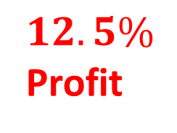
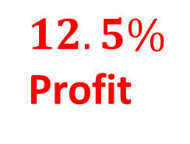
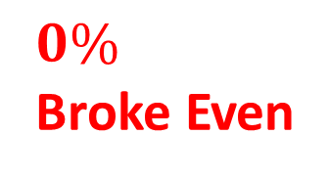
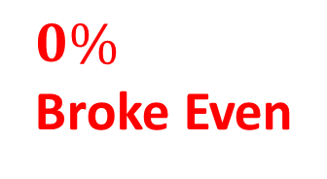
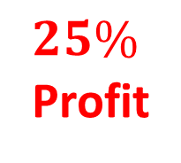
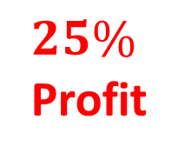
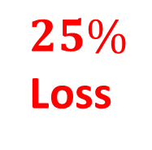
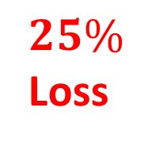
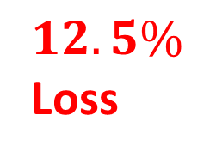
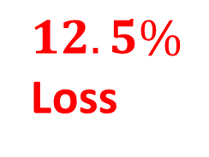
What is the percentage of profit and loss?
1) Investment 400dhs
Return 450dhs
2) Investment 400dhs
Return 350dhs
3) Investment 400dhs
Return 300dhs
4) Investment 400dhs
Return 500dhs
5) Investment 400dhs
Return 400dhs
$$12.5\%$$
Profit
6) Investment 800dhs
Return 900dhs
7) Investment 800dhs
Return 700dhs
8) Investment 800dhs
Return 600dhs
9) Investment 800dhs
Return 1000dhs
10) Investment 800dhs
Return 800dhs
$$12.5\%$$
Profit
$$12.5\%$$
Loss
$$12.5\%$$
Loss
$$25\%$$
Loss
$$25\%$$
Loss
$$25\%$$
Profit
$$25\%$$
Profit
$$0\%$$
Broke Even
$$0\%$$
Broke Even

Slide 5

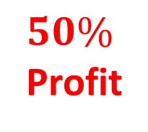


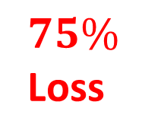

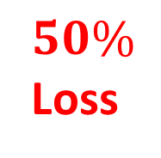
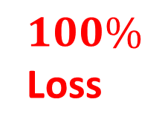
What is the percentage of profit and loss?
1) Investment 200dhs
Return 150dhs
2) Investment 200dhs
Return 100dhs
3) Investment 200dhs
Return 50dhs
4) Investment 200dhs
Return 250dhs
5) Investment 200dhs
Return 300dhs
$$25\%$$
Loss
6) Investment 200dhs
Return 400dhs
7) Investment 200dhs
Return 0dhs
8) Investment 200dhs
Return 200dhs
9) Investment 200dhs
Return 800dhs
10) Investment 200dhs
Return 1600dhs
$$100\%$$
Profit
$$50\%$$
Loss
$$100\%$$
Loss
$$75\%$$
Loss
$$0\%$$
Broke Even
$$25\%$$
Profit
300$\%$
Profit
$$50\%$$
Profit
700$\%$
Profit

