Slide 1
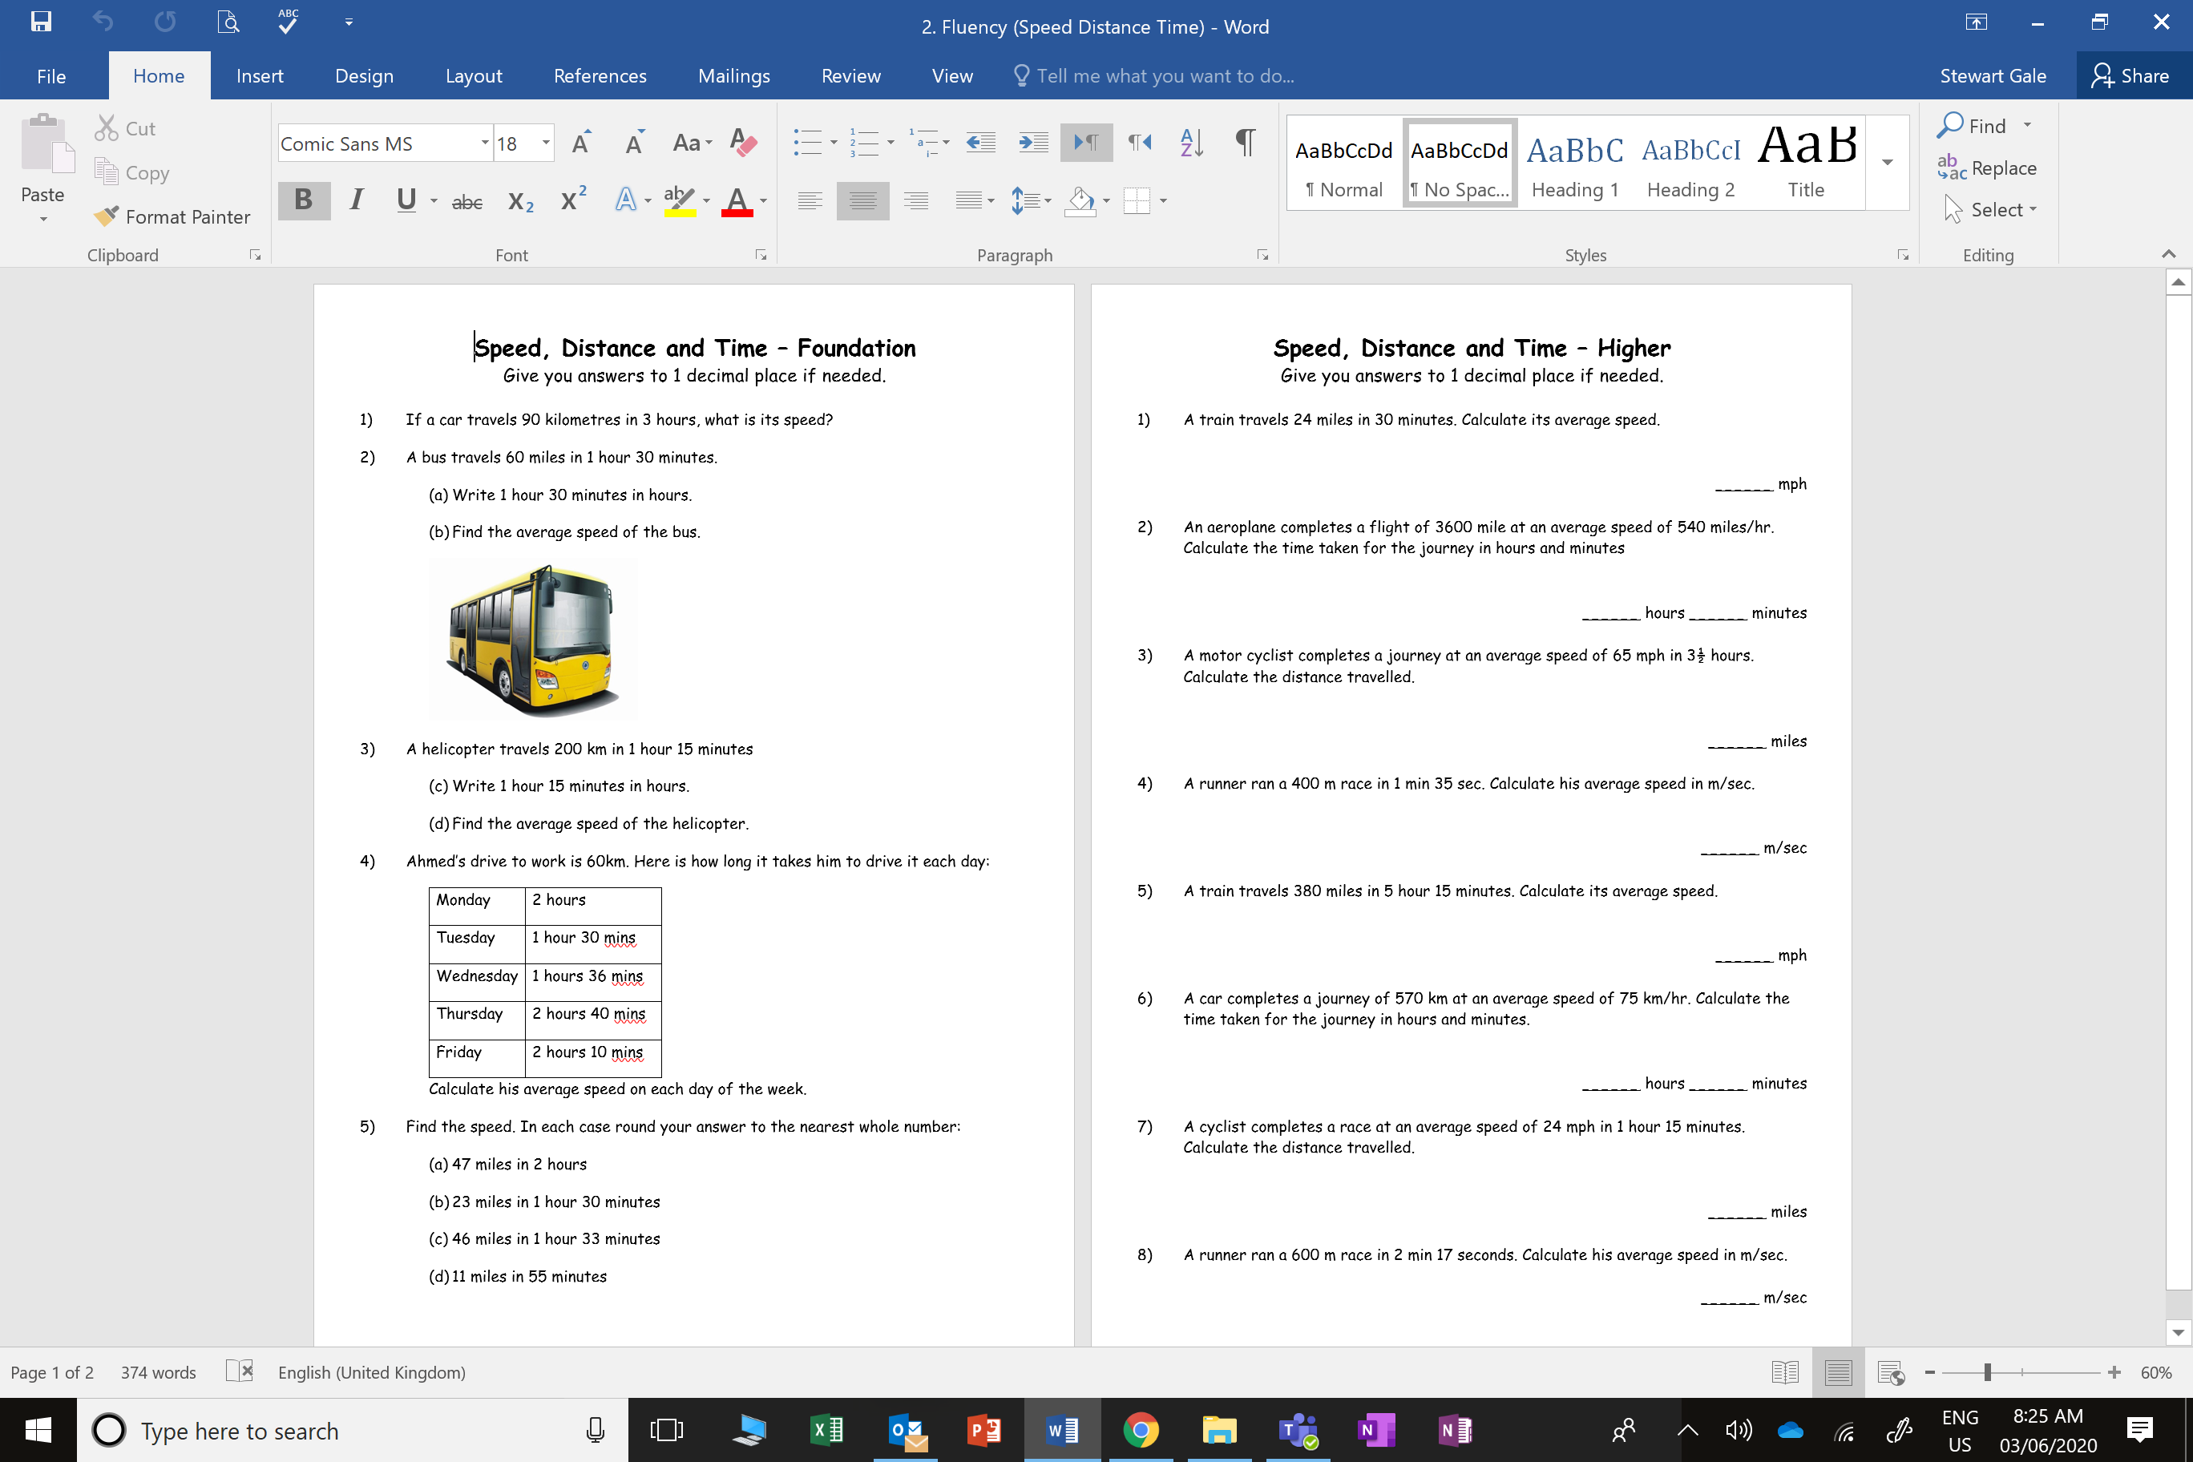

Slide 2
ANSWERS

Slide 5
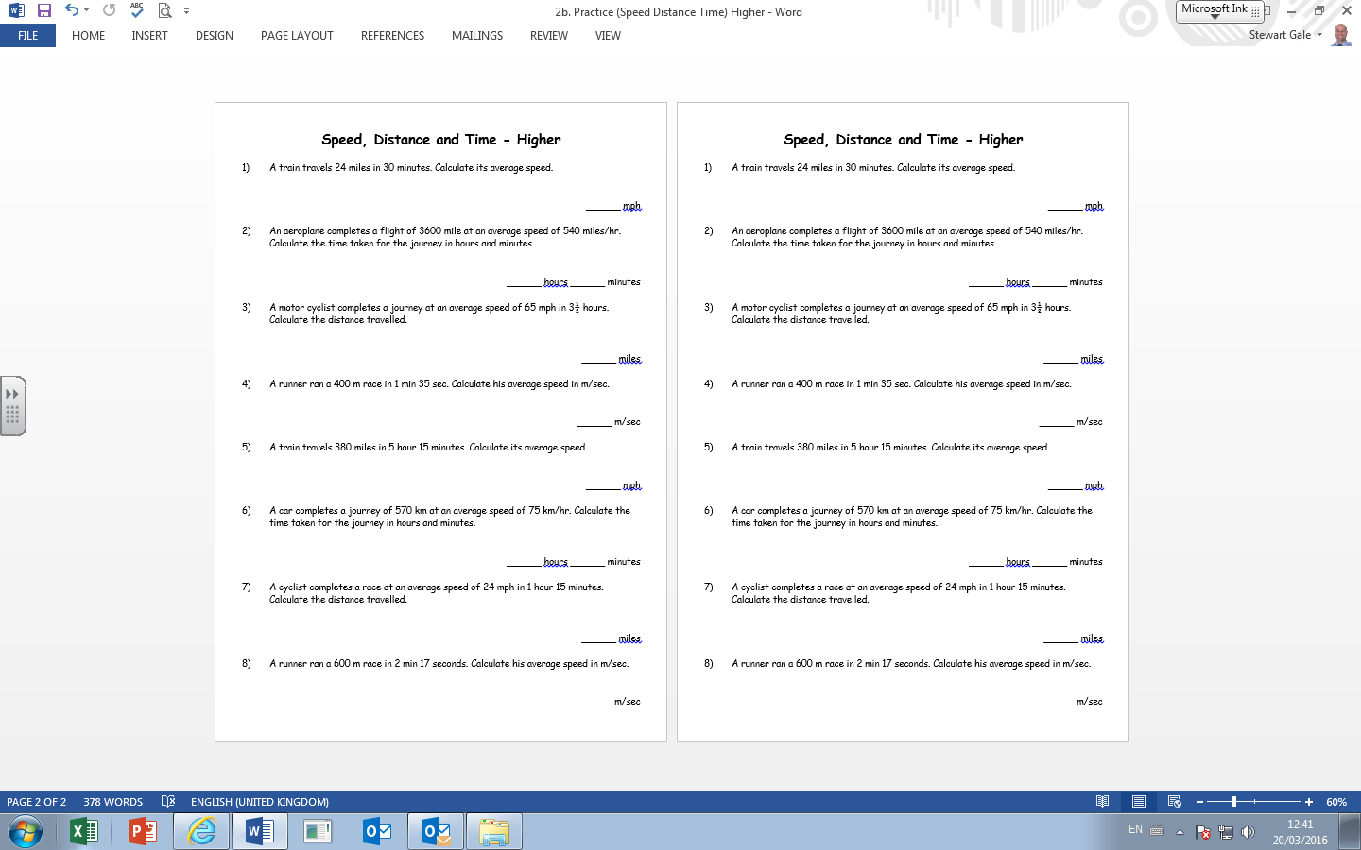
48
6
40
227.5
4.2
72.4

Slide 6
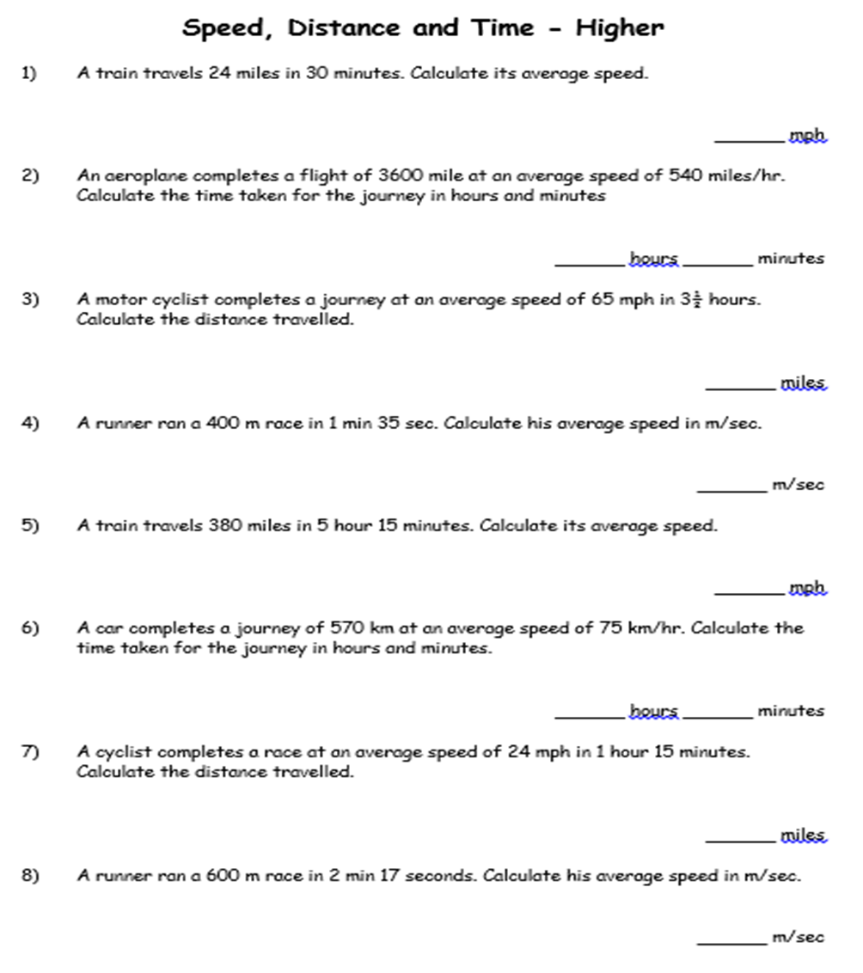
7
36
30
4.4

