Slide 1
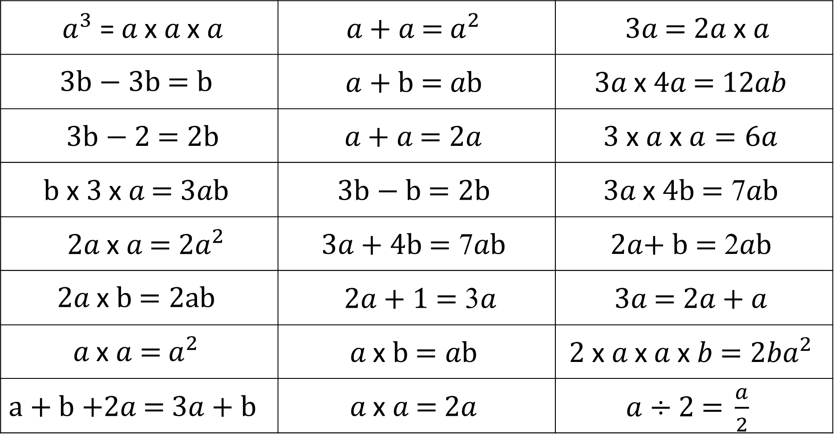
Which of the following should be Identical To?
$a^{3} \text{=} a \text{x} a \text{x} a$ | ${a\text{ +} a\text{ =} a}^{2}$ | $3a\text{ = }2a \text{x} a$
$$3\text{b}\text{ − 3}\text{b}\text{ =} \text{b}$$ | $a+\text{b}\text{ =} a\text{b}$ | $3a \text{x} 4a\text{ =} 12ab$
$3\text{b}\text{ − 2 =} \text{2}\text{b}$ | $a\text{ + }a\text{ =} \text{2}a$ | $3 \text{x} a \text{x} a=6a$
$b \text{x} \text{3} \text{x} a\text{ =} 3a\text{b}$ | $3\text{b}\text{ − }\text{b}\text{ =} \text{2}\text{b}$ | $3a \text{x} 4\text{b}\text{ =}\text{ 7}a\text{b}$
${2a \text{x} a\text{ =} 2a}^{2}$ | $3a\text{ +} \text{4}\text{b}\text{ =}\text{ 7}a\text{b}$ | $\text{2}a\text{+} \text{b}\text{ =}\text{ 2}a\text{b}$
$$2a \text{x} \text{b}\text{ =} \text{2}\text{ab}$$ | $2a\text{ +} \text{1 =}\text{ 3}a$ | $3a\text{ =} 2a\text{ + }a$
$${a \text{x} a \text{=} a}^{2}$$ | $a \text{x} \text{b}\text{ =} a\text{b}$ | ${2 \text{x} a \text{x} a \text{x} b \text{=} 2ba}^{2}$
$a\text{ +} \text{b}\text{ +}2a\text{ =} 3a+\text{b}$ | $a \text{x} a \text{=} 2a$ | $a÷\text{2 =} \frac{a}{2}$

Slide 2
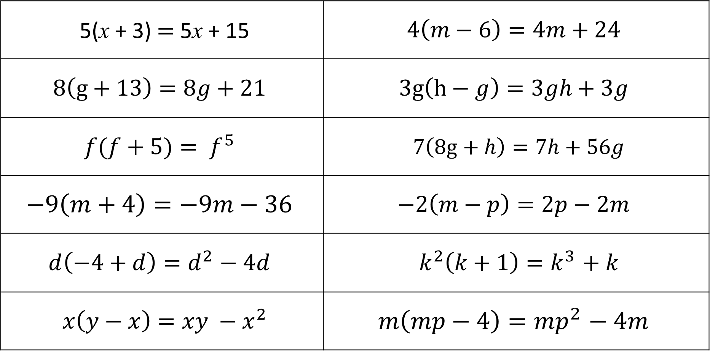
Which of the following should be Identical To?
5(x + 3) $=$ 5x + 15 | $$4\left(m−6\right)=4m+24$$
$$8\left(g+13\right)=8g+21$$ | $$3g\left(h−g\right)=3gh+3g$$
$$f(f+5){= f}^{5}$$ | $7\left(8g+h\right)=7h+56g$
$$−9\left(m+4\right)=−9m−36$$ | $$−2\left(m−p\right)=2p−2m$$
$$d\left(−4+d\right){=d}^{2}− 4d$$ | $k^{2}\left(k+1\right){=k}^{3}+ k$
$x\left(y−x\right){=xy −x}^{2}$ | $$m\left(mp−4\right){=mp}^{2}− 4m$$

Slide 3
ANSWERS

Slide 4
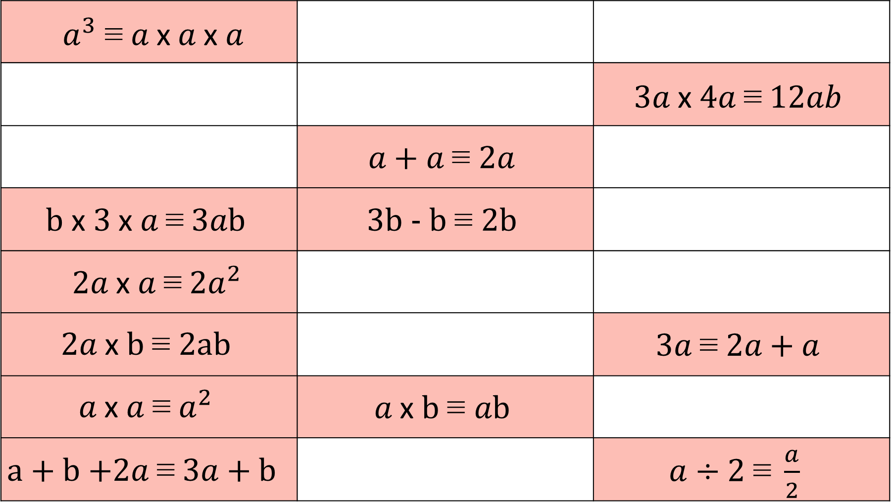
$a^{3} \text{≡} a \text{x} a \text{x} a$
 |  | $3a \text{x} 4a \text{≡} 12ab$
 | $a\text{ + }a \text{≡ }\text{2}a$
$b \text{x} \text{3} \text{x} a \text{≡} 3a\text{b}$ | $3\text{b}\text{ − }\text{b} \text{≡ }\text{2}\text{b}$
${2a \text{x} a \text{≡} 2a}^{2}$
$$2a \text{x} \text{b} \text{≡ }\text{2}\text{ab}$$ |  | $3a \text{≡} 2a\text{ + }a$
$${a \text{x} a \text{≡} a}^{2}$$ | $a \text{x} \text{b} \text{≡ }a\text{b}$
$a\text{ +} \text{b}\text{ +}2a \text{≡} 3a+\text{b}$ |  | $a÷\text{2 }\text{≡} \frac{a}{2}$

Slide 5
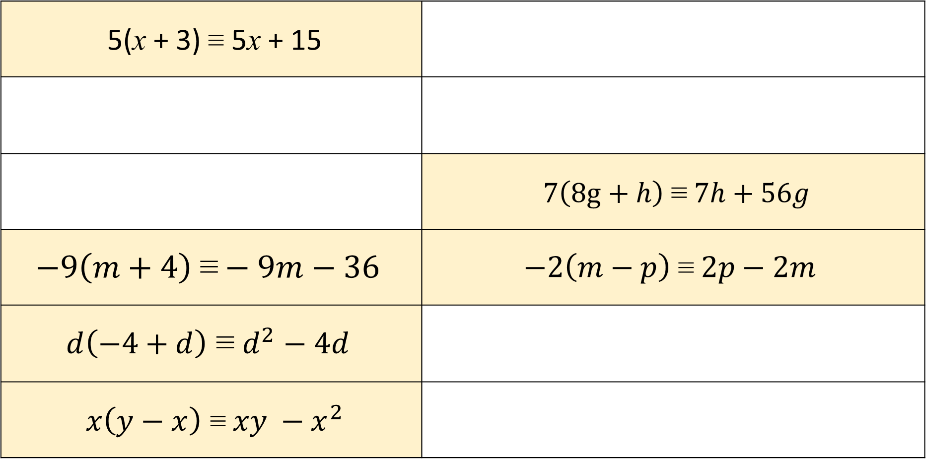
Which of the following should be Identical To?
5(x + 3) $\text{≡}$ 5x + 15
 | $7\left(8g+h\right) \text{≡} 7h+56g$
$$−9\left(m+4\right) \text{≡}−9m−36$$ | $$−2\left(m−p\right) \text{≡} 2p−2m$$
$$d\left(−4+d\right){\text{≡} d}^{2}− 4d$$
$x\left(y−x\right){\text{≡} xy −x}^{2}$

