Slide 1

Diagnostic Assessment .Delta 3
Unit 6
Quadratic Graphs
Cubic Graphs
Reciprocal Graphs

Slide 2
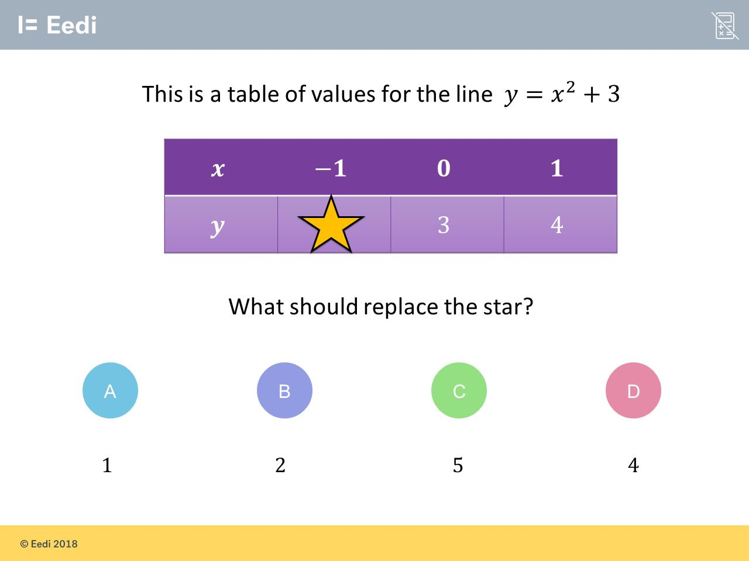
Question 1 – Quadratic Graphs

Slide 3
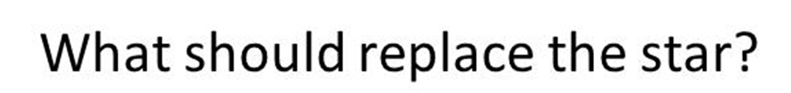
Answer 1 – Quadratic Graphs
CORRECT ANSWER | CORRECT EXPLANATION
4 | We have y = (-1)² + 3 = 1 + 3 = 4.
COMMON MISTAKES | WHAT MIGHT BE YOUR MISTAKE
1 | The student may have multiplied by 2, rather than squaring.
2 | The student may not recognise that a negative squared is positive.
5 | The student may have multiplied by 2, rather than squaring, and has made a sign error.

Slide 4
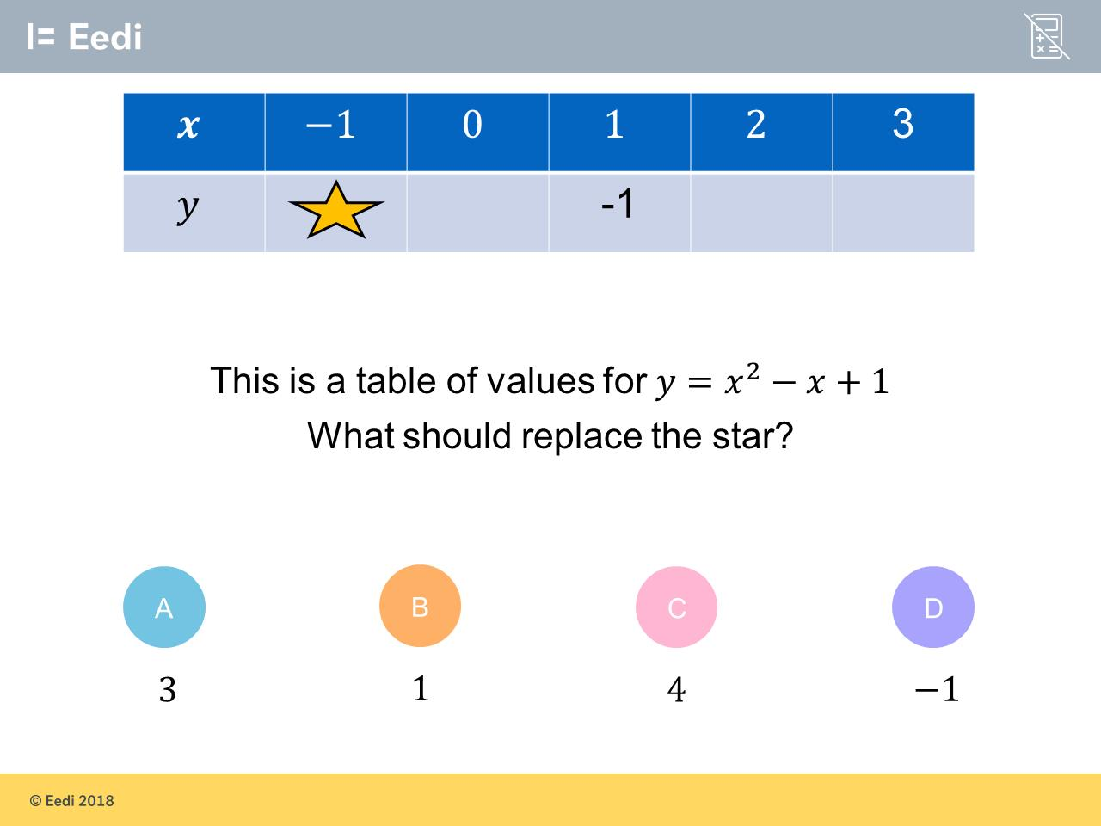
Question 2 – Quadratic Graphs

Slide 5
Answer 2 – Quadratic Graphs
CORRECT ANSWER | CORRECT EXPLANATION
3 | Substituting in x = -1 gives y = (-1)² -(-1) + 1 = 1 +1 + 1 = 3.
COMMON MISTAKES | WHAT MIGHT BE YOUR MISTAKE
1 | The student has not accounted for the double negative when subtracting x.
4 | The student may have interpreted x² as 2x.
-1 | The student has just copied the other y value.

Slide 6
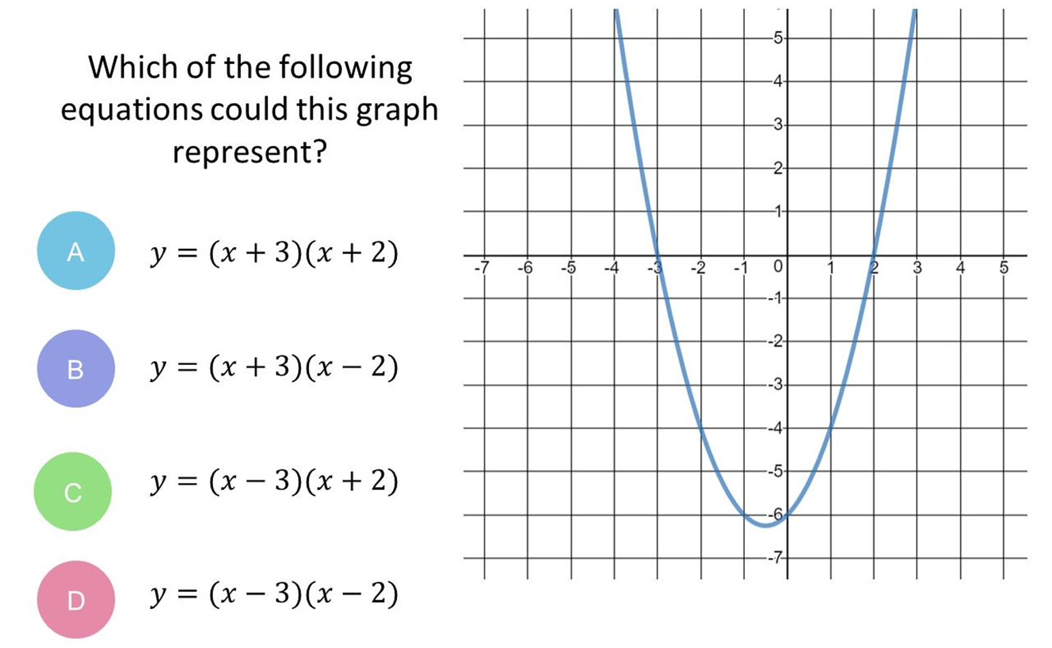
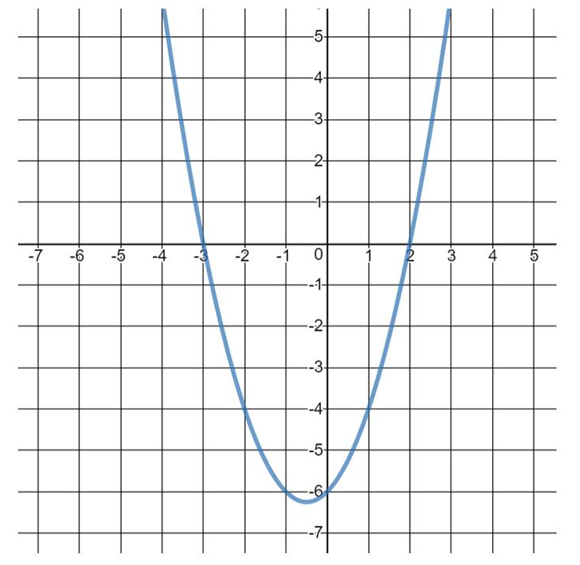
Question 3 – Quadratic Graphs

Slide 7
Answer 3 – Quadratic Graphs
CORRECT ANSWER | CORRECT EXPLANATION
B | This quadratic has roots at x = 2 and x = -3, so the equation of the graph is y = (x - 2)(x + 3). We changed the signs on the roots inside the brackets.
COMMON MISTAKES | WHAT MIGHT BE YOUR MISTAKE
A | The student has given the wrong sign on the 2.
C | The student has not changed the signs of the roots.
D | The student has given the wrong sign on the 3.

Slide 8
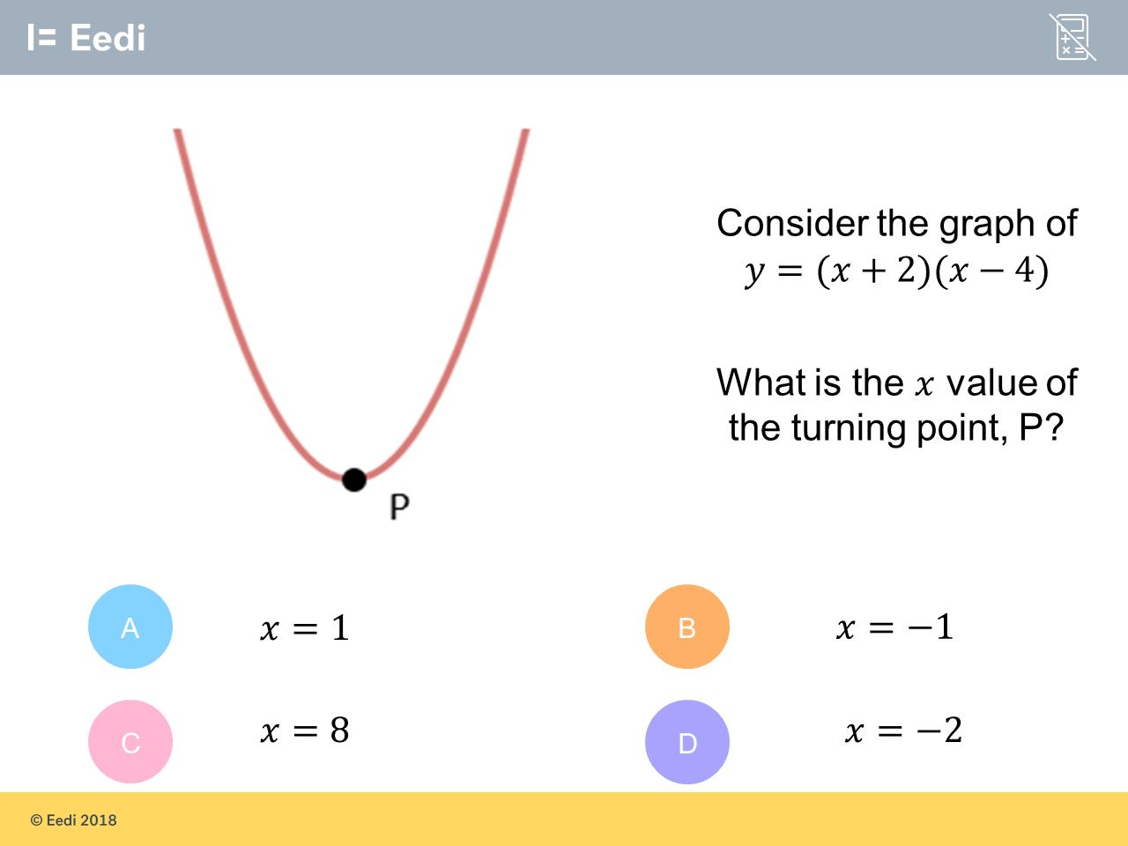
Question 4 – Quadratic Graphs

Slide 9
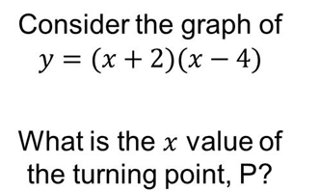
Answer 4 – Quadratic Graphs
CORRECT ANSWER | CORRECT EXPLANATION
1 | The turning point is halfway between the roots x = -2 and x = 4. The midpoint would be x = (4 - 2)/2 = 1.
COMMON MISTAKES | WHAT MIGHT BE YOUR MISTAKE
-1 | The student has given the wrong sign.
8 | The student has given the y intercept.
-2 | The student may have just added the numbers in the brackets together.

Slide 10
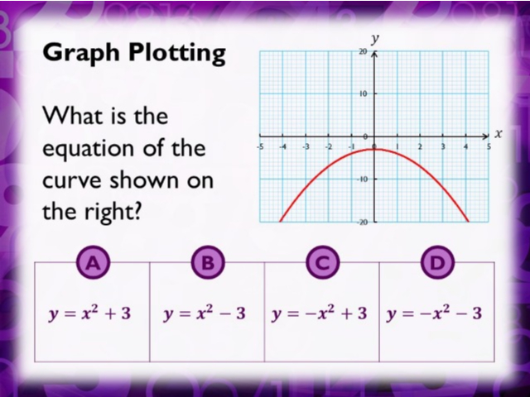
Question 5 – Quadratic Graphs

Slide 11
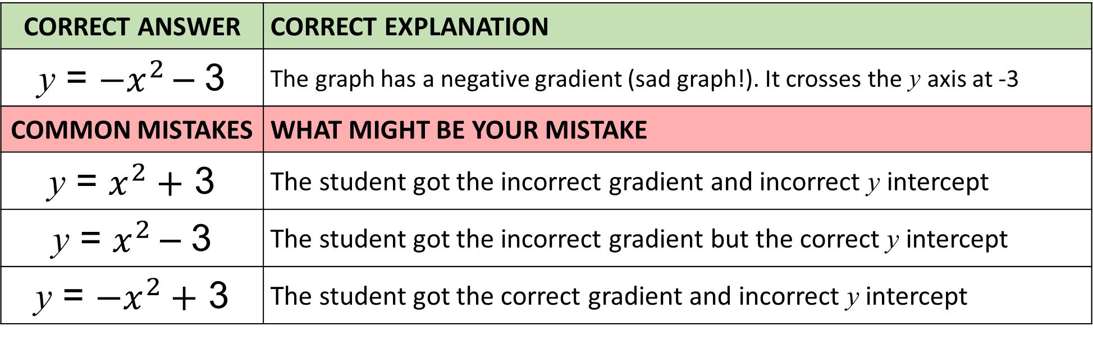
Answer 5 – Quadratic Graphs
CORRECT ANSWER | CORRECT EXPLANATION
y = ${−x}^{2}$– 3 | The graph has a negative gradient (sad graph!). It crosses the y axis at -3
COMMON MISTAKES | WHAT MIGHT BE YOUR MISTAKE
y = $x^{2}+$ 3 | The student got the incorrect gradient and incorrect y intercept
y = $x^{2}$– 3 | The student got the incorrect gradient but the correct y intercept
y = ${−x}^{2}+$ 3 | The student got the correct gradient and incorrect y intercept

Slide 12
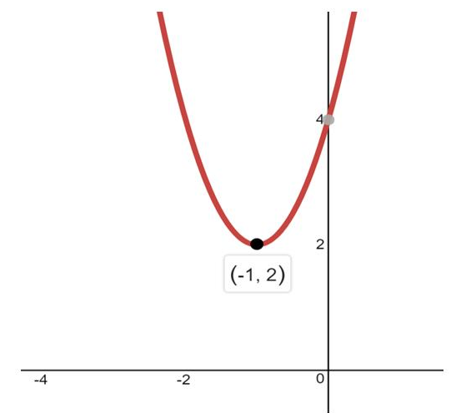
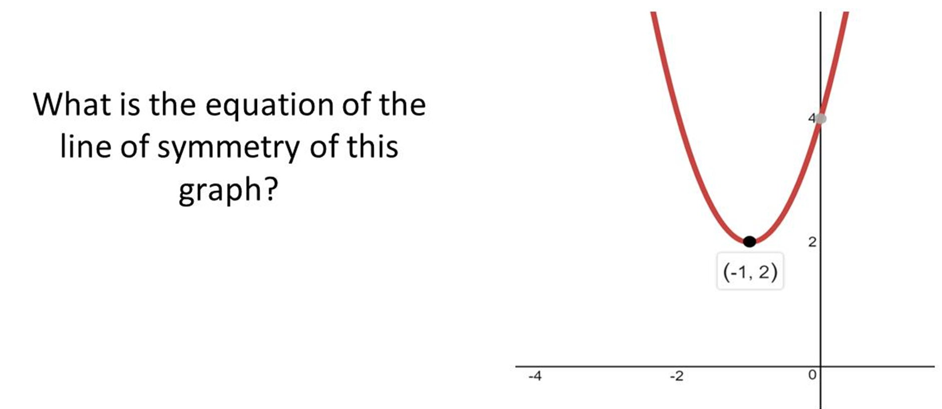
Question 6 – Quadaratic Graphs

Slide 13
Answer 6 – Quadratics Graphs
CORRECT ANSWER | CORRECT EXPLANATION
x = -1 | The minimum point is at (-1,2), so a vertical line running through this point will be the line of symmetry. this will have equation x = -1.
COMMON MISTAKES | WHAT MIGHT BE YOUR MISTAKE
y = 2 | The student has used the y-value, rather than the x-value, and has used a horizontal line.
x = 2 | The student has used the y-value, rather than the x-value.
y = -1 | The student has used y instead of x.

Slide 14
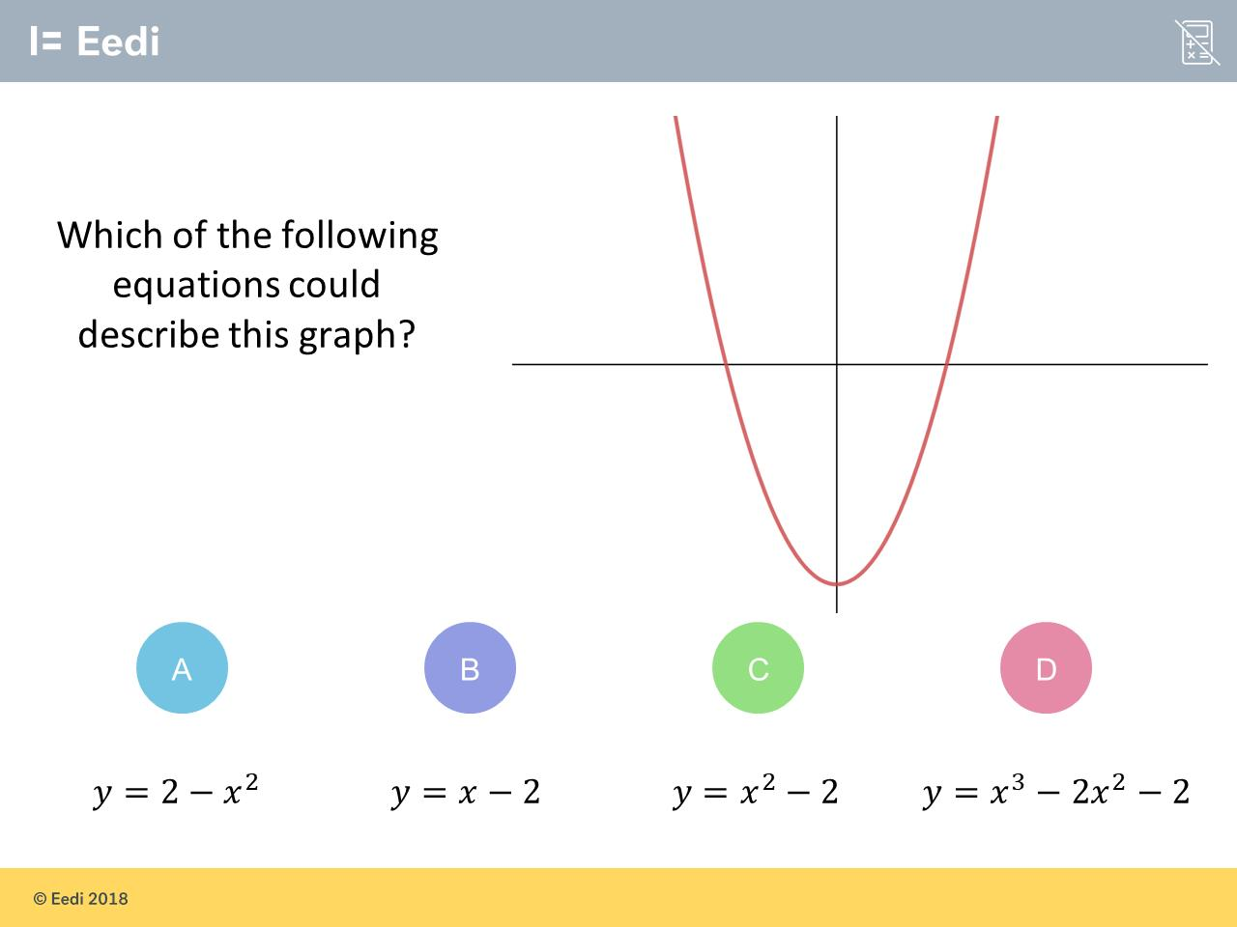
Question 7 – Quadartics Graphs

Slide 15
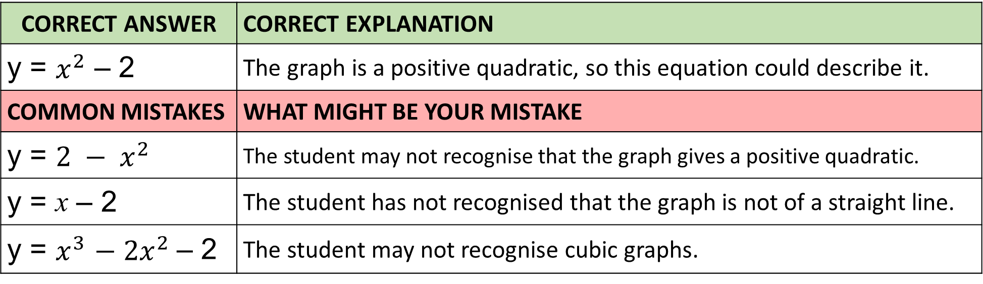
Answer 7 – Quadratics Graphs
CORRECT ANSWER | CORRECT EXPLANATION
y = $x^{2}$ – 2 | The graph is a positive quadratic, so this equation could describe it.
COMMON MISTAKES | WHAT MIGHT BE YOUR MISTAKE
y = ${2 − x}^{2}$ | The student may not recognise that the graph gives a positive quadratic.
y = x – 2 | The student has not recognised that the graph is not of a straight line.
y = $x^{3}$ $− {2x}^{2}$– 2 | The student may not recognise cubic graphs.

Slide 16
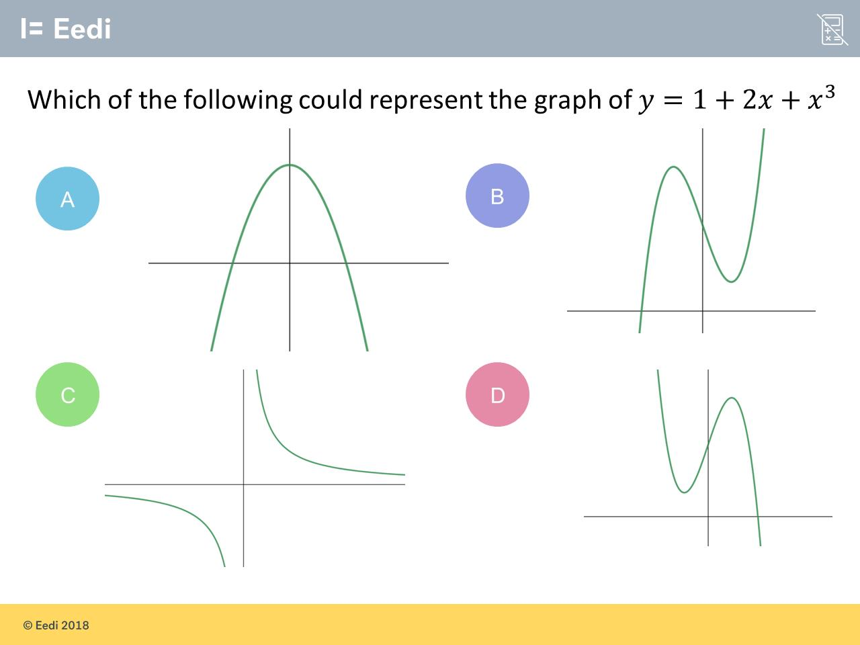
Question 8 – Cubic Graphs

Slide 17
Answer 8 – Cubic Graphs
CORRECT ANSWER | CORRECT EXPLANATION
B | This is a positive cubic graph, as we have two turning points and it goes from the bottom left to the top right.
COMMON MISTAKES | WHAT MIGHT BE YOUR MISTAKE
A | The student may be confusing quadratic and cubic graphs.
C | The student may be confusing cubic and reciprocal graphs
D | The student has picked a negative cubic.

Slide 18
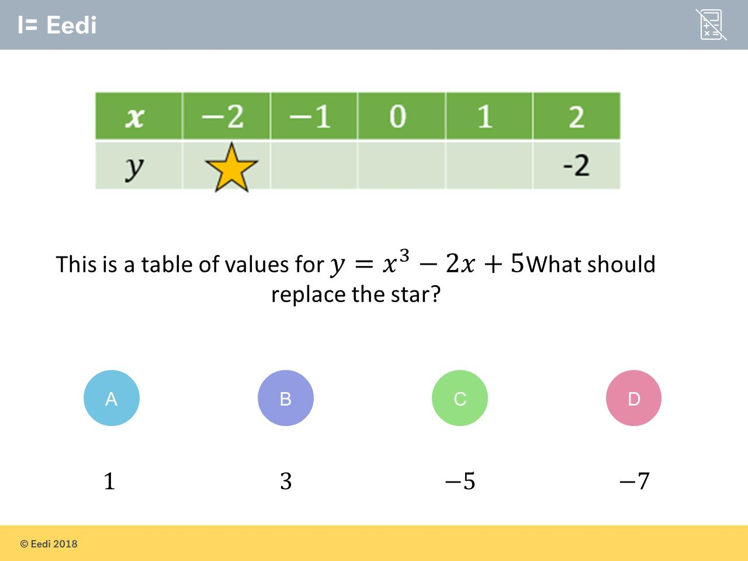
Question 9 – Cubic Graphs

Slide 19
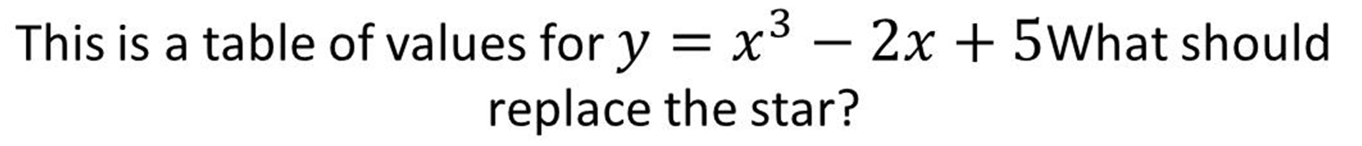
Answer 9 – Cubic Graphs
CORRECT ANSWER | CORRECT EXPLANATION
1 | We have y = (-2)³ - 2(-2) + 5 = -8 + 4 + 5 = 1.
COMMON MISTAKES | WHAT MIGHT BE YOUR MISTAKE
3 | The student may have multiplied by 3, rather than cubing.
-5 | The student may have multiplied by 3, rather than cubing, and has not accounted for the double negative.
-7 | The student may not recognise that a double-negative is positive.

Slide 20
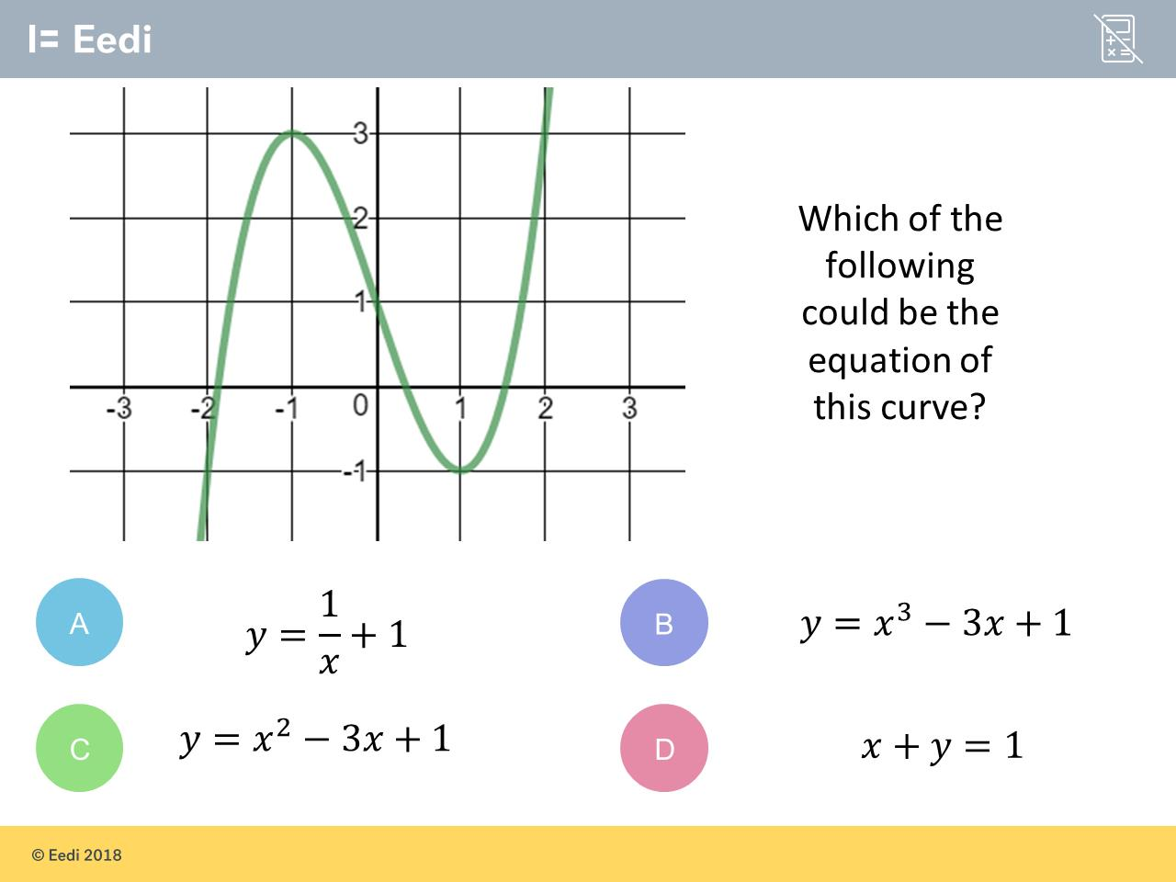
Question 10 – Cubic Graphs

Slide 21
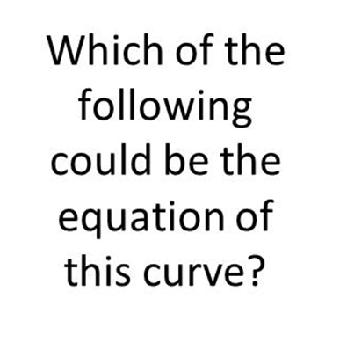
Answer 10 – Cubic Graphs
CORRECT ANSWER | CORRECT EXPLANATION
B | This is a cubic graph, so the highest x term power must be 3.
COMMON MISTAKES | WHAT MIGHT BE YOUR MISTAKE
A | The student may be confusing cubics and reciprocals.
C | The student may be confusing quadratics and cubics.
D | The student may be confusing cubics and straight-line graphs.

Slide 22
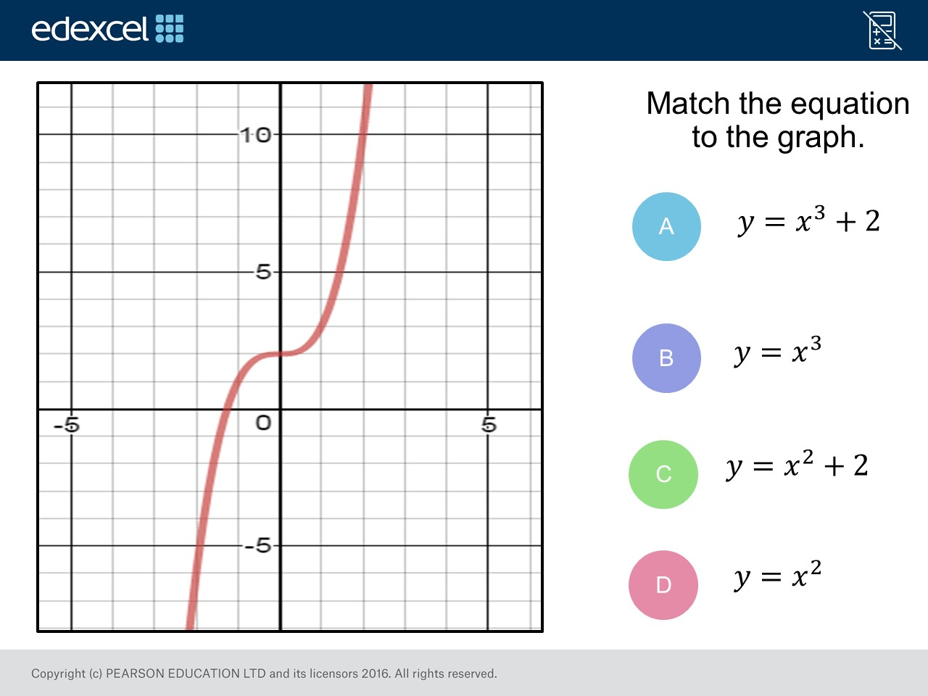
Question 11 – Cubic Graphs

Slide 23
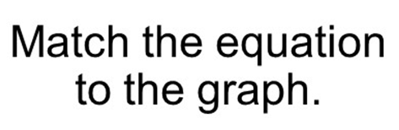
Answer 11 – Cubic Graphs
CORRECT ANSWER | CORRECT EXPLANATION
A | The equations has a power of 3 and the y intercept is at (2,0)
COMMON MISTAKES | WHAT MIGHT BE YOUR MISTAKE
B | The equations has a power of 3 but the y intercept is at (0,0)
C | The equations is for a quadratic graph
D | The equations is for a quadratic graph

Slide 24
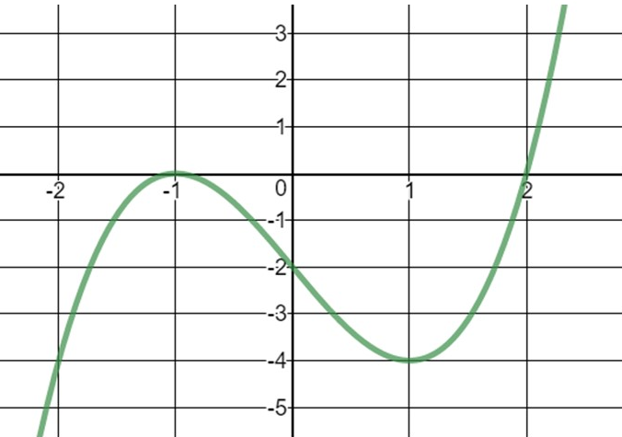
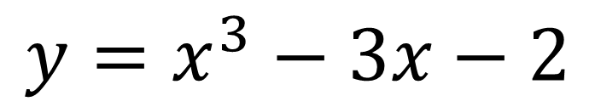
Question 12 – Cubic Graphs
$$y=x^{3}−3x−2$$
What are the solutions of the equation $x^{3} −3x−2=0$

Slide 25
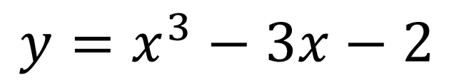

Answer 12 – Cubic Graphs
$$y=x^{3}−3x−2$$
What are the solutions of the equation
$$x^{3} −3x−2=0$$
CORRECT ANSWER | CORRECT EXPLANATION
x = -1 x = 2 | The graph touches and crosses at x = -1 and x = 2
COMMON MISTAKES | WHAT MIGHT BE YOUR MISTAKE
x = 1 x = -2 | The student got the wrong sign
x = 1 x = 2 | The student got the wrong sign
x = 1 x = -2 | The student got the wrong sign

Slide 26
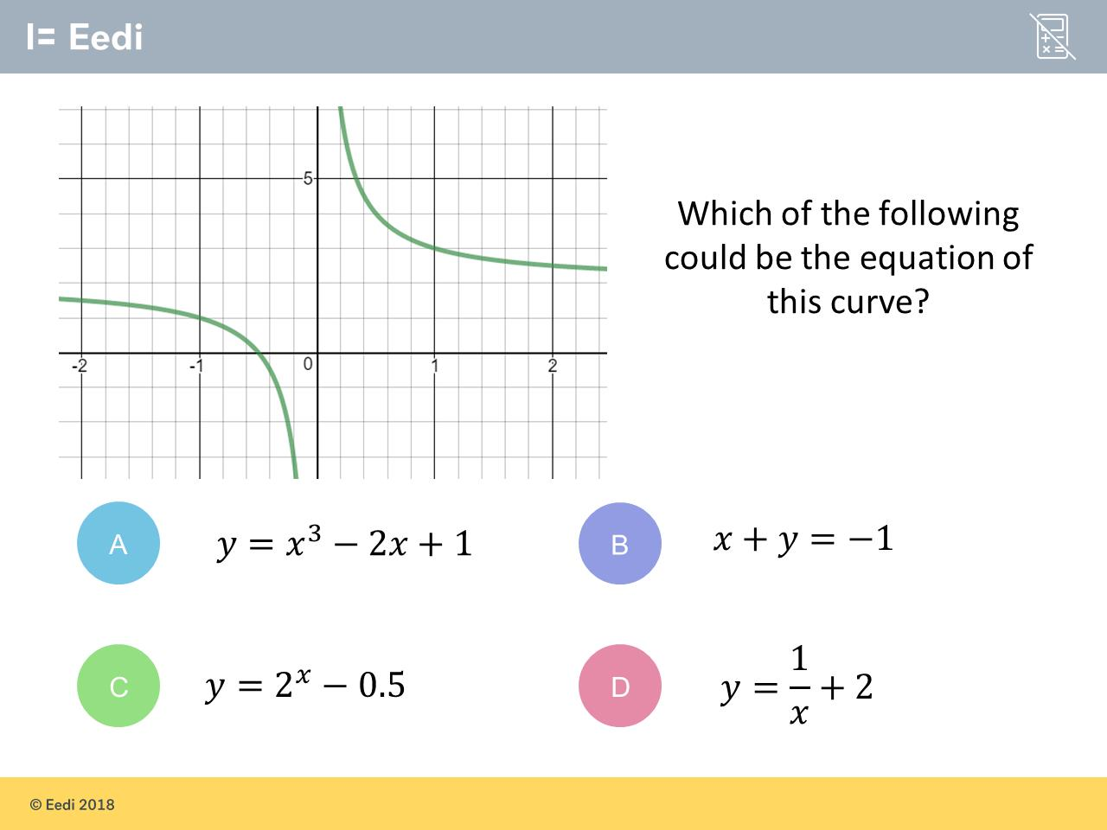
Question 13 – Reciprocal Graphs

Slide 27
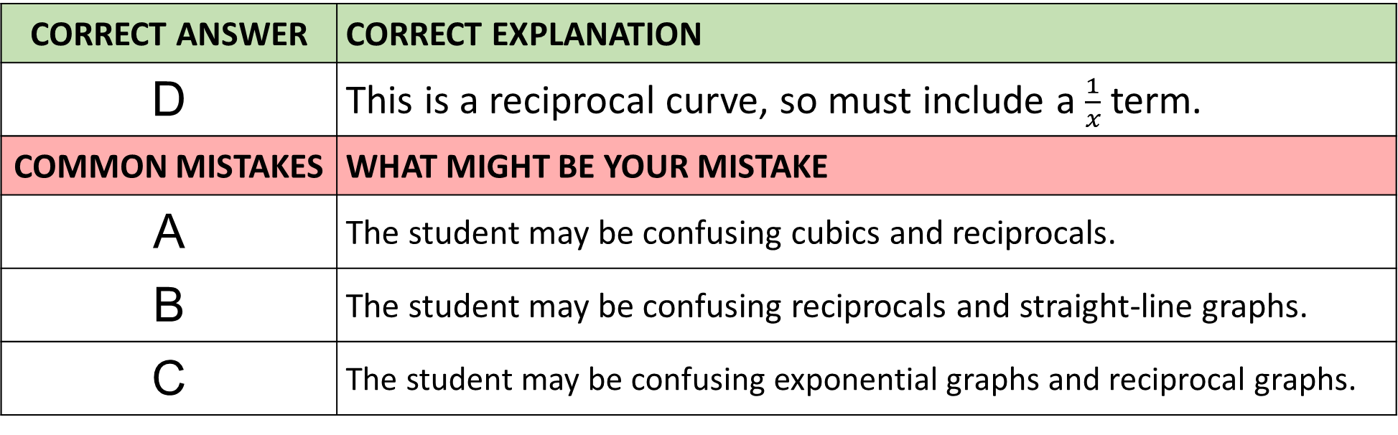
Answer 13 – Reciprocal Graphs
CORRECT ANSWER | CORRECT EXPLANATION
D | This is a reciprocal curve, so must include a $\frac{1}{x}$ term.
COMMON MISTAKES | WHAT MIGHT BE YOUR MISTAKE
A | The student may be confusing cubics and reciprocals.
B | The student may be confusing reciprocals and straight-line graphs.
C | The student may be confusing exponential graphs and reciprocal graphs.

Slide 28
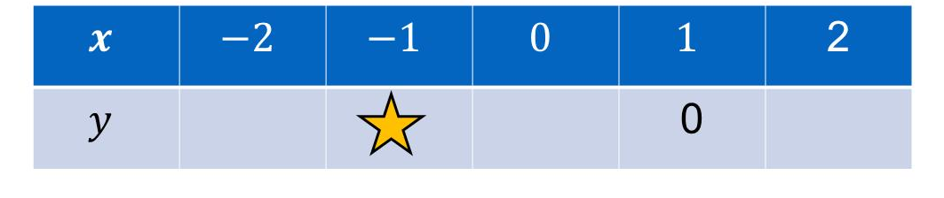
Question 14 – Reciprocal Graphs

Slide 29

Answer 14 – Reciprocal Graphs
CORRECT ANSWER | CORRECT EXPLANATION
0 | This is a reciprocal curve, so must include a $\frac{1}{x}$ term.
COMMON MISTAKES | WHAT MIGHT BE YOUR MISTAKE
-1 | The student may be confusing cubics and reciprocals.
-2 | The student may be confusing reciprocals and straight-line graphs.
-1.5 | The student may be confusing exponential graphs and reciprocal graphs.

