Slide 1
LO: Express a Number
as a Percentage
of Another Number

Slide 2

Whenever you get a test result
as a percentage, it is expressing your
correct answers as a
percentage of total questions.

Slide 3


What percentage did they get in the test?
Test Result
$$\frac{20}{100}$$
20%

Slide 4

What percentage did they get in the test?
Test Result
$$\frac{28}{50}$$
56%

Slide 5

What percentage did they get in the test?
Test Result
$$\frac{3}{5}$$
60%

Slide 6

What percentage did they get in the test?
Test Result
$$\frac{20}{25}$$
80%

Slide 7

What percentage did they get in the test?
Test Result
$$\frac{12}{40}$$
30%

Slide 8

What percentage did they get in the test?
Test Result
$$\frac{3}{15}$$
20%

Slide 9

What percentage did they get in the test?
Test Result
$$\frac{27}{34}$$
79.41%
(Given to 2 decimal Places)

Slide 10

What percentage did they get in the test?
Test Result
$$\frac{7}{67}$$
10.45%
(Given to 2 decimal Places)

Slide 11
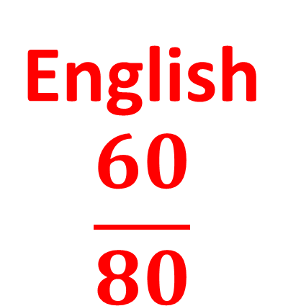


Billy gets the following scores in his tests.
What percentage did Billy get in each subject?
English $$\frac{60}{80}$$
Maths $$\frac{17}{20}$$
Science $$\frac{18}{40}$$
75%
85%
45%

Slide 12
Which product contains the
smallest percentage of carbohydrate?
Chocolate
Cookies
Cheesy
Crisps
Nutrition Information
Nutrition Information
Typical Value
Per 10g biscuit
Typical Value
Per 16g bag
Energy
Protein
Carbohydrate
Fat
Fibre
Sodium
233kj
0.6g
6.7g
2.2g
0.2g
<0.05g
Energy
Protein
Carbohydrate
Fat
Fibre
Sodium
504kj
1.6g
12g
7g
0.3g
0.2g
67%
75%

