Slide 1
Normal Distribution
Standard Normal Distribution
Chapter 3
(Part 4 of 7)

Slide 2
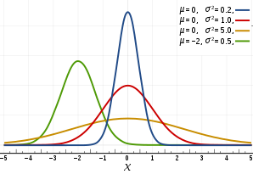
These are examples of various normal distributions.
The red one is known as ‘ The Standard Normal Distribution’.

Slide 3
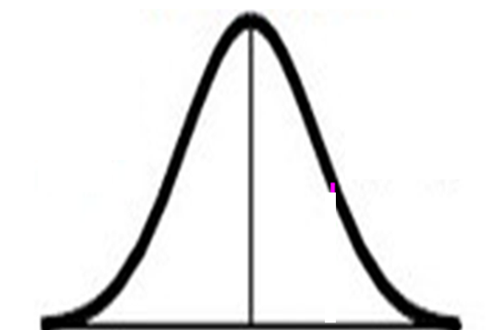


Standard Normal Distribution
The great thing about the
standard normal distribution is
the mean is always 0
and the standard deviation is always 1.
$μ=0$
$$σ=1$$
$0$

Slide 4
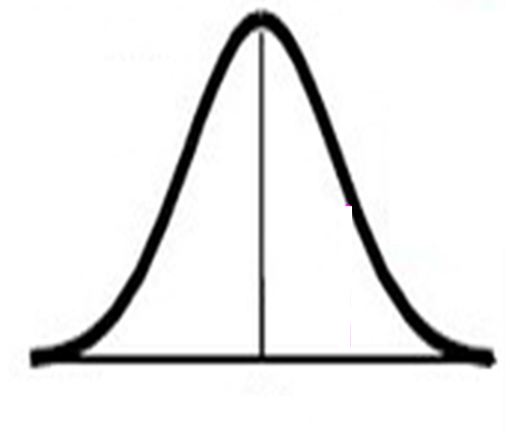


Normal
Distribution
Standard
Distribution
$μ=0$
$$σ=1$$
$$μ$$
0
Z
X
X scale
Z scale

Slide 5
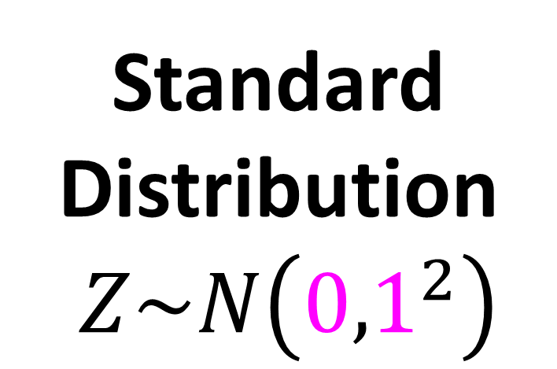
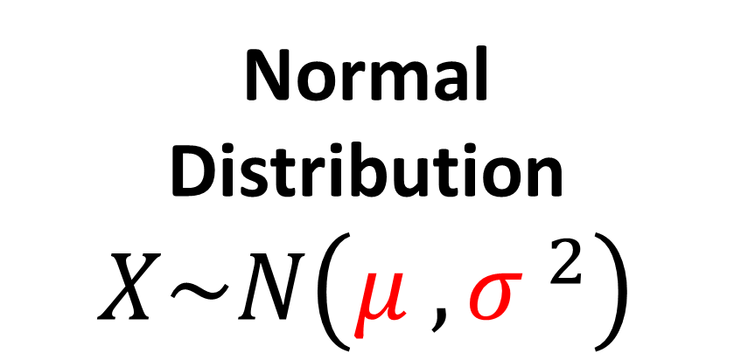
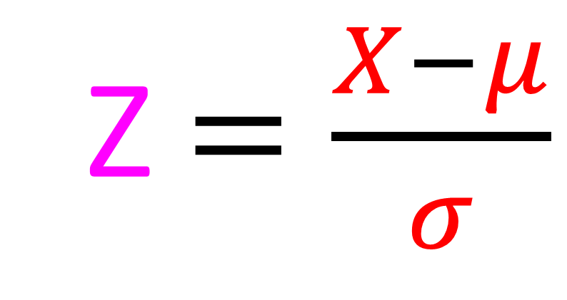
Finding Z Numbers
Standard Distribution
$Z\sim N\left({0,1}^{2}\right)$
Normal
Distribution
$$X\sim N\left({μ ,σ }^{2}\right)$$
Z $=\frac{X−μ}{σ}$

Slide 6
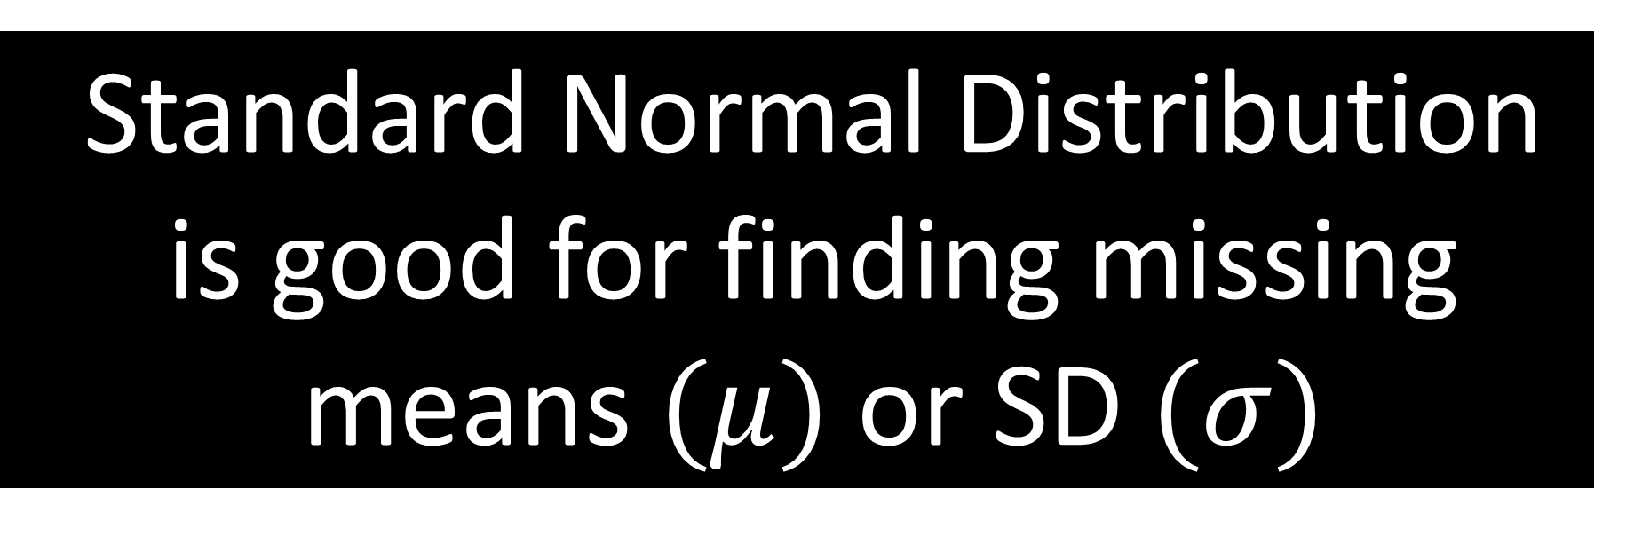
Standard Normal Distribution is good for finding missing means $(μ)$ or SD $(σ)$

Slide 7
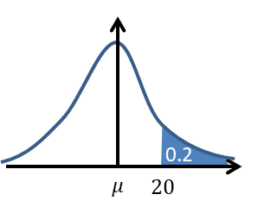



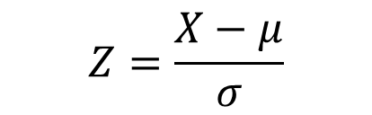



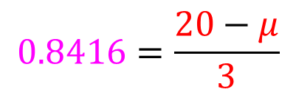

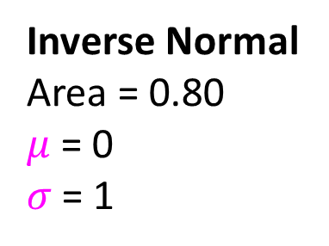
$X\sim N\left(μ,3^{2}\right)$
Given that $P\left(X>20\right)=0.2$, find the value of $μ$.
Normal
$μ= ?$
$$σ=3$$
Standard
$μ=0$
$$σ=1$$
Inverse Normal
Area = 0.80
$μ$ = 0
$σ$ = 1
$$Z=\frac{X−μ}{σ}$$
$$0.8416=\frac{20−μ}{3}$$
$$Z=0.8416$$
$$μ=17.5 (3sf)$$

Slide 8
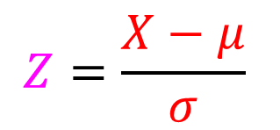

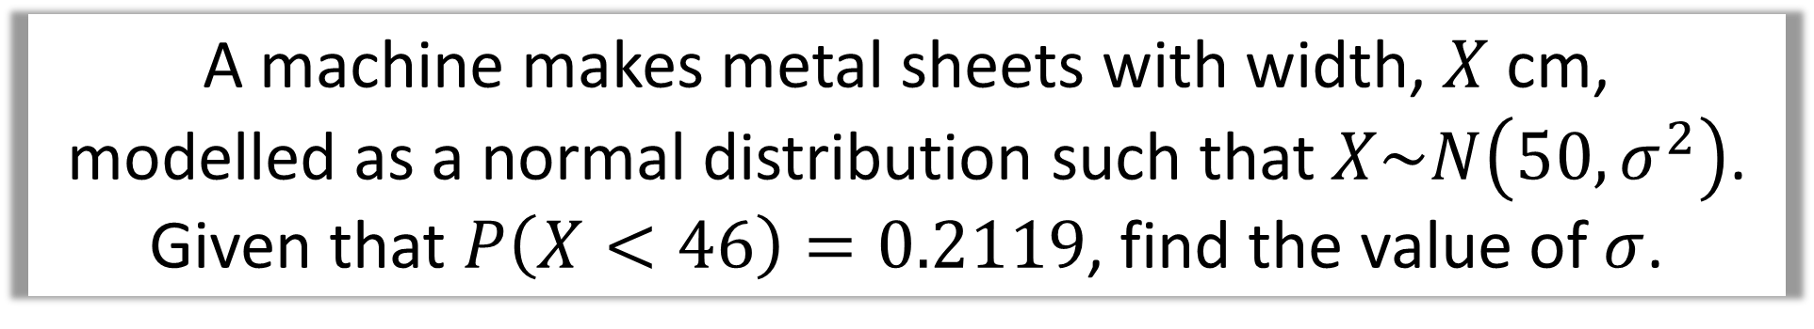
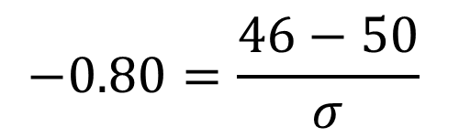
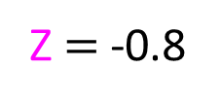
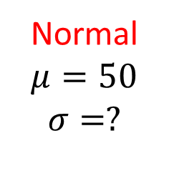
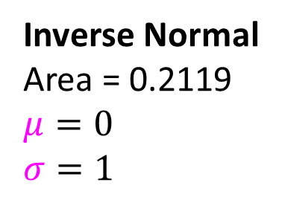

A machine makes metal sheets with width, $X$ cm,
modelled as a normal distribution such that $X\sim N\left(50,σ^{2}\right)$.
Given that $P\left(X<46\right)=0.2119$, find the value of $σ$.
Normal
$μ=50$
$$σ=?$$
Standard
$μ=0$
$$σ=1$$
0.2119
0.2119
46
50
Z
0
Inverse Normal
Area = 0.2119
$μ=0$
$$σ=1$$
$$Z=\frac{X−μ}{σ}$$
$$−0.80=\frac{46−50}{σ}$$
Z $=$ -0.8
$$σ=5$$

Slide 9

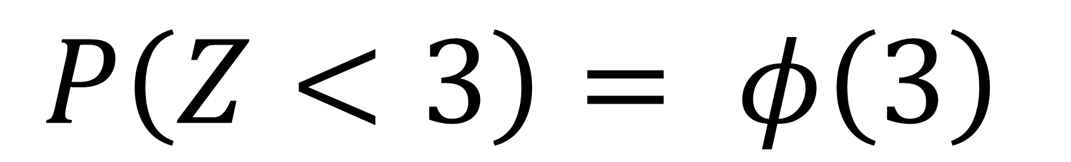
Other notation
that you may come across is phi $φ$
$$P\left(Z<3\right)= φ\left(3\right)$$

