Slide 1
LO: Data Collection, Questionnaires
and Sampling

Slide 2
Classifying Data
Collecting Data
Sampling

Slide 3
Classifying Data

Slide 4
Getting Data
Option A
Option B
Primary Data
Secondary Data
Collect the
data yourself.
Find data that
already exists.
Online Questionnaires
Fact to Face Survey
Internet
Database of Information

Slide 5
Primary or Secondary?
Favourite ice cream flavours in this class
Brands of cars parked in the school car park
Surface Temperature of the planets
Population of the UAE
Most popular local tourist attractions in the UAE
Languages spoken by students at DC
Primary
Primary
Secondary
Secondary
Secondary
Primary

Slide 6
Types of Data
Type A
Type B
Qualitative Data
Quantitative Data
Which exercise machine do you use the most?
How many times did you visit the gym last month?
Descriptions/
Categories
Numerical/
Numbers

Slide 7
Qualitative or Quantitative?
Favourite ice cream flavours in this class
Brands of cars parked in the school car park
Surface Temperature of the planets
Population of the UAE
Most popular local tourist attractions in the UAE
Languages spoken by students at DC
Qualitative
Qualitative
Quantitative
Quantitative
Qualitative
Quantitative

Slide 8
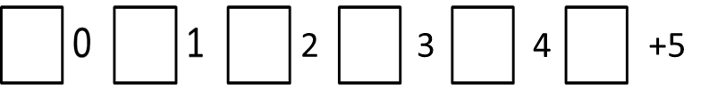
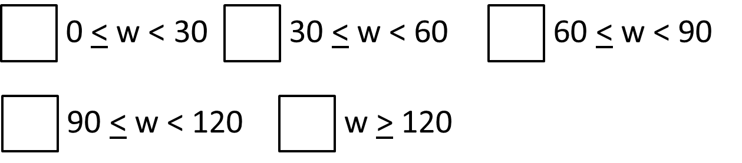
Types of Quantitative Data
Type A
Type B
Discrete Data
Continuous Data
How many times did you visit the gym last week?
What was your weight
when you joined the gym?
Only certain numbers are possible.
Can be any number including all decimals

Slide 9
Discrete or Continuous?
Shoe Size
Number of brothers and sisters
Temperature in the room
Distance between two cities
The height of a person
Age
Discrete
Discrete
Continuous
Continuous
Continuous
Discrete

Slide 10
Primary Data
(Collect Yourself)
Secondary Data
(Internet)
Qualitative Data
(Words)
Quantitative Data
(Numbers)
Discrete Data
(Certain Numbers)
Continuous Data
(All Numbers)

Slide 11
Qualitative Data
al data
Quantitative Data
(Discrete)
al data
Quantitative Data
(Continuous)
al data
G) Eye colour
A) People in your family
H) Time taken to complete a task
B) Football team
D) Shoe size
C) Height of a mountain
i) Birth place
F) Goals in a football match
E) Temperature of a classroom
A) How many people in your family
B) Favourite football team
C) Height of a mountain
D) Shoe size
E) The temperature of a classroom
F) Goals in a football match
H) Time taken to complete a task
i) Birth place
G) Eye colour

Slide 12
Collecting Data

Slide 13
To analyse data, you first have to collect the data.
What is the most common way that data is collected?
Survey/Questionnaire

Slide 14



How many questionnaire have you filled this year already!!

Slide 15

It is important to design a questionnaire so that:
people will co-operate
people answer honestly
answers can be analysed
There are some rules to follow for designing a good questionnaire……

Slide 16

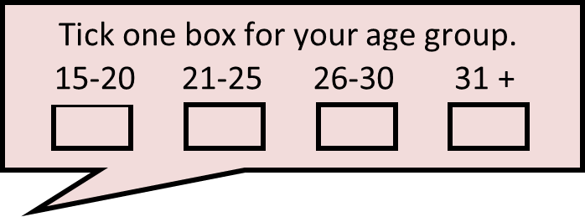

Rule 1
Make sure that questions are not
embarrassing or too personal.

Slide 17

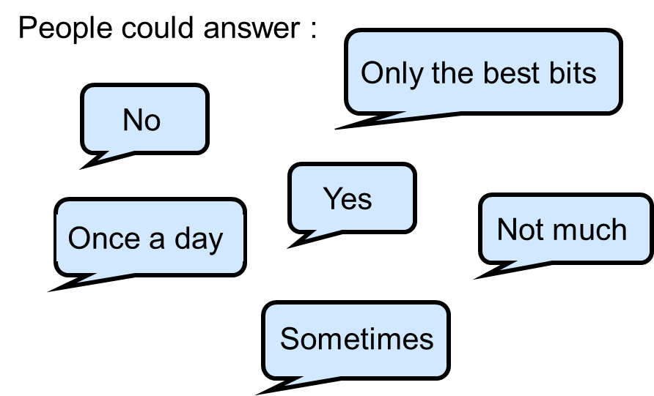
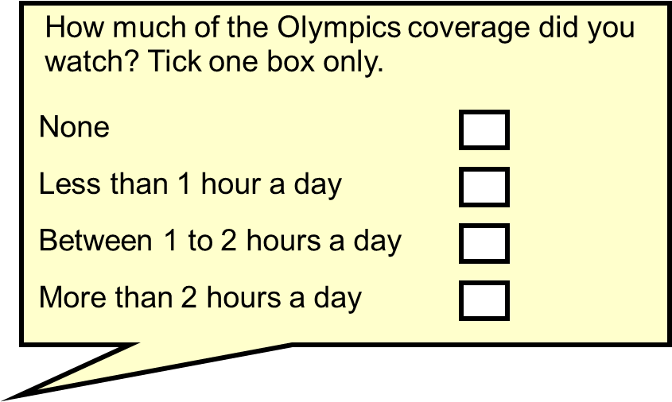
Rule 2
Write questions so that they have
a specific answer.
Did you see the Olympics on TV ?

Slide 18
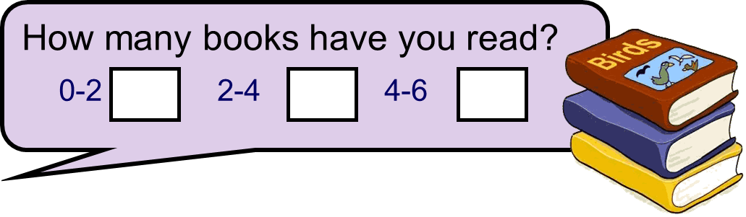
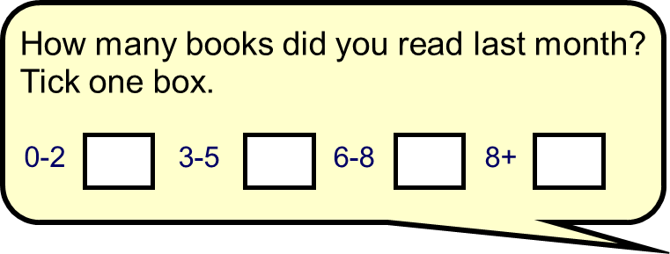
Rule 3
Give questions a time frame
when appropriate.

Slide 19
Rule 4
Make sure there is no
overlap in your answers.

Slide 20
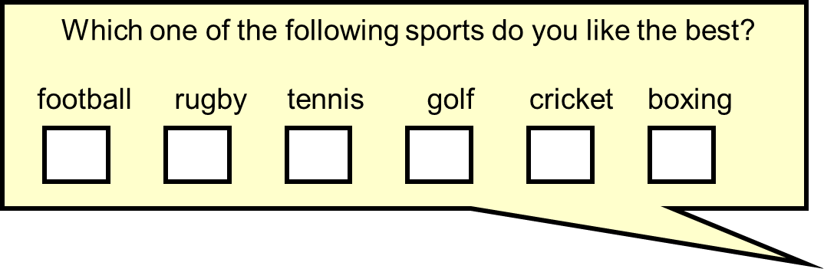
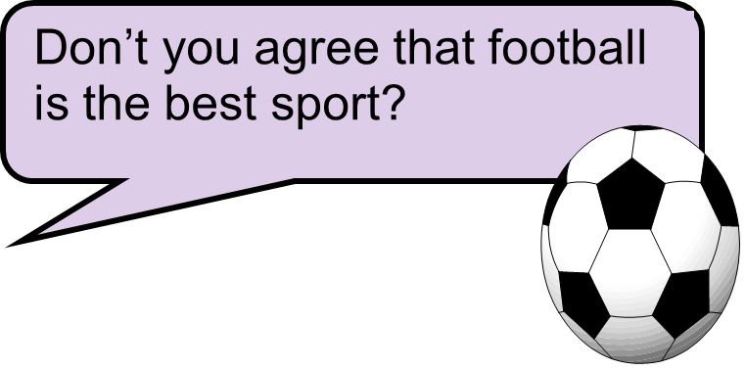
Rule 5
Do not ask leading questions.

Slide 21
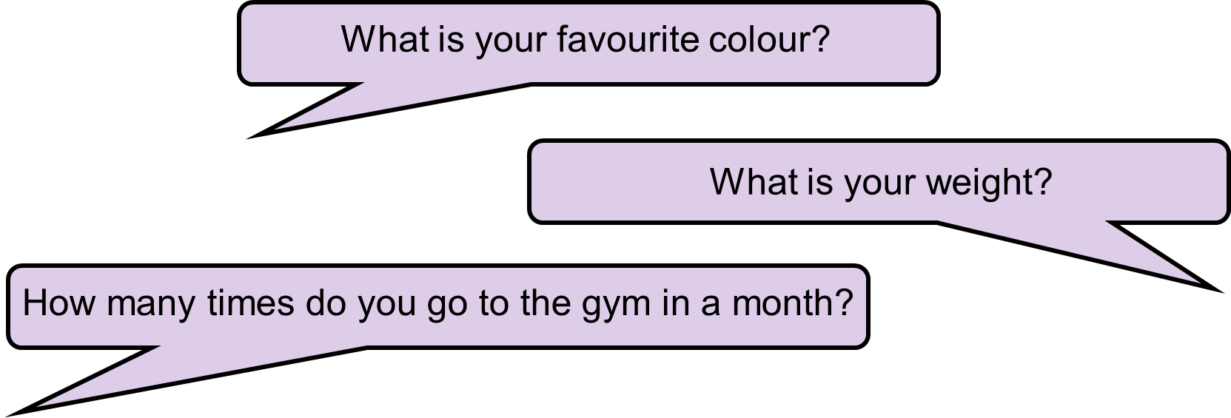
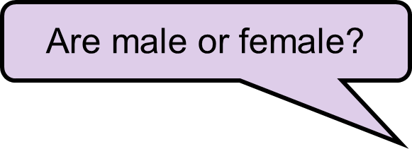
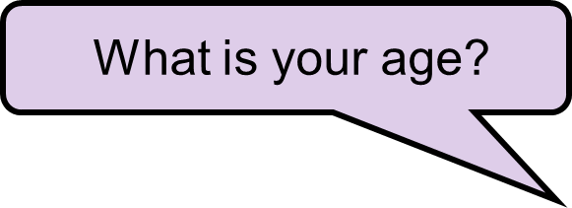
Rule 6
Ask questions that are relevant
to your survey
Survey on favourite TV programs

Slide 22
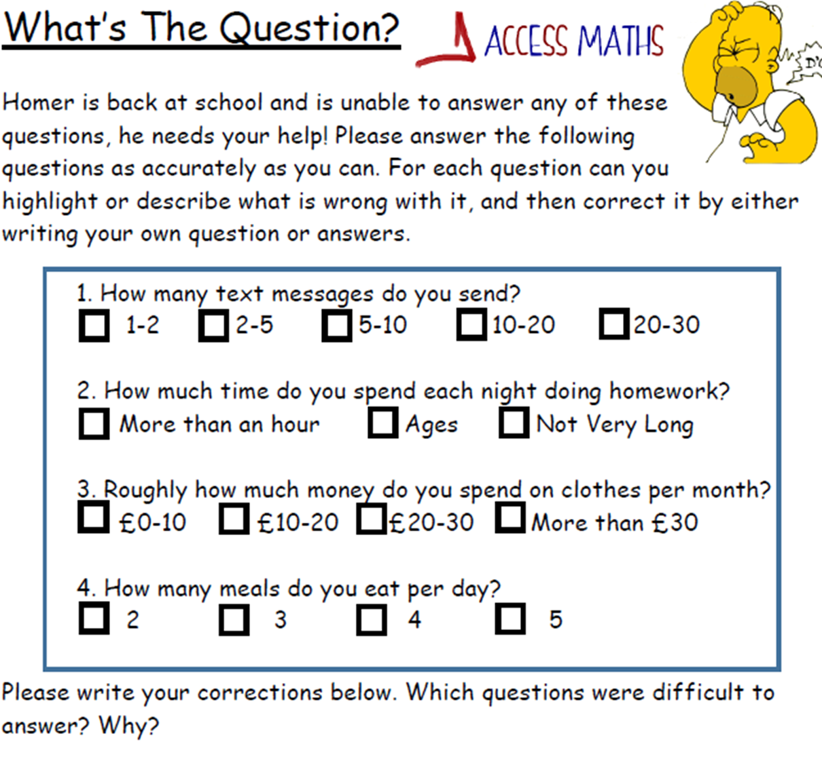
Identify the errors and improvements

Slide 23
Sampling

Slide 24

You want DC students to complete a survey about the canteen.
How many student should
fill in the survey?
Ideally, all students.

Slide 25
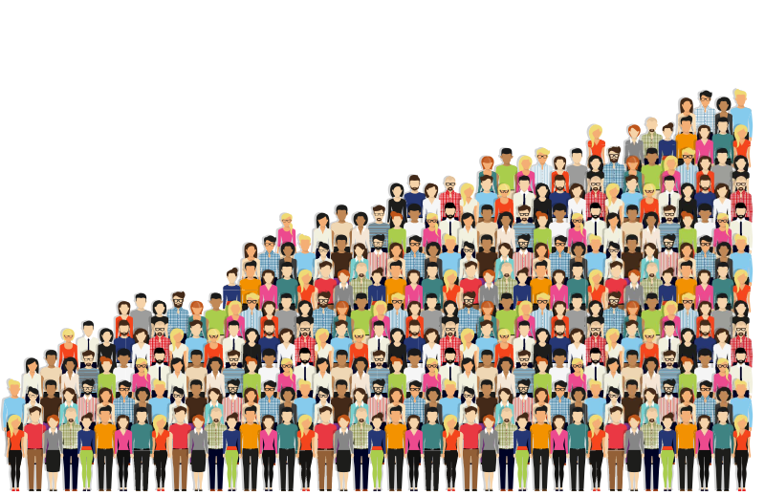
What are the limitations of trying to
get data from your whole population?
Time consuming
Expensive
What could you do instead?
Take a Sample

Slide 26
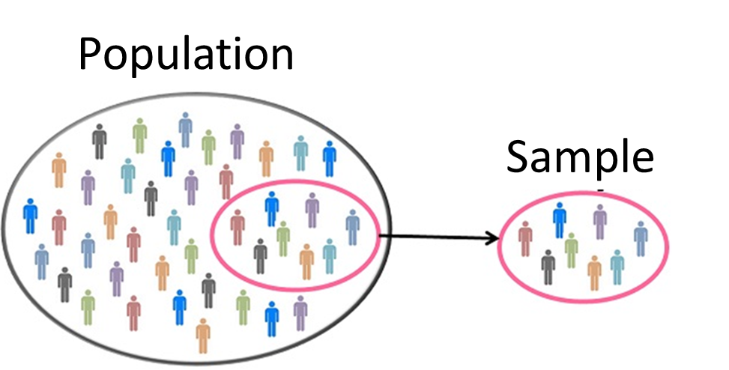
How many should be in a sample?
As large as possible
but at least 10%

Slide 27

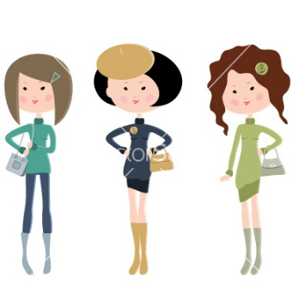


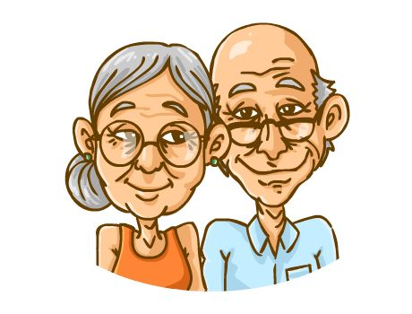

Who should be included in the sample?
A sample should try to reflect the whole group.

Slide 28

How do students travel to
Dubai College?
Who should be represented in the sample?
Boys, Girls,
Year 7, Year 8, Year 9,
Year 10, Year 11, Year 12, Year 13,

Slide 29
Types of Samples

Slide 30
Random Sampling
Each item has
the same chance of being chosen.
What ways could this be done
if you have a list of people?

Slide 31
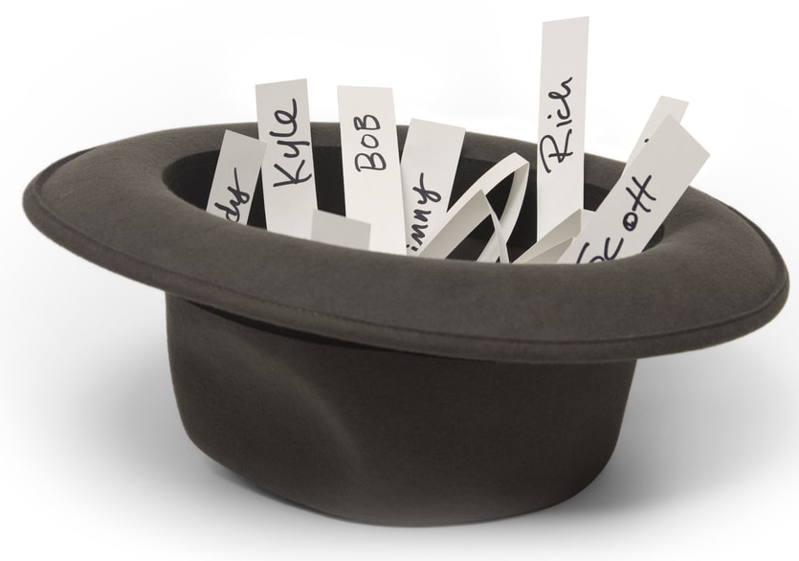
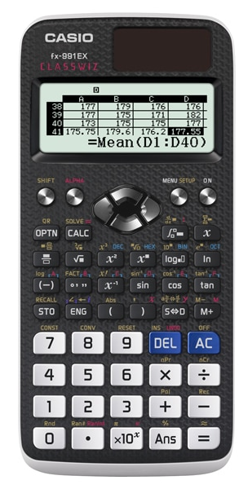
How to Random Sample
Random button
on a calculator.
RAN#
Name out of a hat.

Slide 32
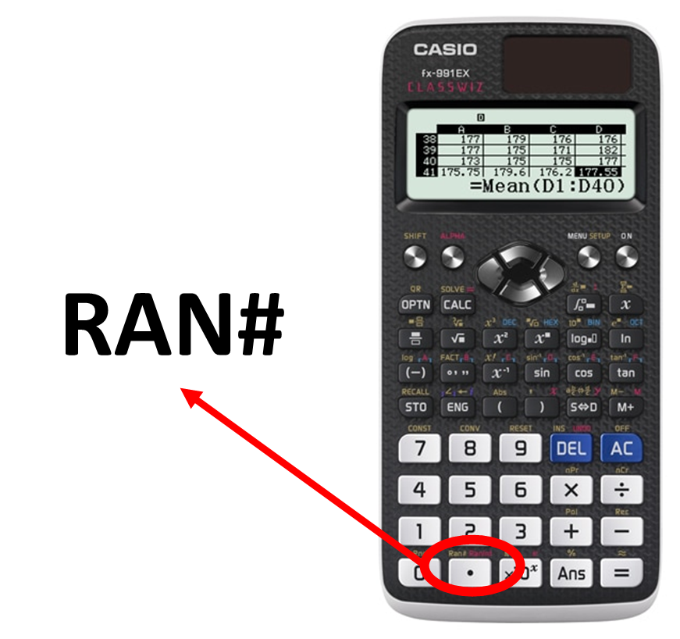
Chose 5 random people
from the list below?
 | John
 | Ines
 | Kai
 | Alina
 | Hugo
 | Lucas
 | Katie
 | Aiza
 | Clarie
 | Richard
 | Bob
 | Sue
1
2
3
4
5
6
7
8
9
10
11
12

Slide 33
Stratified Sampling
The number of items
taken from each group
is proportional to
the population group size.

Slide 34


How to Stratified Sample
 | Population | Sample
Girls | 20
Boys | 80
Total | 100 | 20
4
16

Slide 35
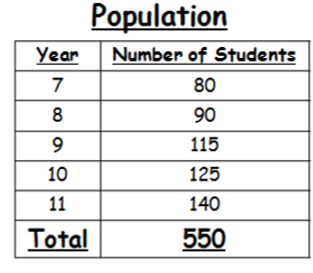
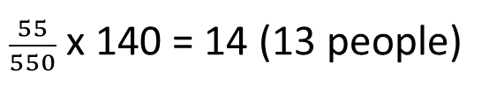
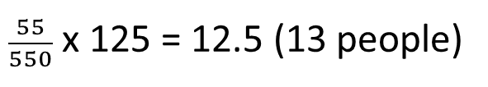
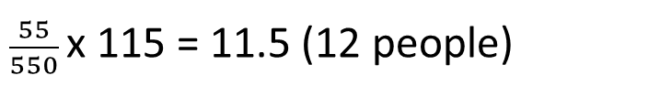
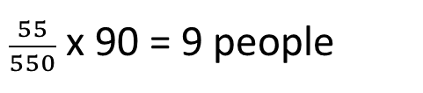
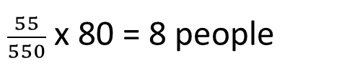
How many people do I pick from
each year group for sample size of 55?
$\frac{55}{550}$ x 80 = 8 people
$\frac{55}{550}$ x 90 = 9 people
$\frac{55}{550}$x 115 = 11.5 (12 people)
$\frac{55}{550}$ x 125 = 12.5 (13 people)
$\frac{55}{550}$ x 140 = 14 (13 people)

