Slide 1
Radians
Arc Lengths
Chapter 5
(Part 2 of 5)

Slide 2




Calculating arc length using radians
$$l$$
$$r$$
$$θ$$
$$l=rθ$$

Slide 3
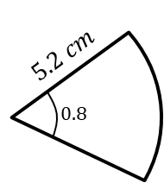
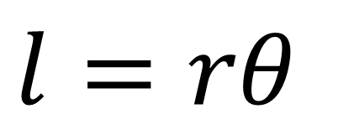
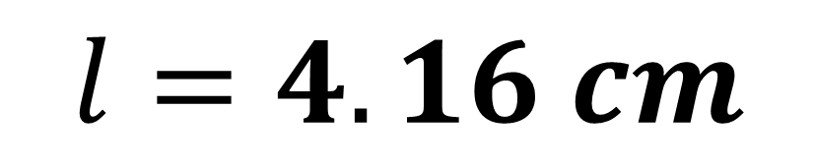
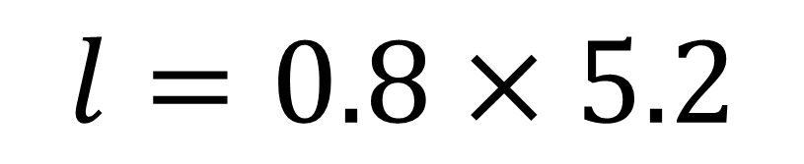

Find the length of the arc$.$
$$l=rθ$$
$$l=0.8×5.2$$
$$l=4.16 cm$$

Slide 4
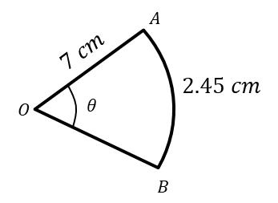
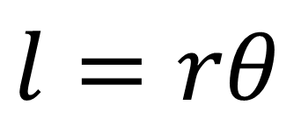
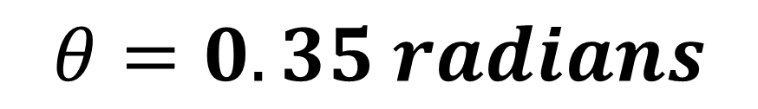
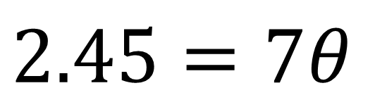
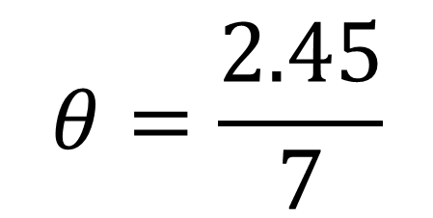
Find the angle ∠𝐴𝑂𝐵
$$l=rθ$$
$$2.45=7θ$$
$$θ=\frac{2.45}{7}$$
$$θ=0.35 radians$$

Slide 5
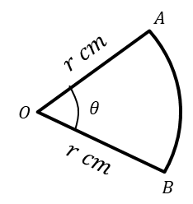
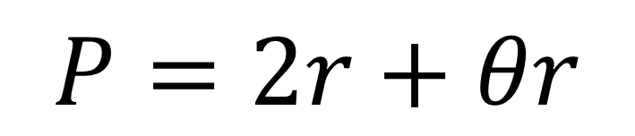
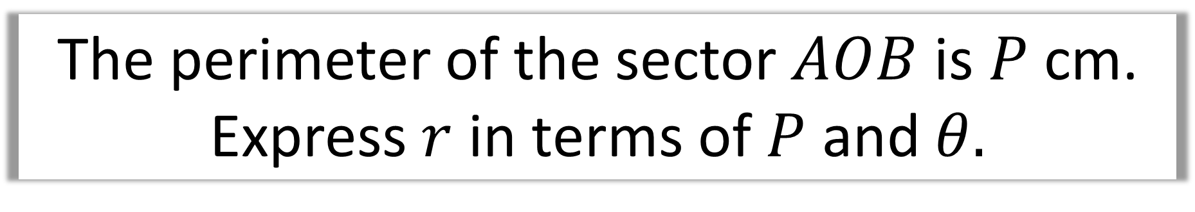
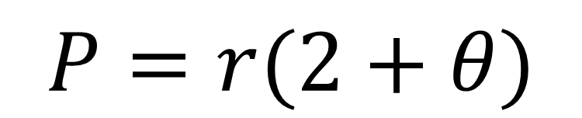
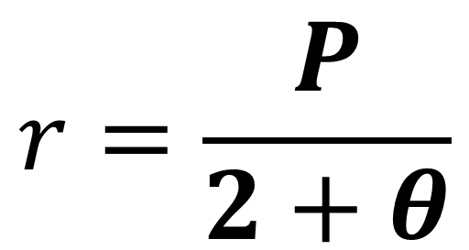
The perimeter of the sector $AOB$ is $P$ cm. Express $r$ in terms of $P$ and $θ.$
$$P=2r+θr$$
$$P=r(2+θ)$$
$$r=\frac{P}{2+θ}$$

Slide 6
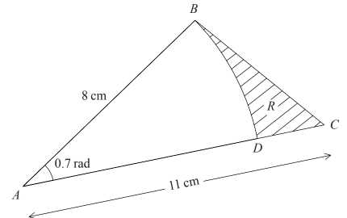

The arc $BD$ is an arc of a circle with centre $A$ and radius 8 cm.
Find
the length of the arc $BD$.
(b) the perimeter of $R$,
giving your answer to 3 significant figures.

Slide 7
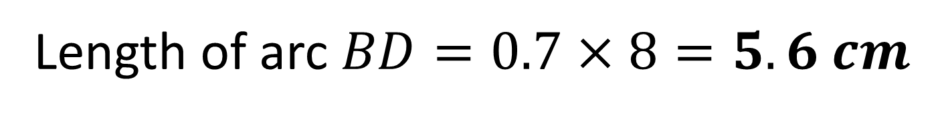
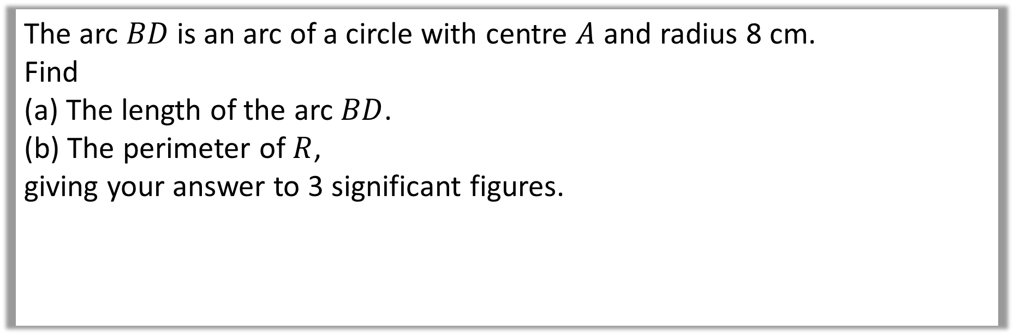
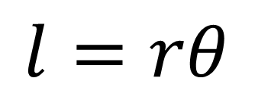
The arc $BD$ is an arc of a circle with centre $A$ and radius 8 cm.
Find
(a) The length of the arc $BD$.
(b) The perimeter of $R$,
giving your answer to 3 significant figures.
$$l=rθ$$
a)
Length of arc $BD=0.7×8=5.6 cm$

Slide 8
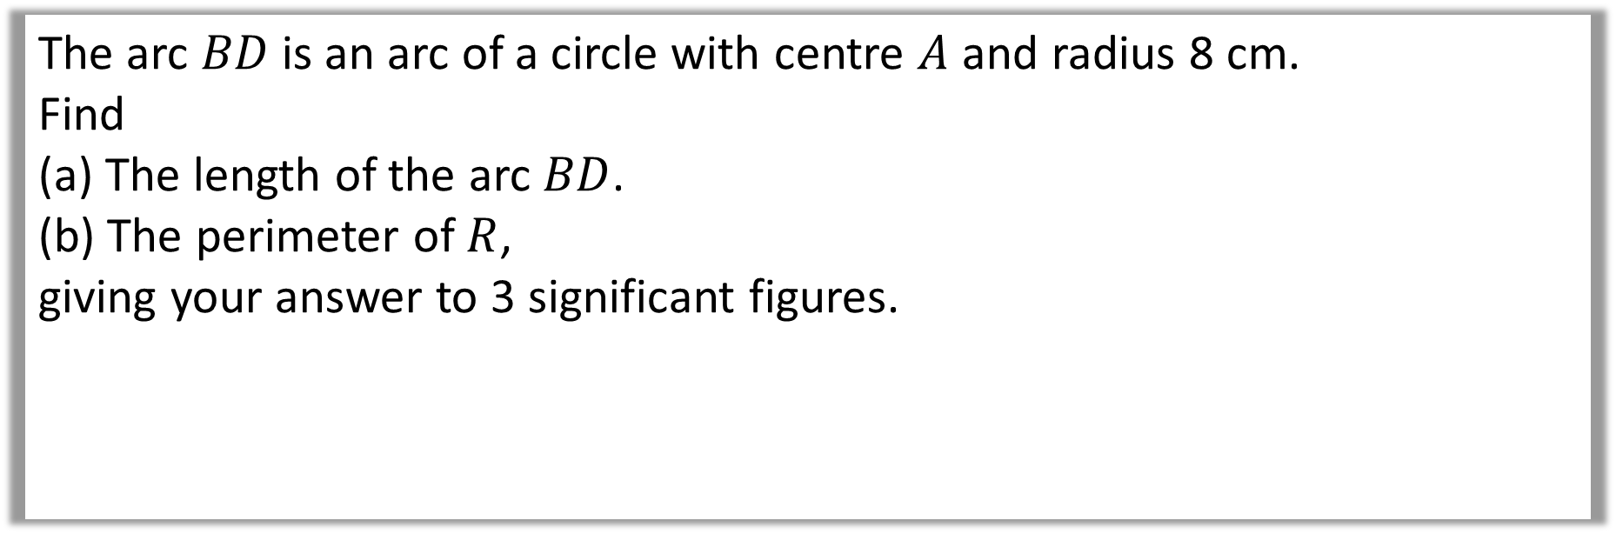

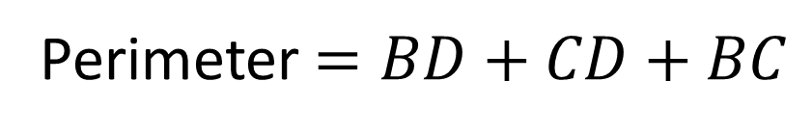
The arc $BD$ is an arc of a circle with centre $A$ and radius 8 cm.
Find
(a) The length of the arc $BD$.
(b) The perimeter of $R$,
giving your answer to 3 significant figures.
b)
Perimeter $=BD+CD+BC$
$CD=11−8=3$
$BC=\sqrt{8^{2}+{11}^{2}−2×8×11×\cos\left(0.7\right)}=7.09 cm$
$$P=5.6+3+7.09=15.7 cm (to 3sf)$$

Slide 9








The border of a garden pond consists of a straight edge $AB$ of length 2.4m,
and a curved part $C$, as shown in the diagram.
The curve part is an arc of a circle, centre $O$ and radius 2m.
Find the length of $C$.
$$C$$
$$θ$$
$$2 cm$$
$$2 cm$$
$$A$$
$$2.4 cm$$
$$B$$

Slide 10

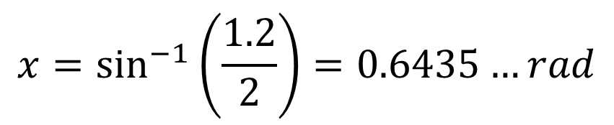



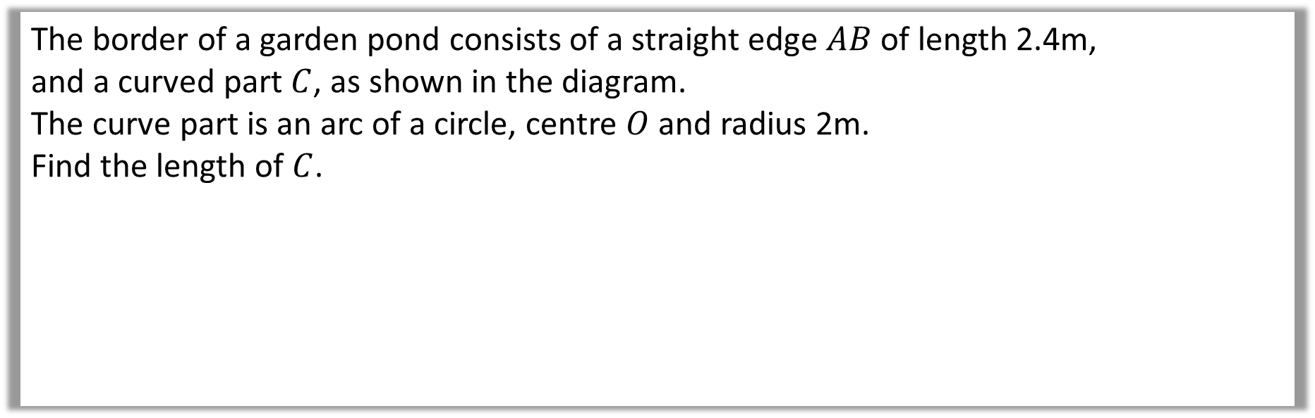







The border of a garden pond consists of a straight edge $AB$ of length 2.4m,
and a curved part $C$, as shown in the diagram.
The curve part is an arc of a circle, centre $O$ and radius 2m.
Find the length of $C$.
$$C$$
$$θ$$
$$2 cm$$
$$2 cm$$
$$A$$
$$2.4 cm$$
$$B$$
$$x=\sin^{−1}\left(\frac{1.2}{2}\right)=0.6435…rad$$
$$2 cm$$
$$x$$
$$θ=2π−2x=4.9961…rad$$
$$1.2 cm$$
$$C=2×4.9961=9.99 m (3sf)$$

