Slide 1
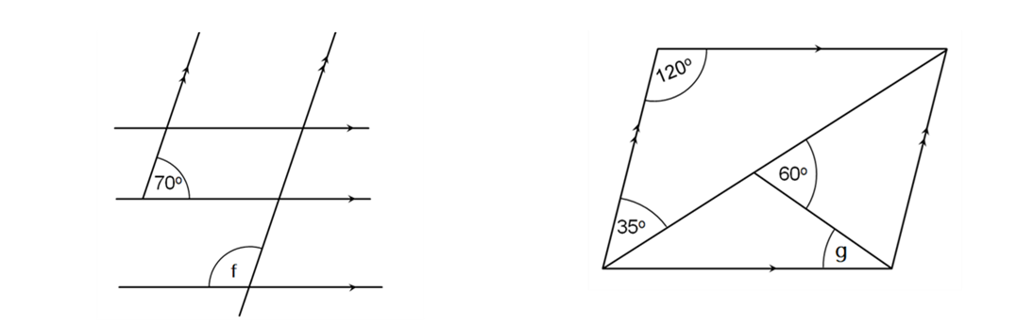
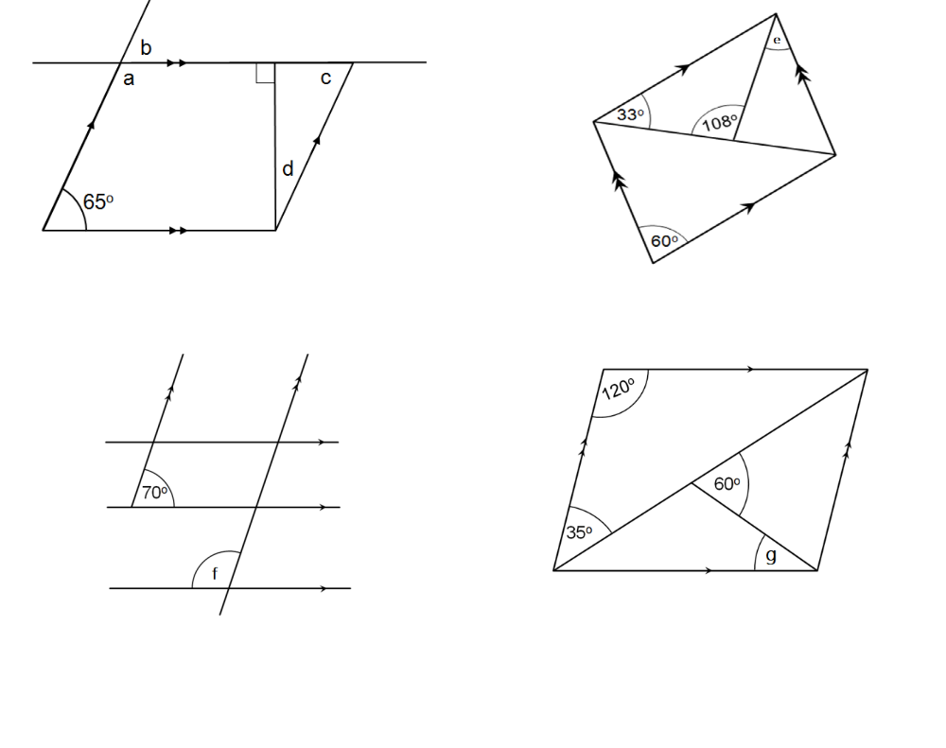
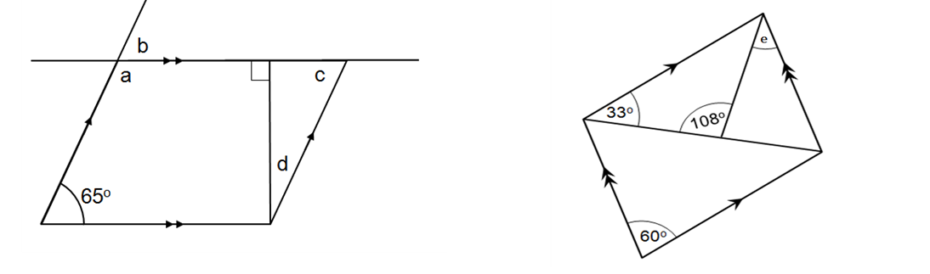
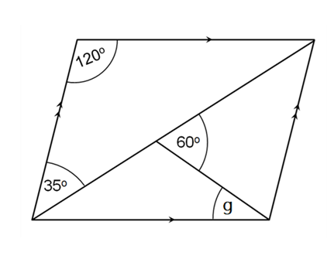
 |  | Angle Facts Used
Angle | Size | Alternate angles are equal | Corresponding angles are equal | Co-interior angles are supplementary | Vertically opposite angles are equal | Angles in a triangle sum to 180º | Adjacent angles on a straight line sum to 180º | Angles at a point sum to 360º | Opposite angles in a parallelogram are equal
a
b
c
d
e
f
g

Slide 2
ANSWERS

Slide 3
 |  | Angle Facts Used
Angle | Size | Alternate angles are equal | Corresponding angles are equal | Co-interior angles are supplementary | Vertically opposite angles are equal | Angles in a triangle sum to 180º | Adjacent angles on a straight line sum to 180º | Angles at a point sum to 360º | Opposite angles in a parallelogram are equal
a
b
c
d
e
f
g
115°
65°
65°
25°
21°
110°
35°

