Slide 1
LO: Writing
Expressions

Slide 2

Expression or Not?
4x + 3
Expression

Slide 3

Expression or Not?
4x + 3 =11
Equation

Slide 4
Expression or Not?
a = 4b + 3
Formula

Slide 5
Expression or Not?
4y + 3x + 3z
Expression

Slide 6
Expression or Not?
a = 4(b + 3)
Formula

Slide 7
Expression or Not?
3(x + 8)
Expression

Slide 8
Simplify
3x + 8x – 3y
11x – 3y

Slide 9
Simplify
3x – y + 8x – 3y
11x – 4y

Slide 10
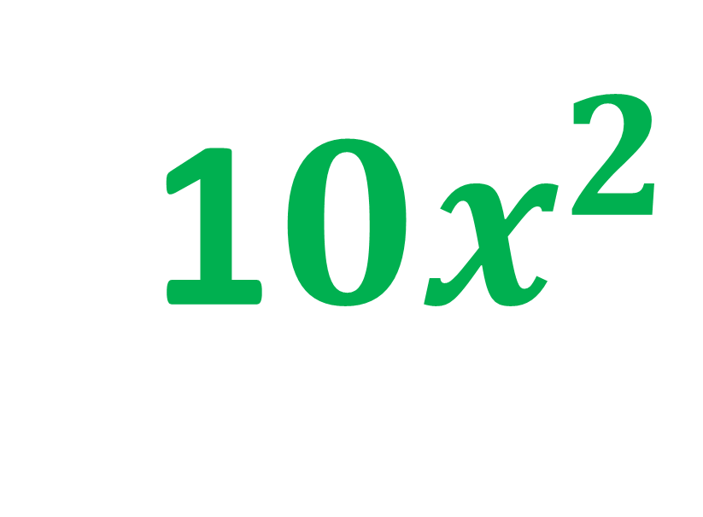
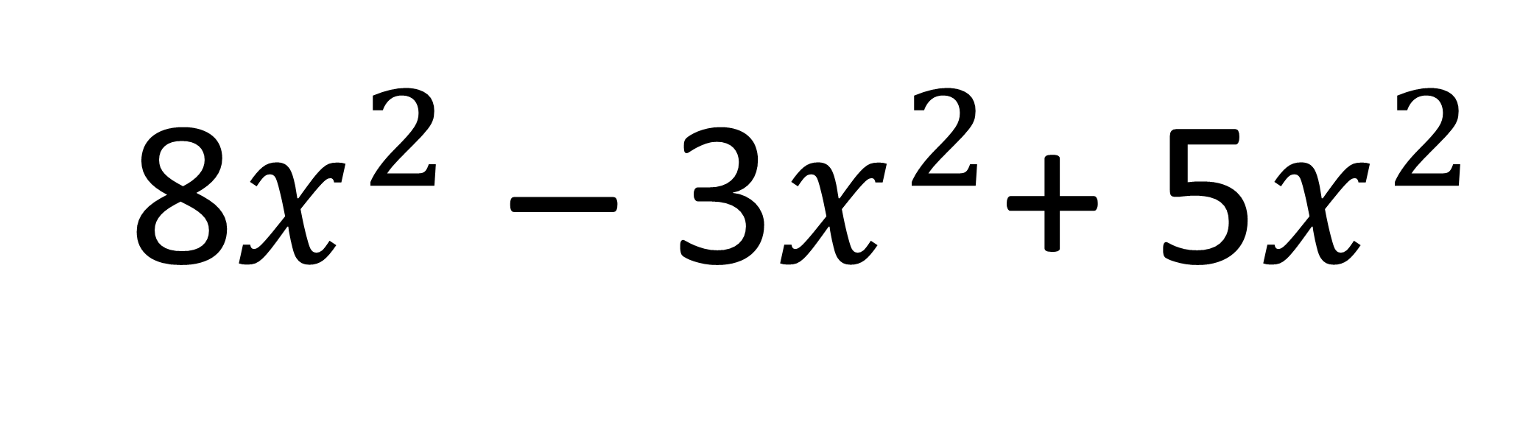
Simplify
8$x^{2}$ – 3$x^{2}$+ 5$x^{2}$
1$0x^{2}$

Slide 11
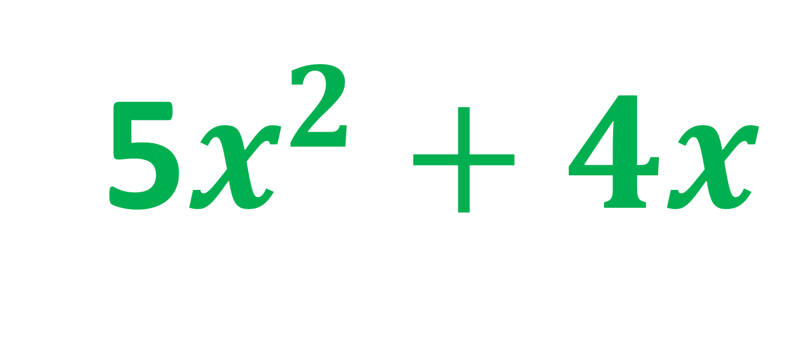
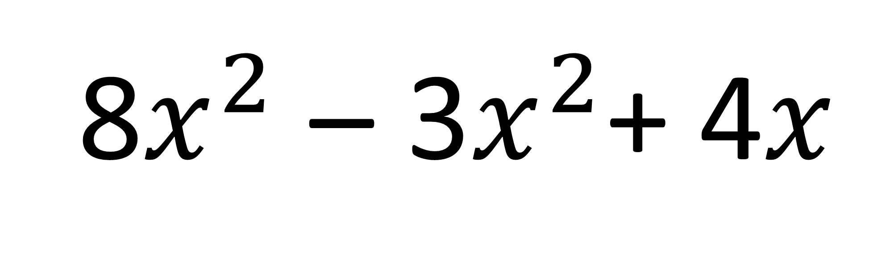
Simplify
8$x^{2}$ – 3$x^{2}$+ 4$x$
5$x^{2}+4x$

Slide 12
An algebraic expression is made up of variable and numbers but does not use an equal sign.
2x + 40
2(x + 4)
2x + 4y

Slide 13
Write an algebraic expression for the perimeter of the rectangle.
x
5
2x + 10

Slide 14
Write an algebraic expression for the perimeter of the rectangle.
2x + 5
x
6x + 10

Slide 15
Write an algebraic expression for the perimeter of the rectangle.
7x + 5
3 – 2x
10x + 16

Slide 16
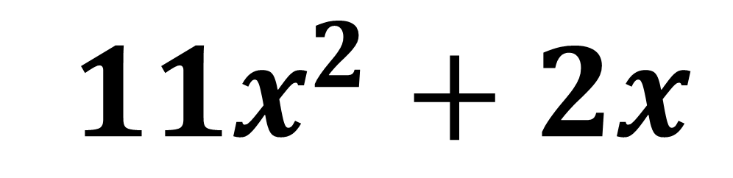


Write an algebraic expression for the perimeter of the triangle.
$${8x}^{2}$$
2x
$${3x}^{2}$$
${11x}^{2}+2x$

Slide 17
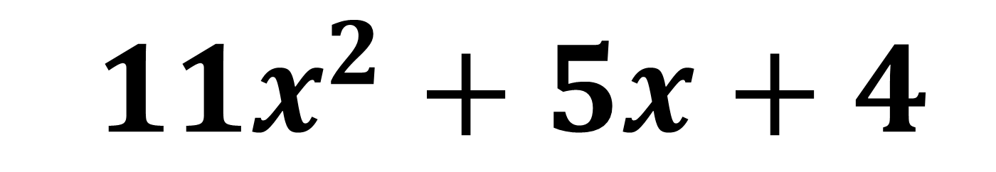
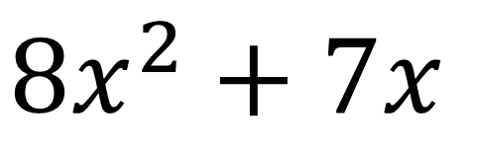
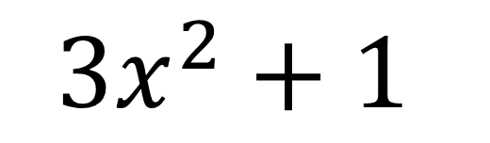
Write an algebraic expression for the perimeter of the triangle.
$${8x}^{2}+7x$$
3 – 2x
$${3x}^{2}+1$$
${11x}^{2}+5x+4$

