Slide 1


Furniture Design Company
You work for a furniture design company and
they have given you a brief for 3 different pieces of furniture.
You will need to complete the role of the
Product modeller
Textiles Manager
Accounts Manger
Use the information supplied to so you can report back to the managing director!

Slide 2
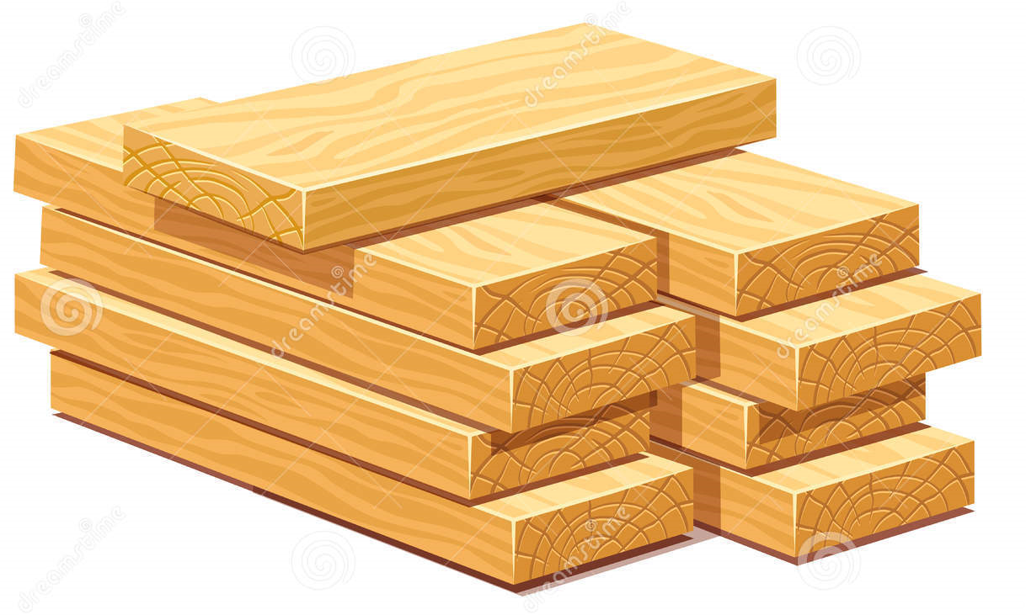
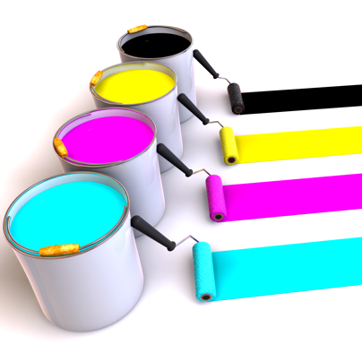
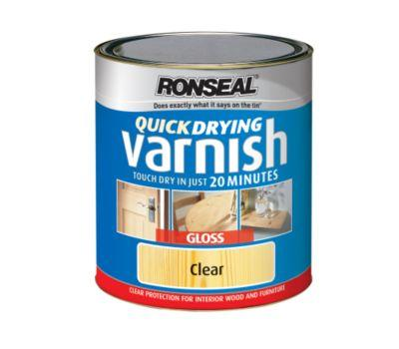
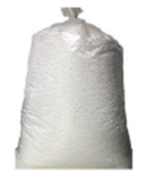
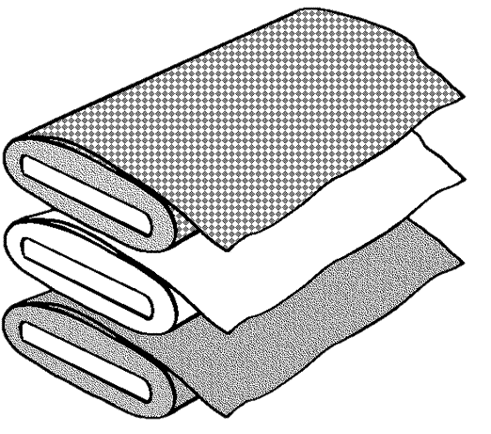
Handy Supplies Catalogue
Colour Paint:
£4 Small Tin (covers 0.5m²)
£7 Larger Tin (covers 1m²)
Wood:
£9 per 0.2m³
£15 per 0.5m³
Varnish:
£5 Small Tin (covers 0.25m²)
£8 Larger Tin (covers 0.5m²)
White Fabric:
£3 per 0.5m³
£5 per 1m²
Black Fabric:
£4 per 0.5m²
£7 per 1m²
Polystyrene Balls:
£7 Small Bag = 0.5m³
£12 Large Bag = 1m³
Red Patterned Fabric:
£5 per 0.5m²
£8 per 1m²

Slide 3
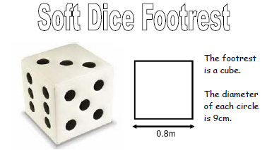
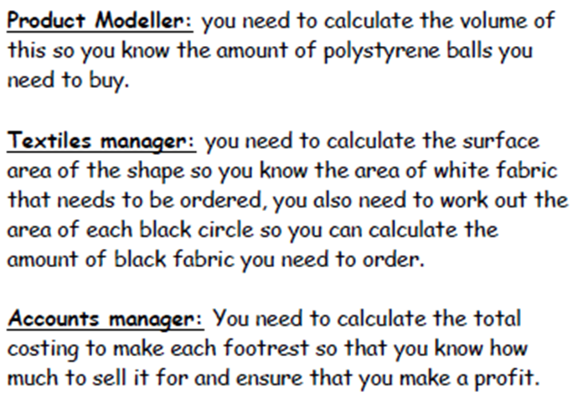
Product Modeller
What is the volume of the polystyrene balls you need?
0.8 x 0.8 x 0.8 = 0.512m³
Textiles Manager
How much white fabric do you need?
The area of each individual circle is 0.03m²
(0.8 x 0.8) x 6 = 3.84m²
How much black fabric do you need in total?
(0.03) x 21 = 0.63m²
Accounts Manager
Cost for polystyrene balls?
1 large bags x £12 = £12
Cost for white fabric?
4 x 1m² = £20
Cost for black fabric?
1m² = £7
Total Cost of these materials?
£39

Slide 4
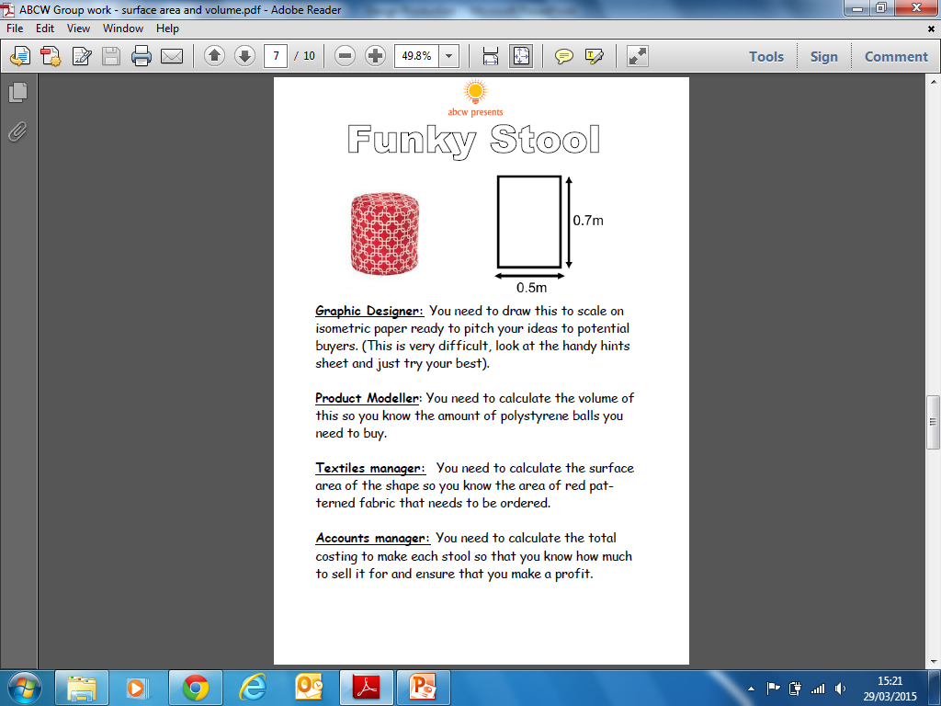
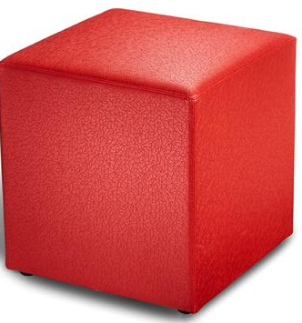
Product Modeller
What is the volume of the polystyrene balls you need?
0.4 x 0.5 x 0.7 = 0.14m³
Textiles Manager
How much patterned red fabric will you need?
0.4 x 0.5 x 2 = 0.4
0.4m
0.5 x 0.7 x 2 = 0.7
0.4 x 0.7 x 2 = 0.56
Total = 1.66m²
Accounts Manager
Cost for polystyrene balls?
1 small bag x £7 = £7
Cost for the red patterned fabric?
2 x 1m² = £16
Total Cost of these materials?
£23

Slide 5
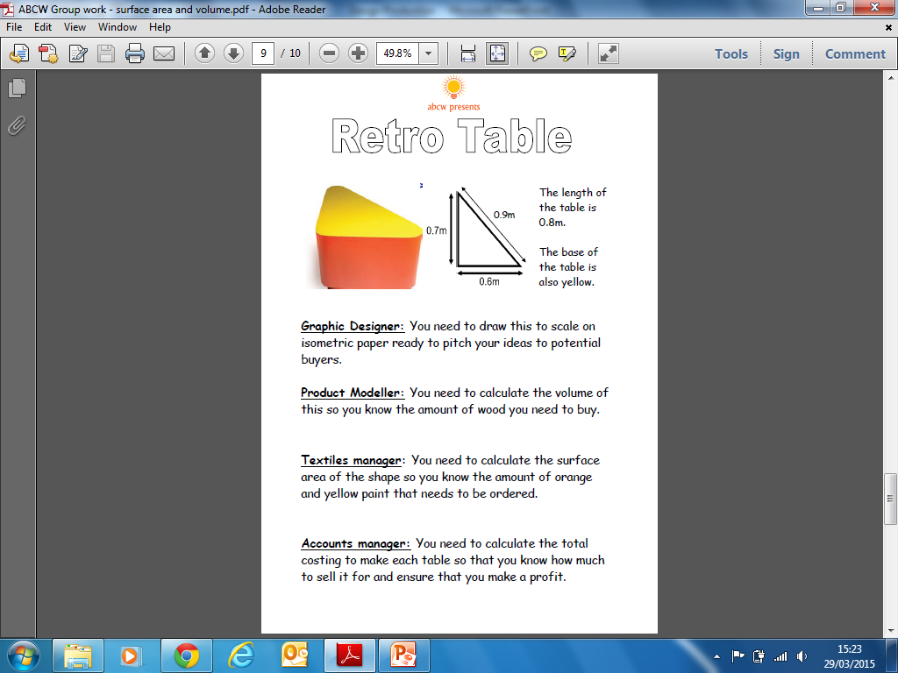
Product Modeller
What is the volume of the wood you need?
(½ x 0.7 x 0.6) x 0.8 = 0.168m³
The height of the table is 0.8m
Textiles Manager
How much yellow paint do you need?
(½ x 0.7 x 0.6) x 2 = 0.42m²
How much orange paint do you need in total?
(0.7 x 0.8) + (0.9 x 0.8) + (0.6 x 0.8) = 1.76m²
Accounts Manager
Cost for the wood?
1 x 0.2m³ = £9
Cost for the yellow paint?
1 x small tin = £4
Cost for the orange paint?
2 x large tins = £14
Total Cost of these materials?
£27

