Slide 1
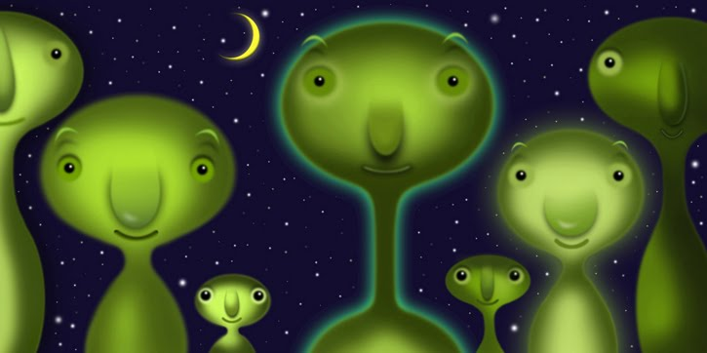

Do aliens know about $π$ too?

Slide 2
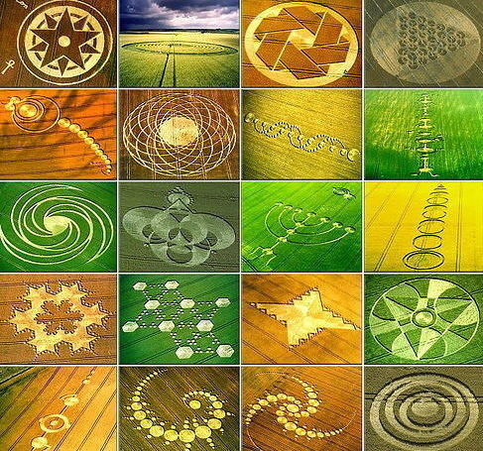

Slide 3
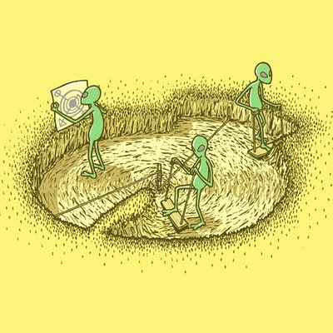
Some people think crop circles are made by aliens…

Slide 4


One very unusual crop circle appeared in Wiltshire in June 2008.
It puzzled crop circle experts because it didn’t seem to show an easily recognisable pattern.
Then a retired astrophysicist, Mike Reed, came up with an explanation involving $π$.

Slide 5
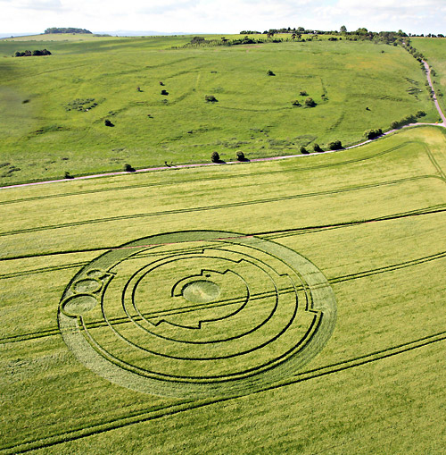

Slide 6
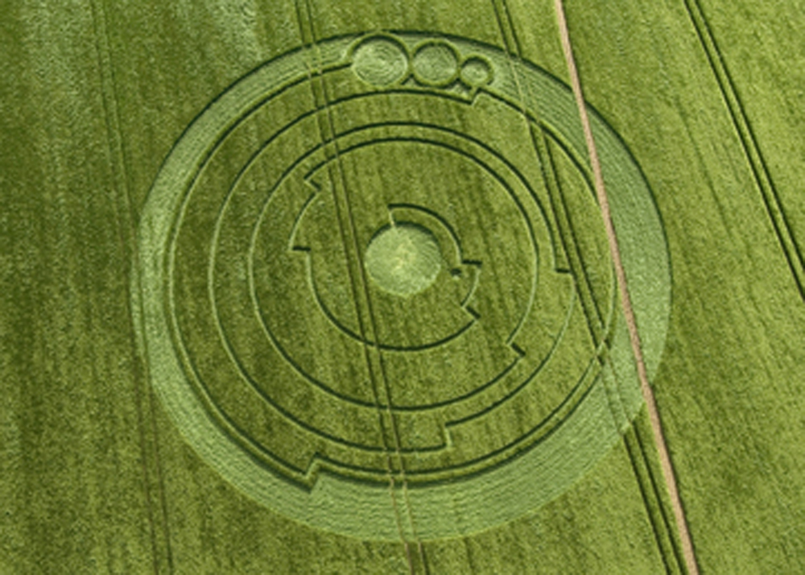
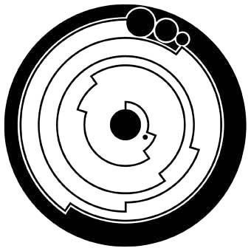


Slide 7
Draw a line down the centre of your diagram.

Slide 8
Then divide the crop circle up into 10 equal sectors

Slide 9
Starting with the innermost ring, count the number of sectors it passes through and note this down.
Decimal point

Slide 10
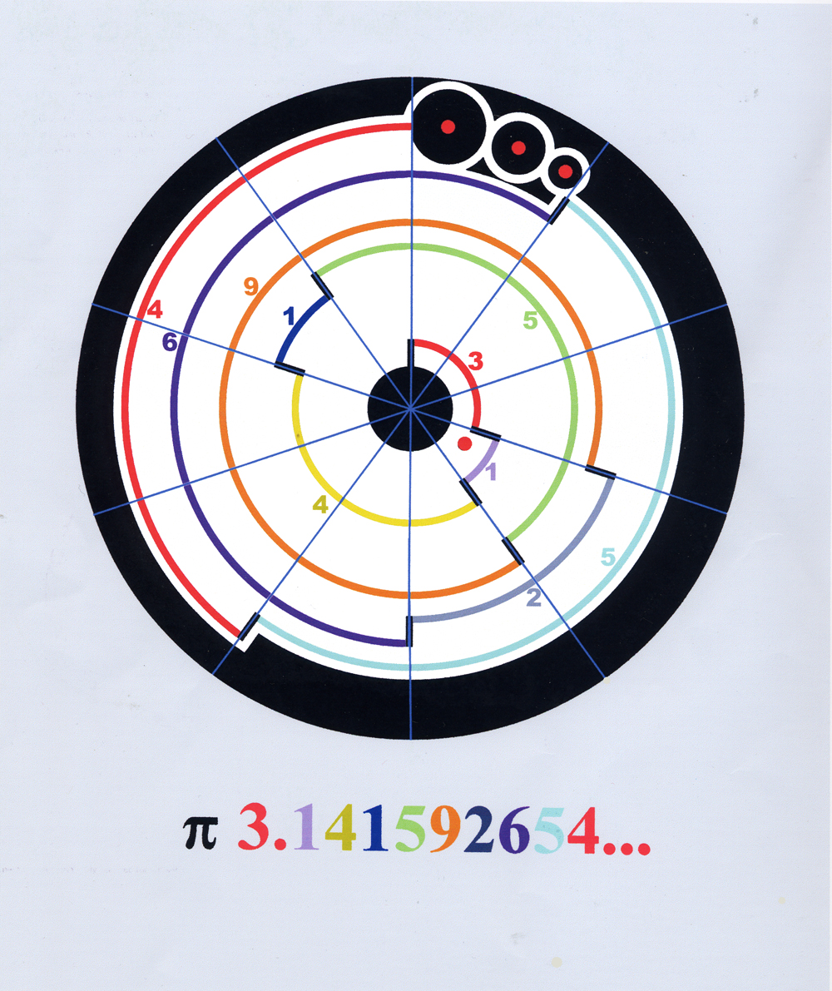

Slide 11
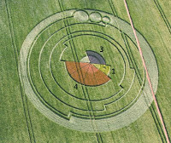

Slide 12
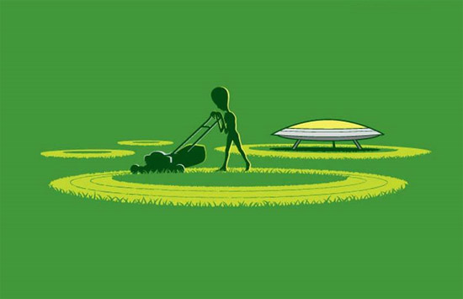

Slide 13
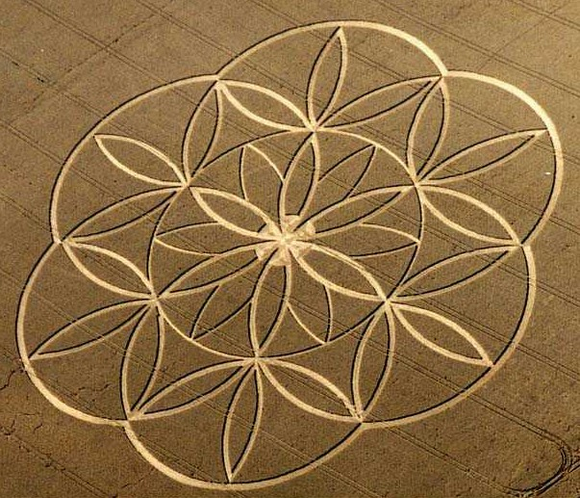
More mathematical crop circles

Slide 14
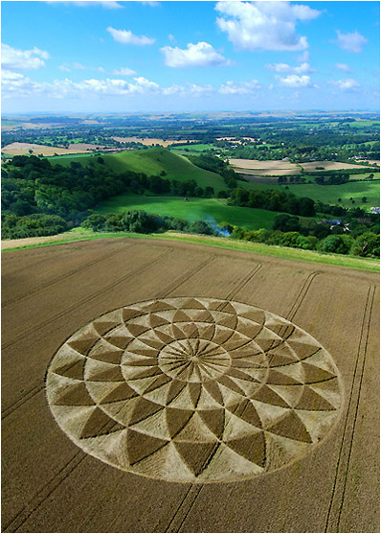

Slide 15
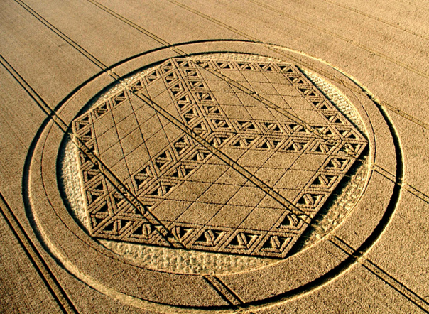

Slide 16
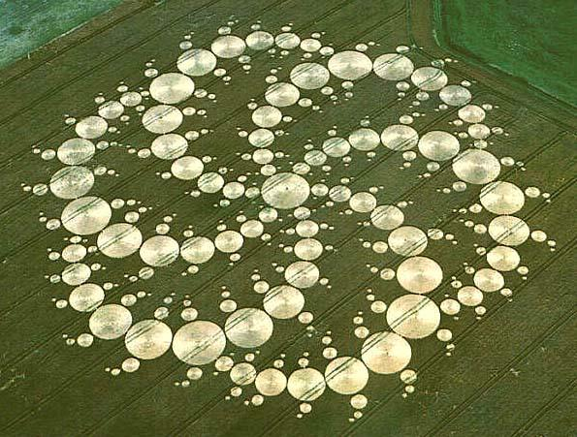

Slide 17
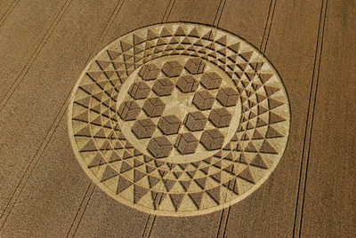

Slide 18
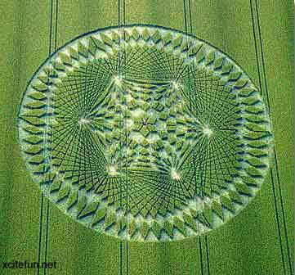

Slide 19
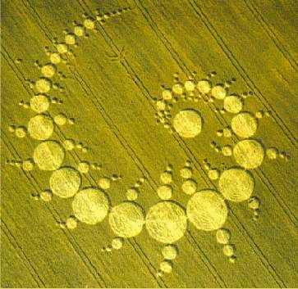

Slide 20
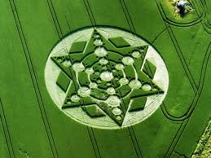

Slide 21
