Slide 1
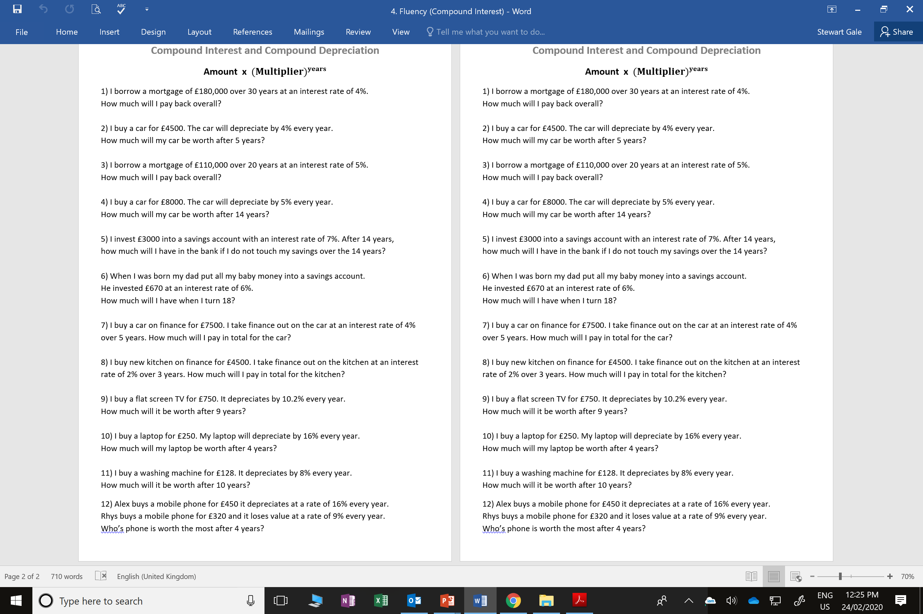

Slide 2
ANSWERS

Slide 3
1) I borrow a mortgage of £180,000 over 30 years at an interest rate of 4%.
How much will I pay back overall?
180000 x 1.04³⁰ = 583,811.55
2) I buy a car for £4500. The car will depreciate by 4% every year.
How much will my car be worth after 5 years?
4500 x 0.96⁵ = 3,669.18
3) I borrow a mortgage of £110,000 over 20 years at an interest rate of 5%.
How much will I pay back overall?
110000 x 1.05²⁰ = 291,862.75

Slide 4
4) I buy a car for £8000. The car will depreciate by 5% every year.
How much will my car be worth after 14 years?
8000 x 0.95¹⁴ = 3,901.40
5) I invest £3000 into a savings account with an interest rate of 7%.
After 14 years, how much will I have in the bank
if I do not touch my savings over the 14 years?
3000 x 1.07¹⁴ = 7,735.60
6) When I was born my dad put all my baby money into a savings account.
He invested £670 at an interest rate of 6%.
How much will I have when I turn 18?
670 x 1.06¹⁸ = 1,912.41

Slide 5
7) I buy a car for £7500.
I take finance out on the car at an interest of 4% over 5 years.
How much will I pay in total for the car?
7500 x 1.04⁵ = 9,124.90
8) I buy new kitchen on finance for £4500.
I take finance out on the kitchen at an interest rate of 2% over 3 years.
How much will I pay in total for the kitchen?
4500 x 1.02³ = 4,775.54
9) I buy a flat screen TV for £750. It depreciates by 10.2% every year.
How much will it be worth after 9 years?
750 x 0.898⁹ = 2,84.81

Slide 6
10) I buy a laptop for £250. My laptop will depreciate by 16% every year.
How much will my laptop be worth after 4 years?
250 x 0.84⁴ = 124.47
11) I buy a washing machine for £128.
It depreciates by 8% every year.
How much will it be worth after 10 years?
128 x 0.92¹⁰ = 55.60
12) Alex buys a mobile phone for £450 it depreciates at a rate of 16% every year.
Rhys buys a mobile phone for £320 and it loses value at a rate of 9% every year.
Who’s phone is worth the most after 4 years?
Alex 450 x 0.84⁴ = 224.04
Rhys 320 x 0.91⁴ = 219.44

