Slide 1
Differentiation
Chain Rule
Chapter 9
(Part 3 of 10)

Slide 2
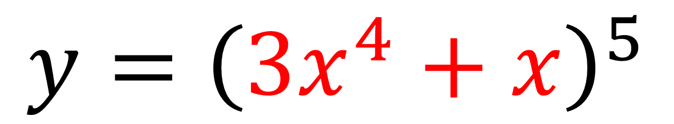
The Chain Rule
The chain rule allows you to differentiate
a function within a function.
$$y={\left(3x^{4}+x\right)}^{5}$$

Slide 3
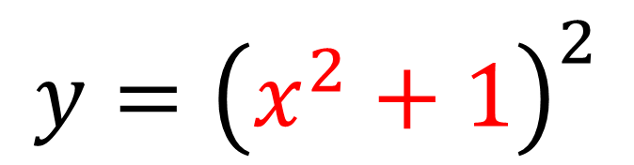
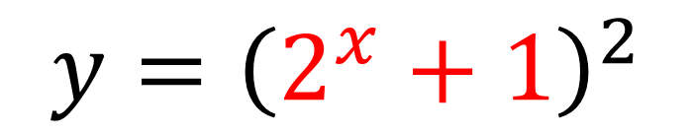
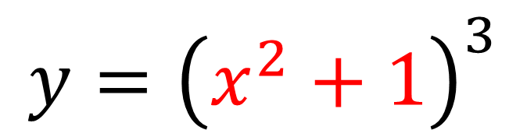
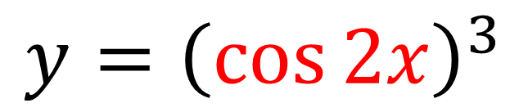
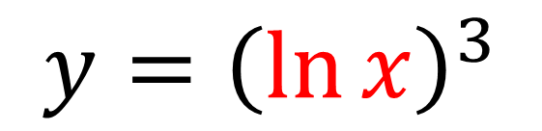
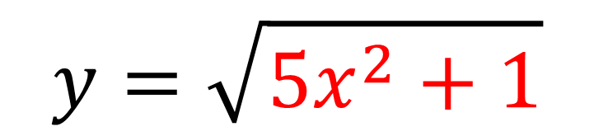
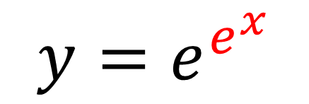
Examples of a function within a function.
$$y=\sqrt{5x^{2}+1}$$
$$y={\left(x^{2}+1\right)}^{2}$$
$$y={\left(\cos{2x}\right)}^{3}$$
$$y={\left(x^{2}+1\right)}^{3}$$
$$y={\left(\ln{x}\right)}^{3}$$
$$y={\left(2^{x}+1\right)}^{2}$$
$$y=e^{e^{x}}$$

Slide 4

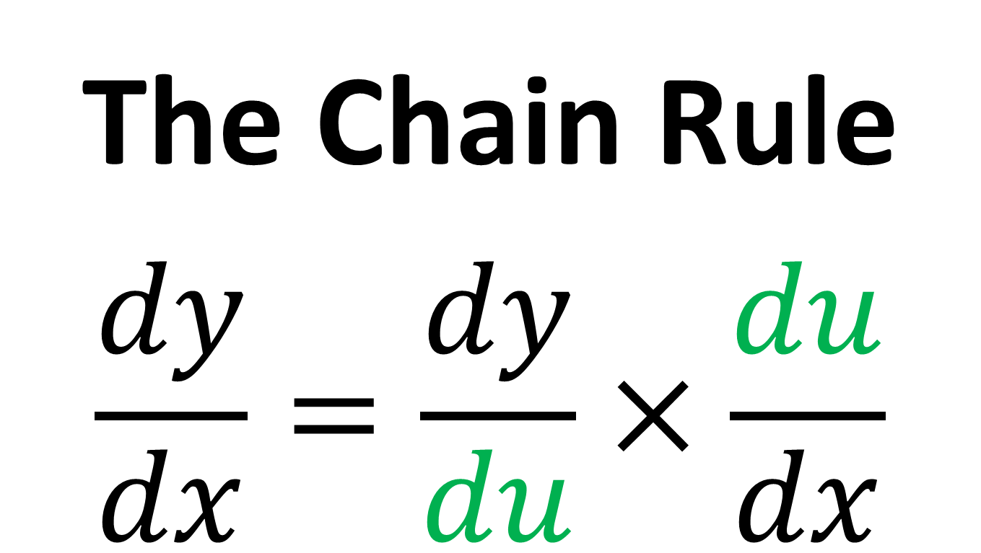
The Chain Rule
$$\frac{dy}{dx}=\frac{dy}{du}×\frac{du}{dx}$$
Note: Notice how the $du$’s sort of ‘cancel’ top and bottom on the RHS. This is not a valid proof.

Slide 5

The Chain Rule
$$\frac{dy}{dx}=\frac{dy}{du}×\frac{du}{dx}$$
$u$ represents the inner function

Slide 6
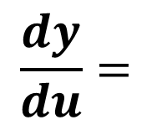
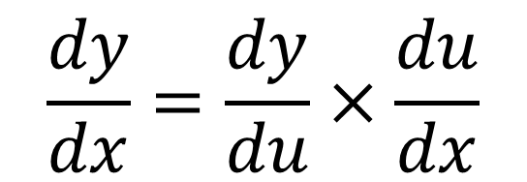
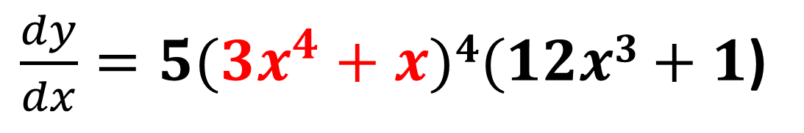
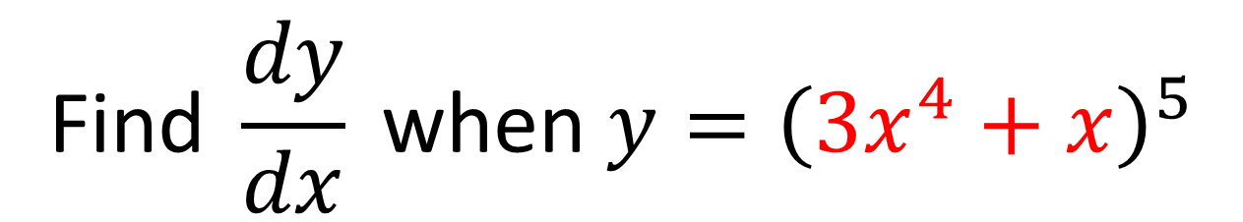
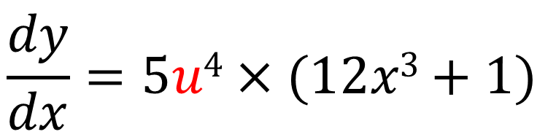
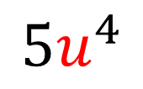
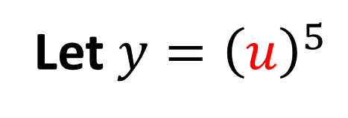
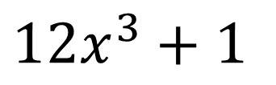
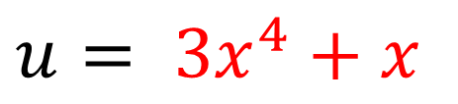
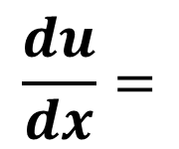
$$\text{Find} \frac{dy}{dx} \text{when} y={\left(3x^{4}+x\right)}^{5}$$
The Chain Rule: Formal Method
Let $y={\left(u\right)}^{5}$
$$\frac{dy}{dx}=\frac{dy}{du}×\frac{du}{dx}$$
$u= 3x^{4}+x$
$$\frac{dy}{dx}=5u4×(12x3+1)$$
$$\frac{dy}{du}=$$
$${5u}^{4}$$
$\frac{dy}{dx}=5(3x^{4}+x)4(12x3+1$)
$$\frac{du}{dx}=$$
$12x^{3}+1$

Slide 7
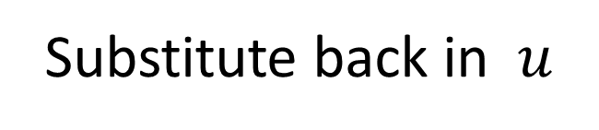
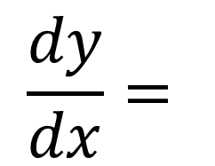

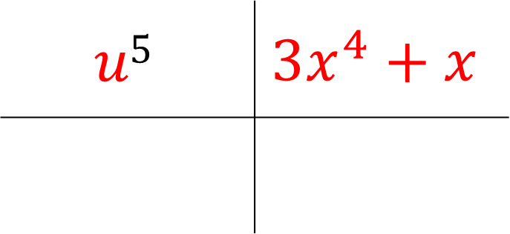
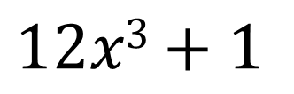
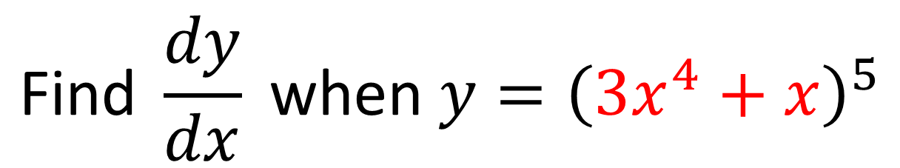
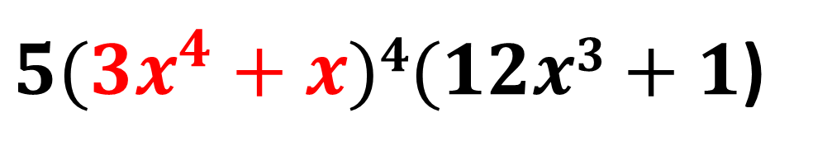
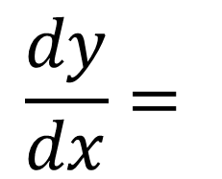
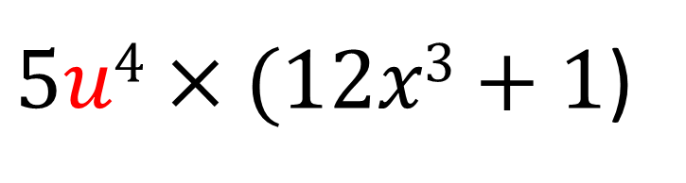
$$\text{Find} \frac{dy}{dx} \text{when} y={\left(3x^{4}+x\right)}^{5}$$
The Chain Rule:
Informal Method
$$u5$$ | $$3x^{4}+x$$
$$5u4$$ | $$12x3+1$$
$$5u4$$
$$12x3+1$$
$$\frac{dy}{dx}=$$
Multiply the bottom row
$5u4×(12x3+1$)
$$\frac{dy}{dx}=$$
Substitute back in $u$
$5(3x^{4}+x)4(12x3+1$)

Slide 8
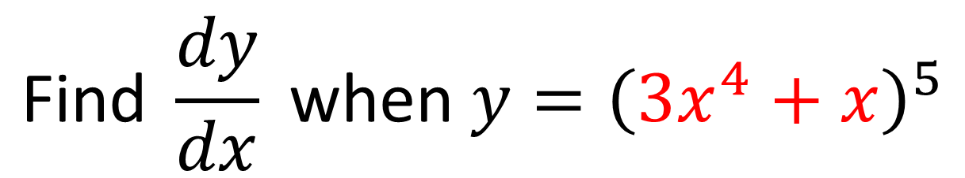
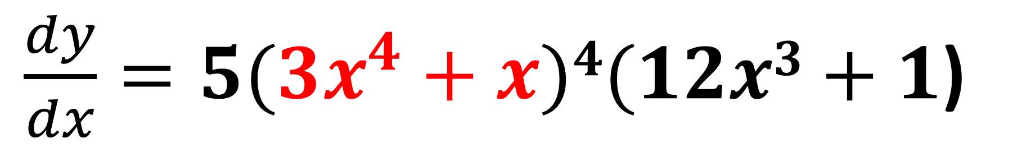
$$\text{Find} \frac{dy}{dx} \text{when} y={\left(3x^{4}+x\right)}^{5}$$
The Chain Rule:
Mentally in one go
Outer function differentiated $×$ Inner function differentiated
$\frac{dy}{dx}=5(3x^{4}+x)4(12x3+1$)

Slide 9

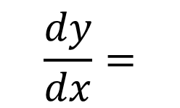

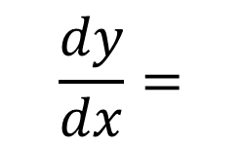
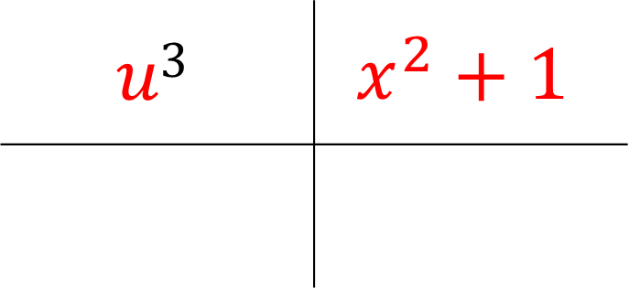
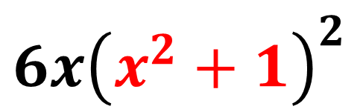
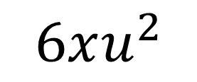
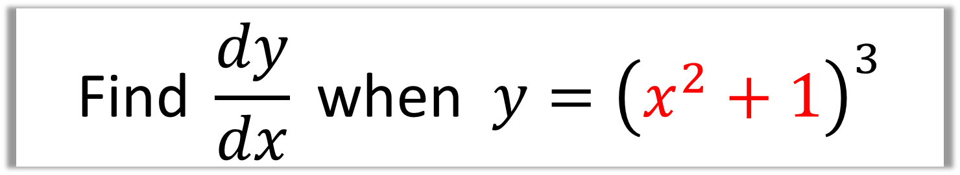
$$\text{Find} \frac{dy}{dx} \text{when} y={\left(x^{2}+1\right)}^{3}$$
$$u3$$ | $$x^{2}+1$$
$$5u4$$ | $$12x3+1$$
$$3u^{2}$$
$$2x$$
$$\frac{dy}{dx}=$$
$$6xu^{2}$$
$$\frac{dy}{dx}=$$
$$6x{\left(x^{2}+1\right)}^{2}$$

Slide 10

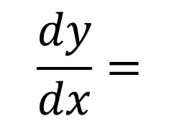

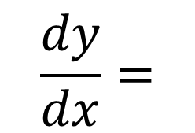
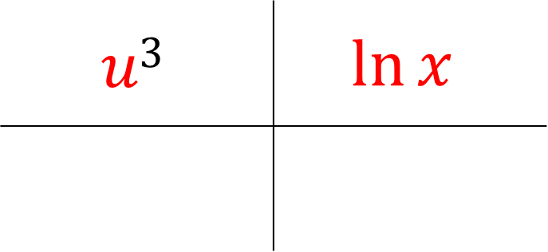
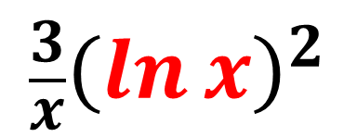
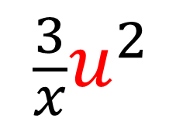
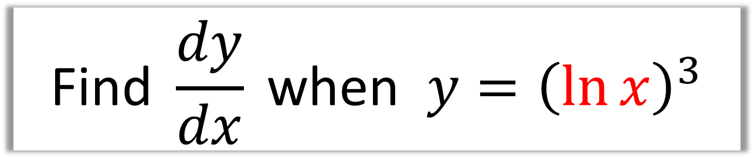
$$\text{Find} \frac{dy}{dx} \text{when} y={\left(\ln{x}\right)}^{3}$$
$$u3$$ | $$\ln{x}$$
$$5u4$$ | $$12x3+1$$
$$3u^{2}$$
$$\frac{1}{x}$$
$$\frac{dy}{dx}=$$
$$\frac{3}{x}u^{2}$$
$$\frac{dy}{dx}=$$
$$\frac{3}{x}{\left(\ln{x}\right)}^{2}$$

Slide 11

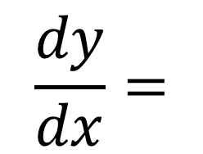

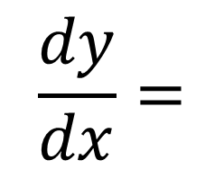
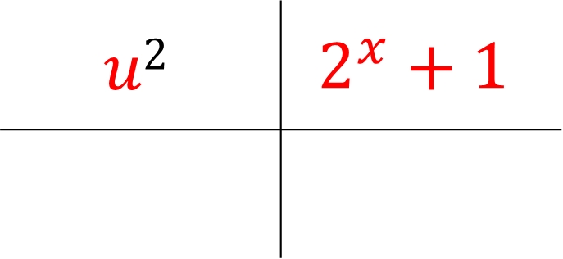
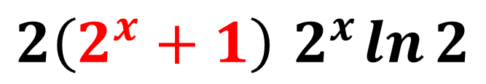


$$\text{Find} \frac{dy}{dx} \text{when} y={\left(2^{x}+1\right)}^{2}$$
$$u2$$ | $$2^{x}+1$$
$$5u4$$ | $$12x3+1$$
$$2u$$
$$2^{x}\ln{2}$$
$$\frac{dy}{dx}=$$
$$2u 2^{x}\ln{2}$$
$$\frac{dy}{dx}=$$
$$2\left(2^{x}+1\right){ 2}^{x}\ln{2}$$

Slide 12









$$\text{Find} \frac{dy}{dx} \text{when} y=\cos^{3}{2x}$$
$$={\left(\cos{2x}\right)}^{3}$$
$$u3$$ | $$cos 2x$$
$$5u4$$ | $$12x3+1$$
$${3u}^{2}$$
$$−2\sin{2x}$$
$$\frac{dy}{dx}=$$
$$3u^{2}\left(−2\sin{2x}\right)$$
$$\frac{dy}{dx}=$$
$$−6\cos^{2}{2x}\sin{2x}$$

Slide 13










$$\text{Find} \frac{dy}{dx} \text{when} y=e^{e^{x}}$$
$$\frac{dy}{dx}=$$
$$e^{u}$$ | $$e^{x}$$
$$5u4$$ | $$12x3+1$$
$$e^{u}e^{x}$$
$$e^{u}$$
$$e^{x}$$
$$\frac{dy}{dx}=$$
$$e^{e^{x}}e^{x}$$
$$\frac{dy}{dx}=$$
$$e^{e^{x} + x}$$

Slide 14








$$\ln{u}$$ | $$x^{2}+3x+5$$
$$5u4$$ | $$12x3+1$$
$$\frac{1}{u}$$
$$2x+3$$
$$\frac{dy}{dx}=$$
$$\frac{1}{u}×\left(2x+3\right)$$
$$\frac{dy}{dx}=$$
$$\frac{2x+3}{x^{2}+3x+5}$$

Slide 15








Given that $y=\sqrt{5x^{2}+1}$, find $\frac{dy}{dx}$ at $\left(4,9\right)$
$$u^{1/2}$$ | $${5x}^{2}+1$$
$$5u4$$ | $$12x3+1$$
When $x=4$,
$${\frac{1}{2}u}^{−1/2}$$
$$10x$$
$$\frac{dy}{dx}=20{\left(5\left(4^{2}\right)+1\right)}^{−\frac{1}{2}}$$
$$\frac{dy}{dx}=5x{\left(5x^{2}+1\right)}^{−\frac{1}{2}}$$
$$\frac{dy}{dx}=\frac{20}{9}$$

Slide 16


$$x={\left(y^{2}+y\right)}^{3}$$
What makes this equation
tricky to find $\frac{dy}{dx}$?
x is the subject of the formula,
and it is not easy to rearrange.

Slide 17


What you can do is find $\frac{dx}{dy}$
and then…….
take the reciprocal of $\frac{dx}{dy}$
to get $\frac{dy}{dx}$

Slide 18



Find $\frac{dy}{dx}$ when $x=2y^{2}+y$
$$\frac{dx}{dy}=4y+1$$
$$\frac{dy}{dx}=\frac{1}{4y+1}$$

Slide 19








$$\text{Find} \frac{dy}{dx} \text{when} x={\left(y^{2}+y\right)}^{3}$$
$$u^{3}$$ | $$y^{2}+y$$
$$5u4$$ | $$12x3+1$$
$$3u^{2}$$
$$2y+1$$
$$\frac{dx}{dy}=$$
$$3(2y+1){\left(y^{2}+y \right)}^{2}$$
$$\frac{dy}{dx}=$$
$$\frac{1}{3(2y+1){\left(y^{2}+y \right)}^{2}}$$

