Slide 1
Algebraic Expressions
Expanding and Factorising
Chapter 1
(Part 2 of 3)

Slide 2
Expanding Brackets
Foil Method
Grid Method
Separate Terms

Slide 3
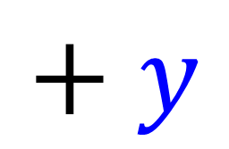
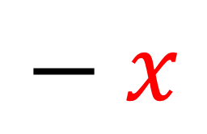
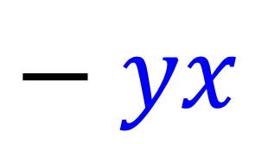
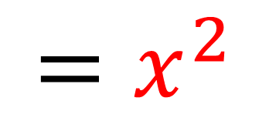
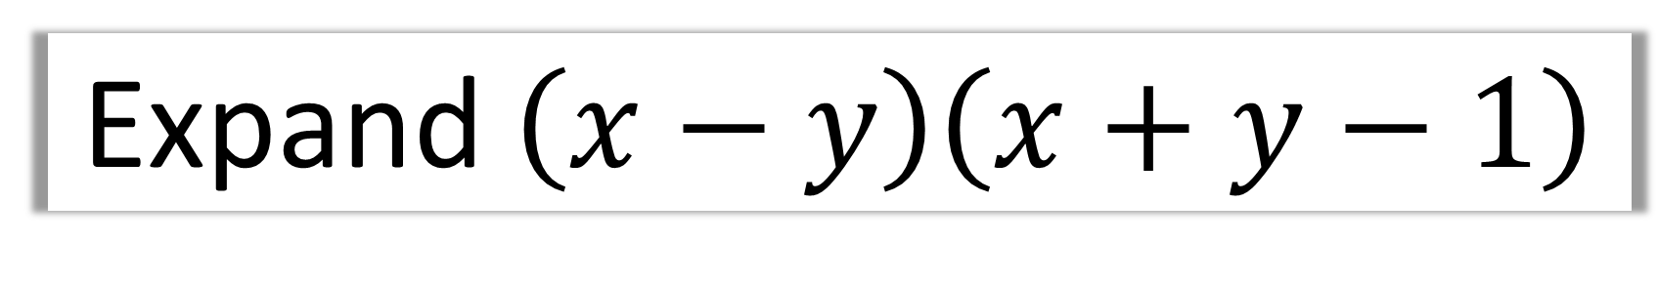
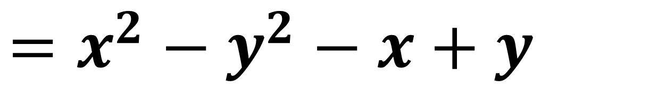


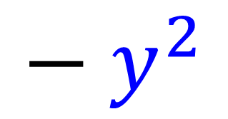
Expand $\left(x−y\right)\left(x+y−1\right)$
$$\left(x−y\right)$$
$$=x^{2}$$
$$+ xy$$
$$− x$$
$$− yx$$
$$− y^{2}$$
$$+ y$$
$$=x^{2}−y^{2}−x+y$$

Slide 4
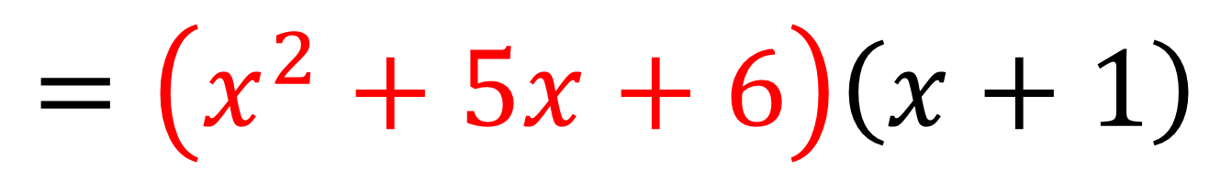
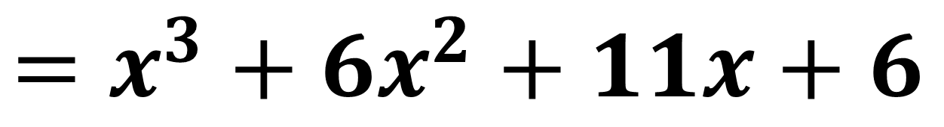
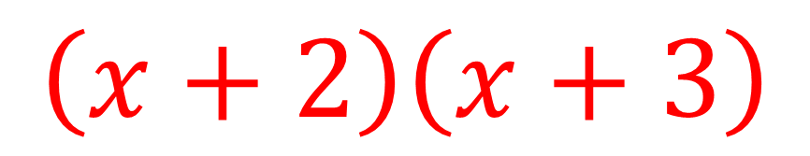
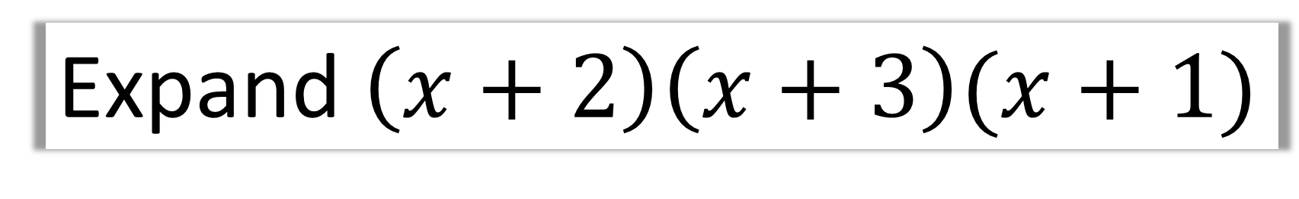
$$\left(x+2\right)\left(x+3\right)$$
Expand $\left(x+2\right)\left(x+3\right)(x+1)$
$$=\left(x^{2}+5x+6\right)\left(x+1\right)$$
$$=x^{3}+5x^{2}+6x+x^{2}+5x+6$$
$$=x^{3}+6x^{2}+11x+6$$

Slide 5
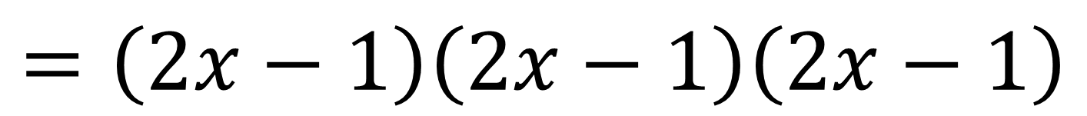
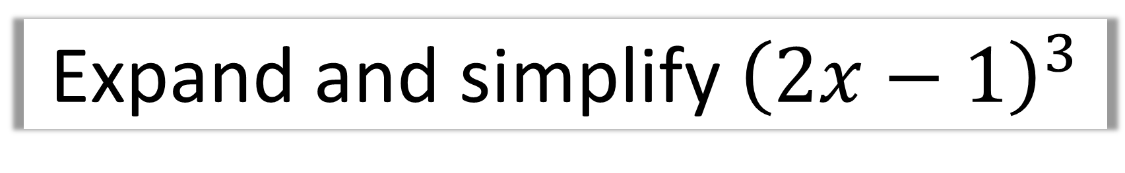
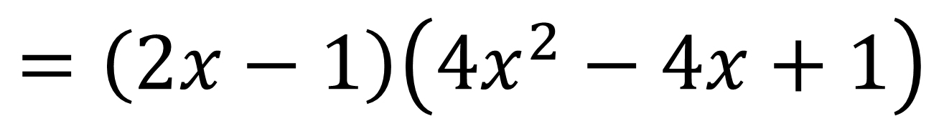
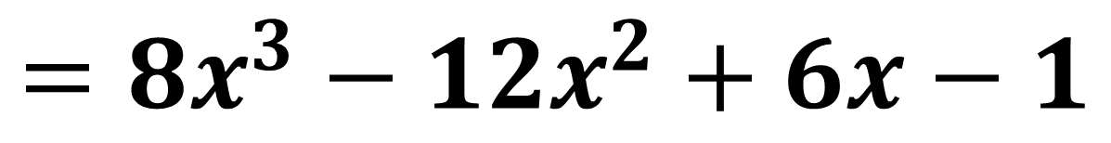
Expand and simplify ${\left(2x−1\right)}^{3}$
$$=\left(2x−1\right)\left(2x−1\right)\left(2x−1\right)$$
$$=\left(2x−1\right)\left(4x^{2}−4x+1\right)$$
$$=8x^{3}−8x^{2}+2x−4x^{2}+4x−1$$
$$=8x^{3}−12x^{2}+6x−1$$

Slide 6
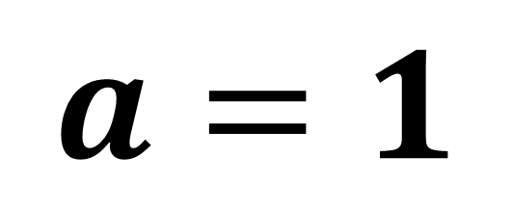
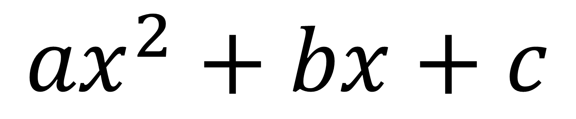
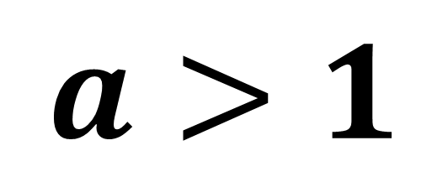
Factorising Quadratics
$${ax}^{2}+bx+c$$
Easier
Harder
$$a=1$$
$$a>1$$

Slide 7


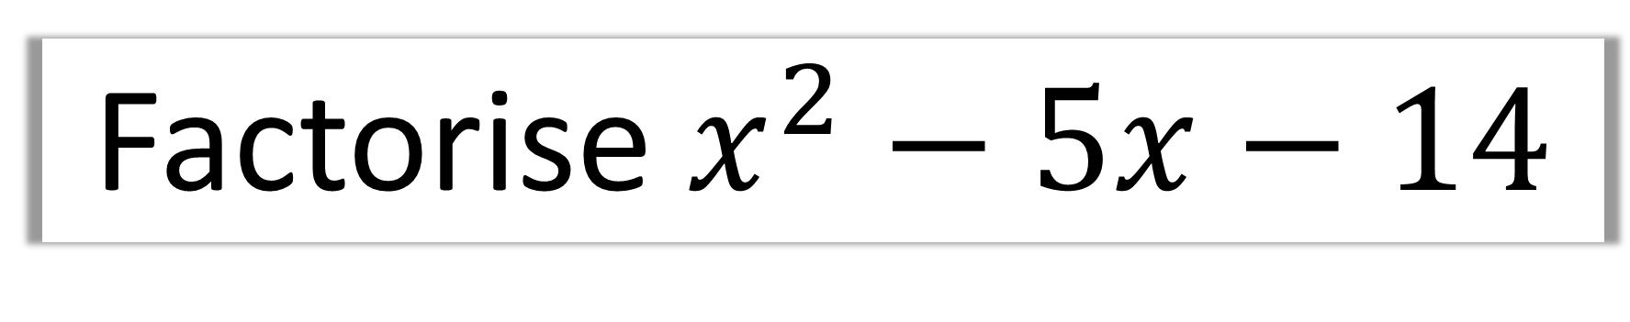
Factorise $x^{2}−5x−14$
Sum $−5$
Product $−14$
$$=\left(x−7\right)\left(x+2\right)$$

Slide 8
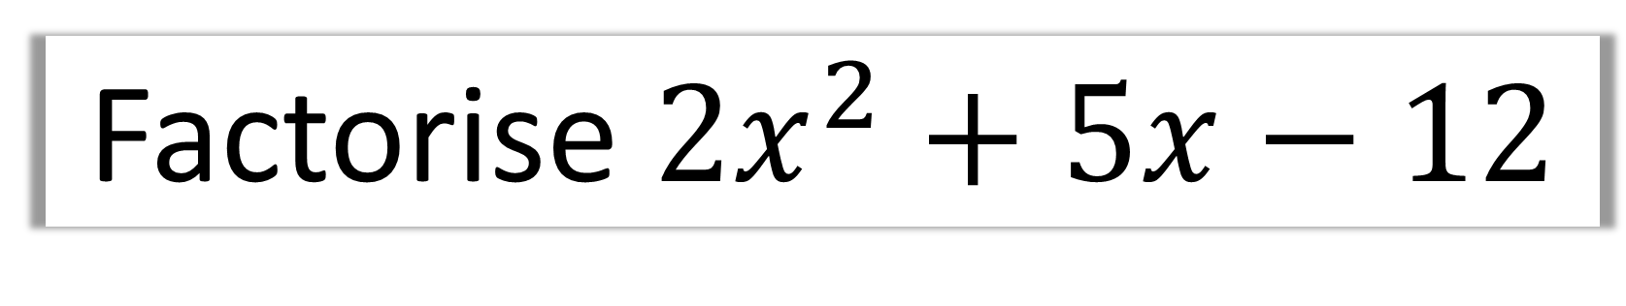
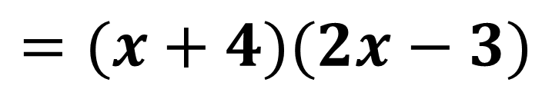
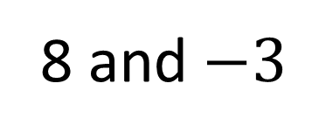
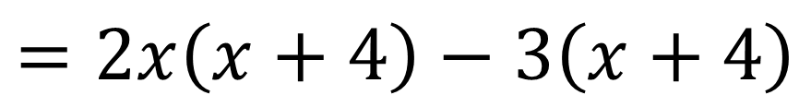
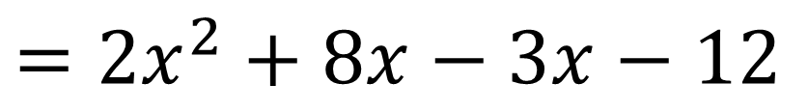
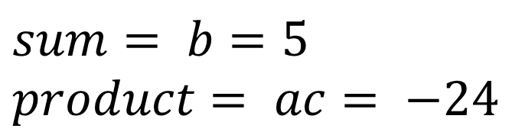
Factorise ${2x}^{2}+5x−12$
$$sum= b=5 \\ product= ac= −24$$
8 and $−3$
STEP 1: Sum and Product
$$=2x^{2}+8x−3x−12$$
STEP 2: Split the middle term.
STEP 3: Factorise in pairs
$$=2x\left(x+4\right)−3\left(x+4\right)$$
$$=(x+4)(2x−3)$$
STEP 4: Factorise out bracket.

Slide 9
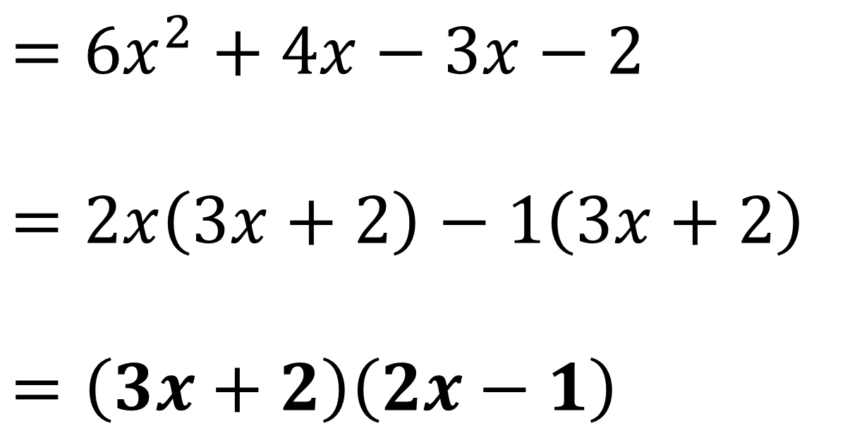
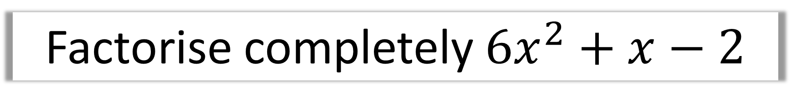
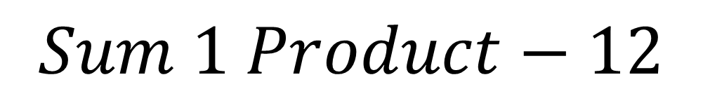
Factorise completely $6x^{2}+x−2$
$$Sum 1 Product−12$$
$$=6x^{2}+4x−3x−2$$
$$=2x\left(3x+2\right)−1\left(3x+2\right)$$
$$=\left(3x+2\right)\left(2x−1\right)$$

Slide 10
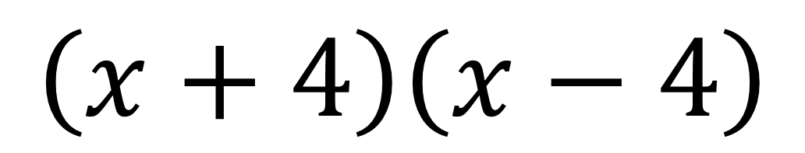
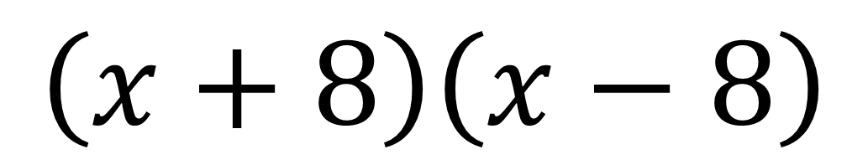
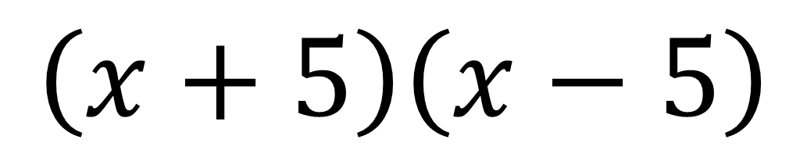
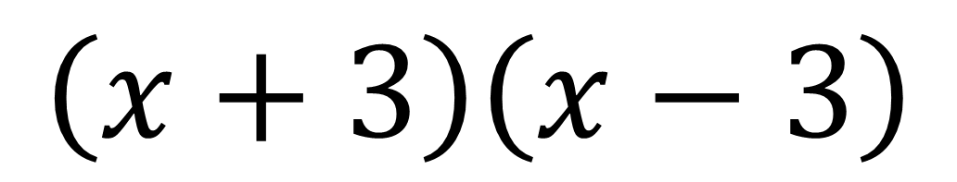
Difference of two squares
$$\left(x+4\right)\left(x−4\right)$$
$$\left(x+3\right)\left(x−3\right)$$
$$\left(x+5\right)\left(x−5\right)$$
$$\left(x+8\right)\left(x−8\right)$$

Slide 11


Factorise completely $x^{2}−16$
Difference of two squares
$$=\left(x+4\right)\left(x−4\right)$$

Slide 12


Factorise completely $4x^{2}−9$
Difference of two squares
$$=\left(2x+3\right)\left(2x−3\right)$$

Slide 13
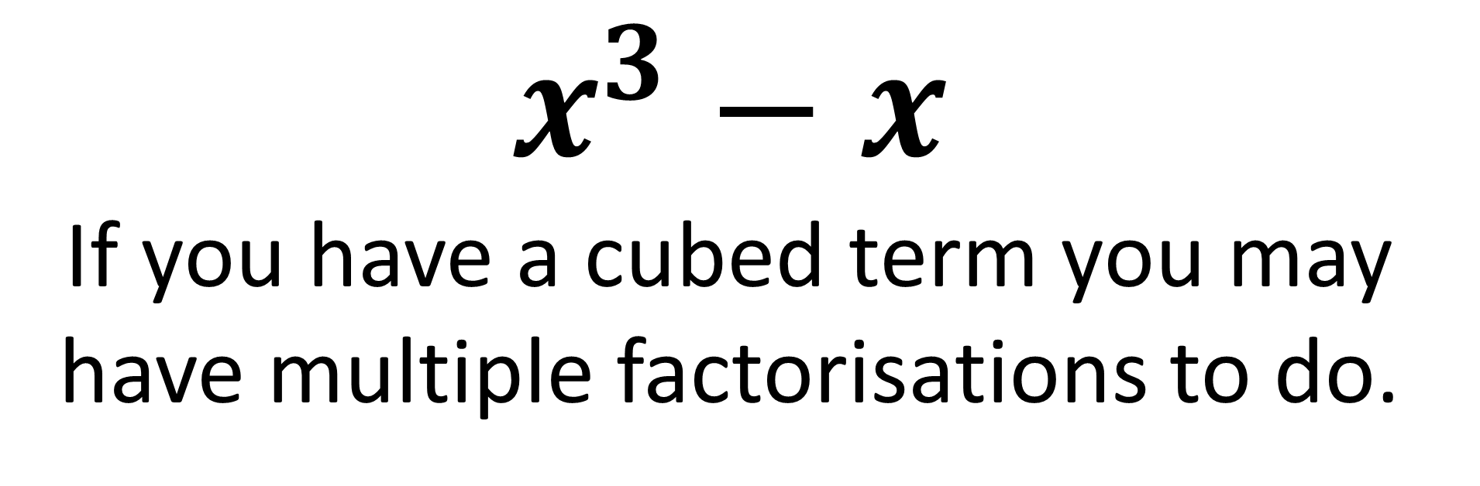
Multiple Factorisations
$$x^{3}−x$$
If you have a cubed term you may have multiple factorisations to do.

Slide 14
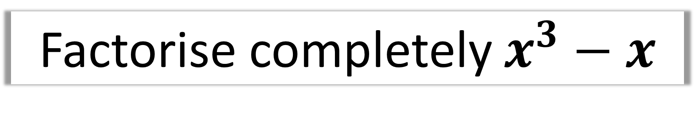
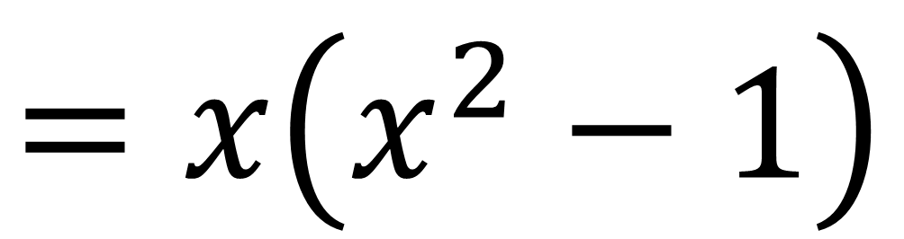
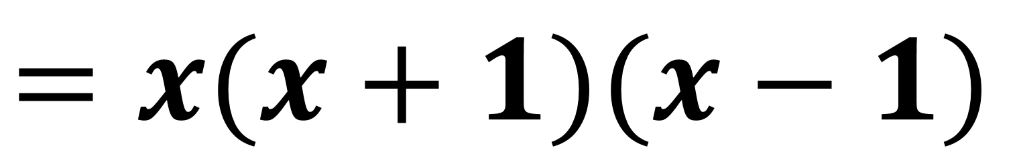
Factorise completely $x^{3}−x$
$$=x\left(x^{2}−1\right)$$
$$=x(x+1)(x−1)$$

Slide 15
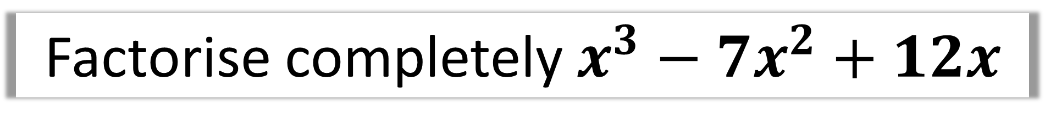
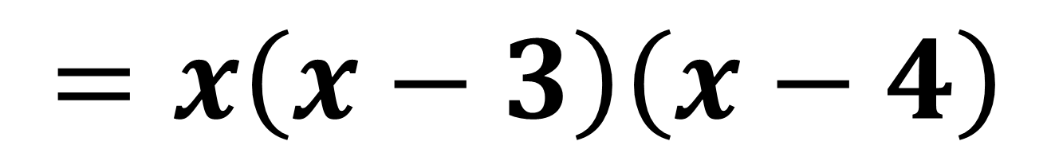
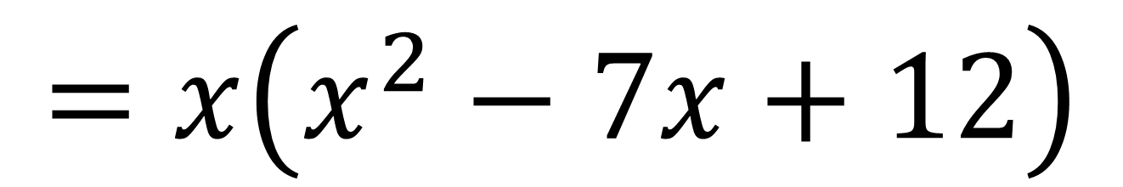
Factorise completely $x^{3}−7x^{2}+12x$
$$=x\left(x^{2}−7x+12\right)$$
$$=x\left(x−3\right)\left(x−4\right)$$

