Slide 1
Term |  | 1st |  |  | 2nd |  |  | 3rd |  |  | 4th |  |  | 5th
Sequence |  | 4 |  |  | 12 |  |  | 24 |  |  | 40 |  |  | 60
First Difference
Second Difference
New Sequence
Original Sequence
Difference
nth term rule for the original sequence:

Slide 2
Term |  | 1st |  |  | 2nd |  |  | 3rd |  |  | 4th |  |  | 5th
Sequence |  | 8 |  |  | 16 |  |  | 28 |  |  | 44 |  |  | 64
First Difference
Second Difference
New Sequence
Original Sequence
Difference
nth term rule for this sequence is:

Slide 3
Term |  | 1st |  |  | 2nd |  |  | 3rd |  |  | 4th |  |  | 5th
Sequence |  | 5 |  |  | 17 |  |  | 35 |  |  | 59 |  |  | 89
First Difference
Second Difference
New Sequence
Original Sequence
Difference
nth term rule for the original sequence:

Slide 4
Term |  | 1st |  |  | 2nd |  |  | 3rd |  |  | 4th |  |  | 5th
Sequence |  | -3 |  |  | 1 |  |  | 7 |  |  | 15 |  |  | 25
First Difference
Second Difference
New Sequence
Original Sequence
Difference
nth term rule for this sequence is:

Slide 5
Term |  | 1st |  |  | 2nd |  |  | 3rd |  |  | 4th |  |  | 5th
Sequence |  | 5.5 |  |  | 9 |  |  | 13.5 |  |  | 19 |  |  | 25.5
First Difference
Second Difference
New Sequence
Original Sequence
Difference
nth term rule for the original sequence:

Slide 6
ANSWERS

Slide 7
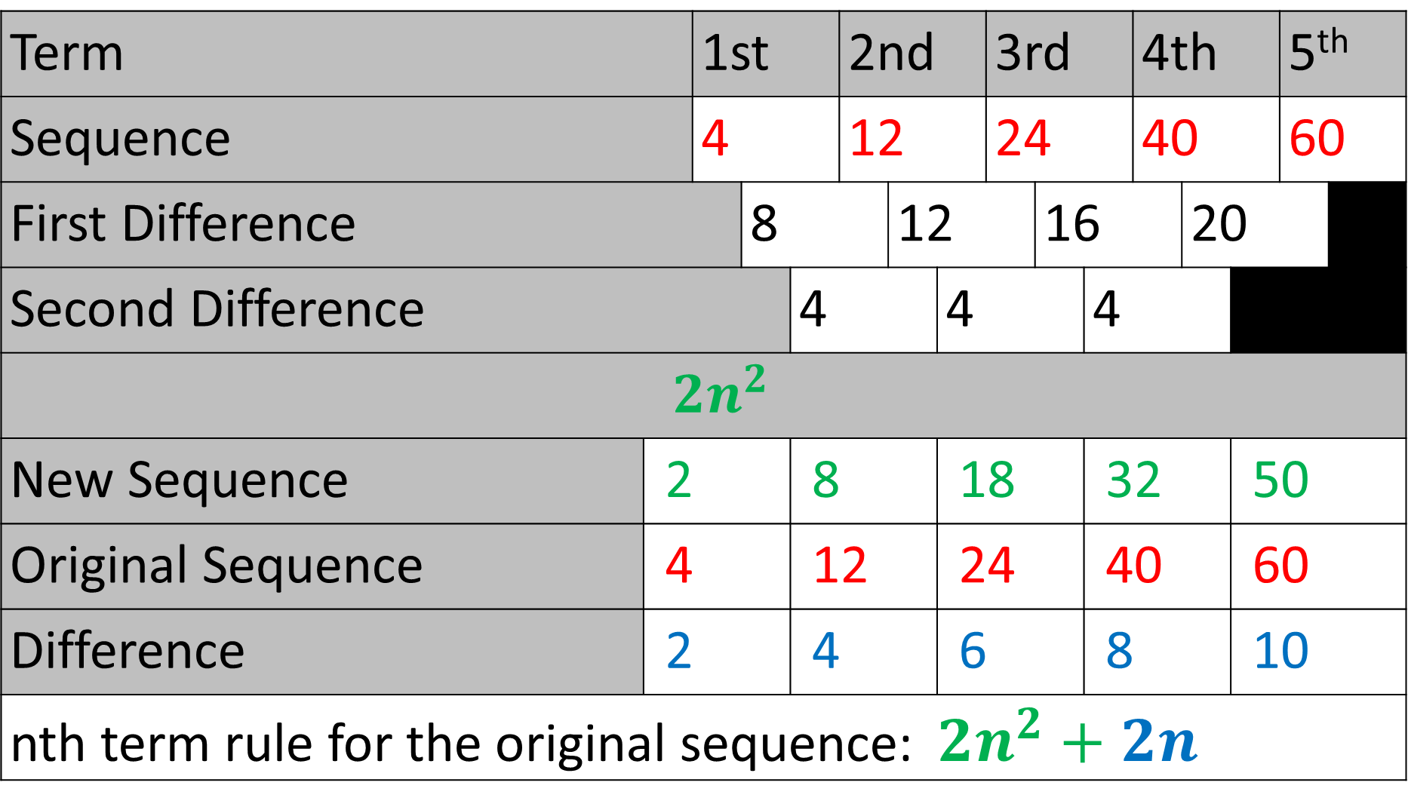
Term |  | 1st |  |  | 2nd |  |  | 3rd |  |  | 4th |  |  | 5th
Sequence |  | 4 |  |  | 12 |  |  | 24 |  |  | 40 |  |  | 60
First Difference |  |  | 8 |  |  | 12 |  |  | 16 |  |  | 20
Second Difference |  |  |  | 4 |  |  | 4 |  |  | 4
${2n}^{2}$
New Sequence | 2 |  |  | 8 |  |  | 18 |  |  | 32 |  |  | 50
Original Sequence | 4 |  |  | 12 |  |  | 24 |  |  | 40 |  |  | 60
Difference | 2 |  |  | 4 |  |  | 6 |  |  | 8 |  |  | 10
nth term rule for the original sequence: ${2n}^{2}+2n$

Slide 8
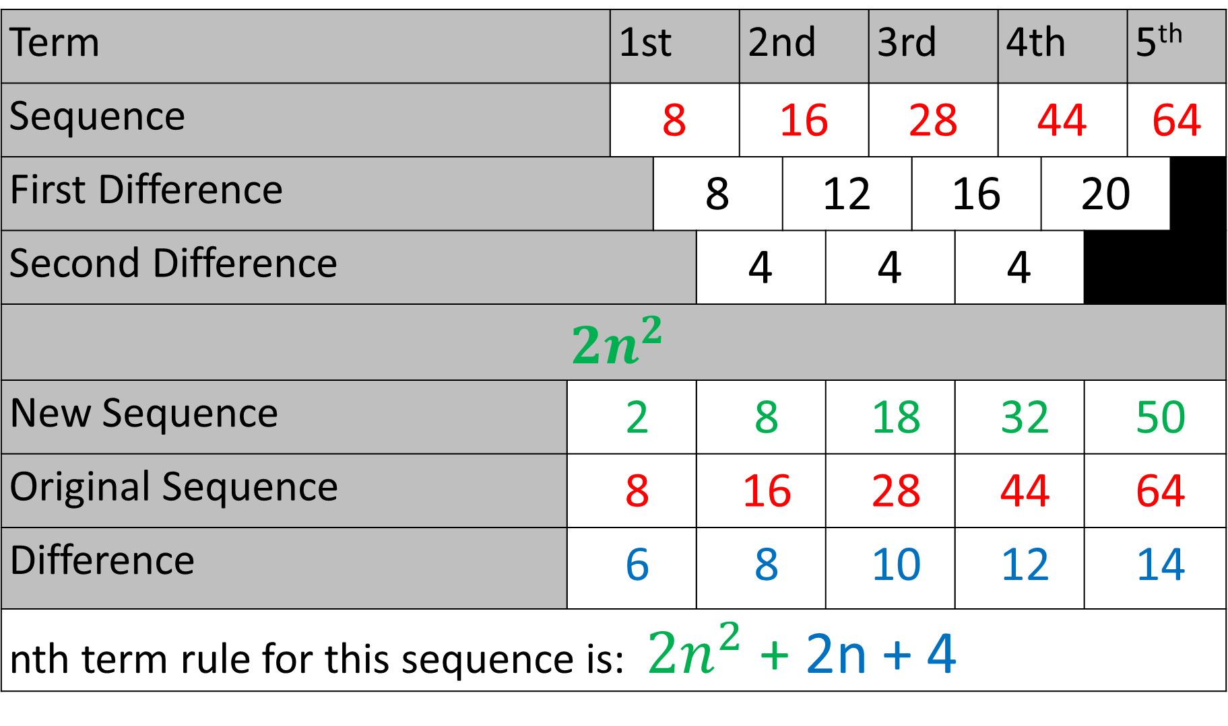
Term |  | 1st |  |  | 2nd |  |  | 3rd |  |  | 4th |  |  | 5th
Sequence |  | 8 |  |  | 16 |  |  | 28 |  |  | 44 |  |  | 64
First Difference |  |  | 8 |  |  | 12 |  |  | 16 |  |  | 20
Second Difference |  |  |  | 4 |  |  | 4 |  |  | 4
${2n}^{2}$
New Sequence | 2 |  |  | 8 |  |  | 18 |  |  | 32 |  |  | 50
Original Sequence | 8 |  |  | 16 |  |  | 28 |  |  | 44 |  |  | 64
Difference | 6 |  |  | 8 |  |  | 10 |  |  | 12 |  |  | 14
nth term rule for this sequence is: ${2n}^{2}$ + 2n + 4

Slide 9
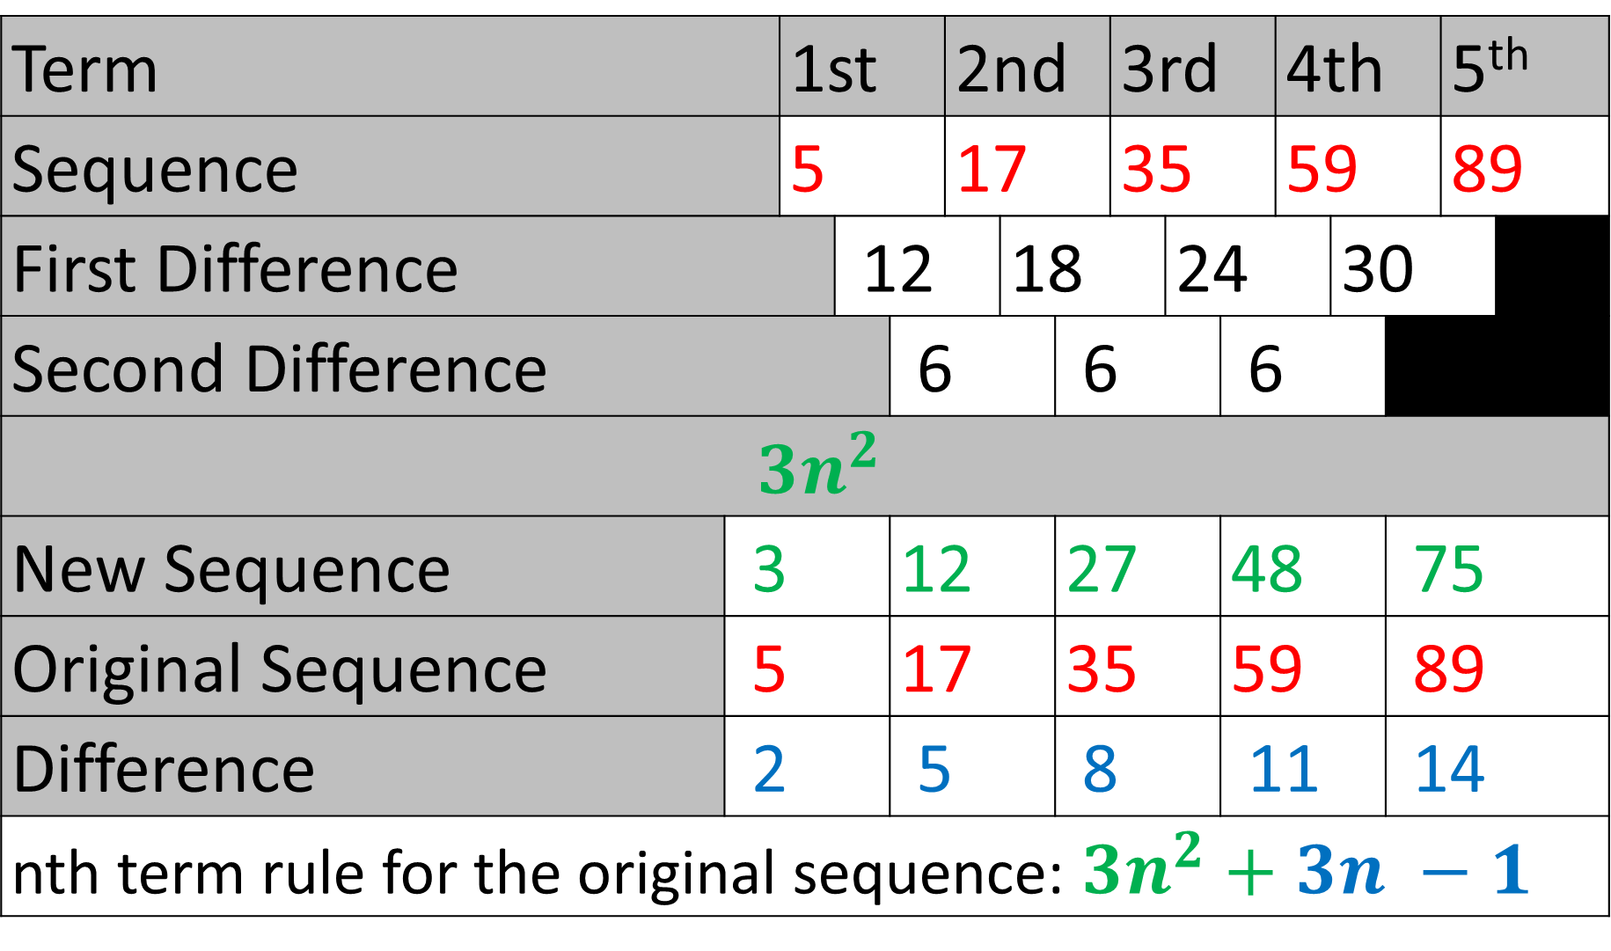
Term |  | 1st |  |  | 2nd |  |  | 3rd |  |  | 4th |  |  | 5th
Sequence |  | 5 |  |  | 17 |  |  | 35 |  |  | 59 |  |  | 89
First Difference |  |  | 12 |  |  | 18 |  |  | 24 |  |  | 30
Second Difference |  |  |  | 6 |  |  | 6 |  |  | 6
${3n}^{2}$
New Sequence | 3 |  |  | 12 |  |  | 27 |  |  | 48 |  |  | 75
Original Sequence | 5 |  |  | 17 |  |  | 35 |  |  | 59 |  |  | 89
Difference | 2 |  |  | 5 |  |  | 8 |  |  | 11 |  |  | 14
nth term rule for the original sequence: ${3n}^{2}+3n −1$

Slide 10
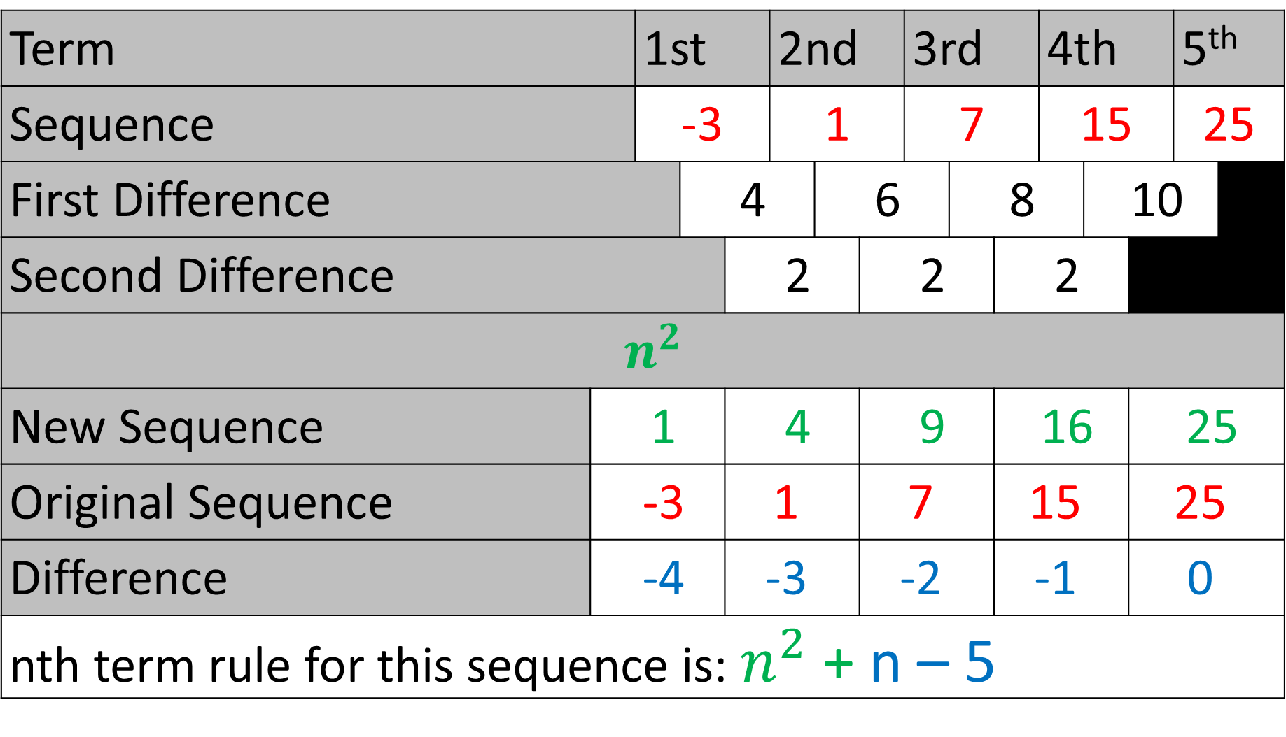
Term |  | 1st |  |  | 2nd |  |  | 3rd |  |  | 4th |  |  | 5th
Sequence |  | -3 |  |  | 1 |  |  | 7 |  |  | 15 |  |  | 25
First Difference |  |  | 4 |  |  | 6 |  |  | 8 |  |  | 10
Second Difference |  |  |  | 2 |  |  | 2 |  |  | 2
$n^{2}$
New Sequence | 1 |  |  | 4 |  |  | 9 |  |  | 16 |  |  | 25
Original Sequence | -3 |  |  | 1 |  |  | 7 |  |  | 15 |  |  | 25
Difference | -4 |  |  | -3 |  |  | -2 |  |  | -1 |  |  | 0
nth term rule for this sequence is: $n^{2}$ + n – 5

Slide 11
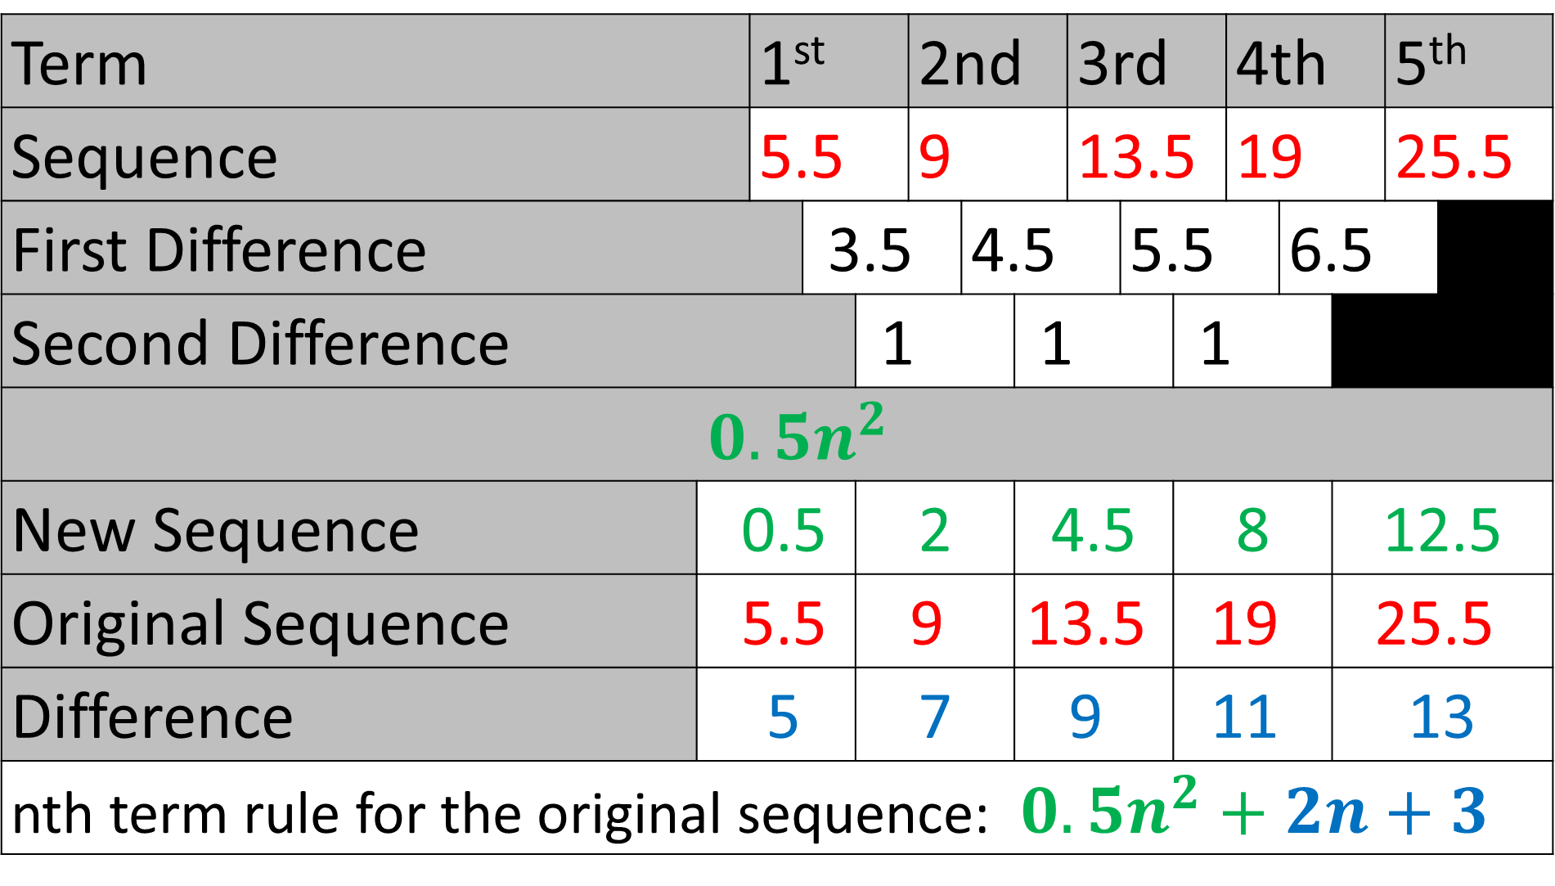
Term |  | 1st |  |  | 2nd |  |  | 3rd |  |  | 4th |  |  | 5th
Sequence |  | 5.5 |  |  | 9 |  |  | 13.5 |  |  | 19 |  |  | 25.5
First Difference |  |  | 3.5 |  |  | 4.5 |  |  | 5.5 |  |  | 6.5
Second Difference |  |  |  | 1 |  |  | 1 |  |  | 1
${0.5n}^{2}$
New Sequence | 0.5 |  |  | 2 |  |  | 4.5 |  |  | 8 |  |  | 12.5
Original Sequence | 5.5 |  |  | 9 |  |  | 13.5 |  |  | 19 |  |  | 25.5
Difference | 5 |  |  | 7 |  |  | 9 |  |  | 11 |  |  | 13
nth term rule for the original sequence: ${0.5n}^{2}+2n+3$

