Slide 1
Application of Forces
Statics on Slopes
Chapter 7
(Part 2 of 6)

Slide 2
Statics on Slopes
If a particle is static,
opposite forces will be equal.

Slide 3
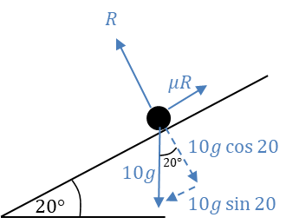

Write an equation for the forces parallel to the slope?
Static Particle
$$μR=10g sin 20$$

Slide 4
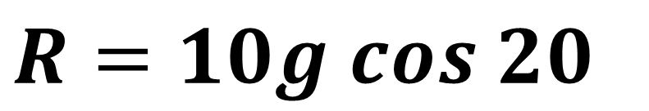
Write an equation for the forces perpendicular to the slope?
Static Particle
$$R=10g cos 20$$

Slide 5
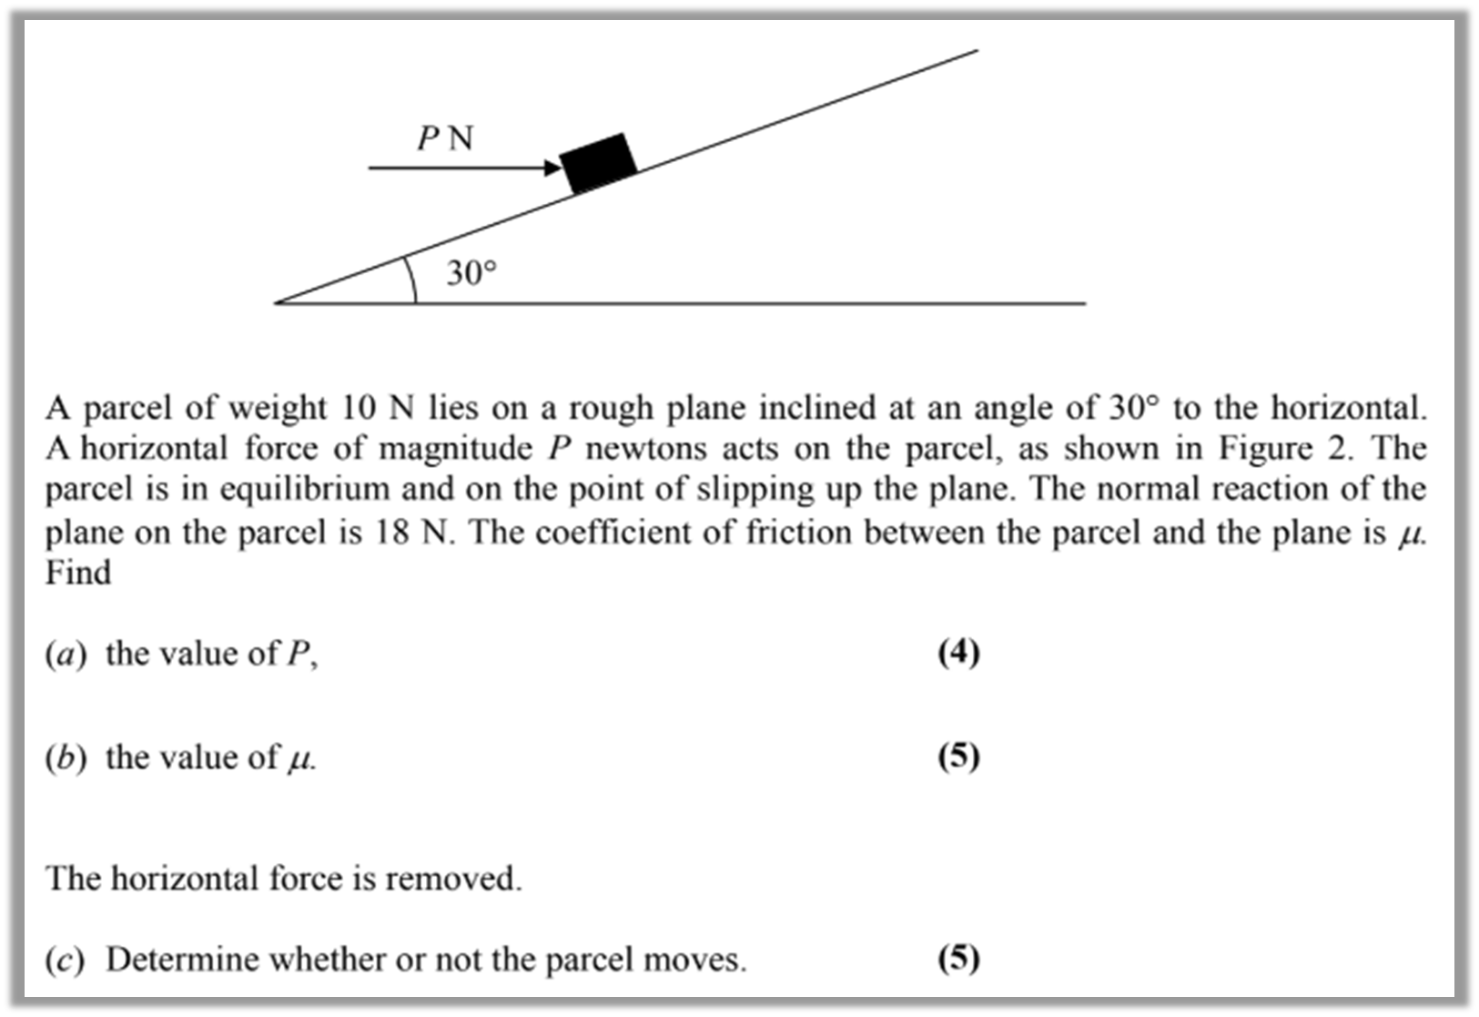







Write an equation for the forces parallel to the slope?
Static Particle
$$Pcos 30=μR+10g sin 30$$
$$18$$
$$μR$$
$$Pcos 30°$$
$$10gcos 30°$$
$$Psin 30°$$
10gsin$30°$

Slide 6






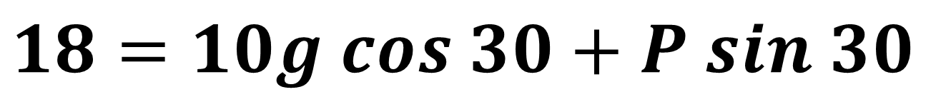
Write an equation for the forces perpendicular to the slope?
Static Particle
$$18=10g cos 30+P sin 30$$
$$18$$
$$μR$$
$$Pcos 30°$$
$$10gcos 30°$$
$$Psin 30°$$
10gsin$30°$

Slide 7
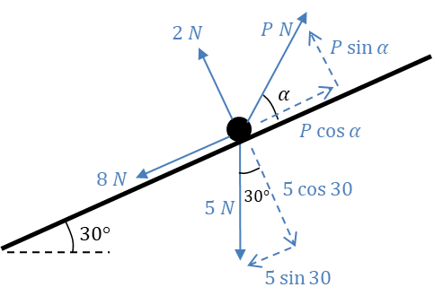
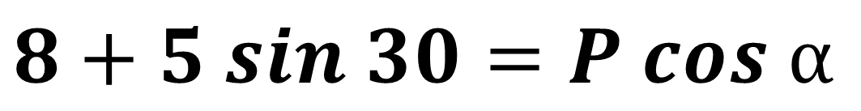
Write an equation for the forces parallel to the slope?
Static Particle
$$8+5 sin 30=P cos ⍺$$

Slide 8
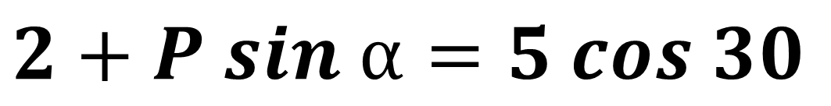
Write an equation for the forces perpendicular to the slope?
Static Particle
$$2+P sin ⍺=5 cos 30$$

Slide 9
Limiting Equilibrium/Point of Slipping
A particle rests in limiting equilibrium
if it is on the point of slipping.
Any addition force applied
will move the particle.
Friction will oppose the motion
that the particle wants to move.

Slide 10

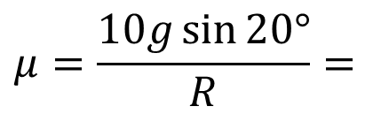



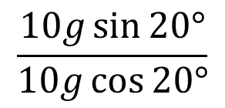

A box of mass 10kg rests in limiting equilibrium
on a rough plane inclined at $20°$ above the horizontal.
Find the coefficient of friction between the box and the plane.
Identify Forces
Resolve Perpendicular
$$R=10g\cos{20°}$$
Resolve Parallel
$$μR=10g\sin{20°}$$
Simultaneous Equations
$$μ=\frac{10g\sin{20°}}{R}=$$
$$\frac{10g\sin{20°}}{10g\cos{20°}}$$
$$μ=\tan{20°}$$
$$μ=0.36 (2sf)$$

Slide 11
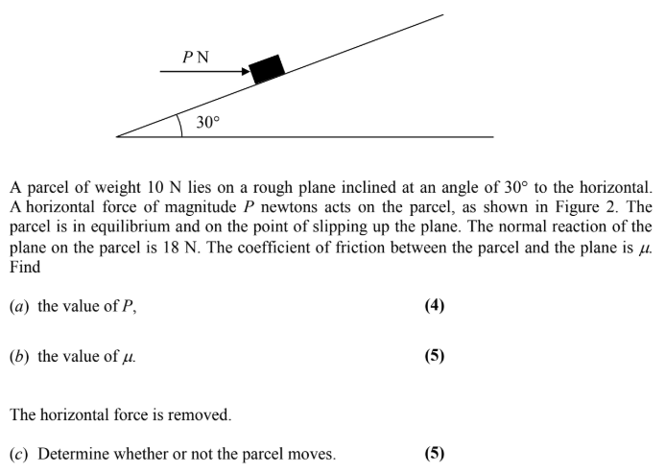

Slide 12
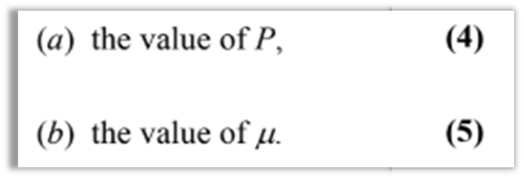











$$18$$
$$μR$$
$$Pcos 30°$$
$$10cos 30°$$
$$Psin 30°$$
10sin$30°$
a)
Resolve Perpendicular
$$Psin 30°+10\cos{30°=18}$$
$$P=18.7N$$
b)
Resolve Parallel
$$Pcos 30°=10\sin{30°+μR }$$
$$18.7cos 30°=5{+ 18μ }$$
$$μ=0.621$$

Slide 13
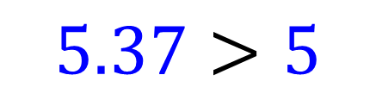




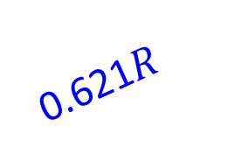
$$10cos 30°$$
0.621$R$
$$10cos 30°$$
5
Resolve Parallel
Down slope $=5$
c)
Up slope $=0.621\left(10cos30\right)=5.37$
$$5.37>5$$
Does not slide down.

Slide 14
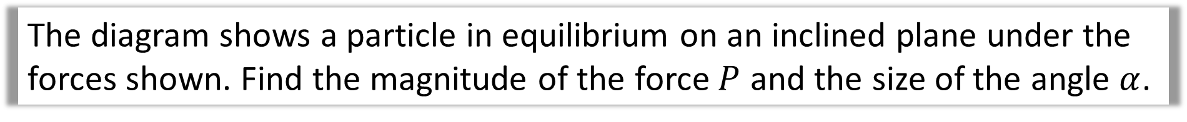


The diagram shows a particle in equilibrium on an inclined plane under the forces shown. Find the magnitude of the force $P$ and the size of the angle $α$.
Resolve Parallel
$$P\cos{α}=8+5\sin{30°}$$
Resolve Perpendicular
$$P\sin{α}+2=5\cos{30°}$$

Slide 15
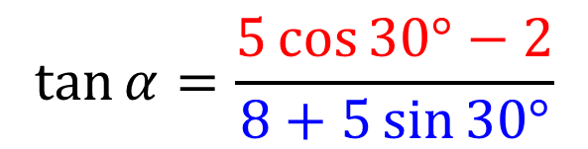

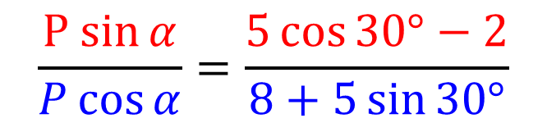
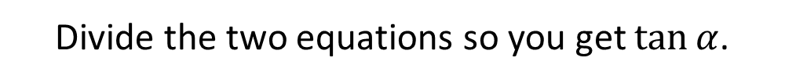



The diagram shows a particle in equilibrium on an inclined plane under the forces shown. Find the magnitude of the force $P$ and the size of the angle $α$.
Simultaneous Equations
$$P\cos{α}=8+5\sin{30°}$$
$$P\sin{α}+2=5\cos{30°}$$
Divide the two equations so you get $\tan{α}$.
$$\frac{P sin{α}}{P\cos{α}}=\frac{5\cos{30°}−2}{8+5\sin{30°}}$$
$$\tan{α}=\frac{5\cos{30°}−2}{8+5\sin{30°}}$$
$$α=12.5° (3sf)$$
$$P=10.8 (3sf)$$

