Slide 1
LO: Interior Angles of Polygons

Slide 2
Interior angles
are the angles inside a side.
2
1
3

Slide 3
What do the interior angles
of this shape add up to?
180˚

Slide 4
What do the interior angles
of this shape decagon add up to?
1440˚

Slide 5
You need a 3, 4, 5, 6, 7, 8, 9 and 10 sided polygons
Pick one corner in each shape and
join it to all the other corners.

Slide 6
Complete the table from your shapes.
Number of Sides | Number of Triangles | Total sum of Interior Angles
3
4
5
6
7
8
9
10
1 | 180
2 | 360
3 | 540
4 | 720
5 | 900
6 | 1080
7 | 1260
8 | 1440
19 | 3420
21

Slide 7
What is the connect between
the Numbers of Side and the Interior Angles?
Number of Sides
3
4
5
6
7
8
9
10
Total Interior Angles
(3 – 2) x 180˚
180
360
540
720
900
1080
1260
1440
(4 – 2) x 180˚
(5 – 2) x 180˚
(6 – 2) x 180˚
(7 – 2) x 180˚
(8 – 2) x 180˚
(9 – 2) x 180˚
(10 – 2) x 180˚
Interior Angles = (Number of Sides – 2) x 180˚

Slide 8
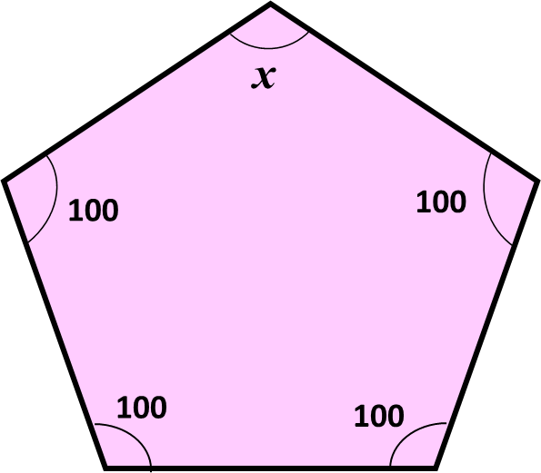
Calculate the missing angle in the pentagon.
140

Slide 9
Come up with two methods for finding x
Method 1
Method 2
720 ÷ 6
x = 120
180 – 60
x = 120
Regular Hexagon
x
60˚

Slide 10
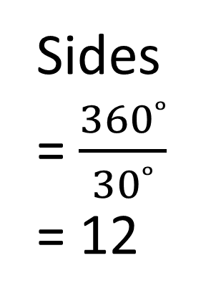
A regular polygon has an interior angle of 150˚
How many sides does it have?
Exterior Angles
= 180 – 150
= 30˚
Sides
= $\frac{360˚}{30˚}$
= 12
150°
30˚

Slide 11
Find the size of ONE exterior angle of a regular heptagon.
900°
128.6°
51.4°
45°

Slide 12
The sum of five interior angles
of a hexagon is 538˚
What is the size of the sixth angle?
120°
182°
720°
108°

Slide 13
The size of each exterior angle
of a regular polygon is 20°.
How many sides does it have?
20
9
24
18

Slide 14
What is the sum of the interior angle of the shape shown below?
540º
720º
360º
None of the above

Slide 15
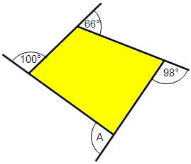
What is the
size of angle A?
90º
360º
76º
96º

Slide 16
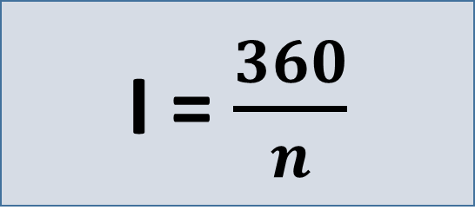
What is the formula for finding
the sum of interior angles?
I = $\frac{360}{n}$
I = 180(n - 2)
I = 180(2n- 4)
I = 180(n + 2)

Slide 17
The sizes of the exterior angles
of a quadrilateral
are x, 3x, 5x, and 3x.
What is the value of x?
90˚
30˚
150˚
60˚

Slide 18
The sum of the interior angles of
a polygon is 720.
Find the number of sides.
12
9
7
6

Slide 19
A regular polygon has an interior angle of 168ºdegrees.
What is the exterior angle and
how many sides does the polygon have?
18º and 30
12º and 20
12º and 30
15º and 18

Slide 20
The sum of Interior and Exterior Angles of a regular polygon is 1080°.
What is the sum of the interior angle?
720°
6
120°
360°

