Slide 1
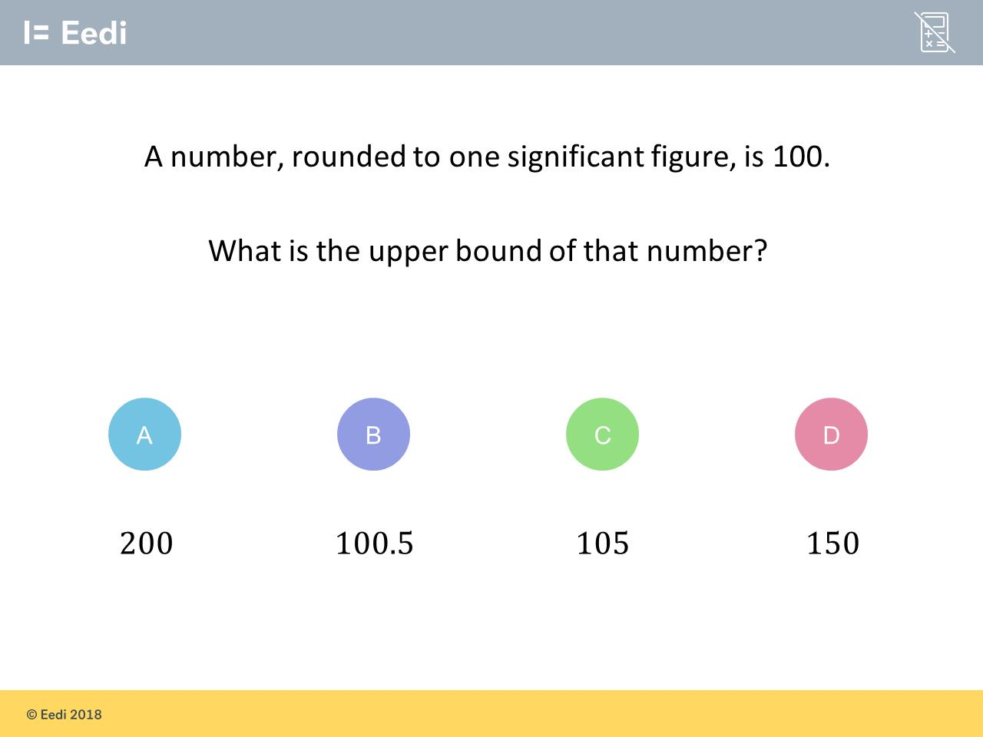
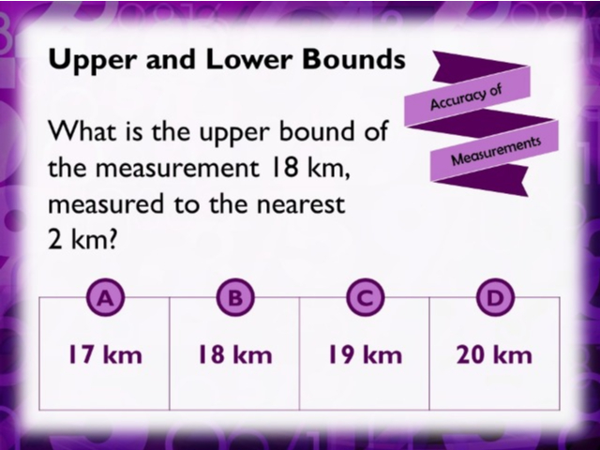
Worst answered question?
Most common wrong answer?

Slide 2
ANSWERS

Slide 3
Worst answered question?

Slide 4
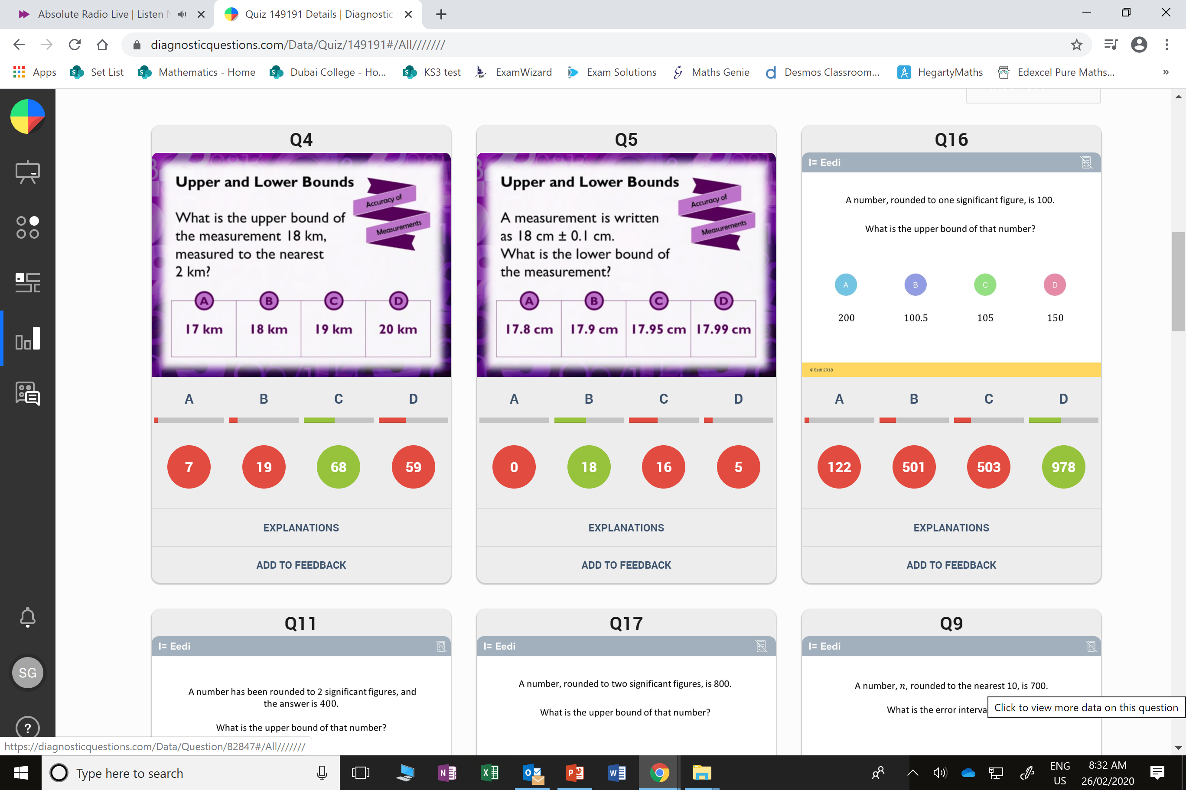
D
They added and subtracted 2.
They should have halved 2
before adding
and subtracting.

Slide 5
C
The did two significant figures.
1sf = 100
2sf = 10
3st = 1

