Slide 1
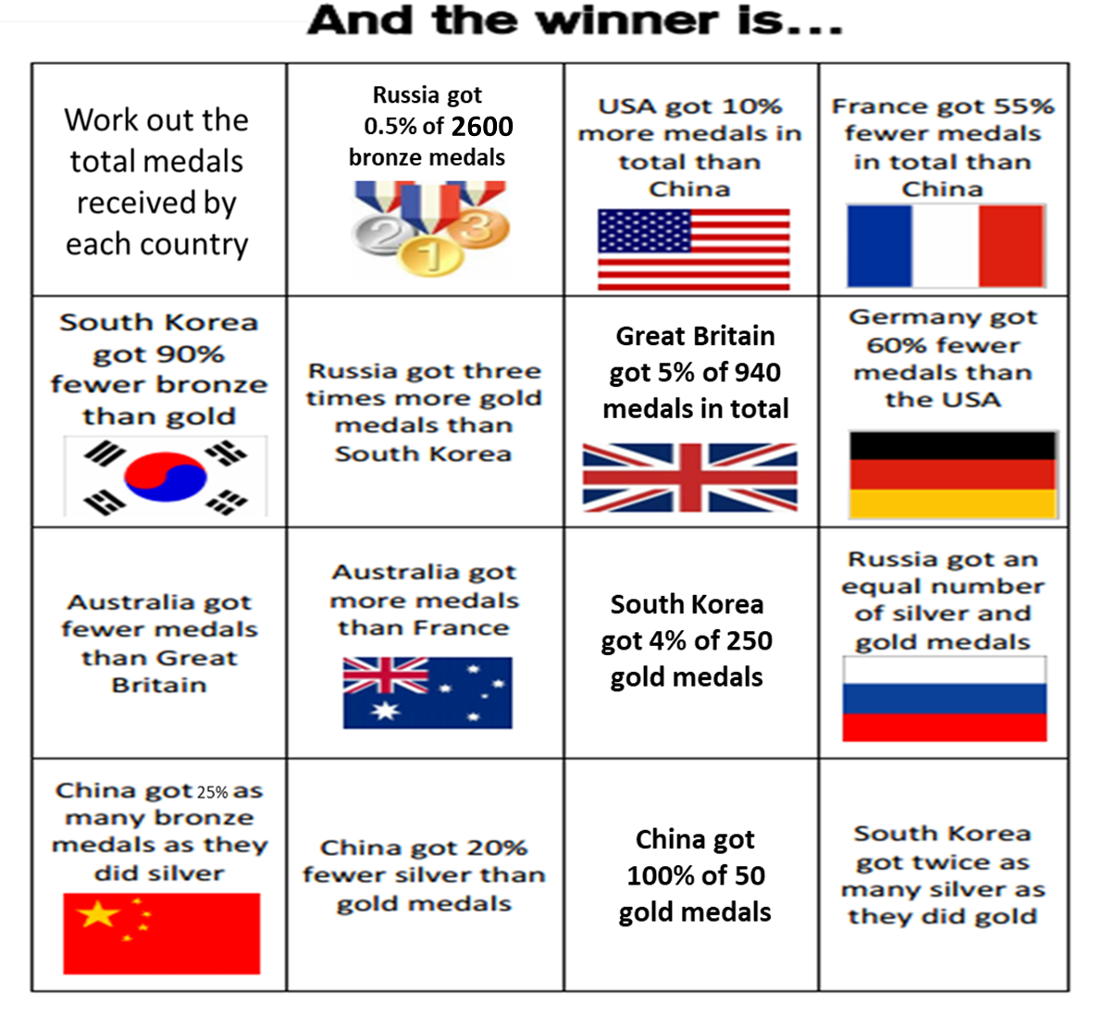

Slide 2
ANSWERS

Slide 3
COUNTRY | Bronze | Silver | Gold | TOTAL
Russia | 13 | 30 | 30 | 73
China | 10 | 40 | 50 | 100
France |  |  |  | 45
UK |  |  |  | 47
Germany |  |  |  | 44
Australia |  |  |  | 46
South Korea | 1 | 20 | 10 | 31
USA |  |  |  | 110

