Slide 1
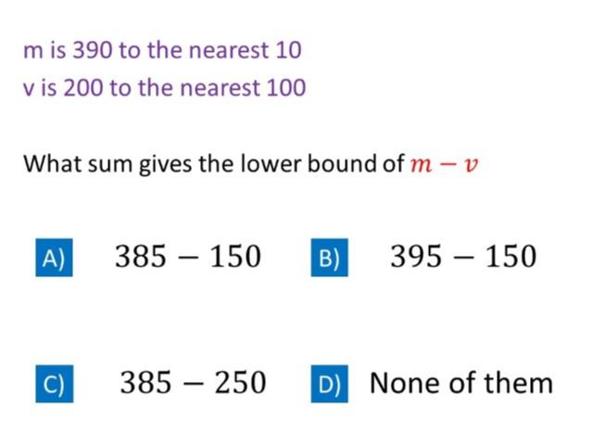
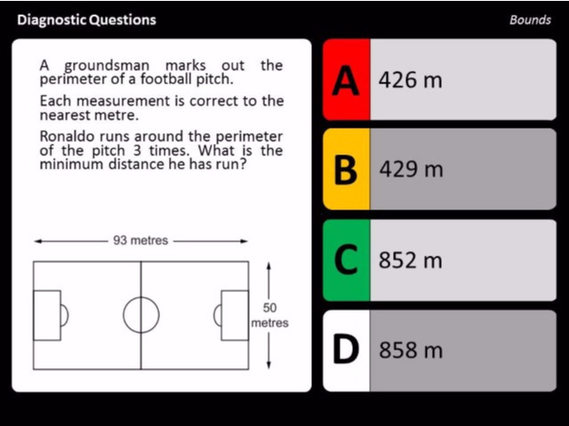
Worst answered question?
Most common wrong answer?

Slide 2
ANSWERS

Slide 3
Worst answered question?

Slide 4
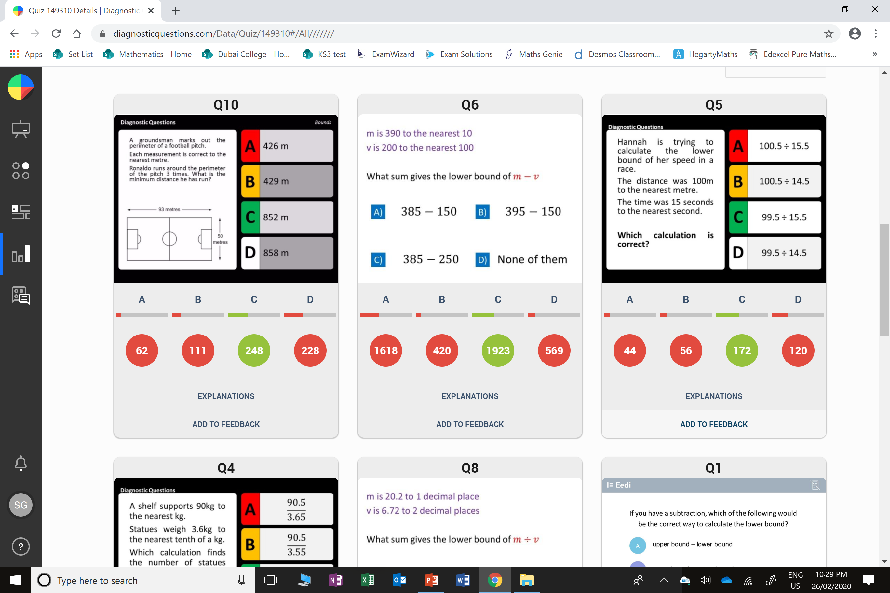
D
They calculated
the upper bound distance.

Slide 5
A
They did
LB – LB
when they should have done
LB – UB

