Slide 1

Diagnostic Assessment .Delta 2
Unit 3
Plan and Elevations
Surface Area
Volume
Circles, Arcs and Sectors
Cylinders
Pythagoras

Slide 2
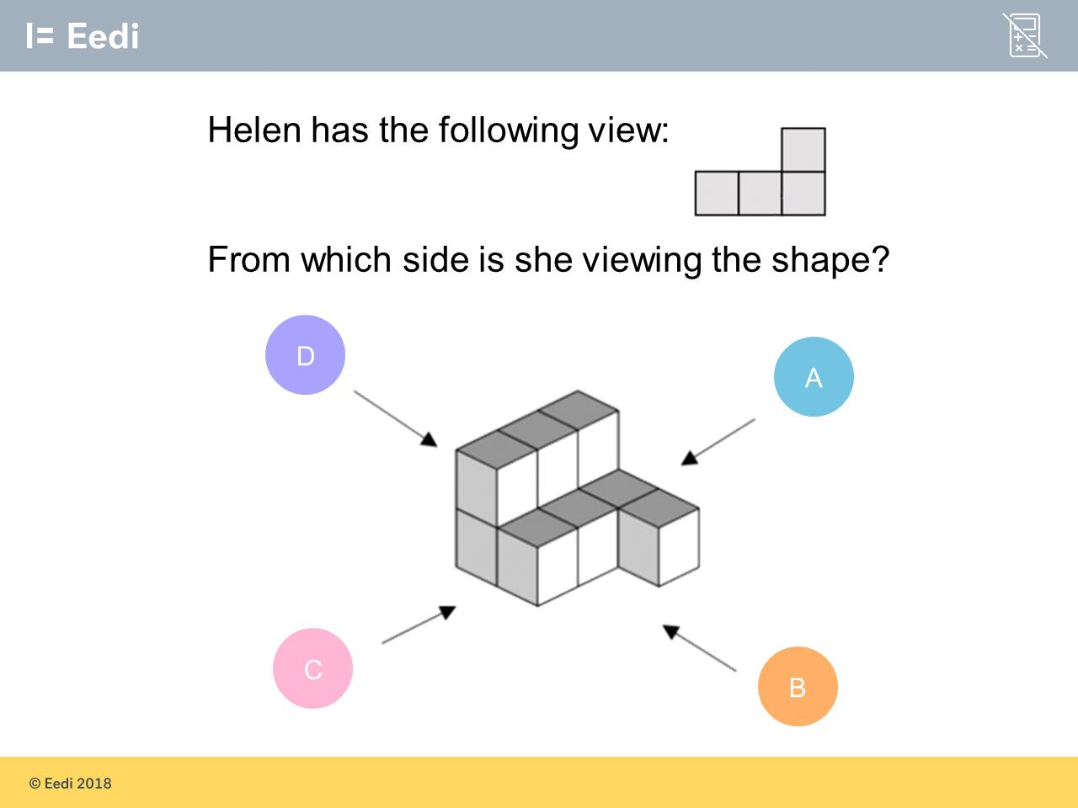
Question 1 – Plans and Elevations

Slide 3
Answer 1 – Plans and Elevations
CORRECT ANSWER | CORRECT EXPLANATION
A | The best way to answer this question is to imagine what the shape looks like from each side. From side A, we would have 4 squares on the bottom and 1 on the top, which is the view in the question.
COMMON MISTAKES | WHAT MIGHT BE YOUR MISTAKE
B | The student has not realised that there are 2 squares missing on top.
C | The student has found the mirror image of the correct answer.
D | The student has not realised that there are 2 squares missing on top.

Slide 4
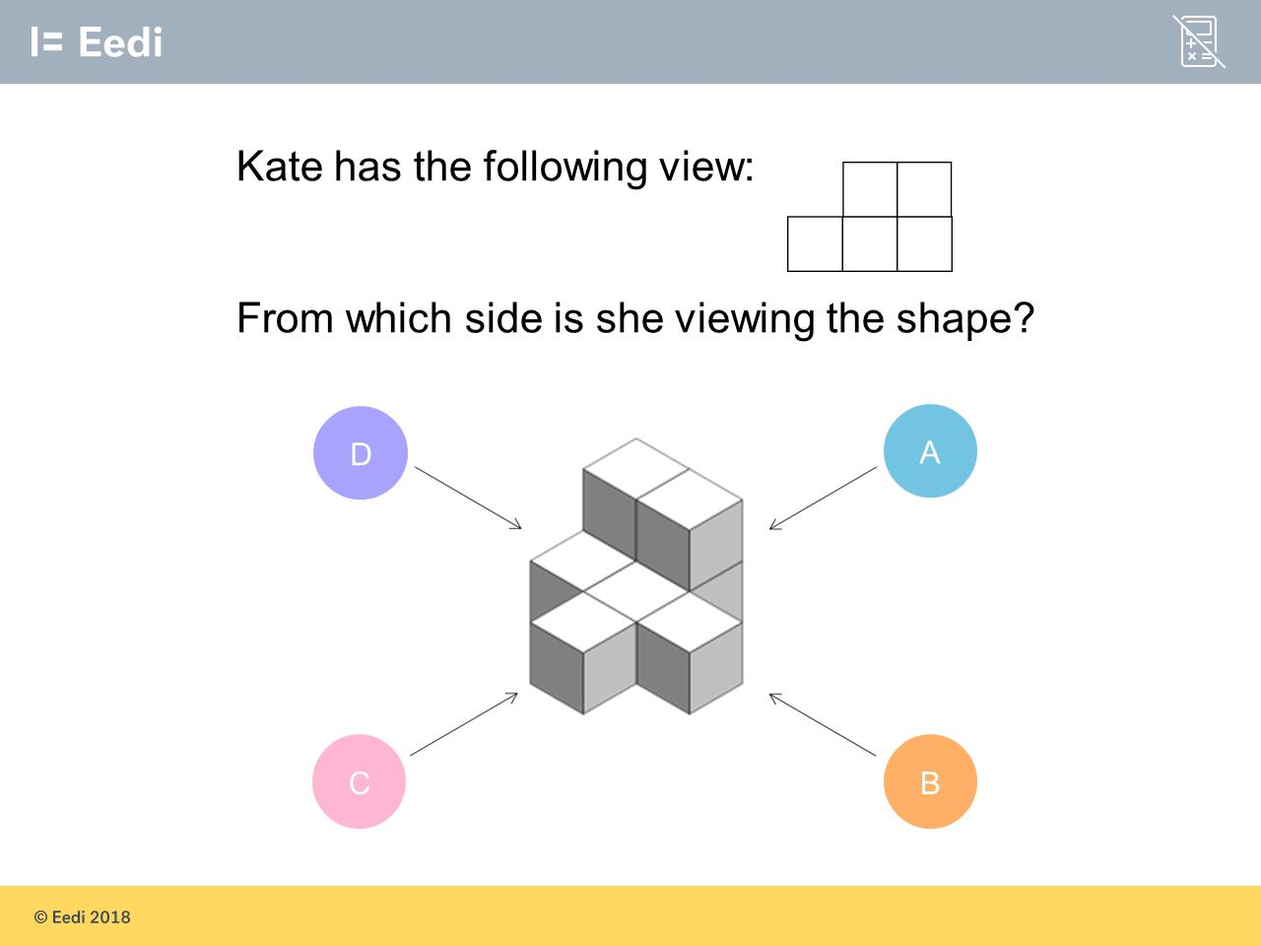
Question 2 – Plans and Elevations

Slide 5
Answer 2 – Plans and Elevations
CORRECT ANSWER | CORRECT EXPLANATION
A | The best way to answer this question is to imagine what the shape looks like from each side. From side A, we would have 3 squares on the bottom and 2 on the top, which is the view in the question.
COMMON MISTAKES | WHAT MIGHT BE YOUR MISTAKE
B | The student has not considered that there are only 4 squares viewable from this side.
C | The student may have mixed this answer up with A as the two are mirror images.
D | The student has not considered that there are only 4 squares viewable from this side.

Slide 6
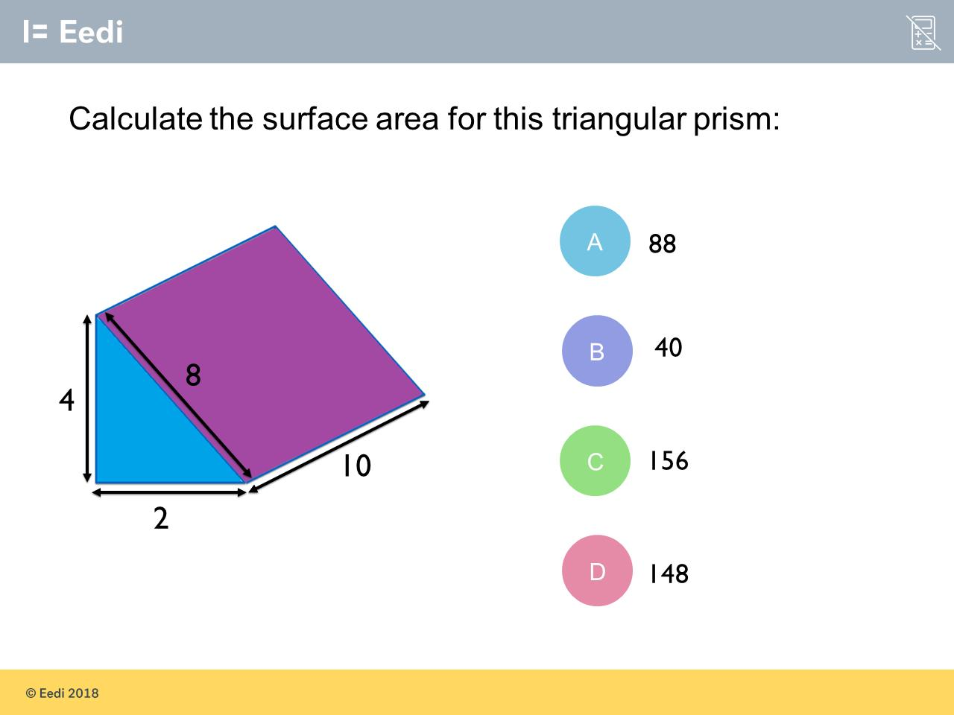
Question 3 – Surface Area

Slide 7
Answer 3 – Surface Area
CORRECT ANSWER | CORRECT EXPLANATION
148 | We have two triangular faces and 3 rectangular faces, so the surface area is (4 ×2 / 2) × 2 + 8 × 10 + 2 × 10 + 4 × 10 = 148.
COMMON MISTAKES | WHAT MIGHT BE YOUR MISTAKE
88 | The student may have tried to find the surface area of the visible faces only, but has not divided by 2 for the triangle.
40 | The student has found the volume.
156 | The student may not have halved the area for each triangle.

Slide 8
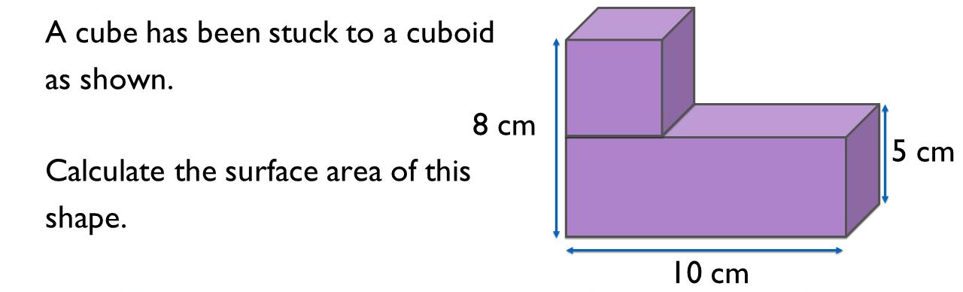
Question 4 – Surface Area

Slide 9
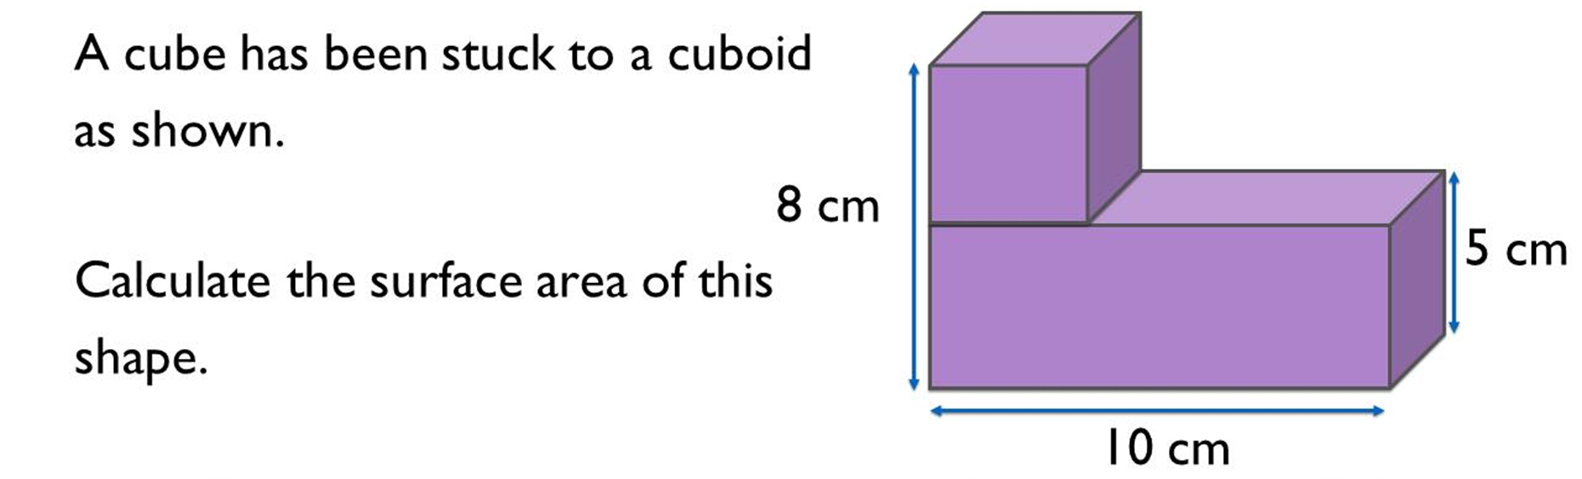
Answer 4 – Surface Area
CORRECT ANSWER | CORRECT EXPLANATION
226 | The cube has sides 8 - 5 = 3, so it has surface area 6 × 3 × 3 = 54. The cuboid has surface area 2 × (10 × 5 + 10 × 3 + 5 × 3) = 190. Adding these together gives 244. However, we need to remove the 2 joined sides from 244, so we have 244 - 2 × 3 × 3 = 226.
COMMON MISTAKES | WHAT MIGHT BE YOUR MISTAKE
244 | The student has not removed the joined sides.
59 | The student may have guessed. They may benefit from revising surface area of composite shapes.
235 | The student has only removed one joining side.

Slide 10
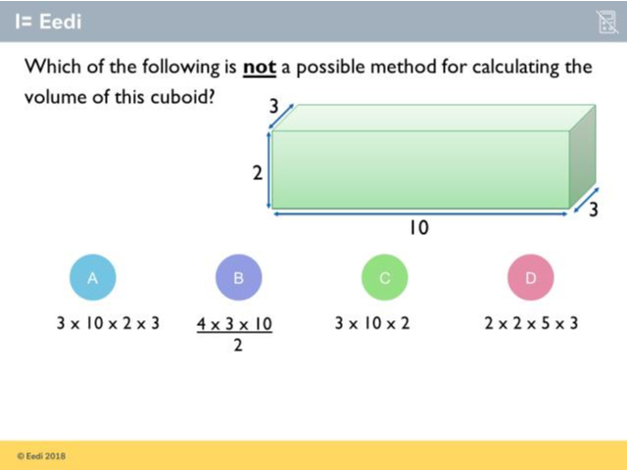
Question 5 – Volume

Slide 11
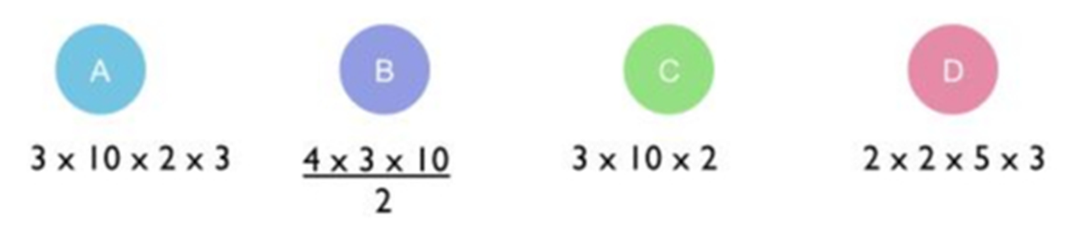
Answer 5 – Volume
CORRECT ANSWER | CORRECT EXPLANATION
A | Here we have multiplied all of the numbers together. We should only include 3 once.
COMMON MISTAKES | WHAT MIGHT BE YOUR MISTAKE
B | This is a correct possible method. Multiplying by 4 and then dividing by 2 is the same as multiplying by 2, so even though this isn't the most straightforward way of calculating the volume, it would work
C | This is how we calculate the volume of a cuboid: the base times the height x the depth.
D | This is a correct possible method. Multiplying by 2 and by 5 is the same as multiplying by 10, so even though this isn't the most obvious way of calculating the volume, it would work.

Slide 12
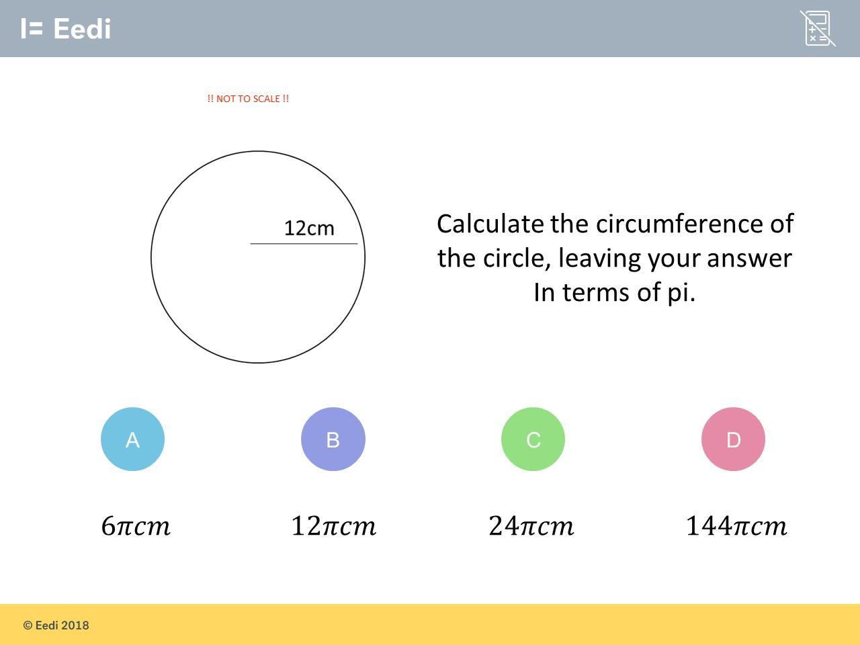
Question 6 – Circles

Slide 13
Answer 6 – Circles
CORRECT ANSWER | CORRECT EXPLANATION
24π | Diameter = 2 x 12 = 24 and circumference = 24 x π
COMMON MISTAKES | WHAT MIGHT BE YOUR MISTAKE
6π | The radius has been halved when it should be doubled to get the diameter.
12π | The circumference of a circle is c = 𝜋d Here it has only been multiplied by the radius.
144π | This calculation would give the area of the circle ( 𝜋r² ).

Slide 14
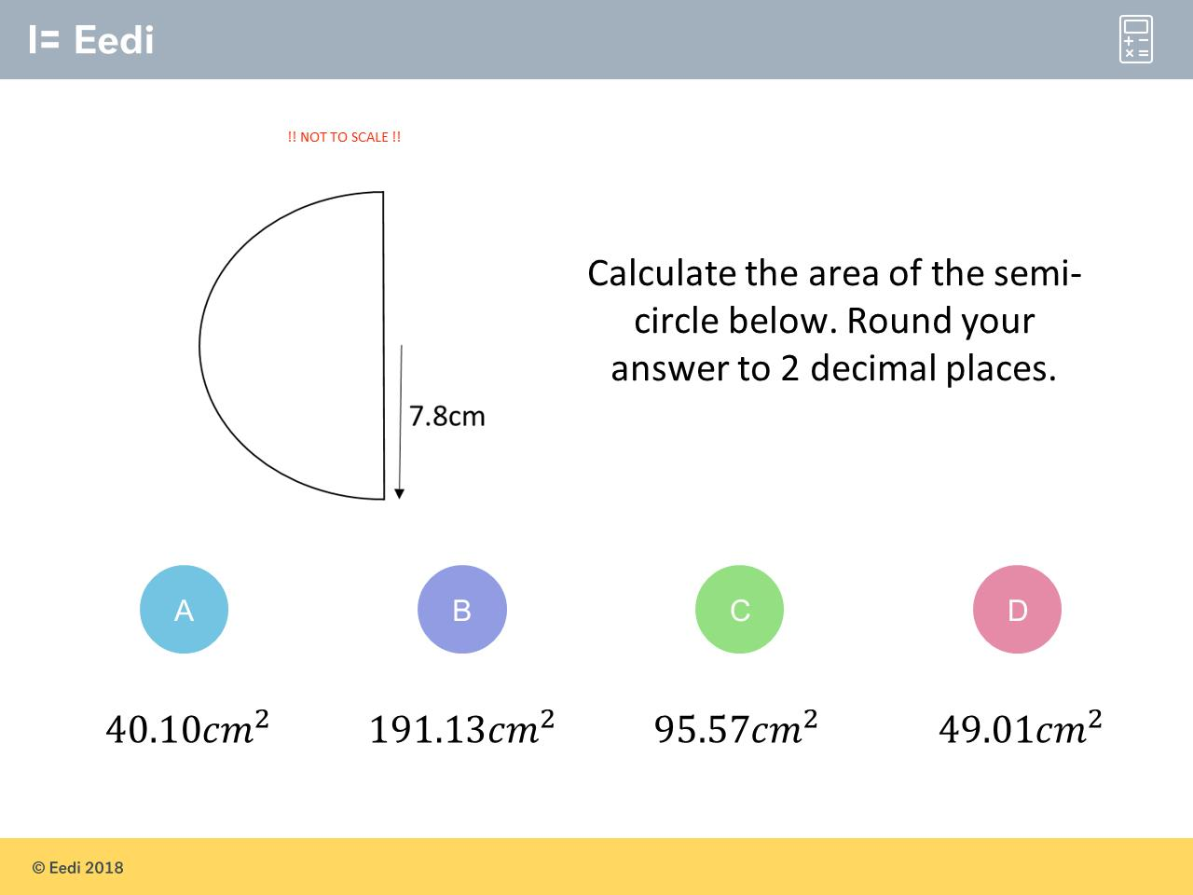
Question 7 – Circles

Slide 15
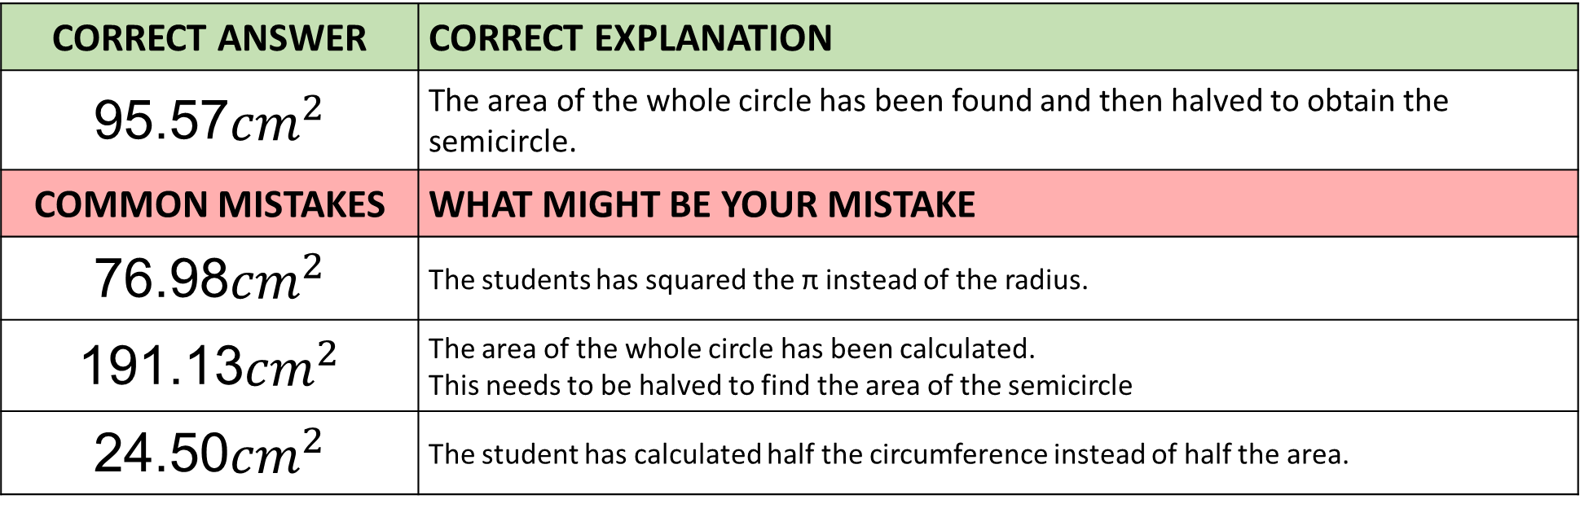
Answer 7 – Circles
CORRECT ANSWER | CORRECT EXPLANATION
95.57${cm}^{2}$ | The area of the whole circle has been found and then halved to obtain the semicircle.
COMMON MISTAKES | WHAT MIGHT BE YOUR MISTAKE
76.98${cm}^{2}$ | The students has squared the π instead of the radius.
191.13${cm}^{2}$ | The area of the whole circle has been calculated. This needs to be halved to find the area of the semicircle
24.50${cm}^{2}$ | The student has calculated half the circumference instead of half the area.

Slide 16
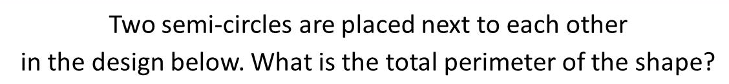
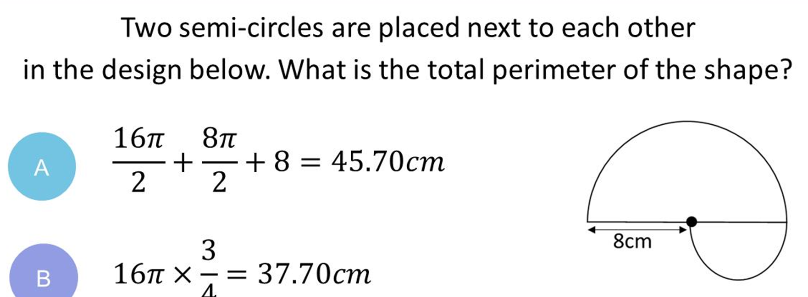
Question 8 – Circles

Slide 17
Answer 8 – Circles
CORRECT ANSWER | CORRECT EXPLANATION
45.70cm | The perimeters of the 2 semicircles have been found and the length of the straight line has been added.
COMMON MISTAKES | WHAT MIGHT BE YOUR MISTAKE
37.70cm | The student looked at the diagram and thought that the perimeter was ¾ of the circumference of the large circle .
83.40cm | The student has found the circumferences of the full circles and not halved them.
26.85cm | The radii have been used as if they were diameters. They should not have been halved.

Slide 18
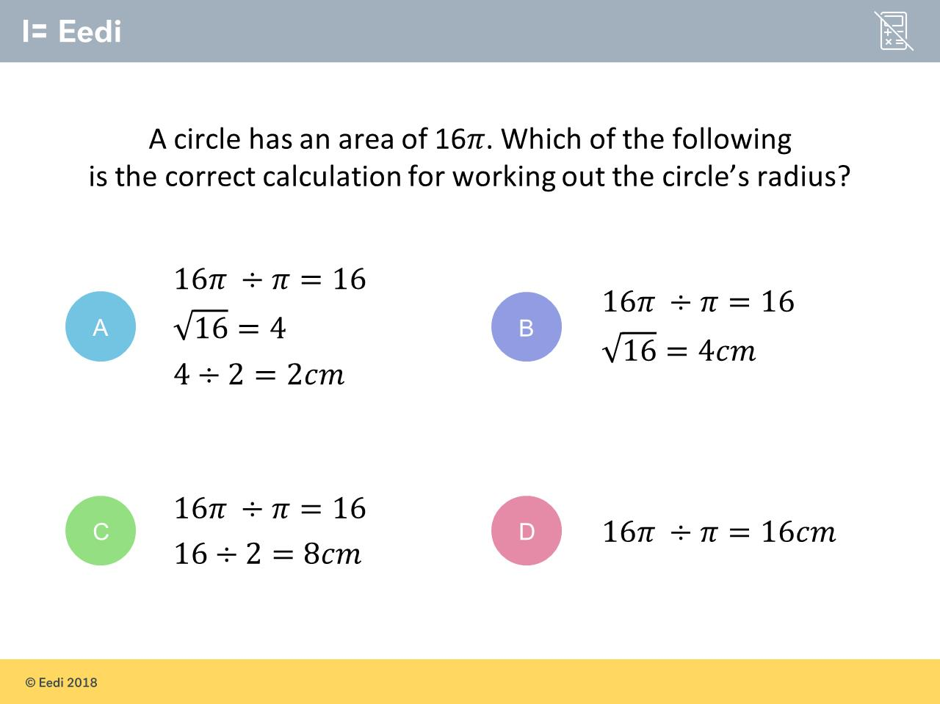
Question 9 – Circles

Slide 19
Answer 9 – Circles
CORRECT ANSWER | CORRECT EXPLANATION
A | Working backwards from the formula for the area of a circle one has to divide by 𝜋 and then take the square root to get the radius.
COMMON MISTAKES | WHAT MIGHT BE YOUR MISTAKE
B | Having found the radius of 4, this has then been divided by 2 which is not correct.
C | Working backwards from the formula for the area of a circle one has to divide by 𝜋 and then take the square root to get the radius.
D | Working backwards from the formula for the area of a circle one has to divide by 𝜋 and then take the square root to get the radius. The square root has not been taken here.

Slide 20
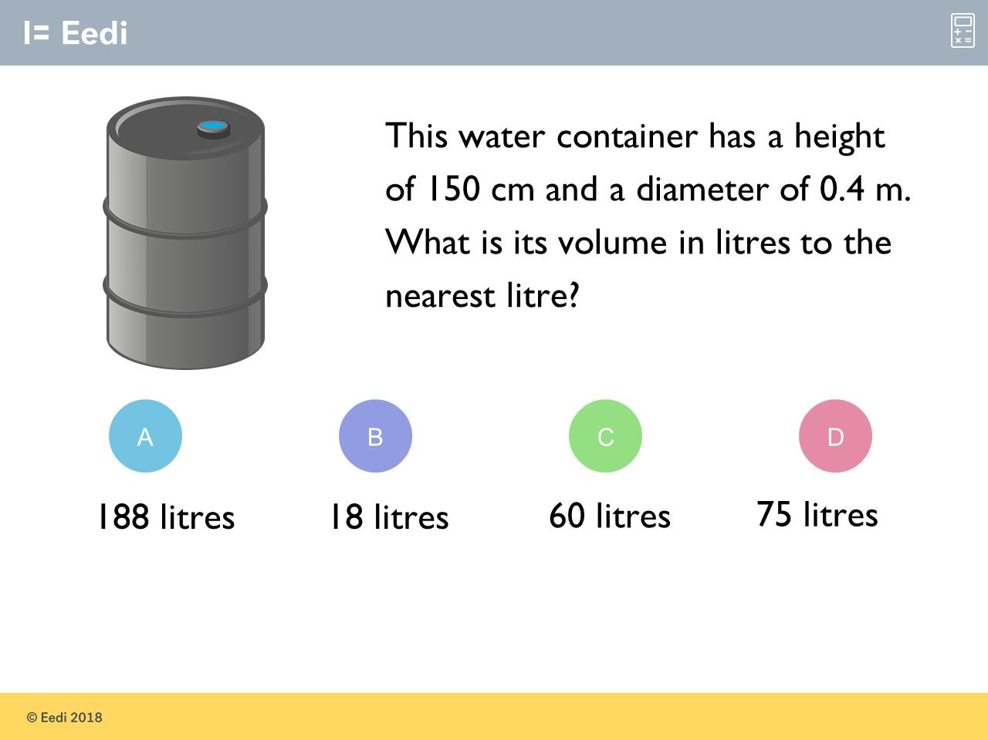
Question 10 – Cylinders

Slide 21
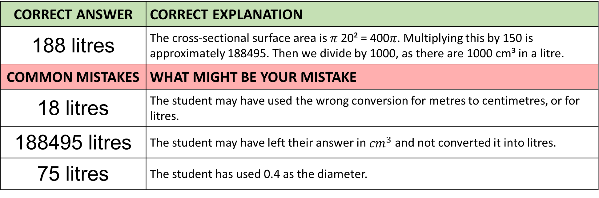
Answer 10 – Cylinders
CORRECT ANSWER | CORRECT EXPLANATION
188 litres | The cross-sectional surface area is 𝜋 20² = 400𝜋. Multiplying this by 150 is approximately 188495. Then we divide by 1000, as there are 1000 cm³ in a litre.
COMMON MISTAKES | WHAT MIGHT BE YOUR MISTAKE
18 litres | The student may have used the wrong conversion for metres to centimetres, or for litres.
188495 litres | The student may have left their answer in ${cm}^{3}$ and not converted it into litres.
75 litres | The student has used 0.4 as the diameter.

Slide 22
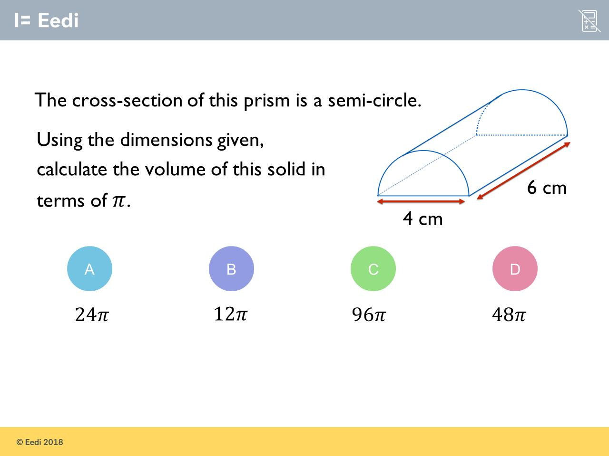
Question 11 – Cylinders

Slide 23
Answer 11 – Cylinders
CORRECT ANSWER | CORRECT EXPLANATION
12π | The cross-sectional area is ½𝜋 2² = 2𝜋. We then multiply by 6 to get 12𝜋.
COMMON MISTAKES | WHAT MIGHT BE YOUR MISTAKE
24π | The student may not have halved the area of a circle for the cross-sectional area.
96π | The student has used 4 as the radius, and has not halved for a semi-circle.
48π | The student has used 4 as the radius.

Slide 24
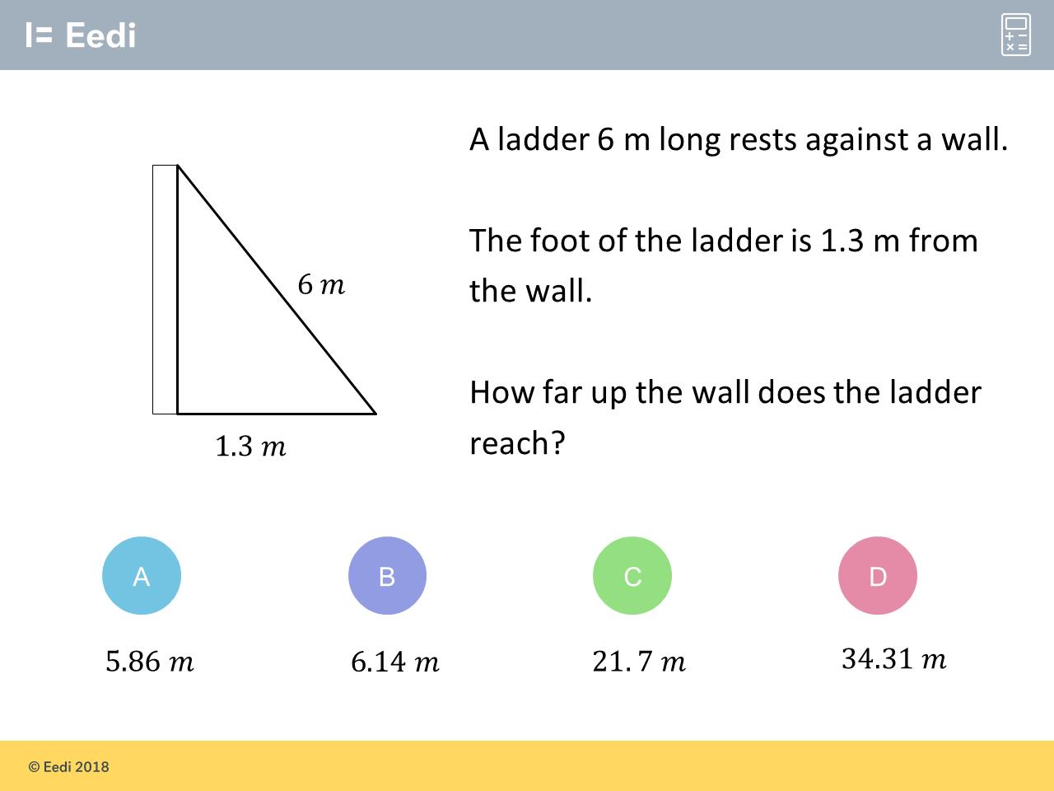
Question 12 – Pythagoras

Slide 25
Answer 12 – Pythagoras
CORRECT ANSWER | CORRECT EXPLANATION
5.86 m | We have 6² - 1.3² = 34.31 and the square root of this is 5.86 m.
COMMON MISTAKES | WHAT MIGHT BE YOUR MISTAKE
6.14 m | The student has added the squares, rather than subtracting.
21.7 m | The student has forgotten to square the sides.
34.31 m | The student has forgotten to square root.

Slide 26
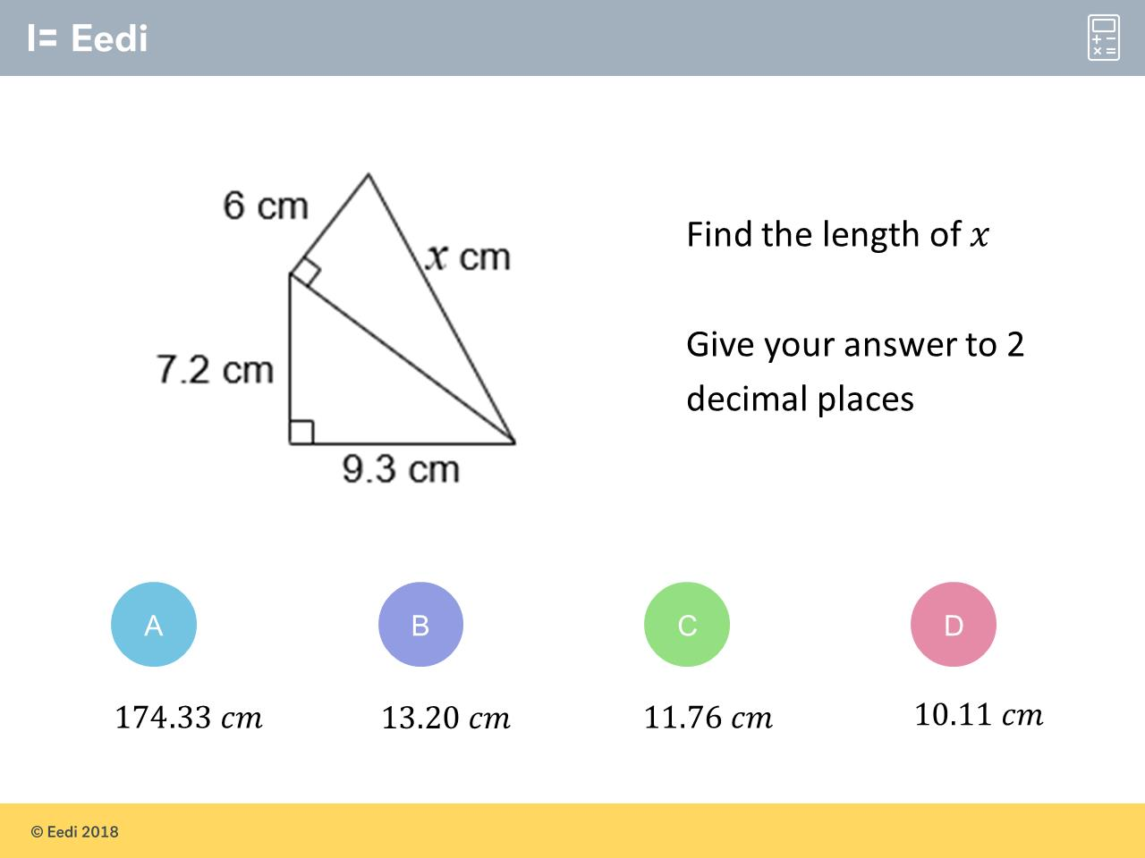
Question 13 – Pythagoras

Slide 27
Answer 13 – Pythagoras
CORRECT ANSWER | CORRECT EXPLANATION
13.20 cm | We can work out the hypotenuse of the lower triangle by √(9.3² + 7.2²) = 11.76 cm. We can then use this to work out x using √(11.76² + 6²) = √174.33 = 13.20.
COMMON MISTAKES | WHAT MIGHT BE YOUR MISTAKE
174.33 cm | The student has forgotten to square root.
11.76 cm | The student has found the incorrect side.
10.11 cm | The student has subtracted the squares in the second calculation.

Slide 28
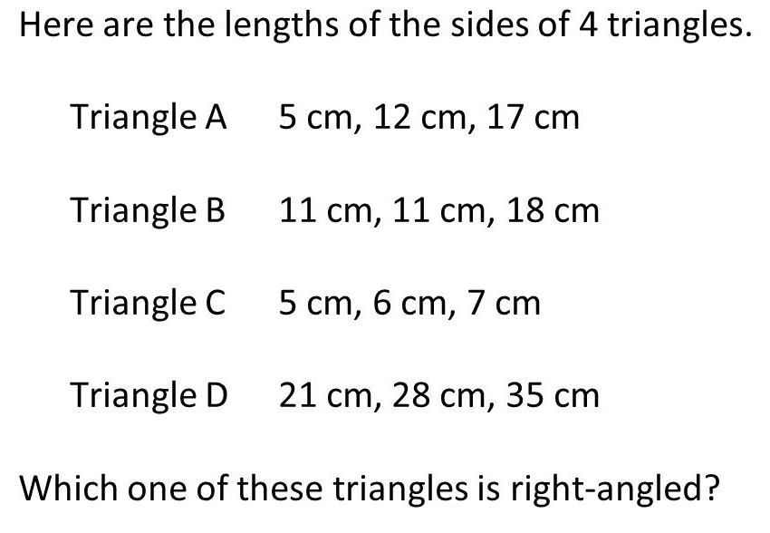
Question 14 – Pythagoras

Slide 29
Answer 14 – Pythagoras
CORRECT ANSWER | CORRECT EXPLANATION
D | We have 21² + 28² = 35², so this is a right-angled triangle.
COMMON MISTAKES | WHAT MIGHT BE YOUR MISTAKE
A | The student has added the sides, without squaring.
B | The student may be confusing this with an isosceles triangle.
C | The student may think that this is a Pythagorean triple.

