Slide 1
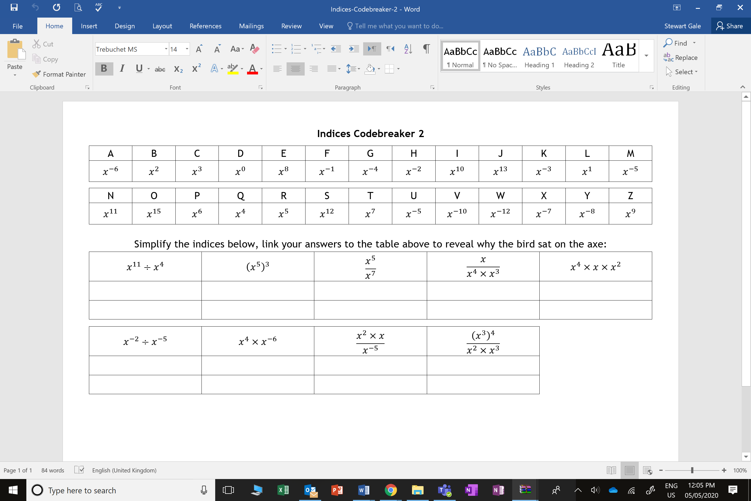

Slide 2
ANSWERS

Slide 3
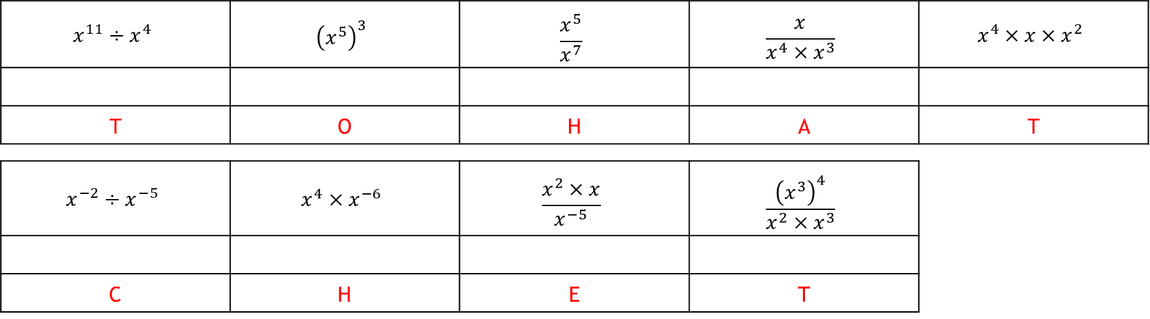
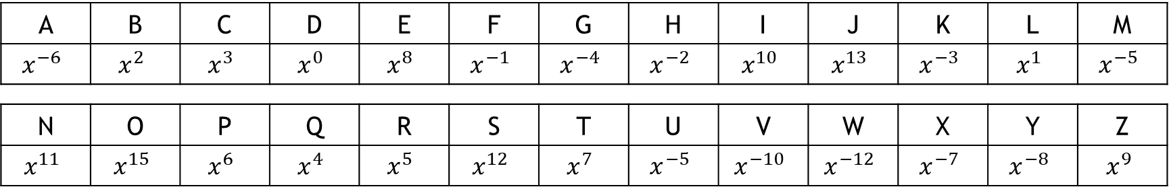
Indices Codebreaker A
Simplify the indices below, link your answers to the table above to reveal why the bird sat on the axe:
A | B | C | D | E | F | G | H | I | J | K | L | M
$$x^{−6}$$ | $$x^{2}$$ | $$x^{3}$$ | $$x^{0}$$ | $$x^{8}$$ | $$x^{−1}$$ | $$x^{−4}$$ | $$x^{−2}$$ | $$x^{10}$$ | $$x^{13}$$ | $$x^{−3}$$ | $$x^{1}$$ | $$x^{−5}$$
N | O | P | Q | R | S | T | U | V | W | X | Y | Z
$$x^{11}$$ | $$x^{15}$$ | $$x^{6}$$ | $$x^{4}$$ | $$x^{5}$$ | $$x^{12}$$ | $$x^{7}$$ | $$x^{−5}$$ | $$x^{−10}$$ | $$x^{−12}$$ | $$x^{−7}$$ | $$x^{−8}$$ | $$x^{9}$$
$$x^{11}÷x^{4}$$ | $${\left(x^{5}\right)}^{3}$$ | $$\frac{x^{5}}{x^{7}}$$ | $$\frac{x}{x^{4}×x^{3}}$$ | $$x^{4}×x×x^{2}$$
T | O | H | A | T
$$x^{−2}÷x^{−5}$$ | $$x^{4}×x^{−6}$$ | $$\frac{x^{2}×x}{x^{−5}}$$ | $$\frac{{\left(x^{3}\right)}^{4}}{x^{2}×x^{3}}$$
C | H | E | T

