Slide 1
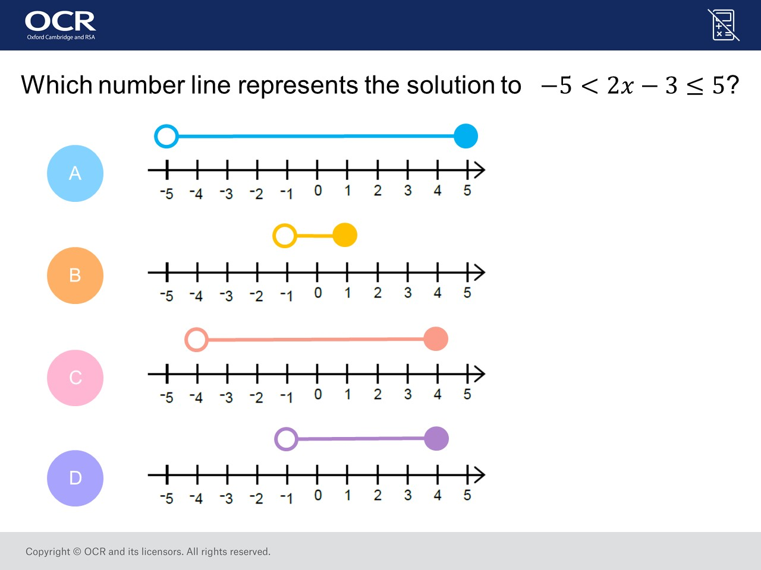
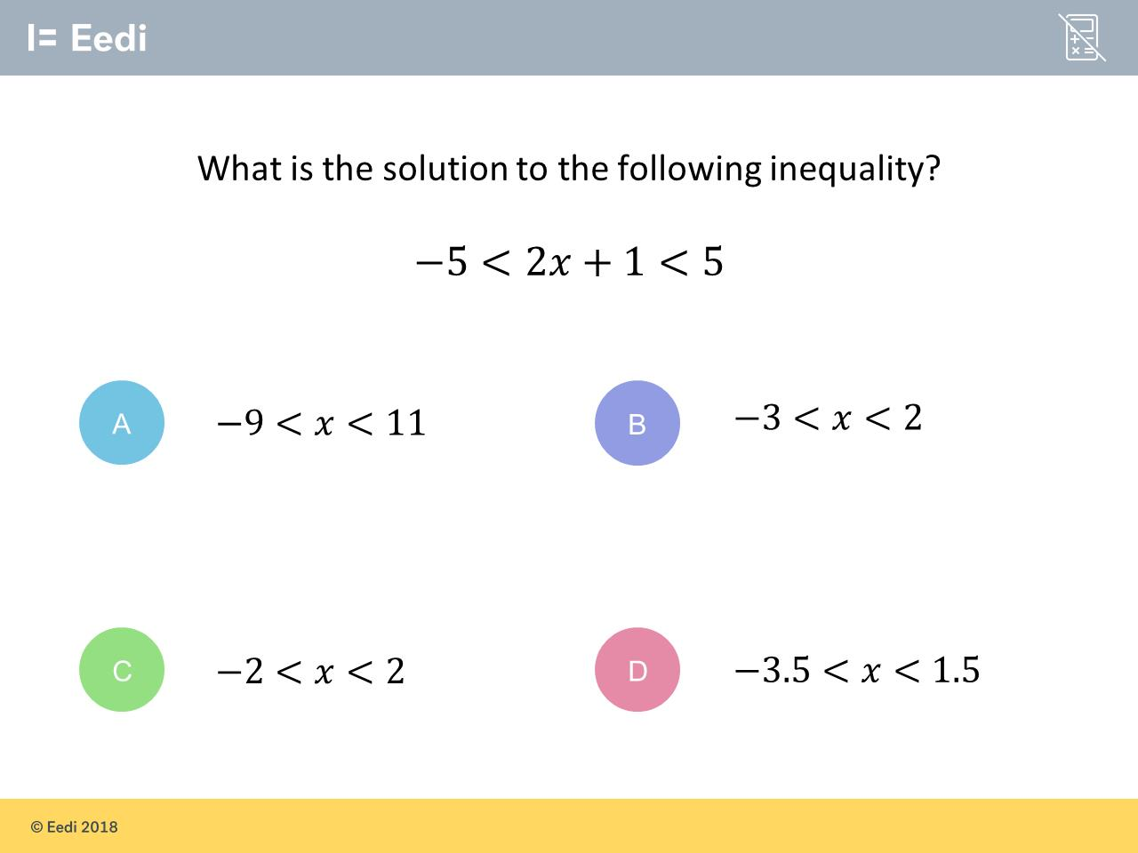
Worst answered question?
Most common wrong answer?

Slide 2
ANSWERS

Slide 3
Worst answered question?

Slide 4
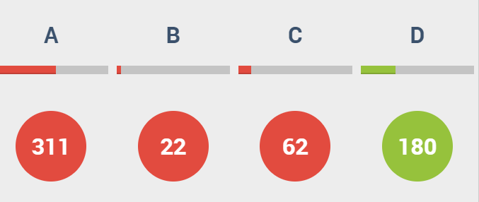
A
The students
did not solve the equation!

Slide 5

C
They add 1
to the -5 instead of subtracting.

