Slide 1
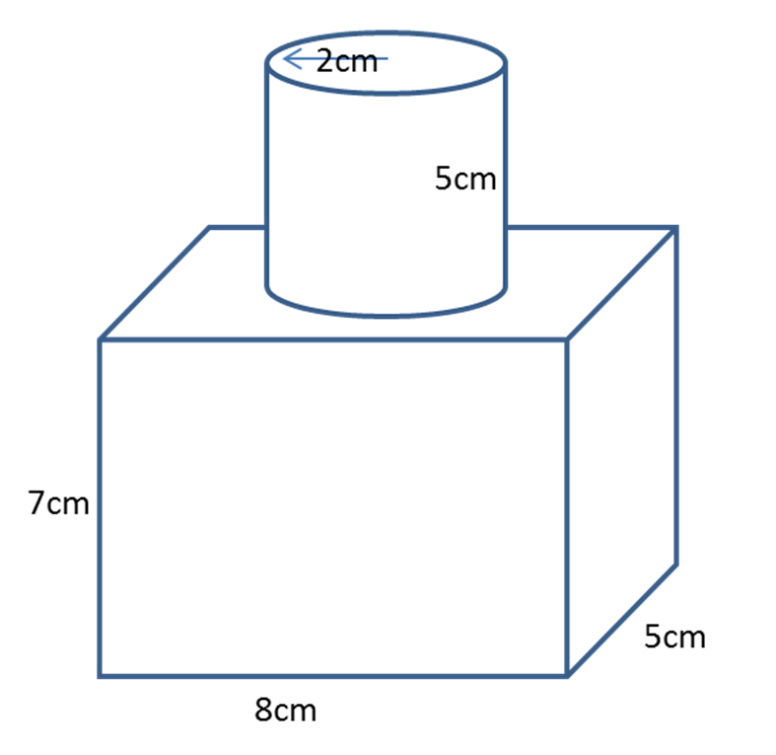
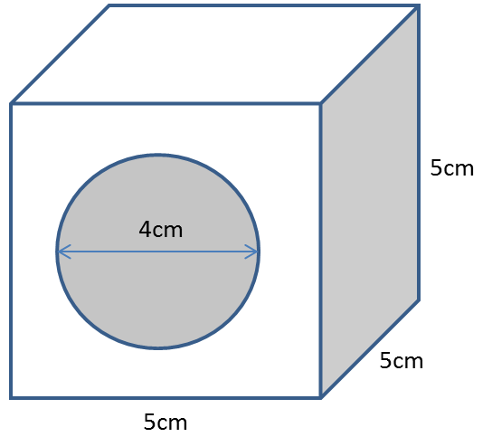
Find the volume and surface area.
Give you answers to 1 decimal place.

Slide 2
ANSWERS

Slide 3
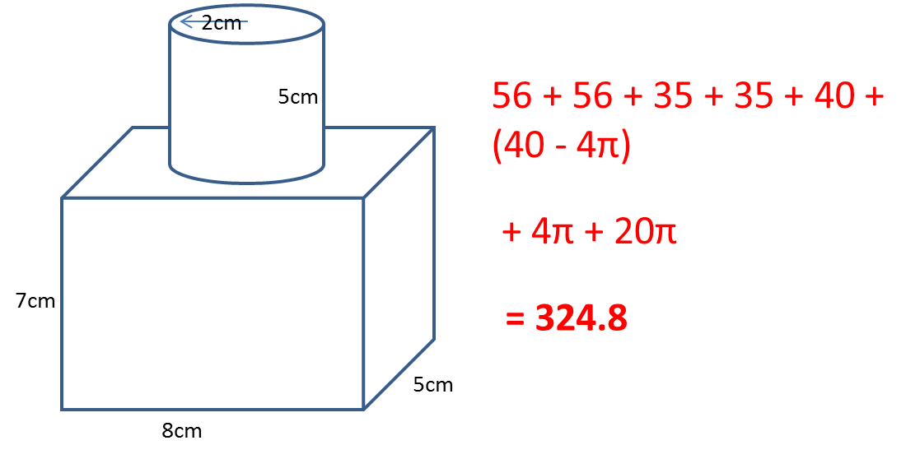
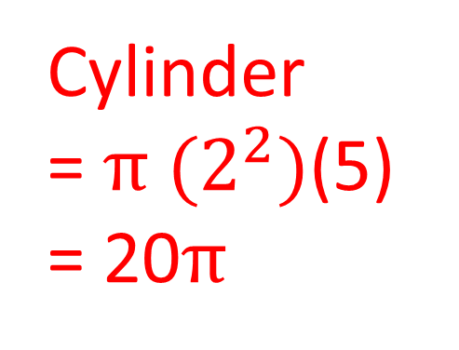
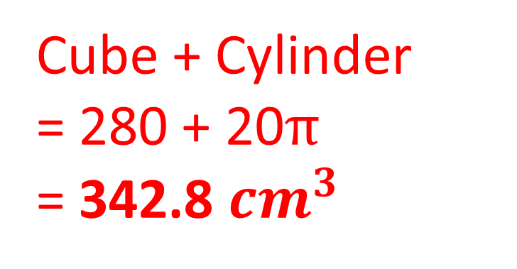
Volume
Cube
= 7 x 8 x 5
= 280
Cylinder
= ${π (2}^{2})$(5)
= 20$π$
Cube + Cylinder
= 280 + 20$π$
= 342.8 ${cm}^{3}$

Slide 4
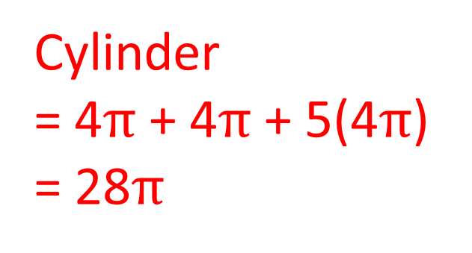
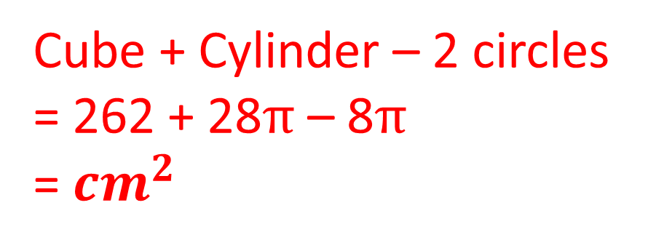
Surface Area
Cube
= 112 + 70 + 80
= 262
Cylinder
= 4$π$ + 4$π$ + 5(4$π$)
= 28$π$
Cube + Cylinder – 2 circles
= 262 + 28$π$ – 8$π$
= ${cm}^{2}$

Slide 5
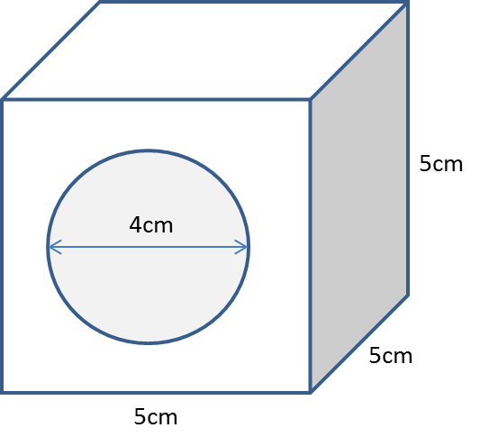
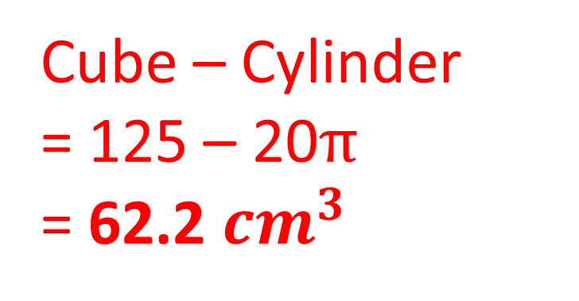
Volume
Cube
= 5 x 5 x 5
= 125
Cylinder
= ${π (2}^{2})$(5)
= 20$π$
Cube – Cylinder
= 125 – 20$π$
= 62.2 ${cm}^{3}$

Slide 6
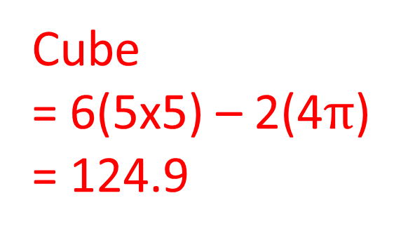
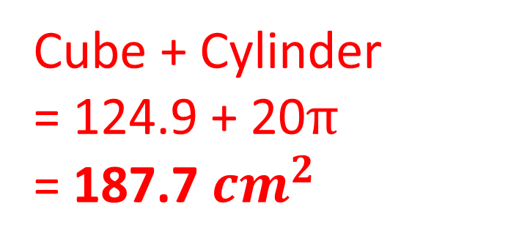
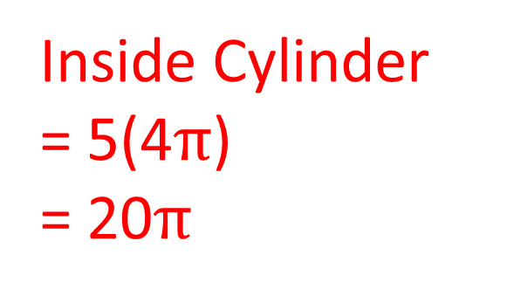
Cube
= 6(5x5) – 2(4$π$)
= 124.9
Surface Area
Inside Cylinder
= 5(4$π$)
= 20$π$
Cube + Cylinder
= 124.9 + 20$π$
= 187.7 ${cm}^{2}$

