Slide 1

Diagnostic Assessment .Delta 3
Unit 10
Proofs

Slide 2
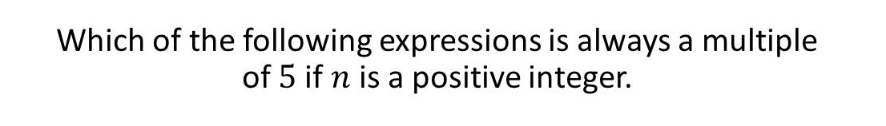
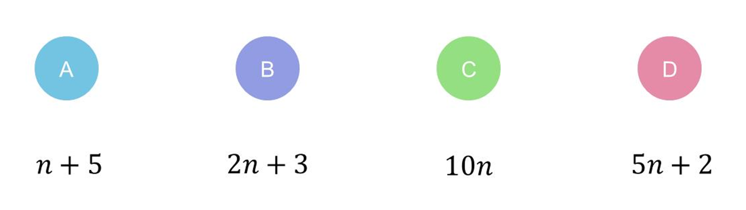
Question 1 – Proofs

Slide 3
Answer 1 – Proofs
CORRECT ANSWER | CORRECT EXPLANATION
C | Any number multiplied by 10 will also be a multiple of 5, as 10 is a multiple of 5.
COMMON MISTAKES | WHAT MIGHT BE YOUR MISTAKE
A | The student may have misread the question as n being a multiple of 5 already.
B | The student may have added 2n and 3 incorrectly to get 5n.
D | The student has not recognised that adding 2 stops the number being a multiple of 5.

Slide 4
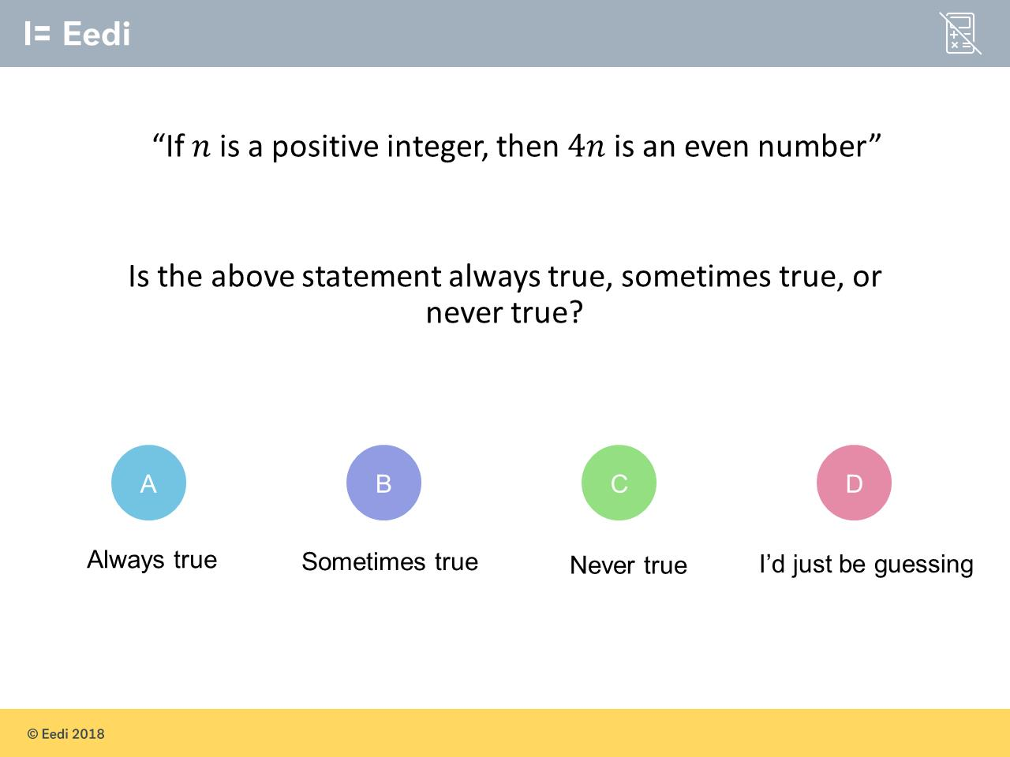
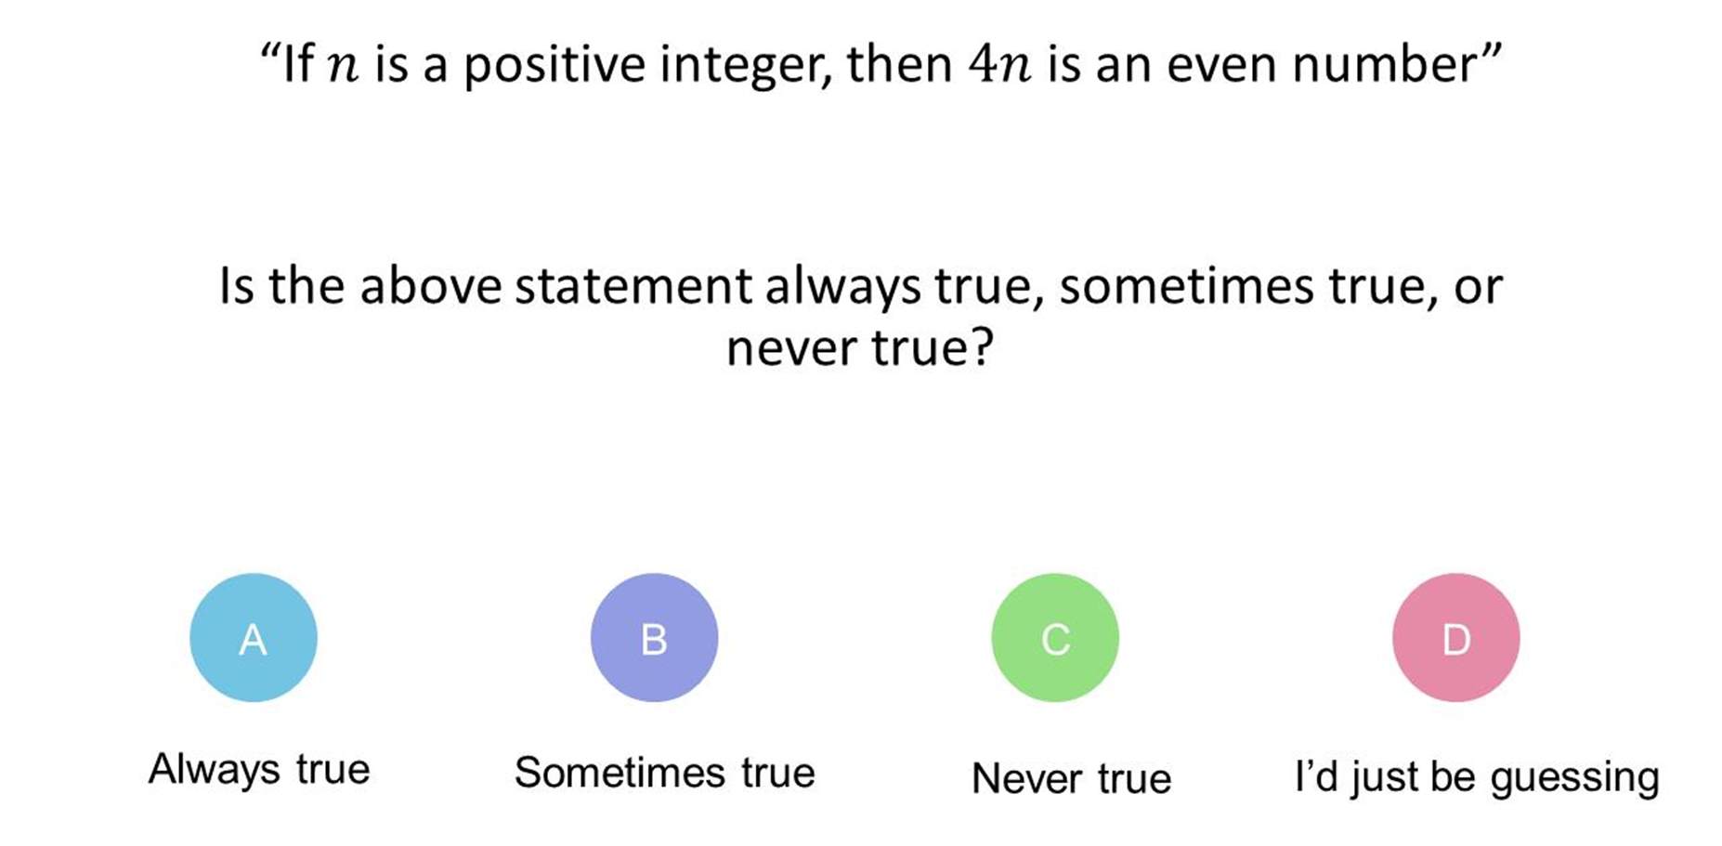
Question 2 – Proofs

Slide 5
Answer 2 – Proofs
CORRECT ANSWER | CORRECT EXPLANATION
A | If you multiply any number by 4, you always get an even number.
COMMON MISTAKES | WHAT MIGHT BE YOUR MISTAKE
B | The student may be considering multiplying by non-integers.
C | The student may not understand the question. They may benefit from thinking about the numbers in the 4 times table.
D | The student may not understand the concept of proof. They may benefit from revising this topic.

Slide 6
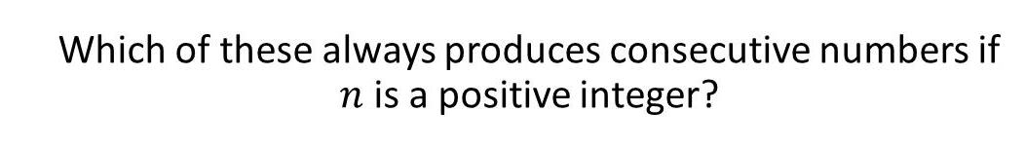
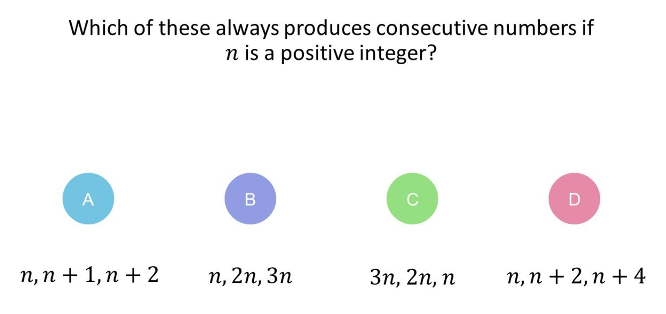
Question 3 – Proofs

Slide 7
Answer 3 – Proofs
CORRECT ANSWER | CORRECT EXPLANATION
A | These numbers will be consecutive, and will go up in increasing order.
COMMON MISTAKES | WHAT MIGHT BE YOUR MISTAKE
B | The student has correctly identified a sequence, but has not understood that the difference must be one.
C | The student has correctly identified a sequence, but has not understood that the difference must be one.
D | The student has given a sequence for consecutive odd or even numbers.

Slide 8
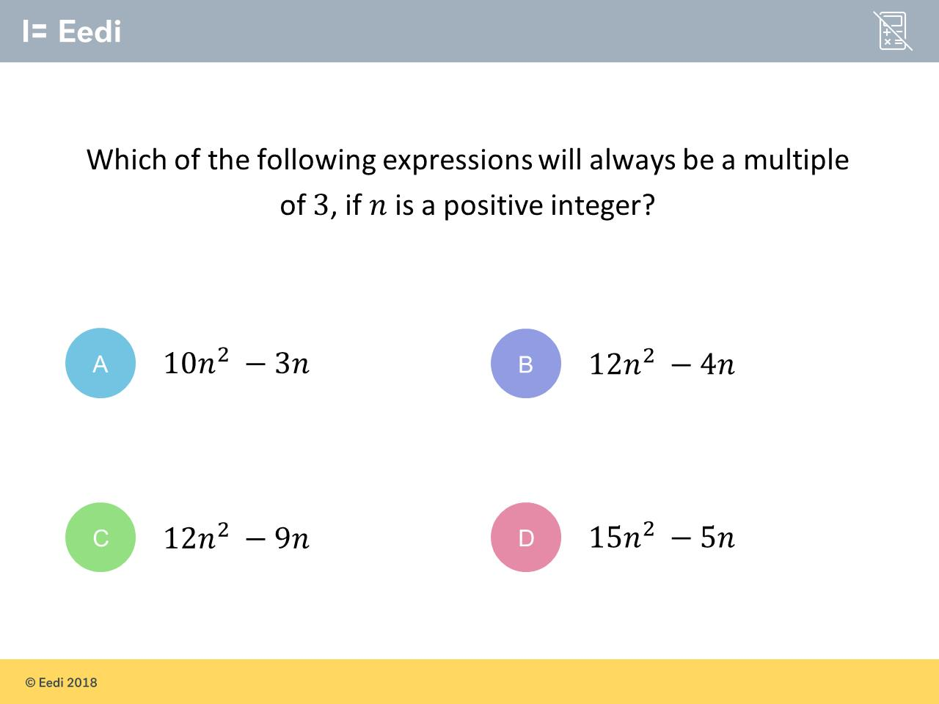
Question 4 – Proofs

Slide 9
Answer 4 – Proofs
CORRECT ANSWER | CORRECT EXPLANATION
C | As 12 and 9 have common factor 3, any number that is made will be a multiple of 3.
COMMON MISTAKES | WHAT MIGHT BE YOUR MISTAKE
A | The student has not recognised that both numbers must have common factor 3.
B | The student has not recognised that both numbers must have common factor 3.
D | The student has not recognised that both numbers must have common factor 3.

Slide 10
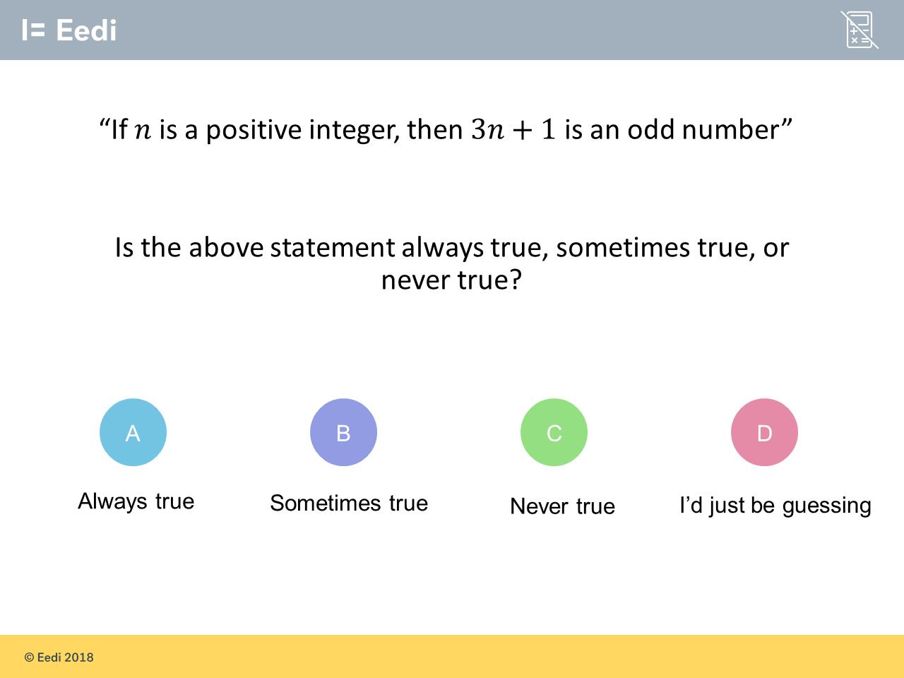
Question 5 – Proofs

Slide 11
Answer 5 – Proofs
CORRECT ANSWER | CORRECT EXPLANATION
B | This is only true if n is an even number.
COMMON MISTAKES | WHAT MIGHT BE YOUR MISTAKE
A | The student may be confusing this with 2n+1.
C | The student may reason that as 3 and 1 are odd, they add together to make an even
D | The student may not understand the concept of proof. They may benefit from revising this topic.

Slide 12

Question 6 – Proofs

Slide 13
Answer 6 – Proofs
CORRECT ANSWER | CORRECT EXPLANATION
C | No matter the choice of n, any square number will be positive.
COMMON MISTAKES | WHAT MIGHT BE YOUR MISTAKE
A | The student may confused negative and positive.
B | The student may not know what happens when you square a negative number.
D | The student may not understand the concept of proof. They may benefit from revising this topic.

Slide 14
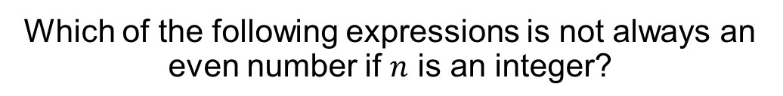
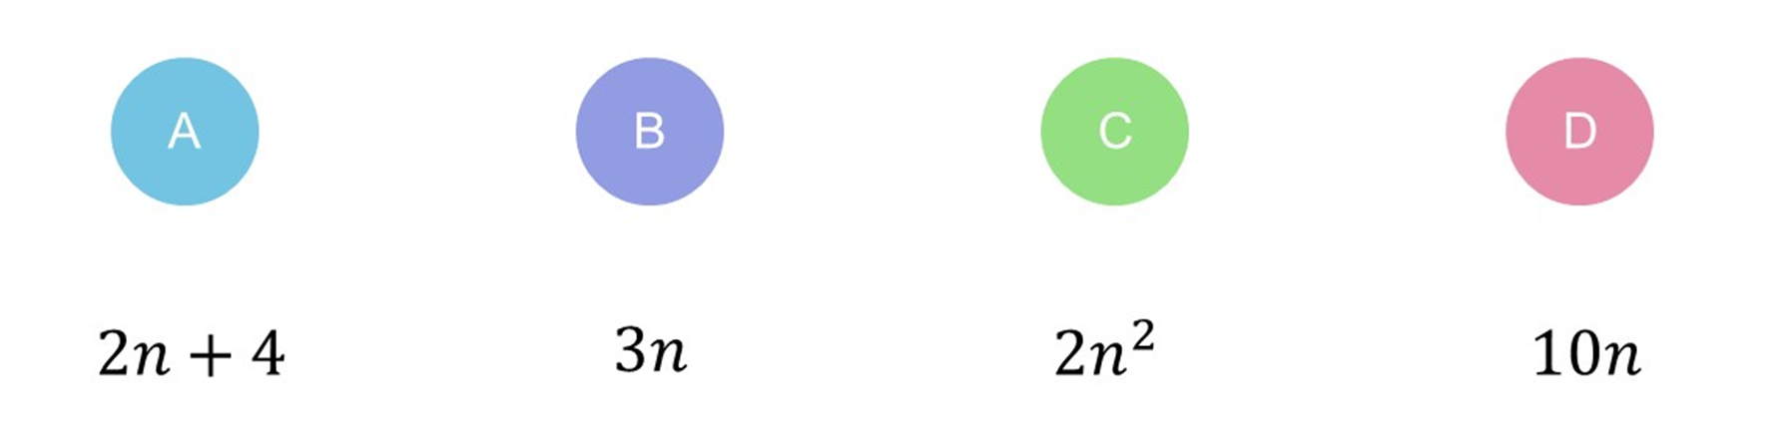
Question 7 – Proofs

Slide 15
Answer 7 – Proofs
CORRECT ANSWER | CORRECT EXPLANATION
B | 3 x odd = odd
COMMON MISTAKES | WHAT MIGHT BE YOUR MISTAKE
A | 2 x even + 4 = even and 2 x odd + 4 = even
C | After squaring the number it gets multiplied by 2 so will always be even.
D | 2(5n) multiple of 2 so will always be even.

Slide 16
Question 8 – Proofs
Show that (n + 4)² – (n – 4)²
is an even number
for all positive integer values of n.

Slide 17
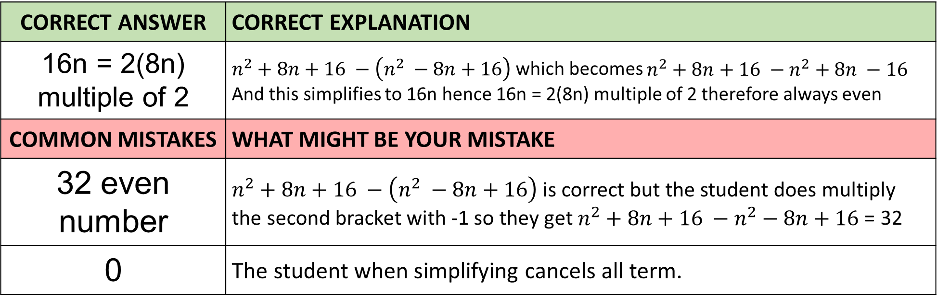
Answer 8 – Proofs
Show that (n + 4)² – (n – 4)²
is an even number
for all positive integer values of n.
CORRECT ANSWER | CORRECT EXPLANATION
16n = 2(8n) multiple of 2 | $n^{2}+8n+16 −\left(n^{2} −8n+16\right)$ which becomes $n^{2}+8n+16 −n^{2}+8n −16$ And this simplifies to 16n hence 16n = 2(8n) multiple of 2 therefore always even
COMMON MISTAKES | WHAT MIGHT BE YOUR MISTAKE
32 even number | $n^{2}+8n+16 −\left(n^{2} −8n+16\right)$is correct but the student does multiply the second bracket with -1 so they get $n^{2}+8n+16 −n^{2}−8n+16$ = 32
0 | The student when simplifying cancels all term.

Slide 18
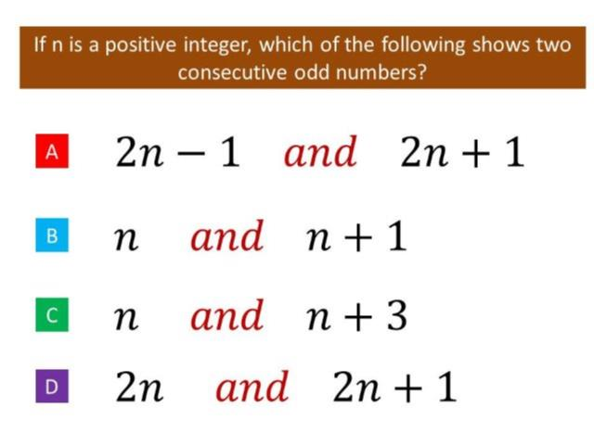
Question 9 – Proofs

Slide 19
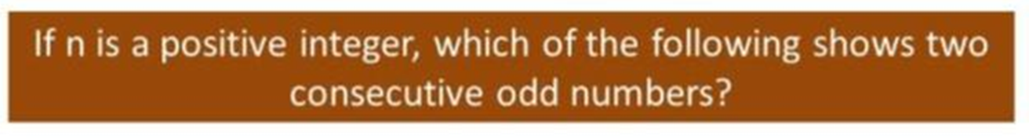
Answer 9 – Proofs
CORRECT ANSWER | CORRECT EXPLANATION
A | To guarantee a odd number you must first turn it into an even number by multiplying by a 2 then add or subtract an odd number. Now you have an odd number you need to add or subtract 2 for the first term’s algebra.
COMMON MISTAKES | WHAT MIGHT BE YOUR MISTAKE
B | You can guarantee that n is odd to start.
C | You can guarantee that n is odd to start.
D | 2n is an even number.

Slide 20
Question 10 – Proofs
Complete the identity
(x + 5)(x – 2) – x(x + 3) ≡ ?

Slide 21
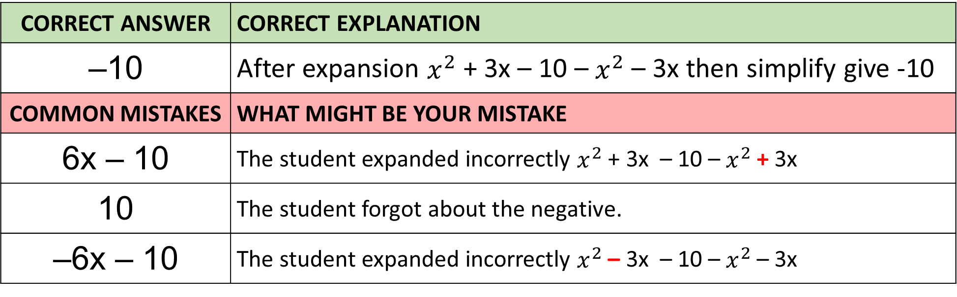
Answer 10 – Proofs
Complete the identity
(x + 5)(x – 2) – x(x + 3) ≡ ?
CORRECT ANSWER | CORRECT EXPLANATION
–10 | After expansion $x^{2}$ + 3x – 10 – $x^{2}$ – 3x then simplify give -10
COMMON MISTAKES | WHAT MIGHT BE YOUR MISTAKE
6x – 10 | The student expanded incorrectly $x^{2}$ + 3x – 10 – $x^{2}$ + 3x
10 | The student forgot about the negative.
–6x – 10 | The student expanded incorrectly $x^{2}$ – 3x – 10 – $x^{2}$ – 3x

