Slide 1
Trigonometry and Modelling
Solving Trig Equations
Chapter 7
(Part 3 of 6)

Slide 2
When solving trigonometric equations
you need to either……………..
- rewrite the equation from
multiple functions to a single function
(sin, cos or tan)
- rewrite into a quadratic form

Slide 3
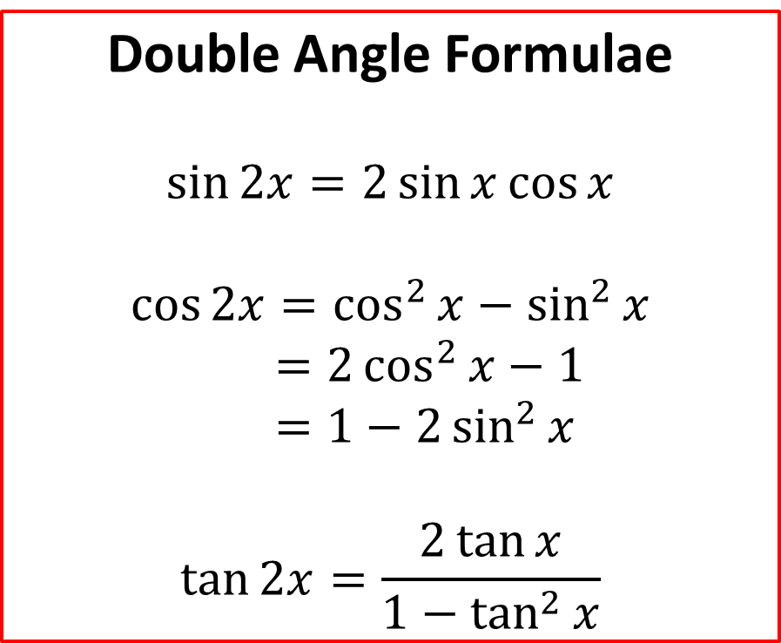
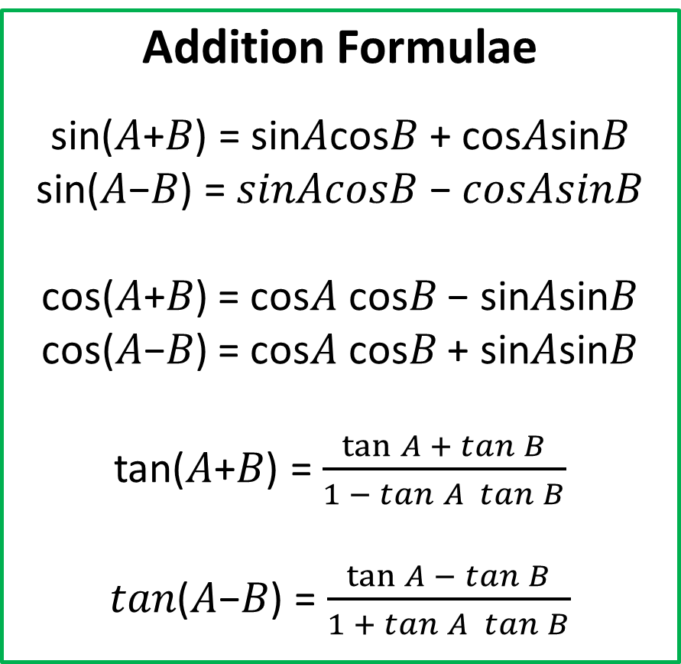
Use the addition formulae and double angle formulae to help rewrite the equation.
Addition Formulae
sin⁡(𝐴+𝐵) = sin⁡𝐴cos⁡𝐵 + cos⁡𝐴sin⁡𝐵
sin⁡(𝐴−𝐵) = 𝑠𝑖𝑛⁡𝐴𝑐𝑜𝑠⁡𝐵 − 𝑐𝑜𝑠⁡𝐴𝑠𝑖𝑛⁡𝐵
cos⁡(𝐴+𝐵) = cos⁡𝐴 cos⁡𝐵 − sin⁡𝐴sin⁡𝐵
cos⁡(𝐴−𝐵) = cos⁡𝐴 cos⁡𝐵 + sin⁡𝐴sin⁡𝐵
tan⁡(𝐴+𝐵) = $\frac{\tan{A} + tan⁡B}{1 − tan⁡A tan⁡B}$
𝑡𝑎𝑛⁡(𝐴−𝐵) = $\frac{\tan{A }− tan⁡B}{1 + tan⁡A tan⁡B}$
Double Angle Formulae
$$\sin{2x}=2\sin{x}\cos{x}$$
$$\cos{2x}=\cos^{2}{x}−\sin^{2}{x} \\ =2\cos^{2}{x}−1 \\ =1−2\sin^{2}{x}$$
$$\tan{2x}=\frac{2\tan{x}}{1−\tan^{2}{x}}$$

Slide 4
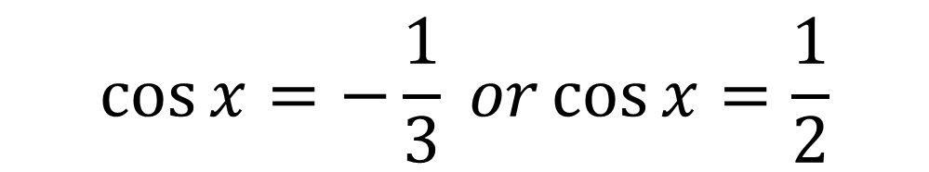
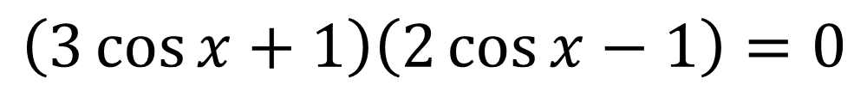

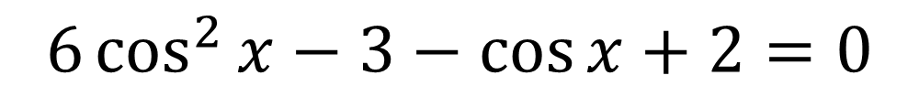
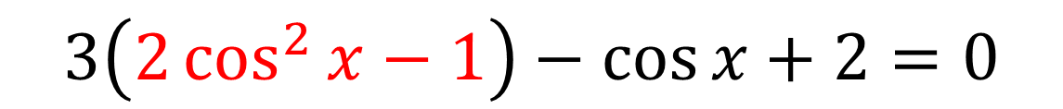
Solve $3\cos{2x}−\cos{x}+2=0$ for $0≤x≤360°$
$$3\left(2\cos^{2}{x}−1\right)−\cos{x}+2=0$$
$$6\cos^{2}{x}−3−\cos{x}+2=0$$
$$6\cos^{2}{x}−\cos{x}−1=0$$
$$\left(3\cos{x}+1\right)\left(2\cos{x}−1\right)=0$$
$$\cos{x}=−\frac{1}{3} or\cos{x}=\frac{1}{2}$$
$$x=109.5°, 250.5° x=60°,300°$$

Slide 5
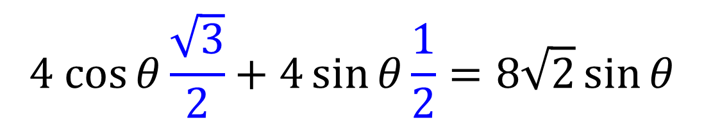

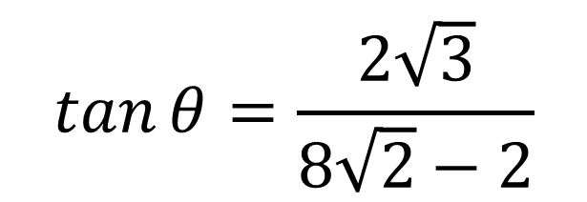
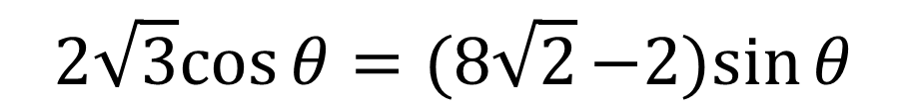
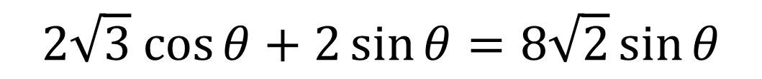
Solve $4\cos{(θ}−30°)=8\sqrt{2} sin θ$ for $0≤x≤360°$
$$4 (cos{θ\cos{30°}}+\sin{θ}\sin{30°)}=8\sqrt{2}\sin{θ}$$
$$4 cos{θ\cos{30°}}+4 sin{θ}\sin{30°}=8\sqrt{2}\sin{θ}$$
$$4 cos{θ\frac{\sqrt{3}}{2}}+4\sin{θ}\frac{1}{2}=8\sqrt{2}\sin{θ}$$
$$2\sqrt{3} cos{θ}+2\sin{θ}=8\sqrt{2}\sin{θ}$$
$$2\sqrt{3}cos{θ}=(8\sqrt{2}−2)sin{θ}$$
$$\tan{θ}=\frac{2\sqrt{3}}{8\sqrt{2}−2}$$
$$θ=20.4°, 200.4°$$

Slide 6
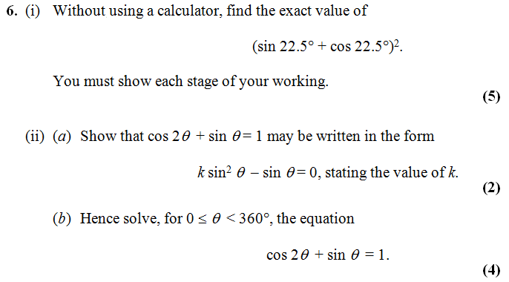
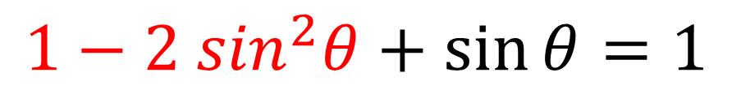
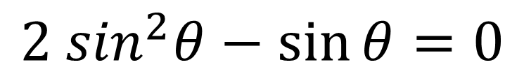
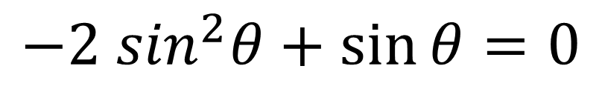
a)
$$1−2 \sin^{2}θ+\sin{θ}=1$$
$$−2 \sin^{2}θ+\sin{θ}=0$$
$$2 \sin^{2}θ−\sin{θ}=0$$
k = 2

Slide 7
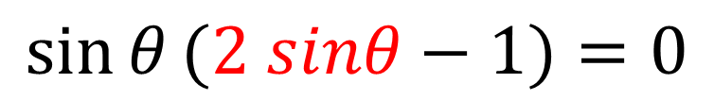
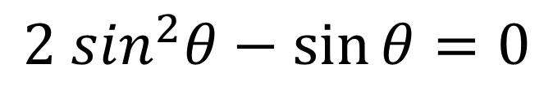
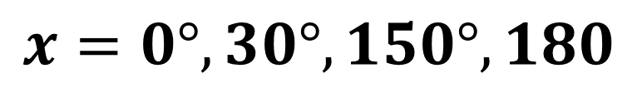
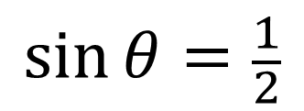
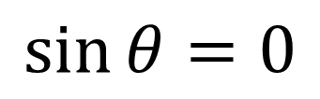
b)
$$2 \sin^{2}θ−\sin{θ}=0$$
$$\sin{θ}(2 sinθ−1)=0$$
$$\sin{θ}=0$$
$$\sin{θ}=\frac{1}{2}$$
$$x=0°, 30°, 150°, 180$$

Slide 8
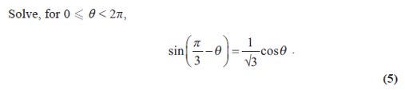
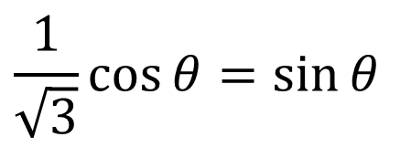
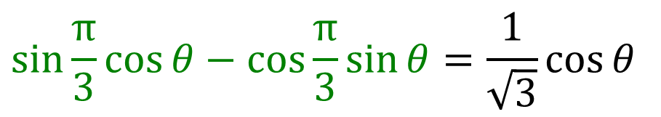
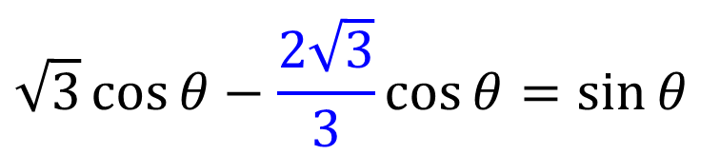
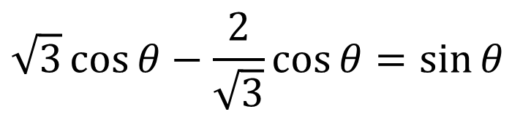
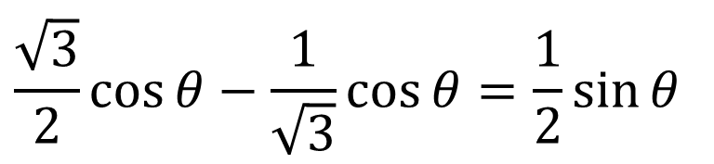
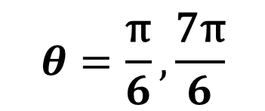
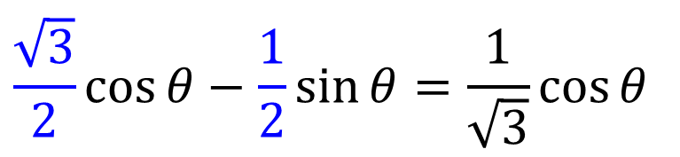
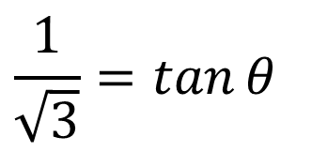
$$\sqrt{3}\cos{θ}−\frac{\text{2}}{\sqrt{3}}\cos{θ}=\sin{θ}$$
$$\sin{\frac{\text{π}}{3}}\cos{θ}−\cos{\frac{\text{π}}{3}}\sin{θ}=\frac{\text{1}}{\sqrt{3}}\cos{θ}$$
$$\sqrt{3}\cos{θ}−\frac{\text{2}\sqrt{3}}{3}\cos{θ}=\sin{θ}$$
$$\frac{\sqrt{3}}{2}\cos{θ}−\frac{\text{1}}{2}\sin{θ}=\frac{\text{1}}{\sqrt{3}}\cos{θ}$$
$$\frac{1}{\sqrt{3}}\cos{θ}=\sin{θ}$$
$$\frac{\sqrt{3}}{2}\cos{θ}−\frac{\text{1}}{\sqrt{3}}\cos{θ}=\frac{\text{1}}{2}\sin{θ}$$
$$\frac{1}{\sqrt{3}}=\tan{θ}$$
$$θ=\frac{\text{π}}{6}, \frac{\text{7}\text{π}}{6}$$

