Slide 1
LO: Angles
in a Triangle

Slide 2
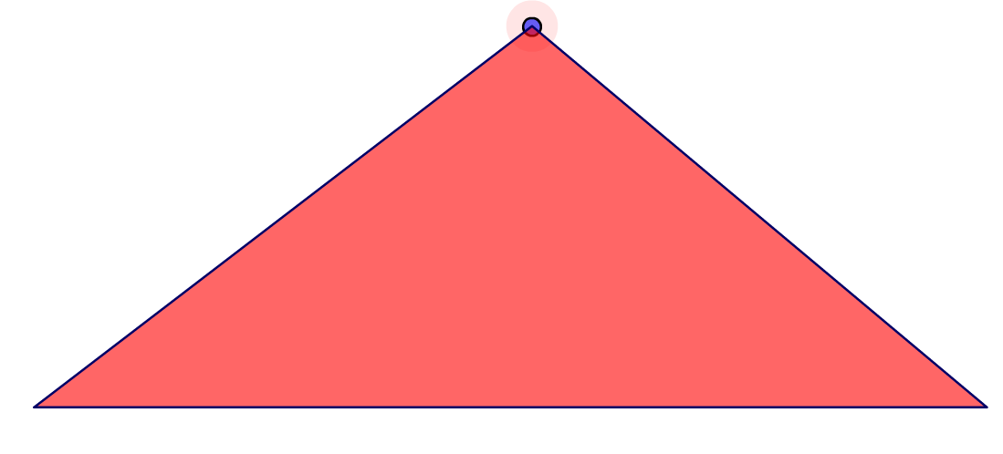
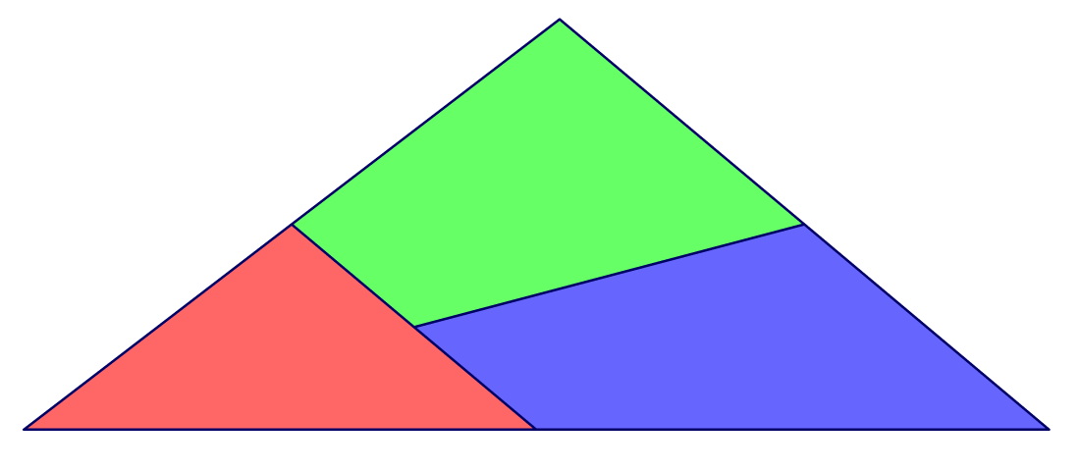
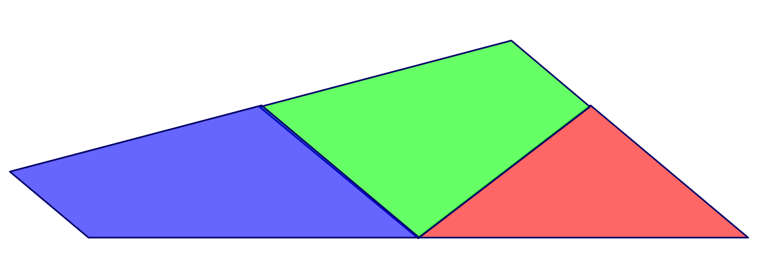
What do the diagrams show?
Angles in a triangle add up to 180˚

Slide 3
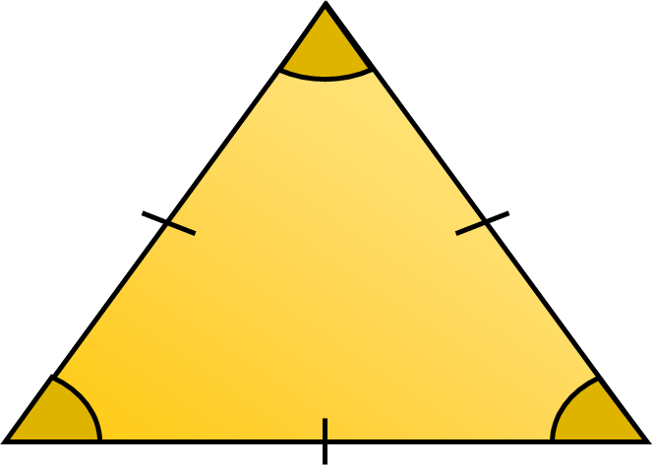
What is the name of this triangle?
x
Equilateral Triangle

Slide 4
What 2 properties do you know about this triangle?
All sides are
the same length.
All angles are
the same size.
60˚

Slide 5
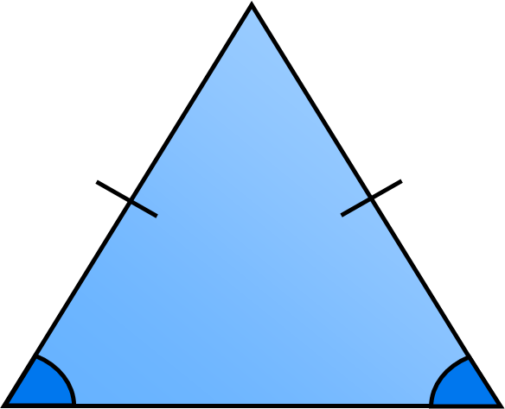
What is the name of this triangle?
Isosceles Triangle

Slide 6

What 2 properties do you know about this triangle?
Two sides are
the same length.
Two angles are
the same size.

Slide 7
50˚
50˚
x
x
x = 50˚
x = (180 – 50) ÷ 2
x = 65˚

Slide 8
What is the size of angle x?
x = 110˚ ÷ 2
x = 55˚
70˚
x

Slide 9
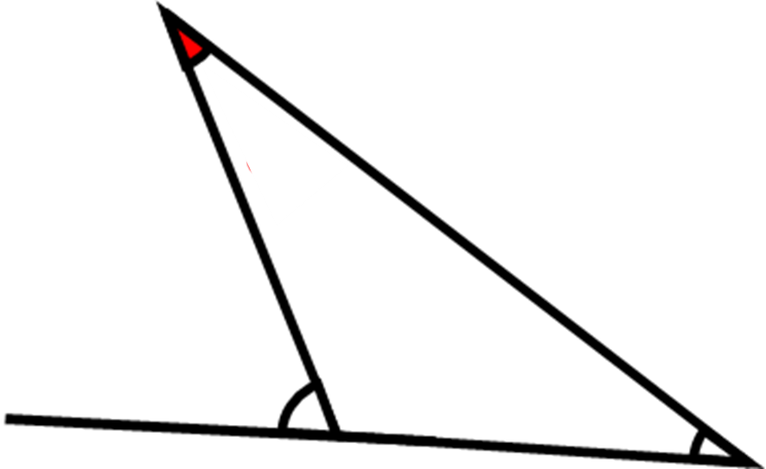
What is the size of angle x?
x
x = 49˚
80˚
100˚
31˚

Slide 10
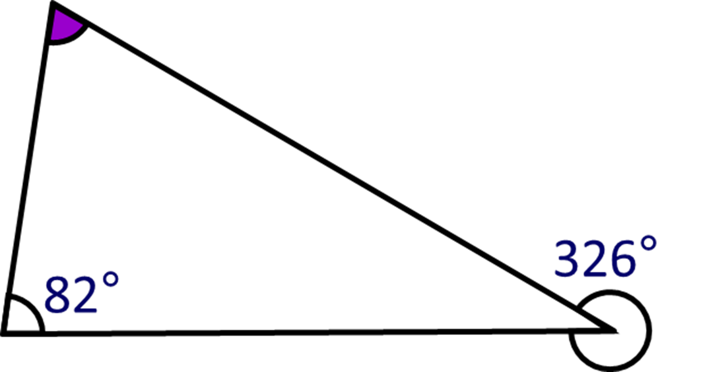
What is the size of angle x?
360 – 326˚ = 34˚
x = 180 – 82 – 34 = 64˚
x
34˚

Slide 11
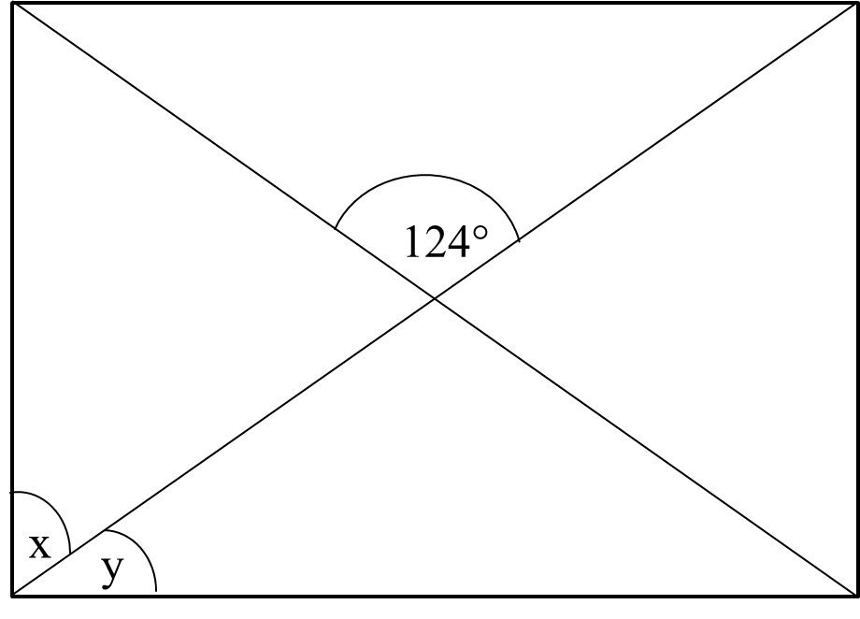
Calculate angles x and y of the rectangle.
124˚
62˚
28˚
28˚

