Slide 1

Further Stats 1 Chapter 8 ::
Quality of Tests
jfrost@tiffin.kingston.sch.uk
www.drfrostmaths.com
@DrFrostMaths
Last modified: 19th March 2025

Slide 2





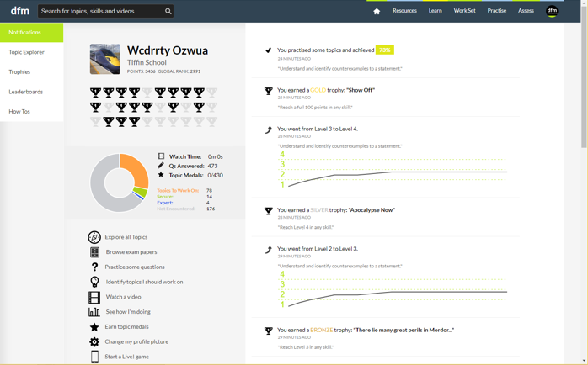

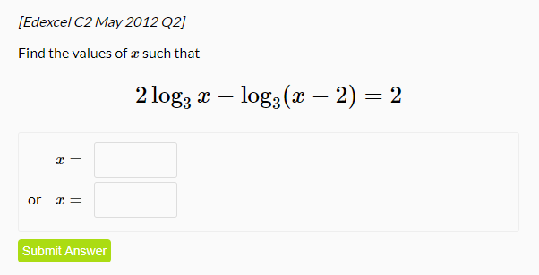
www.drfrostmaths.com
Everything is completely free.
Why not register?
Register now to interactively practise questions on this topic, including past paper questions and extension questions (including MAT + UKMT).
Teachers: you can create student accounts (or students can register themselves), to set work, monitor progress and even create worksheets.
With questions by:
Dashboard with points, trophies, notifications and student progress.
Questions organised by topic, difficulty and past paper.
Teaching videos with topic tests to check understanding.

Slide 3

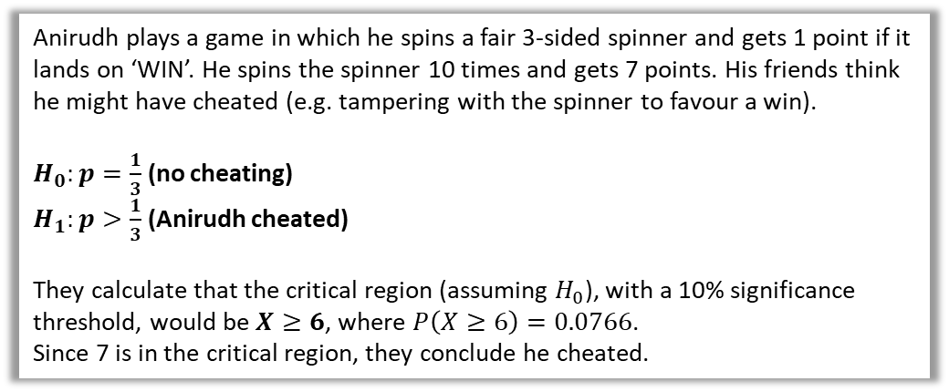
What are Type I and Type II errors?
Anirudh plays a game in which he spins a fair 3-sided spinner and gets 1 point if it lands on ‘WIN’. He spins the spinner 10 times and gets 7 points. His friends think he might have cheated (e.g. tampering with the spinner to favour a win).
$H_{0}:p=\frac{1}{3}$ (no cheating)
$H_{1}:p>\frac{1}{3}$ (Anirudh cheated)
They calculate that the critical region (assuming $H_{0}$), with a 10% significance threshold, would be $X≥6$, where $P\left(X≥6\right)=0.0766$.
Since 7 is in the critical region, they conclude he cheated.
OMG
WIN!
You suck
You suck
Anirudh’s friends rejected $H_{0}$ and concluded he cheated. But there’s a small chance (i.e. 7.66%) that they’re wrong, and Anirudh was just lucky.
! To incorrectly reject $H_{0}$ is known as a Type I error. The probability of a Type I error is the actual significance level of the hypothesis test (in this case 7.66%)
This is sometimes informally known as a false positive.
Suppose Anirudh got 5 points. This is not in the critical region, so his friends would conclude he hadn’t cheated. But it might still be the case that $p>\frac{1}{3}$, i.e. he did cheat!
! To incorrectly accept $H_{0}$ is known as a Type II error.
Sometimes known as a false negative.
To work out the probability of a Type II error, we would need to know the actual $p$, (given it is not $\frac{1}{3}$ if $H_{0}$ is false). This is not usually known.

Slide 4
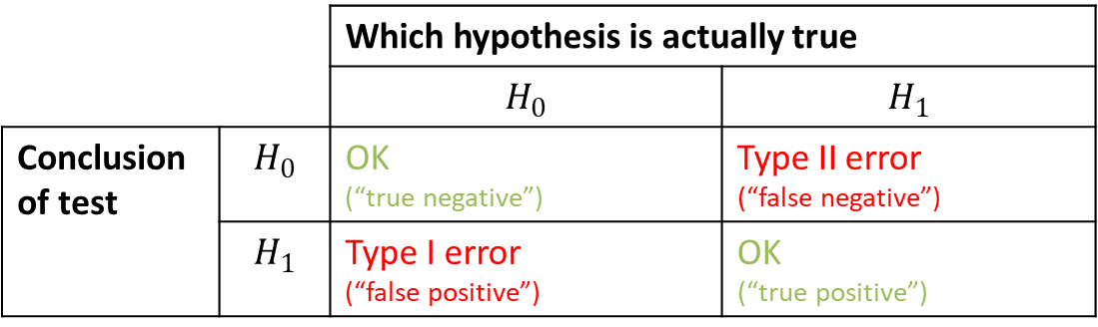
Summary Table
e.g. As a doctor, concluding someone doesn’t have a disease, when they actually have it (the worst-case scenario!)
e.g. As a doctor, concluding someone doesn’t have a disease when they indeed don’t.
 |  | Which hypothesis is actually true
 |  | $$H_{0}$$ | $$H_{1}$$
Conclusion of test | $$H_{0}$$ | OK (“true negative”) | Type II error (“false negative”)
 | $$H_{1}$$ | Type I error (“false positive”) | OK (“true positive”)
e.g. Making an incorrect diagnosis of a disease when the patient doesn’t have it.
e.g. Correctly diagnosing someone to have the disease.

Slide 5


Example
[Textbook] Accidents occurred on a stretch of motorway at an average rate of 6 per month. Many of the accidents that occurred involved vehicles skidding into the back of other vehicles. By way of a trial, a new type of road surface that is said to reduce the risk of vehicles skidding is laid on this stretch of road, and during the first month of operation 4 accidents occurred.
Test this result to see if it gives evidence that there has been an improvement at the 5% level of significance.
Calculate P(Type I error) for this test.
If the true average rate of accidents occurring with the new type of road surface was 3.5, calculate the probability of a Type II error.
a
Let $X=$ num accidents in given month. $X\sim Po\left(λ\right)$
$H_{0}:λ=6$ (i.e. no change)
$H_{1}:λ<6$ (i.e. fewer accidents)
Assuming $H_{0}, X\sim Po\left(6\right)$
$P\left(X≤4 | λ=6\right)=0.2851$
0.2851 > 0.5 so do not reject $H_{0}$; insufficient evidence that number of accidents per month has decreased.
Using tables, critical region: $X≤1$ and $P\left(X≤1\right)=0.0174$
Therefore probability of Type I error = 0.0174
$P\left(Type II error \right|λ=3.5)=P\left(X≥2 \right|λ=3.5)$
$=1−P\left(X≤1 \right|λ=3.5)=0.8641$
?
For Type I or II tests you need to calculate the critical region.
b
?
Carefully reflect on what a Type II error: it’s when we incorrectly accepted $H_{0}$ when in fact $H_{1}$ was true. If $H_{1}$ is true, the parameter $λ$ we use is different. If we accepted $H_{0}$, then it’s the probability we’re NOT in the (original) critical region.
c
?

Slide 6

Two-Tailed Example
[Textbook] A coin is spun 20 times and a head is obtained on 7 occasions.
Test, at the 5% significance level, to see whether or not the coin is biased.
Calculate the probability of a Type I error for this test.
Given that the coin is biased and that this causes the tail to appear 3 times for each head that appears, calculate the probability of a Type II error for the test.
a
$H_{0}:p=0.5, H_{1}:p≠0.5$
Let $X=$ num heads in 20 spins
Assuming $H_{0}$, $X\sim B(20,0.5)$
Uses tables, critical region is $X≤5$or $X≥15$
where $P\left(X≤5\right)=0.0207$ and $P\left(X≥15\right)=0.0207$
$$P\left(Type I error\right)=P\left(X≤5 | p=0.5\right)+P\left(X≥15 | p=0.5\right)=0.0207+0.0207=0.0414$$
$P\left(Type II error\right)=P\left(6≤X≤14 | p=0.25\right)=…=0.3828$
?
b
?
c
?

Slide 7
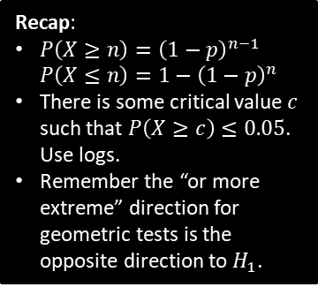

Test Your Understanding
[Textbook] Jane knows from experience that 10% of the emails she receives are spam. After her email service upgraded the spam filters, she recorded the number of emails sent up to and including the first spam email. She wants to test, at the 5% significance level, whether this upgrade improved the spam filter.
Find the critical region for her test.
Calculate the probability of a Type I error for this test.
Given that after the upgrade the probability of an email she receives being spam is now 1 in a 100, calculate the probability of a Type II error for the test.
a
Let $X=$ num emails sent up to and including first spam email. $X\sim Geo(p)$
$H_{0}:p=0.1, H_{1}:p<0.1$
Assuming $H_{0}, X\sim Geo(0.1)$
If critical value $c$, $P\left(X≥c\right)≤0.05$
$${0.9}^{c−1}≤0.05 \\ c≥(\log_{0.9}{0.05})+1 → c=30$$
Critical region is $X≥30$
$P\left(X≥30| p=0.1\right)={0.9}^{30−1}=0.0471$
$P\left(X≤29 \right| p=0.01)=1−{0.99}^{29}=0.2528$
?
Recap:
$P\left(X≥n\right)={\left(1−p\right)}^{n−1}$
$P\left(X≤n\right)=1−{\left(1−p\right)}^{n}$
There is some critical value $c$ such that $P\left(X≥c\right)≤0.05$. Use logs.
Remember the “or more extreme” direction for geometric tests is the opposite direction to $H_{1}$.
b
?
c
?

Slide 8
Exercise 8A
Pearson Further Statistics 1
Pages 152-153

Slide 9

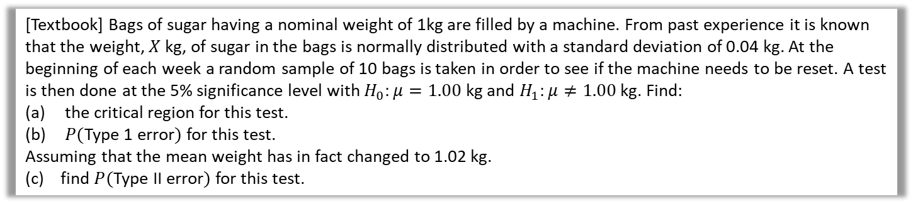


Type I and II Errors for Normal Distribution
The same theory as before applies. The only thing to note is that as a normal distribution is a continuous distribution, the actual significance level is the same as the significance threshold, because we can find a critical value that gives us the exact threshold wanted, rather than choosing a discrete value that gets the probability closest to the threshold.
[Textbook] Bags of sugar having a nominal weight of 1kg are filled by a machine. From past experience it is known that the weight, $X$ kg, of sugar in the bags is normally distributed with a standard deviation of 0.04 kg. At the beginning of each week a random sample of 10 bags is taken in order to see if the machine needs to be reset. A test is then done at the 5% significance level with $H_{0}:μ=1.00$ kg and $H_{1}:μ≠1.00$ kg. Find:
the critical region for this test.
$P($Type 1 error$)$ for this test.
Assuming that the mean weight has in fact changed to 1.02 kg.
(c) find $P($Type II error$)$ for this test.
a
$\overline{X}\sim N\left(1.0,\frac{{0.04}^{2}}{10}\right)$
Two-tailed test, so using tables to obtain $Z$ values for critical region corresponding to top/bottom 2.5%:
$Z>1.96$or$Z<−1.96$
Critical values $\overline{x}=1±1.96×\sqrt{\frac{{0.04}^{2}}{10}}$
$=0.9752$ and $1.0248$
Critical region $\overline{X}≤0.9752$ and $\overline{X}≥1.0248$
?
b
0.05 (same as significance level)
?
c
$${\overline{X}}_{H_{1}}=N\left(1.02,\frac{{0.04}^{2}}{10}\right) \\ P\left(0.9752<\overline{X}<1.0248\right)=0.6476$$
?
Recall that for a Type II error we find the error of being outside the original critical region, but change the parameters.
Rearrange $Z=\frac{\overline{X}−μ}{\frac{σ}{\sqrt{n}}}$
Use calculator.

Slide 10

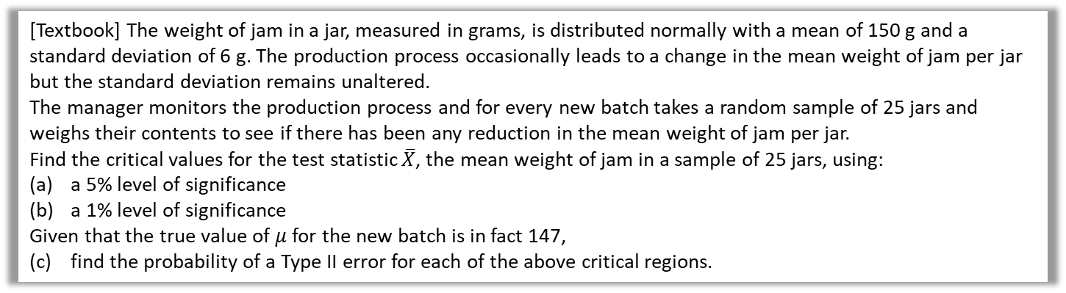

Further Example
[Textbook] The weight of jam in a jar, measured in grams, is distributed normally with a mean of 150 g and a standard deviation of 6 g. The production process occasionally leads to a change in the mean weight of jam per jar but the standard deviation remains unaltered.
The manager monitors the production process and for every new batch takes a random sample of 25 jars and weighs their contents to see if there has been any reduction in the mean weight of jam per jar.
Find the critical values for the test statistic $\overline{X}$, the mean weight of jam in a sample of 25 jars, using:
a 5% level of significance
a 1% level of significance
Given that the true value of $μ$ for the new batch is in fact 147,
(c) find the probability of a Type II error for each of the above critical regions.
b
?
a
$H_{0}:μ=150$
$H_{1}:μ<150$
$\overline{X}\sim N\left(150,\frac{6^{2}}{25}\right)$
Using tables, bottom 5% corresponds to $z=−1.6449$
$$−1.6449=\frac{\overline{x}−150}{\frac{6}{\sqrt{25}}} \\ → \overline{x}=148.02612$$
So critical region is $\overline{X}≤148.02612$
Using previous method,
$$\overline{X}≤147.20844$$
5% test
$$P\left(Type II error\right) \\ =P\left(\overline{X}>148.026 | μ=147\right) \\ =0.1963$$
Similarly for 1% test:
$$P\left(\overline{X}>147.2084 | μ=147\right) \\ =0.4311$$
?
c
?

Slide 11
Exercise 8B
Pearson Further Statistics 1
Pages 156-157

Slide 12
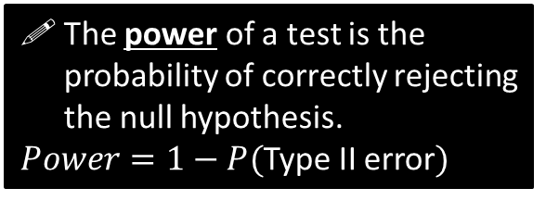
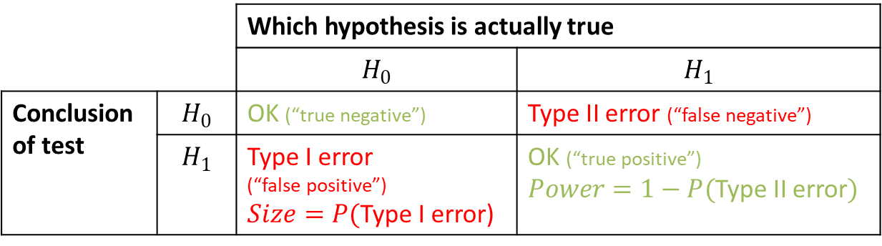
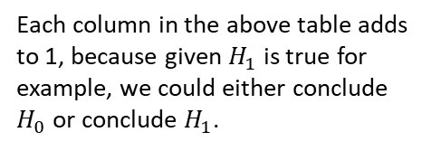
Calculate the Size and Power of a Test
 |  | Which hypothesis is actually true
 |  | $$H_{0}$$ | $$H_{1}$$
Conclusion of test | $$H_{0}$$ | OK (“true negative”) | Type II error (“false negative”)
 | $$H_{1}$$ | Type I error (“false positive”) $Size=P($Type I error) | OK (“true positive”) $Power=1−P($Type II error$)$
The power of a test is the probability of correctly rejecting the null hypothesis.
$Power=1−P($Type II error$)$
! The probability of a Type I error is known as the size of a test.
Memory Tip: Both of these terms relate to when we conclude the alternative hypothesis.
Each column in the above table adds to 1, because given $H_{1}$ is true for example, we could either conclude $H_{0}$ or conclude $H_{1}$.

Slide 13

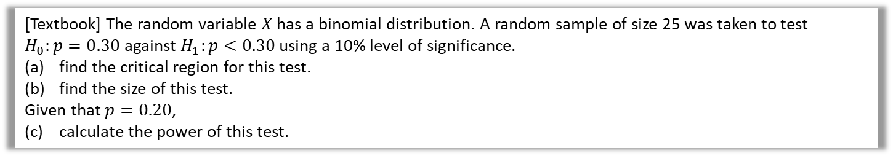


Example
[Textbook] The random variable $X$ has a binomial distribution. A random sample of size 25 was taken to test $H_{0}:p=0.30$ against $H_{1}:p<0.30$ using a 10% level of significance.
find the critical region for this test.
find the size of this test.
Given that $p=0.20$,
(c) calculate the power of this test.
$X\sim B\left(25,p\right)$
$H_{0}:p=0.30 H_{1}:p<0.30$
Assuming $H_{0}, X\sim B(25,0.30)$
Using tables, critical region $X≤4$ where $P\left(X≤4\right)=0.0905$
Size $=P($Type I error$)=0.0905$
Power $=P($accepting $H_{1} | H_{1}$ is true$)$
$$=P\left(X≤4 \right| p=0.20) \\ =0.4207$$
a
?
b
?
$P($Type I error$)$ is actual significance level.
c
?
Calculate directly. No need to do $1−P($Type II error$)$

Slide 14

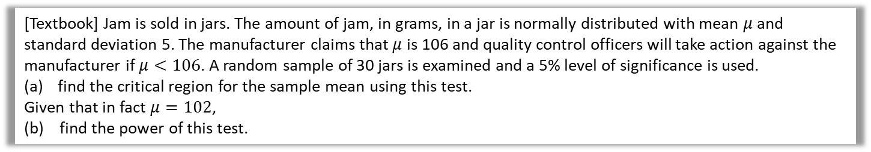
Test Your Understanding
[Textbook] Jam is sold in jars. The amount of jam, in grams, in a jar is normally distributed with mean $μ$ and standard deviation 5. The manufacturer claims that $μ$ is 106 and quality control officers will take action against the manufacturer if $μ<106$. A random sample of 30 jars is examined and a 5% level of significance is used.
find the critical region for the sample mean using this test.
Given that in fact $μ=102$,
(b) find the power of this test.
$H_{0}:μ=106, H_{1}:μ<106$
$\overline{X}\sim N\left(106,\frac{5^{2}}{30}\right)$
Critical $z$ for bottom 5%: $−1.6449$
$$\frac{\overline{X}−106}{5/\sqrt{30}}<−1.6449 \\ \overline{X}<104.498…$$
Power $=P(H_{1}$ concluded | $H_{1}$ true)
$$=P\left(\overline{X}<104.498 \right| μ=102) \\ =0.9968$$
a
?
b
?

Slide 15

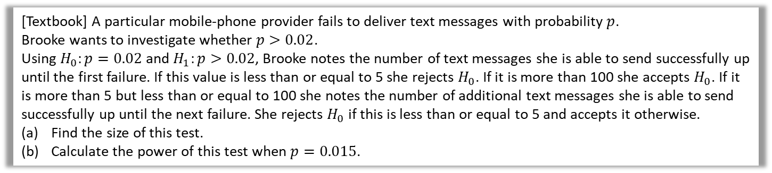
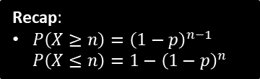
Geometric Example
[Textbook] A particular mobile-phone provider fails to deliver text messages with probability $p$.
Brooke wants to investigate whether $p>0.02$.
Using $H_{0}:p=0.02$ and $H_{1}:p>0.02$, Brooke notes the number of text messages she is able to send successfully up until the first failure. If this value is less than or equal to 5 she rejects $H_{0}$. If it is more than 100 she accepts $H_{0}$. If it is more than 5 but less than or equal to 100 she notes the number of additional text messages she is able to send successfully up until the next failure. She rejects $H_{0}$ if this is less than or equal to 5 and accepts it otherwise.
Find the size of this test.
Calculate the power of this test when $p=0.015$.
a
?
Let $X$ be number of messages up to an including first failure. $X\sim Geo(p)$
Assuming $H_{0}, X\sim Geo(0.02)$
$P\left(X≤5\right)=1−{0.98}^{5}=0.09607$
$$P\left(5<X≤100\right)=P\left(X≤100\right)−P\left(X≤5\right)=0.77130…$$
$P(H_{1}$ concluded | $H_{0}$ true)
$=P\left(X≤5\right)+\left[P\left(5<X≤100\right)×P\left(X≤5\right)\right]$
$=0.09607+\left(0.77130×0.09607\right)=0.1702$
$Y\sim Geo\left(0.015\right)$
$P\left(Y≤5\right)=…=0.07278 P\left(5<Y≤100\right)=0.70660$
$P(H_{1}$ concluded | $H_{1}$ true)
$=P\left(X≤5\right)+\left[P\left(5<X≤100\right)×P\left(X≤5\right)\right]$
$=0.1242$
Recap:
$P\left(X≥n\right)={\left(1−p\right)}^{n−1}$
$P\left(X≤n\right)=1−{\left(1−p\right)}^{n}$
b
?

Slide 16
Exercise 8C
Pearson Further Statistics 1
Pages 160-162

Slide 17

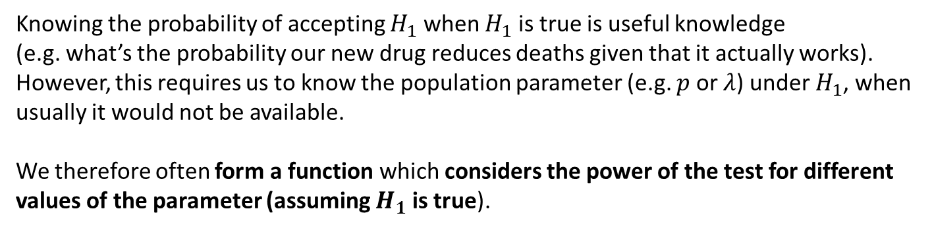
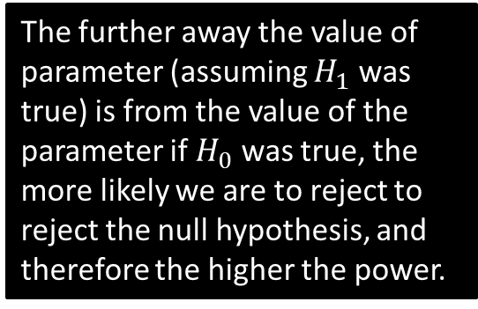
Power Function
Knowing the probability of accepting $H_{1}$ when $H_{1}$ is true is useful knowledge
(e.g. what’s the probability our new drug reduces deaths given that it actually works).
However, this requires us to know the population parameter (e.g. $p$ or $λ$) under $H_{1}$, when usually it would not be available.
We therefore often form a function which considers the power of the test for different values of the parameter (assuming $H_{1}$ is true).
Power
1.0
0.8
0.6
0.4
0.2
The further away the value of parameter (assuming $H_{1}$ was true) is from the value of the parameter if $H_{0}$ was true, the more likely we are to reject to reject the null hypothesis, and therefore the higher the power.
$$λ$$
3 4 5 6 7 8 9

Slide 18
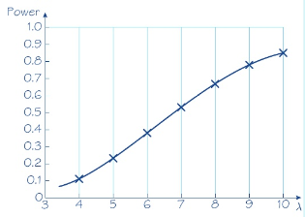

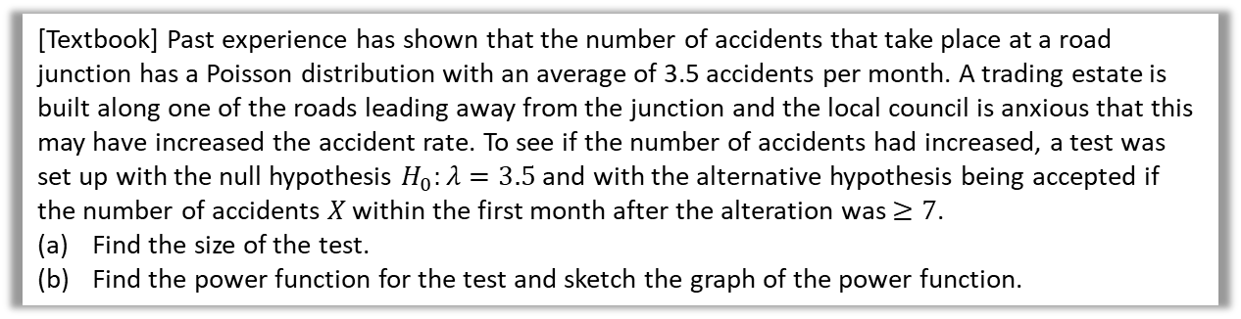

Example
[Textbook] Past experience has shown that the number of accidents that take place at a road junction has a Poisson distribution with an average of 3.5 accidents per month. A trading estate is built along one of the roads leading away from the junction and the local council is anxious that this may have increased the accident rate. To see if the number of accidents had increased, a test was set up with the null hypothesis $H_{0}:λ=3.5$ and with the alternative hypothesis being accepted if the number of accidents $X$ within the first month after the alteration was $≥7$.
Find the size of the test.
Find the power function for the test and sketch the graph of the power function.
a
?
$P\left(X≥7 \right| λ=3.5)=1−0.9347=0.0653$
Power function
$$=P\left(X≥7\right)=1−P\left(X≤6\right) \\ =1−e^{−λ}\left(1+λ+\frac{λ^{2}}{2}+\frac{λ^{3}}{6}+\frac{λ^{4}}{24}+\frac{λ^{5}}{120}+\frac{λ^{6}}{720}\right)$$
Then using your calculator for different values of $λ$:
$$λ=4 → Power=0.1107 \\ λ=5 →0.2378 \\ λ=6 →0.3937 \\ …$$
b
?
A function of the parameter $λ$.
In an exam question they might give you a partially completed table.

Slide 19
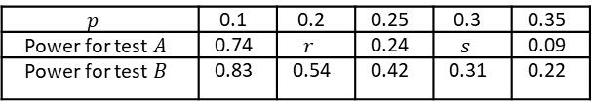
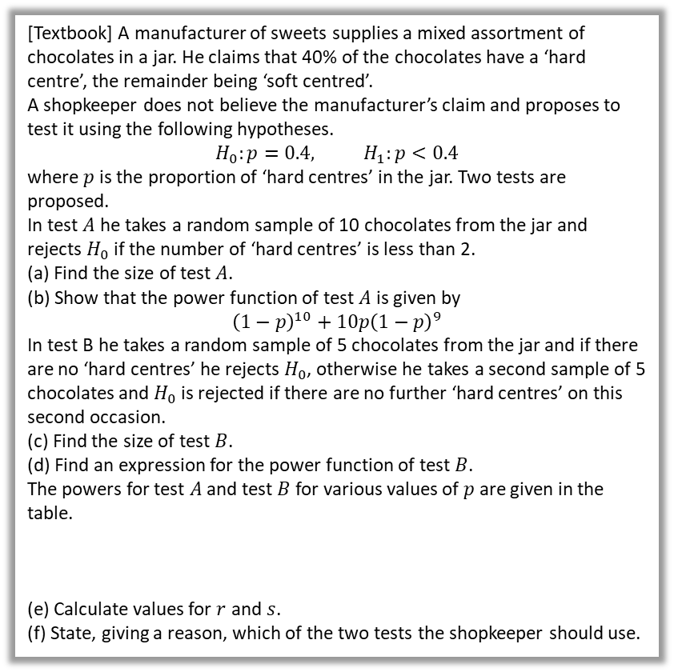

Comparing Tests
We can construct different tests for example by varying the critical region and/or the sample size.
When comparing two tests (of comparable size), you should recommend the test with the higher power within the likely range of the parameter, as being more confident in the claim we’re making (e.g. new drugs reduces death rate) is clearly desirable.
a
$P\left(X<2 | p=0.4\right)=0.0464$
$P\left(X<2\right)=P\left(X=0\right)+P\left(X=1\right)$
$={\left(1−p\right)}^{10}+10p{\left(1−p\right)}^{9}$
Size of test $B=P($accept $H_{1}$ | $p=0.4)$
$$=P\left(X=0\right)+(1−P\left(X=0\right))P(X=0) \\ ={0.6}^{5}+\left(1−{0.6}^{5}\right)×{0.6}^{5} \\ =0.1495$$
Power of test B = $P($0 hard centres in first 5) + P(0 hard centres in second 5 and >0 hard centres in first 5)
$$=P\left(X=0\right)+\left(1−P\left(X=0\right)\right)P\left(X=0\right) \\ ={\left(1−p\right)}^{5}+\left(1−{\left(1−p\right)}^{5}\right){\left(1−p\right)}^{5} \\ =2{\left(1−p\right)}^{5}−{\left(1−p\right)}^{10}$$
Using (d), $p=0.2 →r=0.38$
$$p=0.3 → s=0.15$$
Power for test $B>$ Power for test $A$ for all given values of $p$, so he should use test $B$.
[Textbook] A manufacturer of sweets supplies a mixed assortment of chocolates in a jar. He claims that 40% of the chocolates have a ‘hard centre’, the remainder being ‘soft centred’.
A shopkeeper does not believe the manufacturer’s claim and proposes to test it using the following hypotheses.
$$H_{0}:p=0.4, H_{1}:p<0.4$$
where $p$ is the proportion of ‘hard centres’ in the jar. Two tests are proposed.
In test $A$ he takes a random sample of 10 chocolates from the jar and rejects $H_{0}$ if the number of ‘hard centres’ is less than 2.
(a) Find the size of test $A$.
(b) Show that the power function of test $A$ is given by
$${\left(1−p\right)}^{10}+10p{\left(1−p\right)}^{9}$$
In test B he takes a random sample of 5 chocolates from the jar and if there are no ‘hard centres’ he rejects $H_{0}$, otherwise he takes a second sample of 5 chocolates and $H_{0}$ is rejected if there are no further ‘hard centres’ on this second occasion.
(c) Find the size of test $B$.
(d) Find an expression for the power function of test $B$.
The powers for test $A$ and test $B$ for various values of $p$ are given in the table.
(e) Calculate values for $r$ and $s$.
(f) State, giving a reason, which of the two tests the shopkeeper should use.
?
b
?
c
?
Note: Textbook gets wrong value, 0.1495 here is correct.
d
?
$$p$$ | 0.1 | 0.2 | 0.25 | 0.3 | 0.35
Power for test $A$ | 0.74 | $$r$$ | 0.24 | $$s$$ | 0.09
Power for test $B$ | 0.83 | 0.54 | 0.42 | 0.31 | 0.22
e
?
f
?

Slide 20
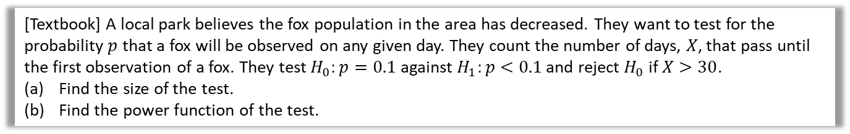
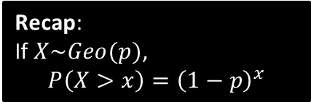

Final Geometric Example
[Textbook] A local park believes the fox population in the area has decreased. They want to test for the probability $p$ that a fox will be observed on any given day. They count the number of days, $X$, that pass until the first observation of a fox. They test $H_{0}:p=0.1$ against $H_{1}:p<0.1$ and reject $H_{0}$ if $X>30$.
Find the size of the test.
Find the power function of the test.
a
$P\left(X>30 \right|p=0.1)$
$={0.9}^{30}=0.0424$
$P\left(X>30\right)={\left(1−p\right)}^{30}$
Recap:
If $X\sim Geo(p)$,
$$P\left(X>x\right)={\left(1−p\right)}^{x}$$
?
b
?

Slide 21
Exercise 8D
Pearson Further Statistics 1
Pages 165-167

