Slide 1
LO: Advanced Trigonometry
(Sine and Cosine Rules)

Slide 2
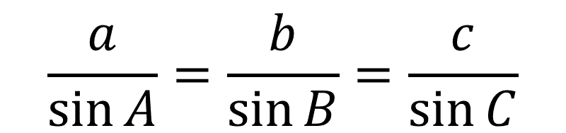
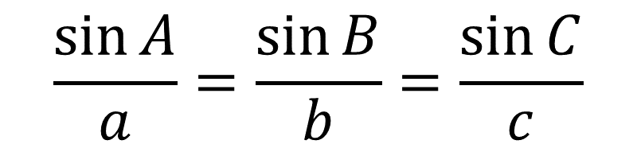
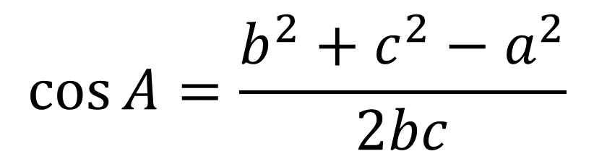
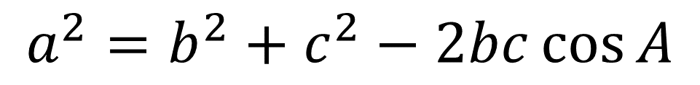
Sides
Angles
$$\frac{a}{\sin{A}}=\frac{b}{\sin{B}}=\frac{c}{\sin{C}}$$
$$\frac{\sin{A}}{a}=\frac{\sin{B}}{b}=\frac{\sin{C}}{c}$$
$$\cos{A}=\frac{b^{2}+c^{2}−a^{2}}{2bc}$$
$$a^{2}=b^{2}+c^{2}−2bc\cos{A}$$

Slide 3
When do you use the SINE Rule?
a
b
B
A
When you have
two opposite angles and the sides

Slide 4
When do you use the COSINE Rule?
A
c
b
c
b
a
When you have
two sides and the angle between them
When you have three sides

Slide 5

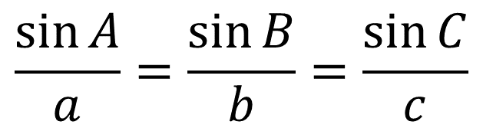
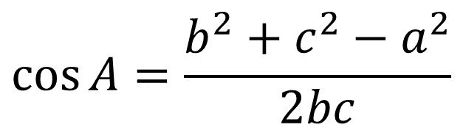

Which rule?
$$\frac{\sin{A}}{a}=\frac{\sin{B}}{b}=\frac{\sin{C}}{c}$$
1.
15m
$$\frac{a}{\sin{A}}=\frac{b}{\sin{B}}=\frac{c}{\sin{C}}$$
2.
102⁰
?
3.
$$a^{2}=b^{2}+c^{2}−2bc\cos{A}$$
22m
$$\cos{A}=\frac{b^{2}+c^{2}−a^{2}}{2bc}$$
4.

Slide 6
Which rule?
$$\frac{\sin{A}}{a}=\frac{\sin{B}}{b}=\frac{\sin{C}}{c}$$
1.
70⁰
$$\frac{a}{\sin{A}}=\frac{b}{\sin{B}}=\frac{c}{\sin{C}}$$
?
2.
3.
$$a^{2}=b^{2}+c^{2}−2bc\cos{A}$$
$$\cos{A}=\frac{b^{2}+c^{2}−a^{2}}{2bc}$$
14cm
49⁰
4.

Slide 7
Which rule?
$$\frac{\sin{A}}{a}=\frac{\sin{B}}{b}=\frac{\sin{C}}{c}$$
1.
$$\frac{a}{\sin{A}}=\frac{b}{\sin{B}}=\frac{c}{\sin{C}}$$
80mm
2.
?
75mm
3.
$$a^{2}=b^{2}+c^{2}−2bc\cos{A}$$
81mm
$$\cos{A}=\frac{b^{2}+c^{2}−a^{2}}{2bc}$$
4.

Slide 8
Which rule?
$$\frac{\sin{A}}{a}=\frac{\sin{B}}{b}=\frac{\sin{C}}{c}$$
1.
$$\frac{a}{\sin{A}}=\frac{b}{\sin{B}}=\frac{c}{\sin{C}}$$
2.
14cm
66⁰
?
3.
$$a^{2}=b^{2}+c^{2}−2bc\cos{A}$$
47⁰
$$\cos{A}=\frac{b^{2}+c^{2}−a^{2}}{2bc}$$
4.

Slide 9
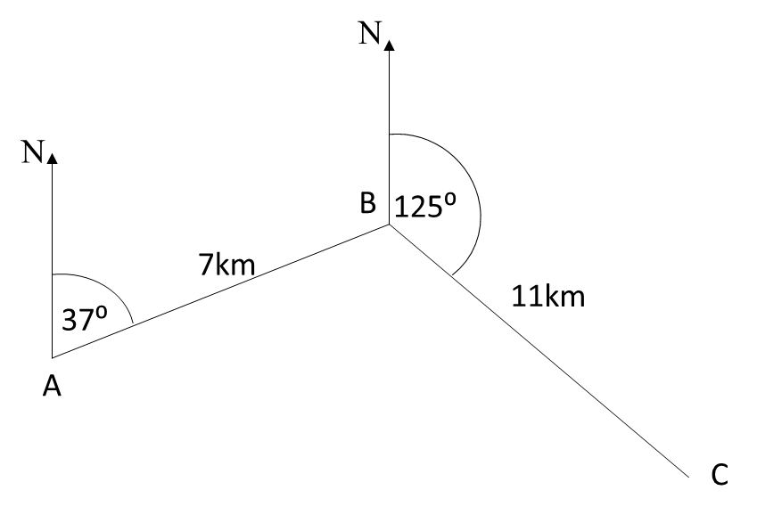
Which rule?
$$\frac{\sin{A}}{a}=\frac{\sin{B}}{b}=\frac{\sin{C}}{c}$$
1.
Work out length AC
$$\frac{a}{\sin{A}}=\frac{b}{\sin{B}}=\frac{c}{\sin{C}}$$
2.
3.
$$a^{2}=b^{2}+c^{2}−2bc\cos{A}$$
$$\cos{A}=\frac{b^{2}+c^{2}−a^{2}}{2bc}$$
4.

Slide 10
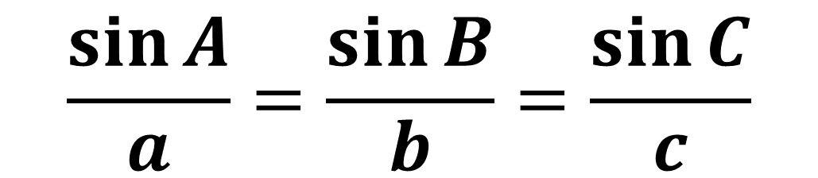
Which rule?
71m
?
103m
52m
$$\frac{\sin{A}}{a}=\frac{\sin{B}}{b}=\frac{\sin{C}}{c}$$

Slide 11
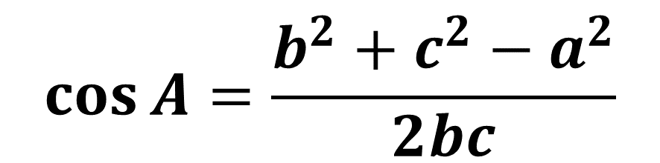
Which rule?
80mm
?
75mm
81mm
$$\cos{A}=\frac{b^{2}+c^{2}−a^{2}}{2bc}$$

Slide 12
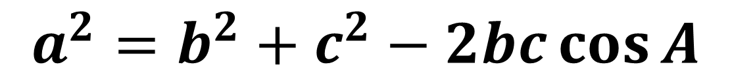
Which rule?
15m
102⁰
?
22m
$$a^{2}=b^{2}+c^{2}−2bc\cos{A}$$

Slide 13
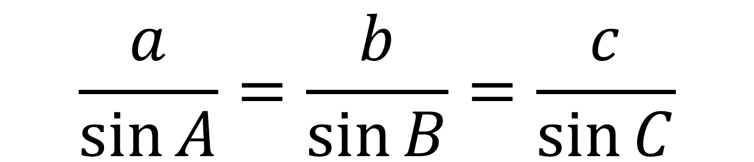
$$\frac{a}{\sin{A}}=\frac{b}{\sin{B}}=\frac{c}{\sin{C}}$$
$$a^{2}=b^{2}+c^{2}−2bc\cos{A}$$

