Slide 1
LO: Speed,
Distance and Time

Slide 2
Convert
hours and minutes
to hours.
30 minutes =
0.5 hour

Slide 3
Convert
hours and minutes
to hours.
2 hours 30 minutes =
2.5 hours

Slide 4
Convert
hours and minutes
to hours.
15 minutes =
0.25 hour

Slide 5
Convert
hours and minutes
to hours.
1 hour 15 minutes =
1.25 hours

Slide 6
Convert
hours and minutes
to hours.
45 minutes =
0.75 hour

Slide 7
Convert
hours and minutes
to hours.
6 hours 45 minutes =
6.75 hours

Slide 8
Convert
hours and minutes
to hours.
12 minutes =
0.2 hour

Slide 9
Convert
hours and minutes
to hours.
5 hours 12 minutes =
5.2 hours

Slide 10
Convert
hours and minutes
to hours.
20 minutes =
0.3 hour

Slide 11
Convert
hours and minutes
to hours.
1 hour 20 minutes =
1.3 hours

Slide 12
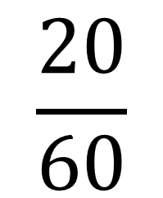
1 hour 20 minutes =
1.3 hours
Whole Hours
$$\frac{20}{60}$$

Slide 13



What is the formula for calculating Speed?
$$Speed=\frac{Distance}{Time}$$
What is the formula for calculating Distance?
$Distance=Time$ x $Speed$
What is the formula for calculating Time?
$$Time=\frac{Distance}{Speed}$$

Slide 14
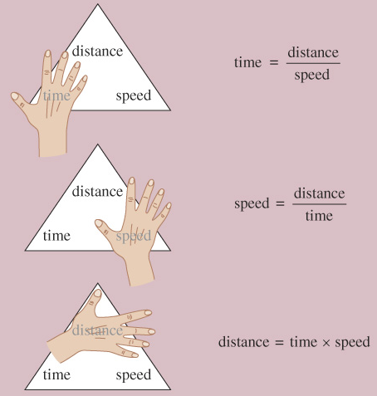
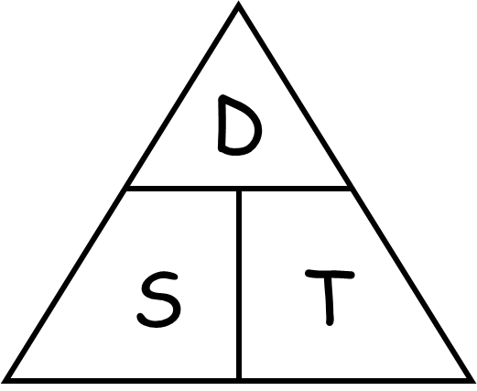

Slide 15
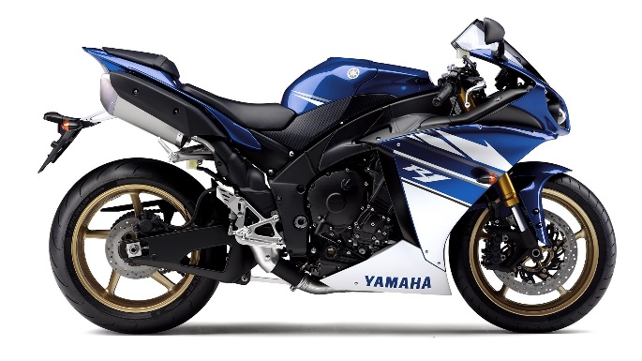

A motorbike travels 80km
at an average speed of 120km/h.
How long is the journey (give your answer in minutes)?
Time = $\frac{80}{120}$ = 0.6
80
?
= 40 mins
?
120

Slide 16
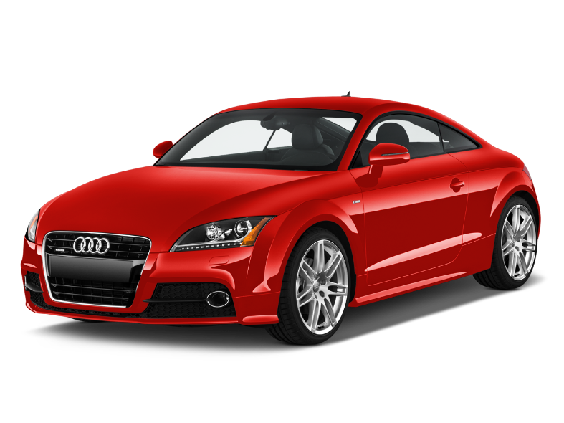

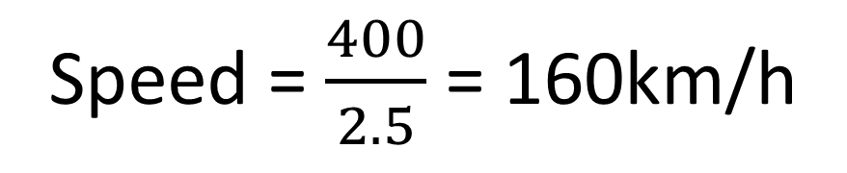
A car travels 400km in 2 hours 30 mins.
What is the average speed in km/h?
Speed = $\frac{400}{2.5}$ = 160km/h
400
?
?
2.5
Extension what is average speed in km/min?
Speed = $\frac{400}{150}$ = $2.6$km/min

Slide 17
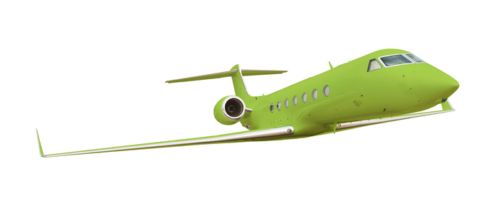
A plane travels 2000km/hour in 15 minutes.
How far does the plane travel?
Distance
= 2000 x 0.25
= 500km
2000
?
?
0.25

