Slide 1
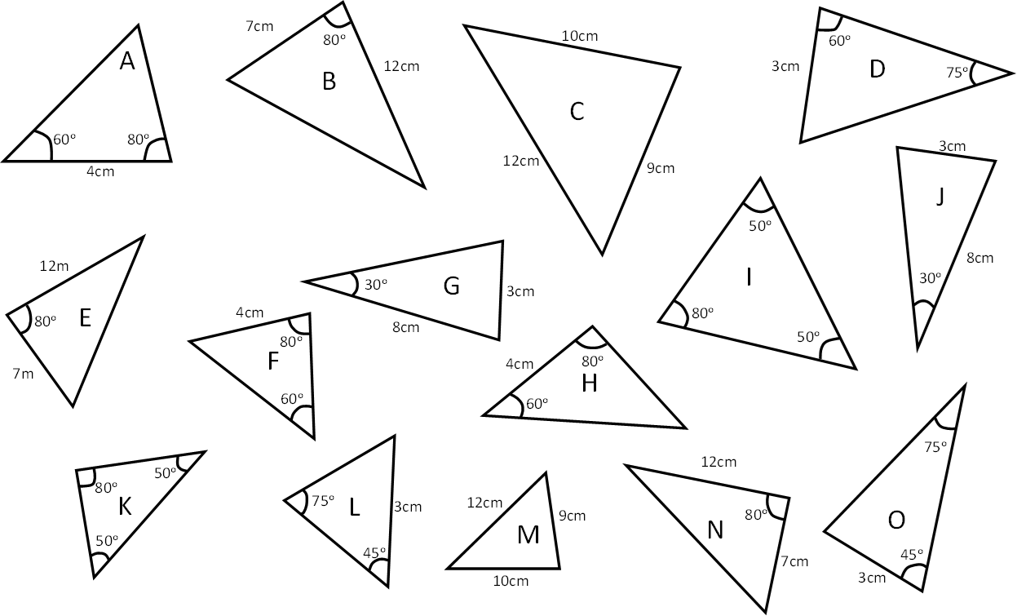

Slide 2
ANSWERS

Slide 3
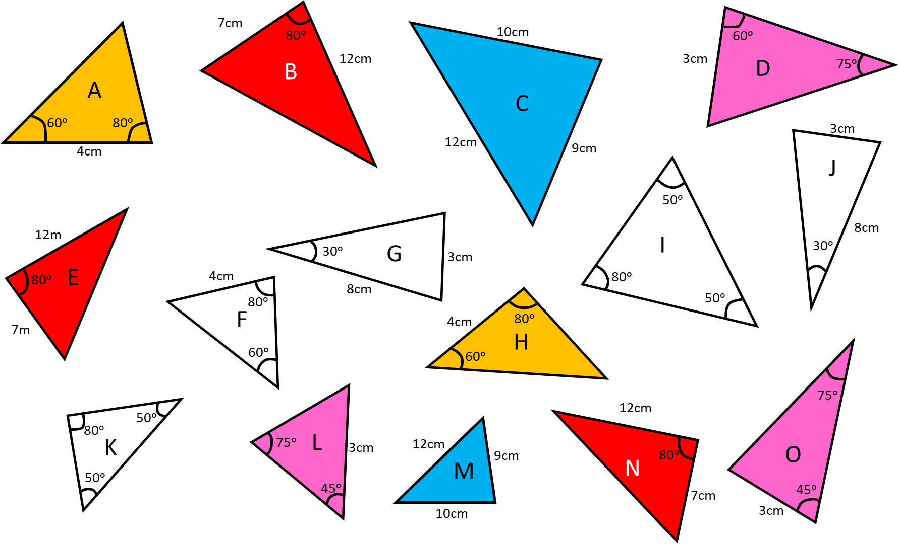
Identify congruent triangles and give a reason for them being congruent.
ASA = A and H
SAS = B, E and N
SSS = C and M
AAS = O, D and L

