Slide 1
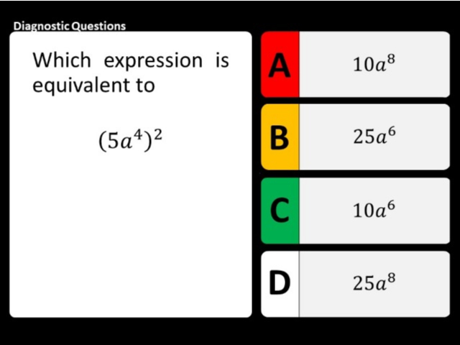
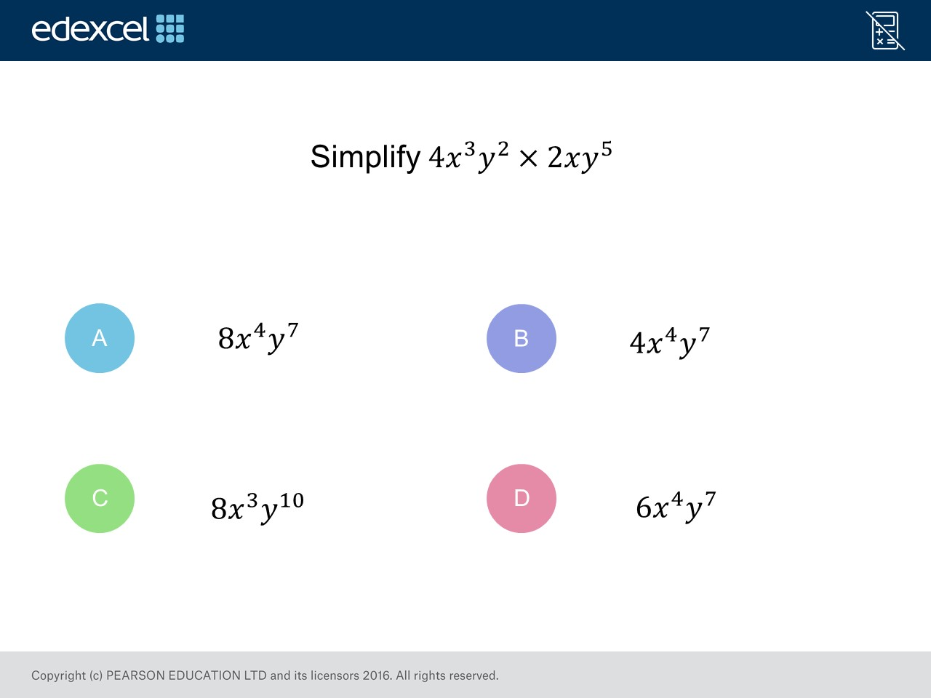
Worst answered question?
Most common wrong answer?

Slide 2
ANSWERS

Slide 3
Worst answered question?

Slide 4
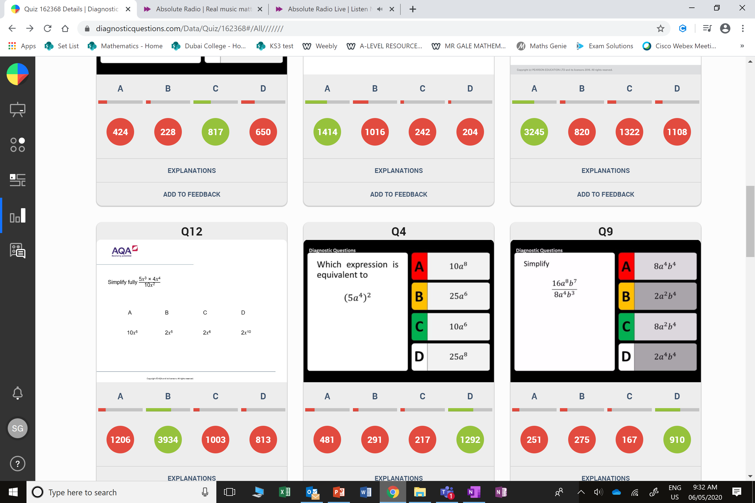
C
The added the coefficients rather than multiplying.

Slide 5
A
They multiplied the power with the coefficient rather than squaring
the number.

