Slide 1
Regression Correlation and Hypothesis Testing
Exponential Models
Chapter 1
(Part 1 of 3)

Slide 2
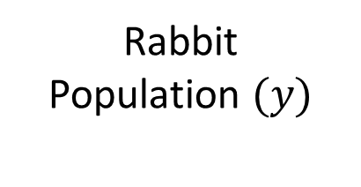
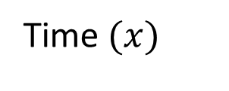
Rabbit
Population $(y)$
Time$(x)$
Is this a good regression line for the data?

Slide 3
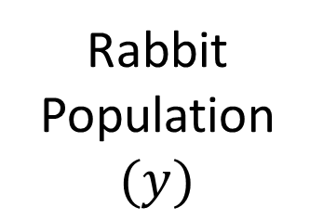
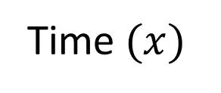
Exponential Regression
Rabbit
Population $(y)$
Time$(x)$
An exponential line is a much better fit.

Slide 4
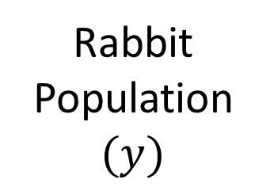
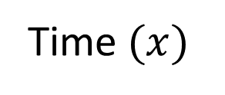
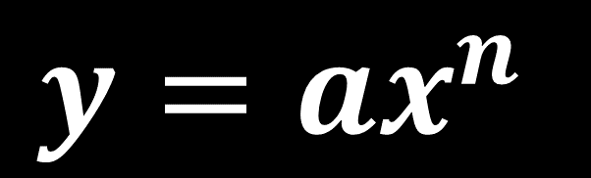
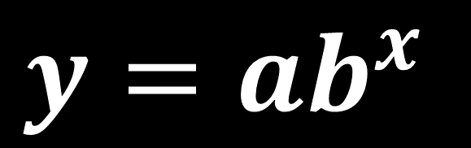

Rabbit
Population $(y)$
Time$(x)$
There are two possible models you could use,
$$y=ab^{x}$$
$$y=ax^{n}$$
or
where $a$, b and $n$ are constants

Slide 5
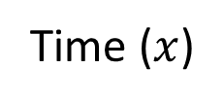
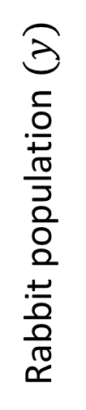


It is not easy to examine trends of non-linear data.
$$\log{y}$$
Rabbit population $(y)$
Coding
Time ($x$)
Time ($x$)
It can be easier to use coding to see if
the data can be transformed into a linear relationship.

Slide 6




Coding
$$y=ab^{x}$$
Log both sides
$$\log{y}=\log\left(ab^{x}\right)$$
Separate the log(ab^{x})
$$\log{y}=\log{a}+\log{b^{x}}$$
Apply the power law
$$\log{y}=\log{a}+x\log{b}$$

Slide 7
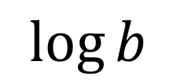
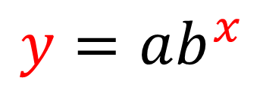
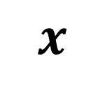
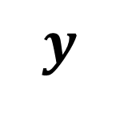
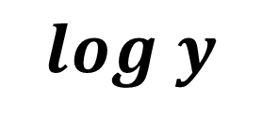
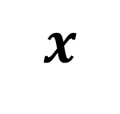

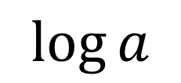
$$y=ab^{x}$$
$$\log{y}=\log{a}+x\log{b}$$
$$y$$
$$log y$$
Coding
$$x$$
$$x$$
Gradient =
$$\log{b}$$
y intercept =
$$\log{a}$$

Slide 8




Coding
$$y=ax^{n}$$
Log both sides
$$\log{y}=\log\left(ax^{n}\right)$$
Separate the log(ab^{x})
$$\log{y}=\log{a}+\log{x^{n}}$$
Apply the power law
$$\log{y}=\log{a}+n\log{x}$$

Slide 9
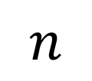
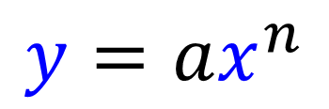
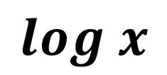

$$y=ax^{n}$$
$$\log{y}=\log{a}+n\log{x}$$
$$y$$
$$log y$$
Coding
$$x$$
$$log x$$
Gradient =
$$n$$
y intercept =
$$\log{a}$$

Slide 10



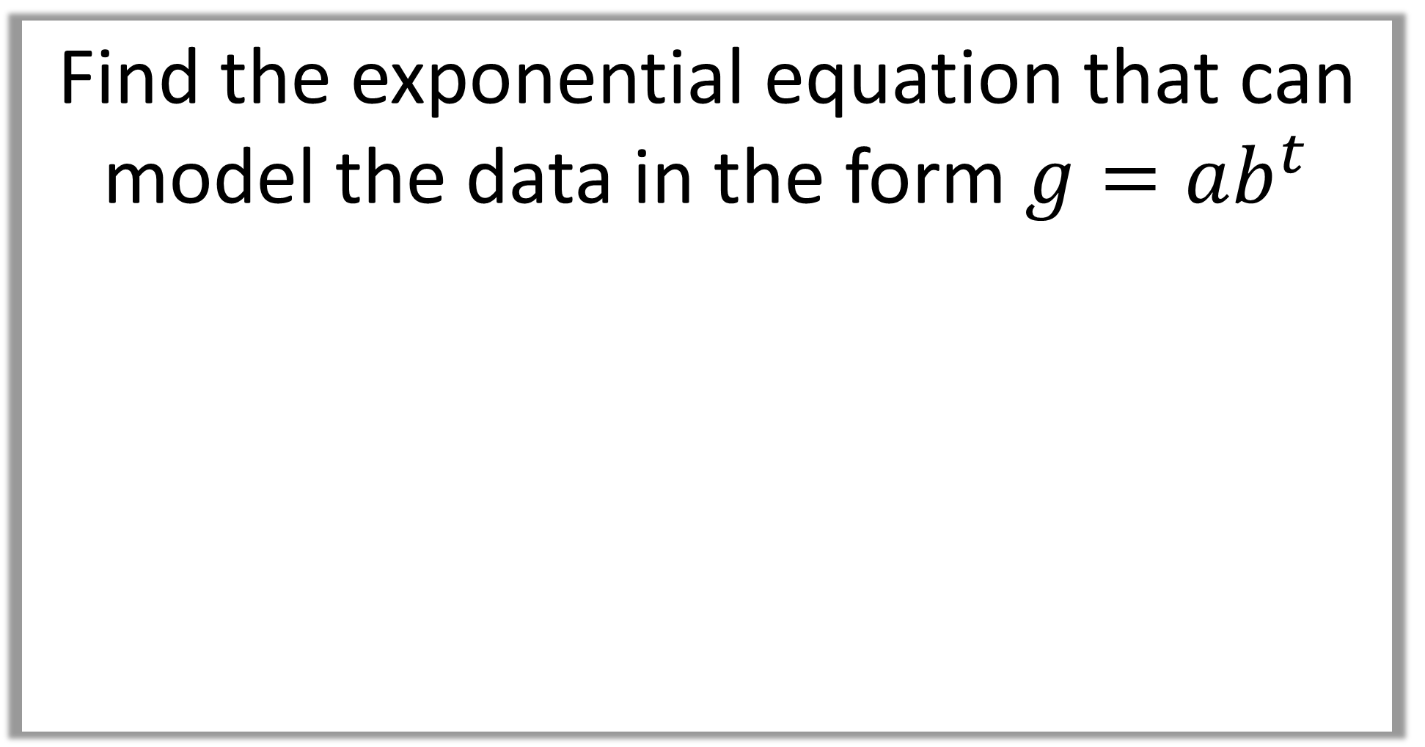



Find the exponential equation that can model the data in the form $g=ab^{t}$
$$g=ab^{t}$$
$$y=−0.2215+0.0792x$$
$$g$$
$$\log{g}$$
Coding
$$t$$
$$t$$

Slide 11
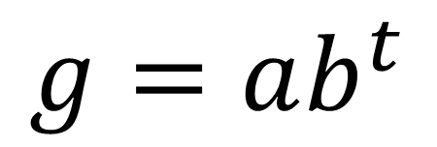
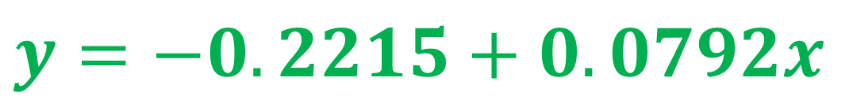
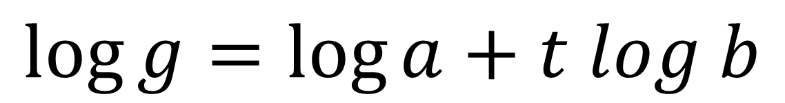
$$g=ab^{t}$$
Rewrite as:
$$\log{g}=\log{a}+t log b$$
Compare with:
$$y=−0.2215+0.0792x$$
Therefore:
$$y\text{−}\text{intercept} \text{is} \log{a}hence log{a}=−0.2215$$
$$\text{gradient} \text{is}\log{b}\text{hence} log{b}=0.0792$$

Slide 12
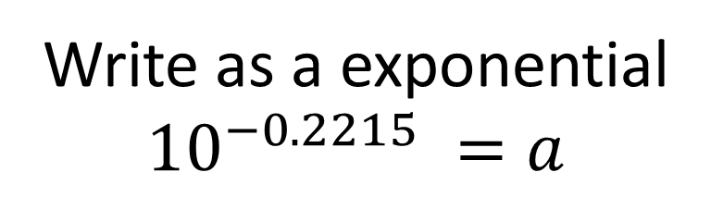
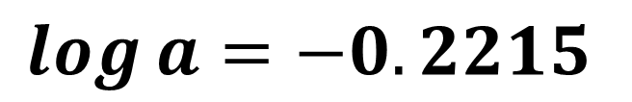
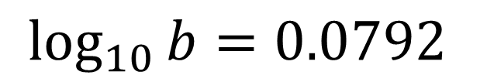
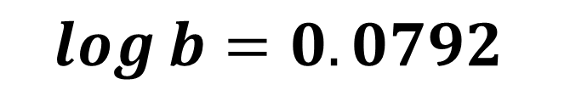
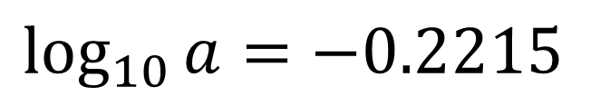
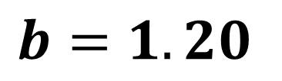
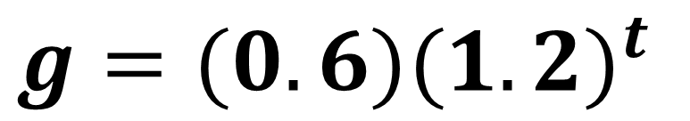
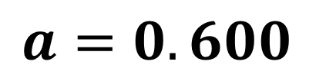
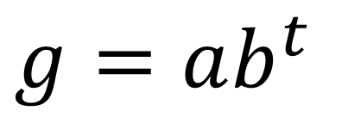

$$\log{a}=−0.2215$$
$$\log{b}=0.0792$$
$$\log_{10}{a}=−0.2215$$
$$\log_{10}{b}=0.0792$$
Write as a exponential
$${10}^{−0.2215} =a$$
Write as a exponential
${10}^{0.0792}$ $=b$
$$a=0.600$$
$$b=1.20$$
$g=ab^{t}$
$g=(0.6){(1.2)}^{t}$

Slide 13
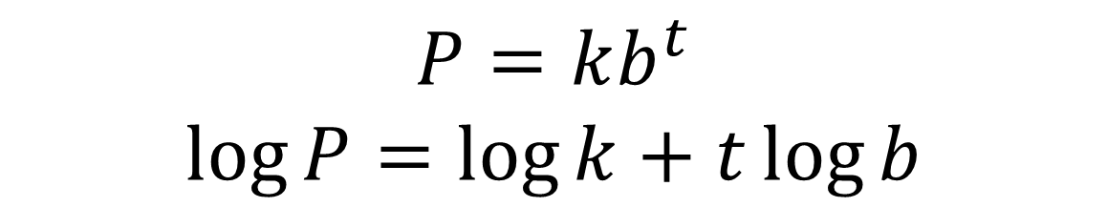
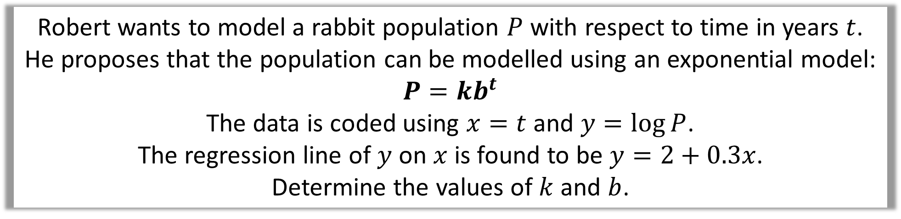
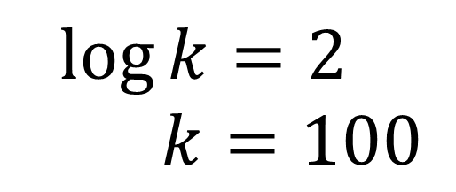
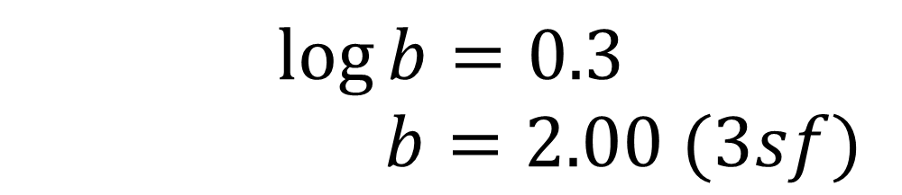
Robert wants to model a rabbit population $P$ with respect to time in years $t$.
He proposes that the population can be modelled using an exponential model:
$$P=kb^{t}$$
The data is coded using $x=t$ and $y=\log{P}$.
The regression line of $y$ on $x$ is found to be $y=2+0.3x$.
Determine the values of $k$ and $b$.
$$P=kb^{t} \\ \log{P}=\log{k}+t\log{b}$$
$$\log{k}=2$$
$$k=100$$
$$\log{b}=0.3$$
$$b=2.00 (3sf)$$

