Slide 1
LO: Grouping
Data

Slide 2
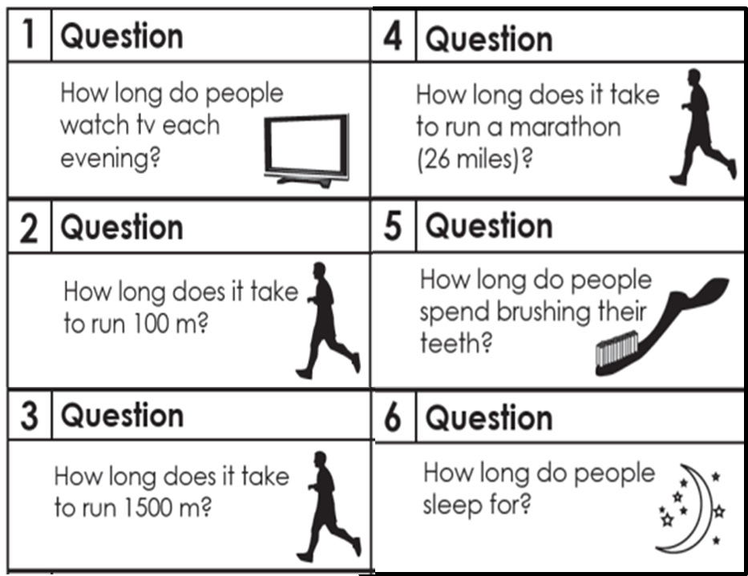
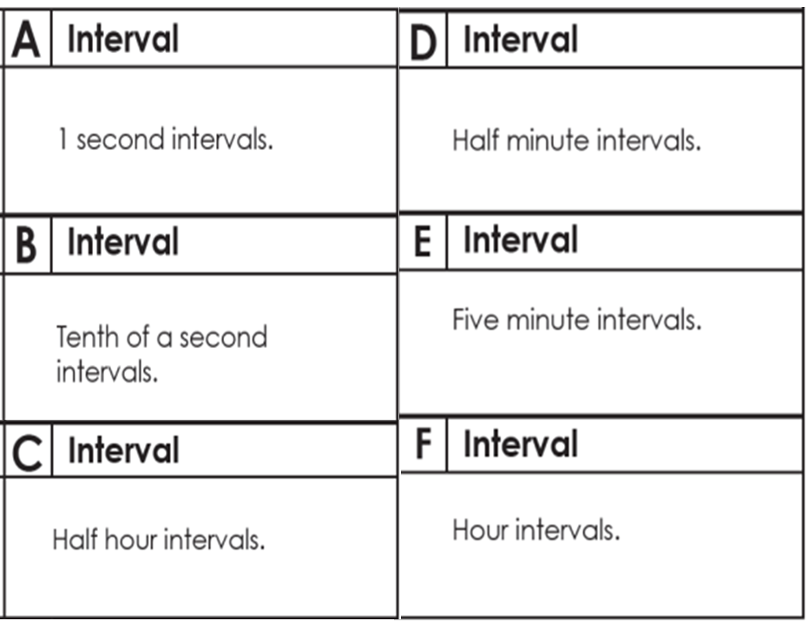
Match each question with
a size of group interval.
Discuss you reasons for your choices.

Slide 3


A tally chart is a way of collecting data.
Which one is easier to count?
OR

Slide 4
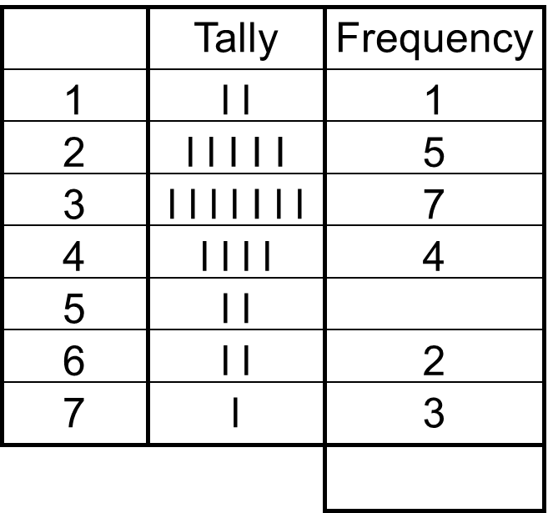
What is bad about this frequency table?

Slide 5
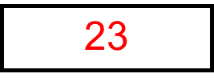
What is good about this frequency table?

Slide 6
Why would you not want to produce a
frequency table for the following data?
88 91 92 93 93 94 95 95 95
95 95 96 96 96 97 97 97 97
97 97 97 97 98 98 98 98 98
98 98 99 99 99 99 99 100 100
100 101 101 101 101 101 101 101 101
102 102 102 102 103 103 103 104 105
105 105 105 105 105 105 106 107 108

Slide 7
The frequency table would be very long!
Time (Seconds) | Frequency
88
89
90
91
92
93
94
95
96
97
98

Slide 8
Grouped Frequency Table
Times in seconds
Frequency
Group frequency tables are a good way of recording a wide spread of data in a manageable table.
85 ≤ t < 90
90 ≤ t < 95
95 ≤ t < 100
100 ≤ t < 105
105 ≤ t < 110

Slide 9
Times in seconds
Frequency
Where would you place the number 95?
85 ≤ t < 90
90 ≤ t < 95
95 ≤ t < 100
100 ≤ t < 105
105 ≤ t < 110

Slide 10
Times in seconds
Frequency
Where would you place the number 100?
85 ≤ t < 90
90 ≤ t < 95
95 ≤ t < 100
100 ≤ t < 105
105 ≤ t < 110

Slide 11
Times in seconds
Frequency
Where would you place the number 105?
85 ≤ t < 90
90 ≤ t < 95
95 ≤ t < 100
100 ≤ t < 105
105 ≤ t < 110

Slide 12
Times in seconds | Frequency
85 – 90
90 – 95
95 – 100
100 – 105
105 - 110
What is wrong with this table?
The groups overlap

Slide 13
Times in seconds | Frequency
85 – 90
91 – 95
96 – 100
101 – 105
106 - 110
What is wrong with this table?
There are gaps between the groups.

Slide 14
Times in seconds | Frequency
85 – 90
91 – 95
96 – 100
101 – 105
106 - 110
You could make this frequency group table work if you do what the original data?
Round the times
to the nearest
whole numbers.

