Slide 1
Sequences and Series
Modelling
Chapter 3
(Part 8 of 8)

Slide 2
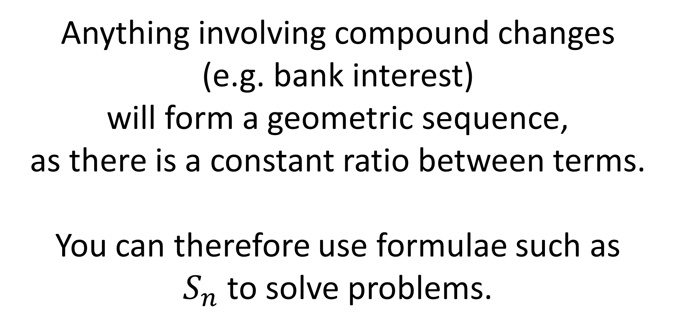
Anything involving compound changes
(e.g. bank interest)
will form a geometric sequence,
as there is a constant ratio between terms.
You can therefore use formulae such as
$S_{n}$ to solve problems.

Slide 3
Question A
Bruce starts a new company. In year 1 his profits will be £20 000.
He predicts his profits to increase by £5000 each year, so that his profits in year 2 are modelled to be £25 000, in year 3, £30 000 and so on.
He predicts this will continue until he reaches annual profits of £100 000.
He then models his annual profits to remain at £100 000.
Calculate the profits for Bruce’s business in the first 20 years.
State one reason why this may not be a suitable model.
Bruce’s financial advisor says the yearly profits are likely to increase by 5% per annum. Using this model, calculate the profits for Bruce’s business in the first 20 years.

Slide 4

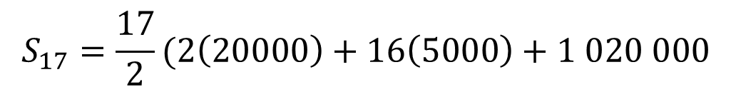



Bruce starts a new company. In year 1 his profits will be £20 000.
He predicts his profits to increase by £5000 each year, so that his profits in year 2 are modelled to be £25 000, in year 3, £30 000 and so on.
He predicts this will continue until he reaches annual profits of £100 000.
He then models his annual profits to remain at £100 000.
Calculate the profits for Bruce’s business in the first 20 years.
a)
The sequence is arithmetic up until £100 000, but stops increasing thereafter.
You need to know the position of this term.
$$a=20 000 d=5000$$
First find sum of first 17 terms
(where sequence is arithmetic)
$$u_{n}=a+\left(n−1\right)d$$
$$S_{17}=\frac{17}{2}(2\left(20000\right)+16\left(5000\right)+1 020 000$$
$$100000=20000+\left(n−1\right)d$$
$$n=17$$
$$S_{20}=1 020 000+3\left(100 000\right)=1 320 000$$

Slide 5
Bruce starts a new company. In year 1 his profits will be £20 000.
He predicts his profits to increase by £5000 each year, so that his profits in year 2 are modelled to be £25 000, in year 3, £30 000 and so on.
He predicts this will continue until he reaches annual profits of £100 000.
He then models his annual profits to remain at £100 000.
b) State one reason why this may not be a suitable model.
b)
It is unlikely that Bruce’s profits will increase by exactly the same amount each year.

Slide 6


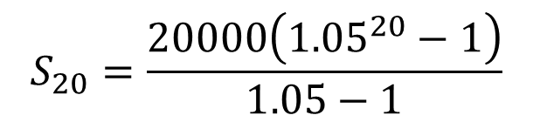
Bruce starts a new company. In year 1 his profits will be £20 000.
He predicts his profits to increase by £5000 each year, so that his profits in year 2 are modelled to be £25 000, in year 3, £30 000 and so on.
He predicts this will continue until he reaches annual profits of £100 000.
He then models his annual profits to remain at £100 000.
c) Bruce’s financial advisor says the yearly profits are likely to increase by 5% per annum. Using this model, calculate the profits for Bruce’s business in the first 20 years.
$$a=20 000 r=1.05$$
c)
$$S_{20}=\frac{20000\left({1.05}^{20}−1\right)}{1.05−1}$$
$$S_{20}=£ 661 319.08$$

Slide 7
Question B
A piece of A4 paper is folded in half repeatedly.
The thickness of the A4 paper is 0.5 mm.
a) Work out the thickness of the paper after four folds.
b) Work out the thickness of the paper after 20 folds.
c) State one reason why this might be an unrealistic model.

Slide 8
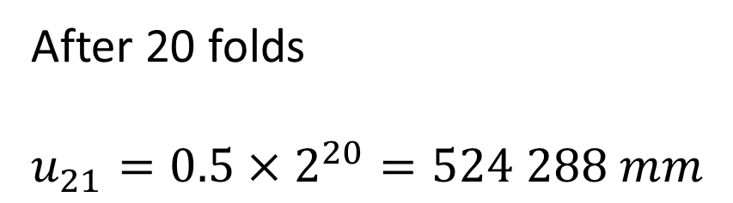
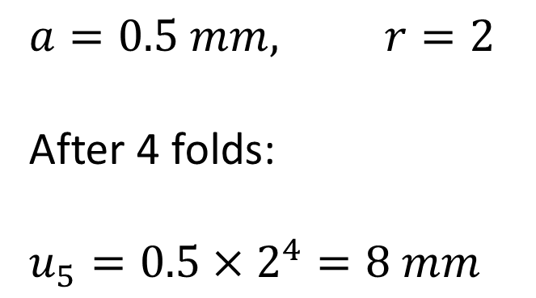
A piece of A4 paper is folded in half repeatedly.
The thickness of the A4 paper is 0.5 mm.
a) Work out the thickness of the paper after four folds.
b) Work out the thickness of the paper after 20 folds.
c) State one reason why this might be an unrealistic model.
a)
b)
$$a=0.5 mm, r=2$$
After 4 folds:
$$u_{5}=0.5×2^{4}=8 mm$$
After 20 folds
$$u_{21}=0.5×2^{20}=524 288 mm$$
c)
It is impossible to fold the paper that many times so the model is unrealistic.

Slide 9
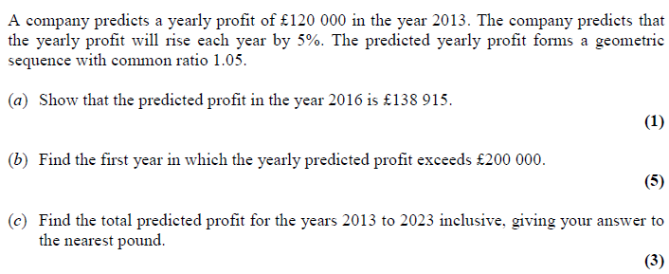
Question C

Slide 10
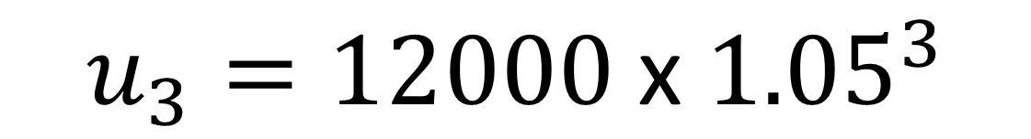
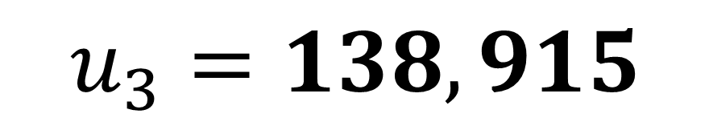
$$u_{3}=12000 \text{x} {1.05}^{3}$$
a)
$$u_{3}=138, 915$$

Slide 11


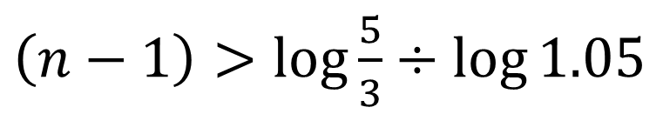
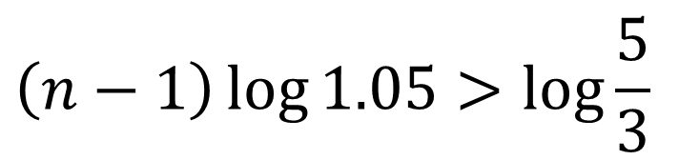
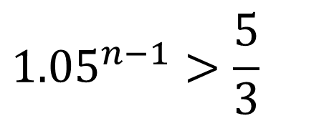
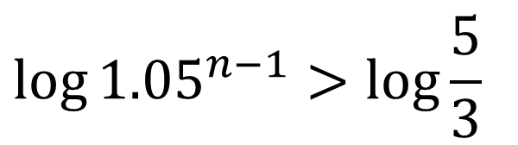
$$12000 \text{x} {1.05}^{n−1}>200000$$
$$\left(n−1\right)\log{1.05}>\log{\frac{5}{3}}$$
b)
$${1.05}^{n−1}>\frac{5}{3}$$
$\left(n−1\right)>\log{\frac{5}{3}}$ $÷\log{1.05}$
$${\log{1.05}}^{n−1}>\log{\frac{5}{3}}$$
$$n>10.469…$$
2024

Slide 12
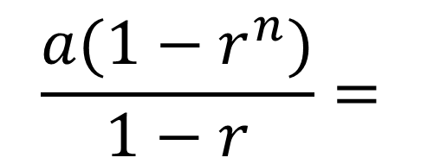
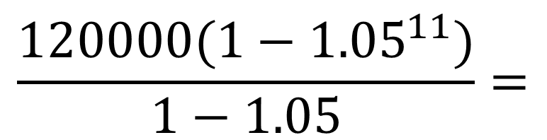
c)
$$\frac{{a(1−r}^{n})}{1−r}=$$
$$\frac{{120000(1−1.05}^{11})}{1−1.05}=$$
1,704,814

Slide 13
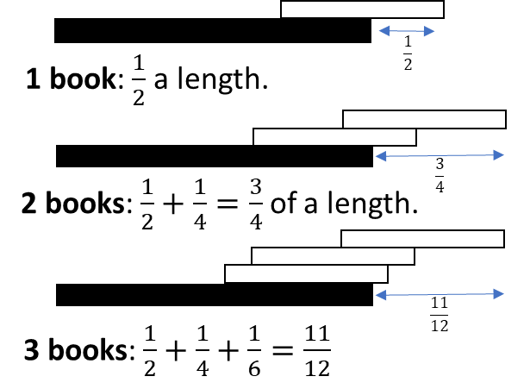
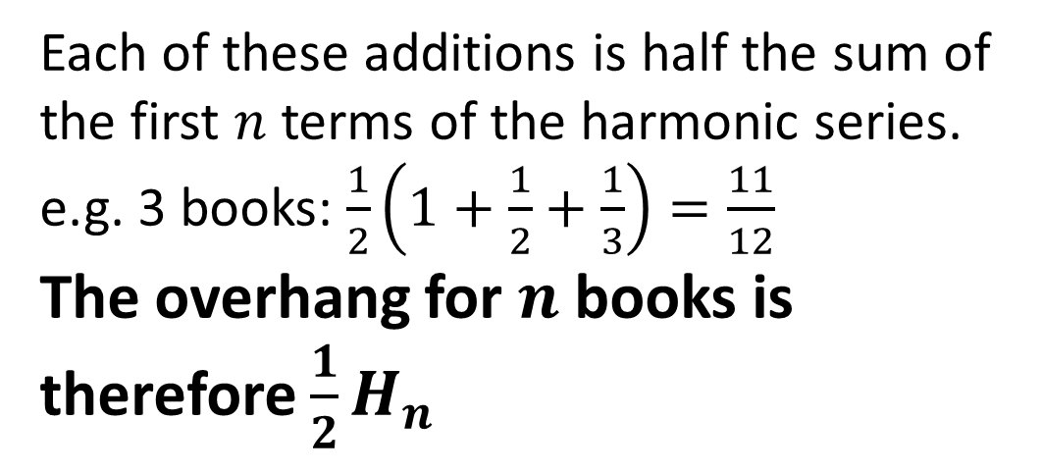

Really cool application
How far can a stack of $n$ books
protrude over the edge of a table?
Each of these additions is half the sum of the first $n$ terms of the harmonic series.
e.g. 3 books: $\frac{1}{2}\left(1+\frac{1}{2}+\frac{1}{3}\right)=\frac{11}{12}$
The overhang for $n$ books is therefore $\frac{1}{2}H_{n}$
Because the harmonic series is divergent, you can keep adding books to get an arbitrarily large amount of overhang. But note that the harmonic series increases very slowly. A stack of 10,000 books would only overhang by 5 book lengths!

