Slide 1
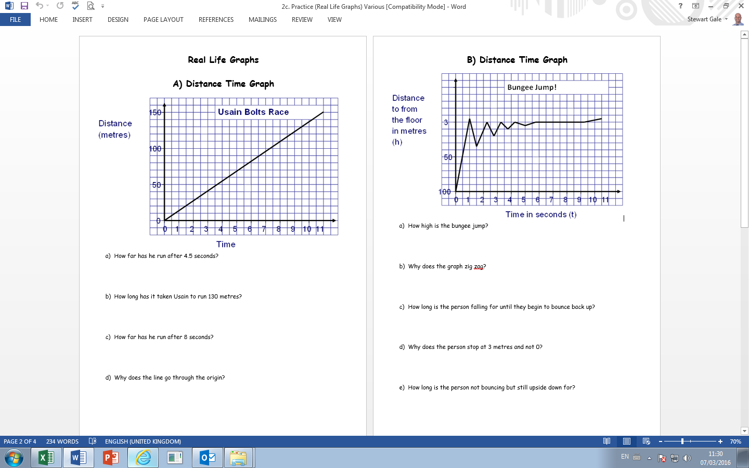

Slide 2
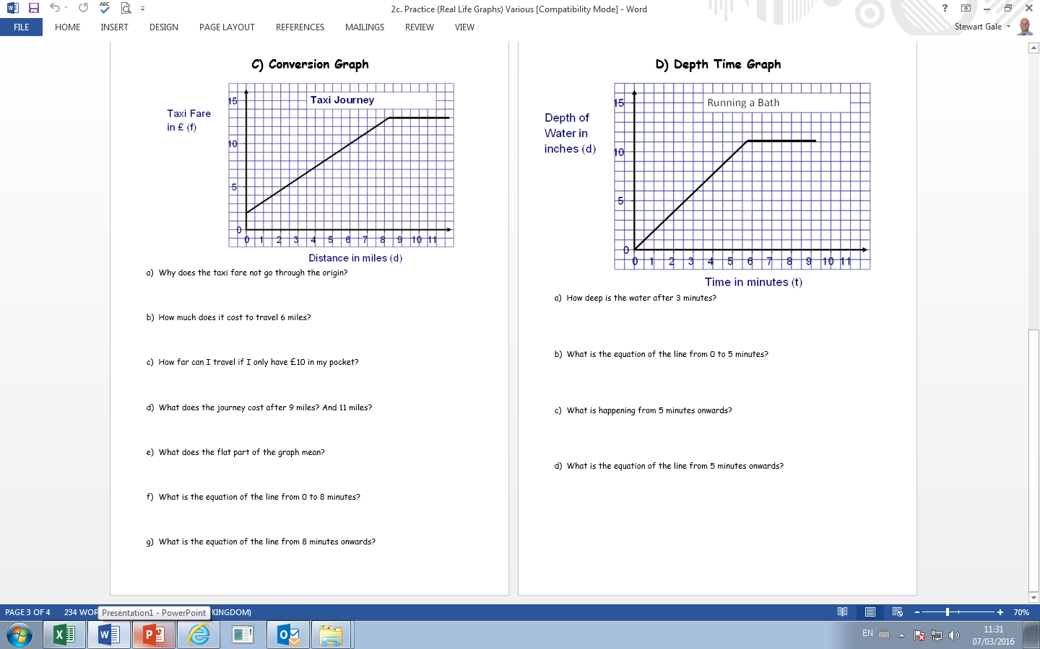
6 minutes onwards?

Slide 3
ANSWERS

Slide 4
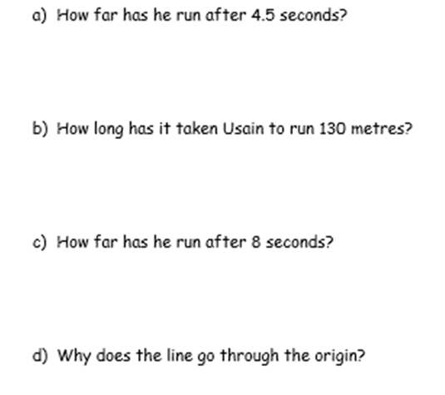
60 metres
9.5 seconds
110 metres
No time no distance!

Slide 5
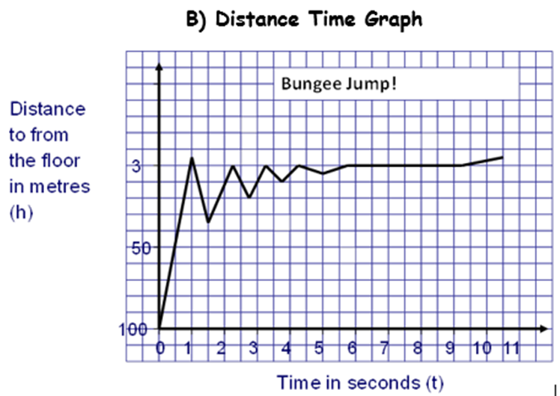
100 metres
The spring in the bungee
1 second
So they don’t hit their head as they are upside down!
Approx 4 seconds

Slide 6
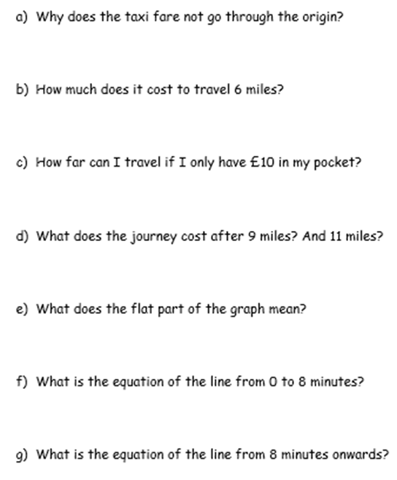
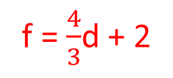
£2 starting fee
£10
6 miles
£13 and £13
The meter is switch off
f = $\frac{4}{3}$d + 2
F = 13

Slide 7
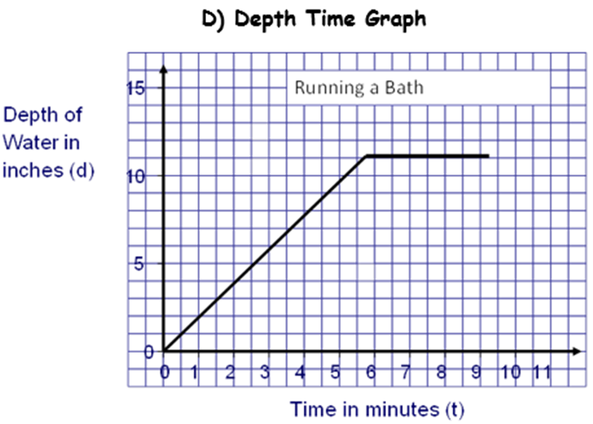
6 inches
d = 2t
6 minutes onwards?
the level of water remains the same
d = 11

