Slide 1
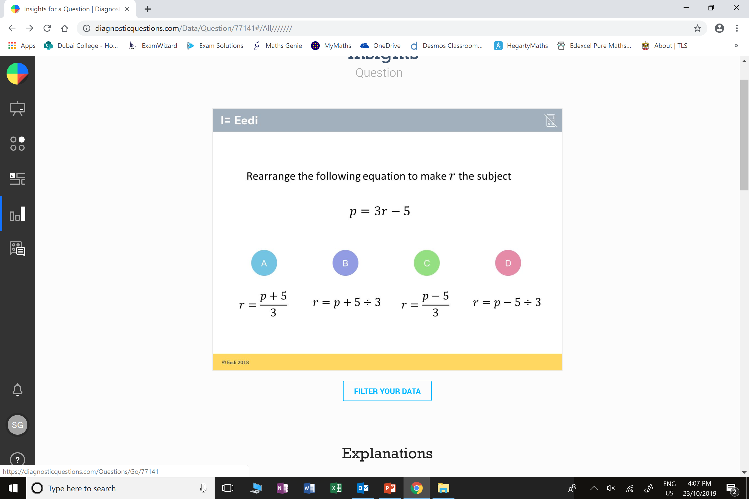
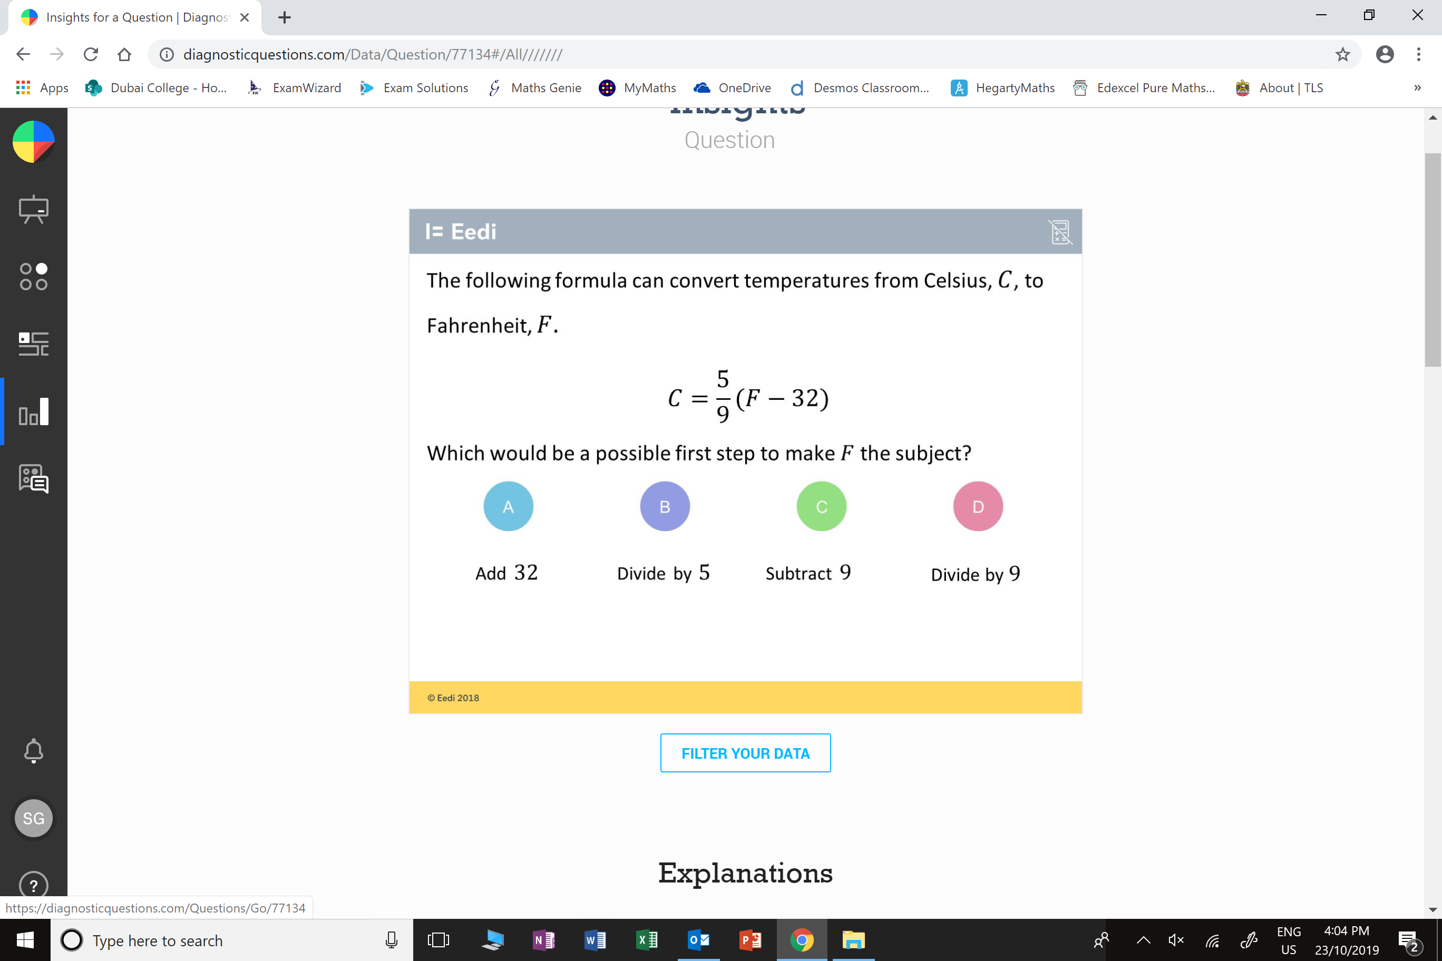
Which question had the lowest percentage of
correct answers?
For each question, what was the most common
wrong answer?

Slide 2
ANSWERS

Slide 3
Which question had the lowest percentage of
correct answers?

Slide 4
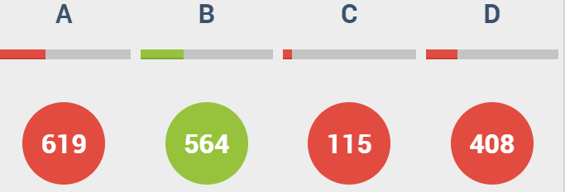
A
The student has misunderstood that we are multiplying everything by 5/9, so we need to do the inverse of this first.

Slide 5
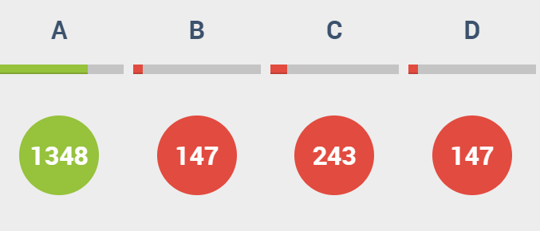
C
The student has subtracted 5,
instead of adding.

