Slide 1

Senior Challenge 3
SILVER

Slide 2
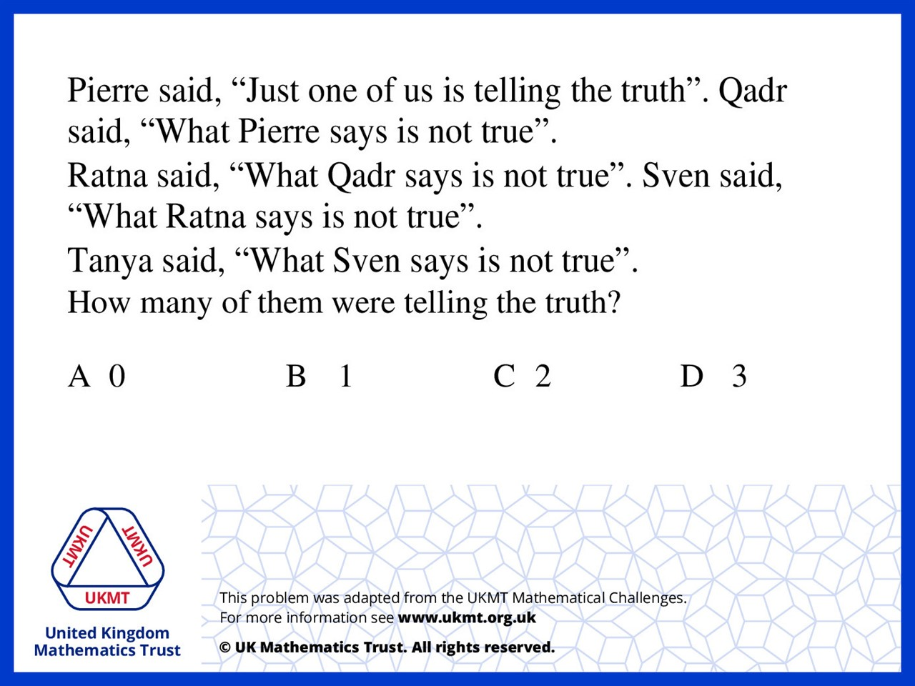
Q1.
If we assume Pierre is telling the truth then
Quadr would be lying but then Ratna would be telling the truth
so that is not possible.
If we assume Pierre is lying then
Quadr is telling the truth, Ratna is lying,
Sven is telling the truth, and Tanya is lying

Slide 3
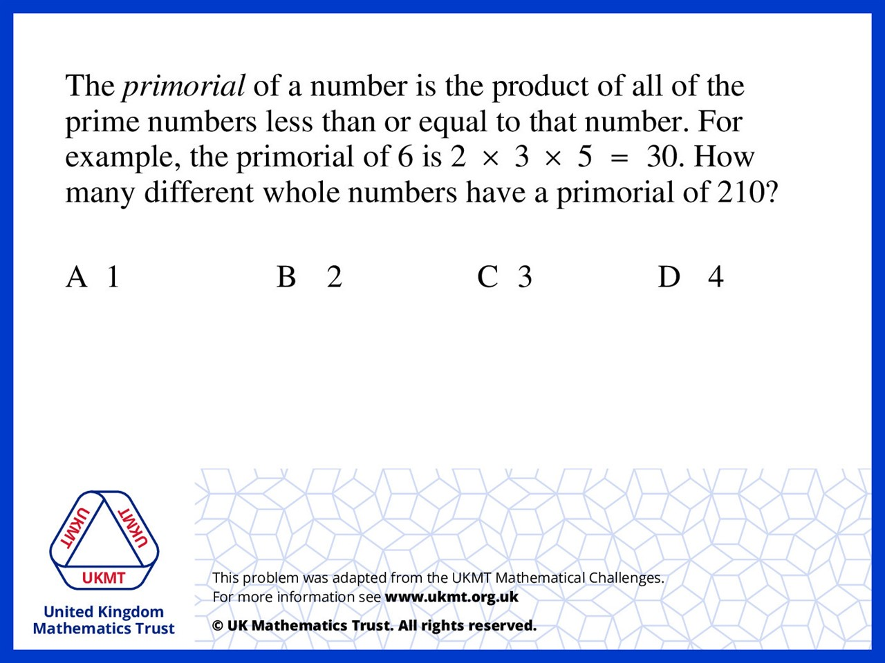
Q2.
210 = 2 x 3 x 5 x 7 so the whole numbers that have a primorial of 210 would be 7,8,9,10, hence the answer is 4

Slide 4
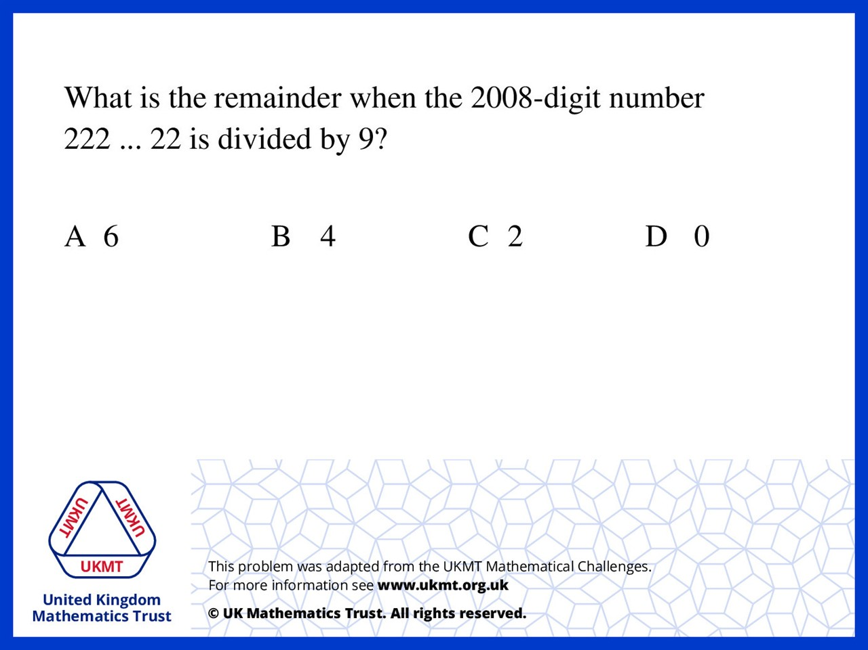
Q3.
x 2 = 4016
4016 ÷ 9 = 446 remainder 2

Slide 5
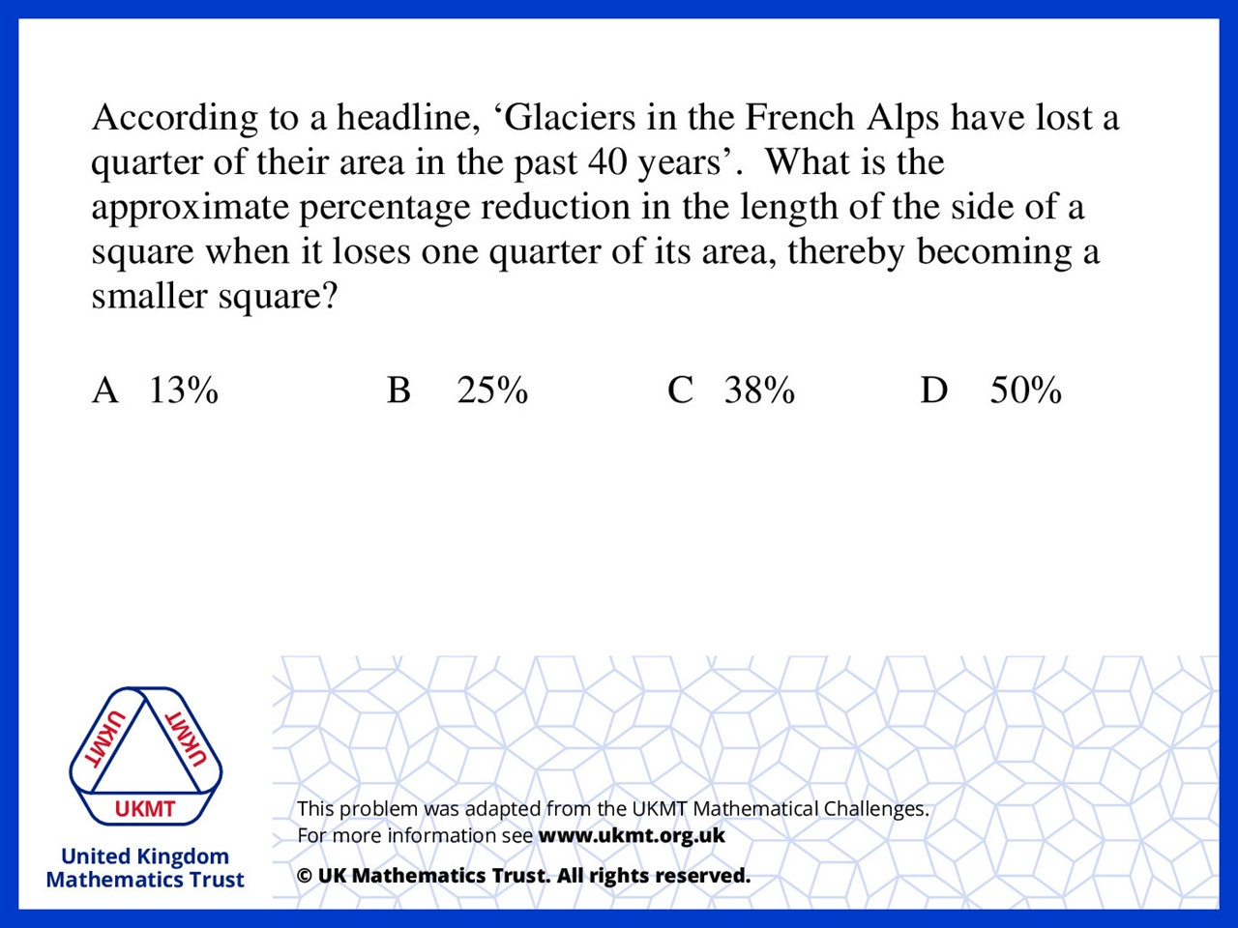
Q4.
If the side length of a square is 100,
then its area is 10000.
3 quarters of 10000 is 7500,
and the square root of 7500 is roughly 87.
100 - 87 = 13% reduction.

Slide 6
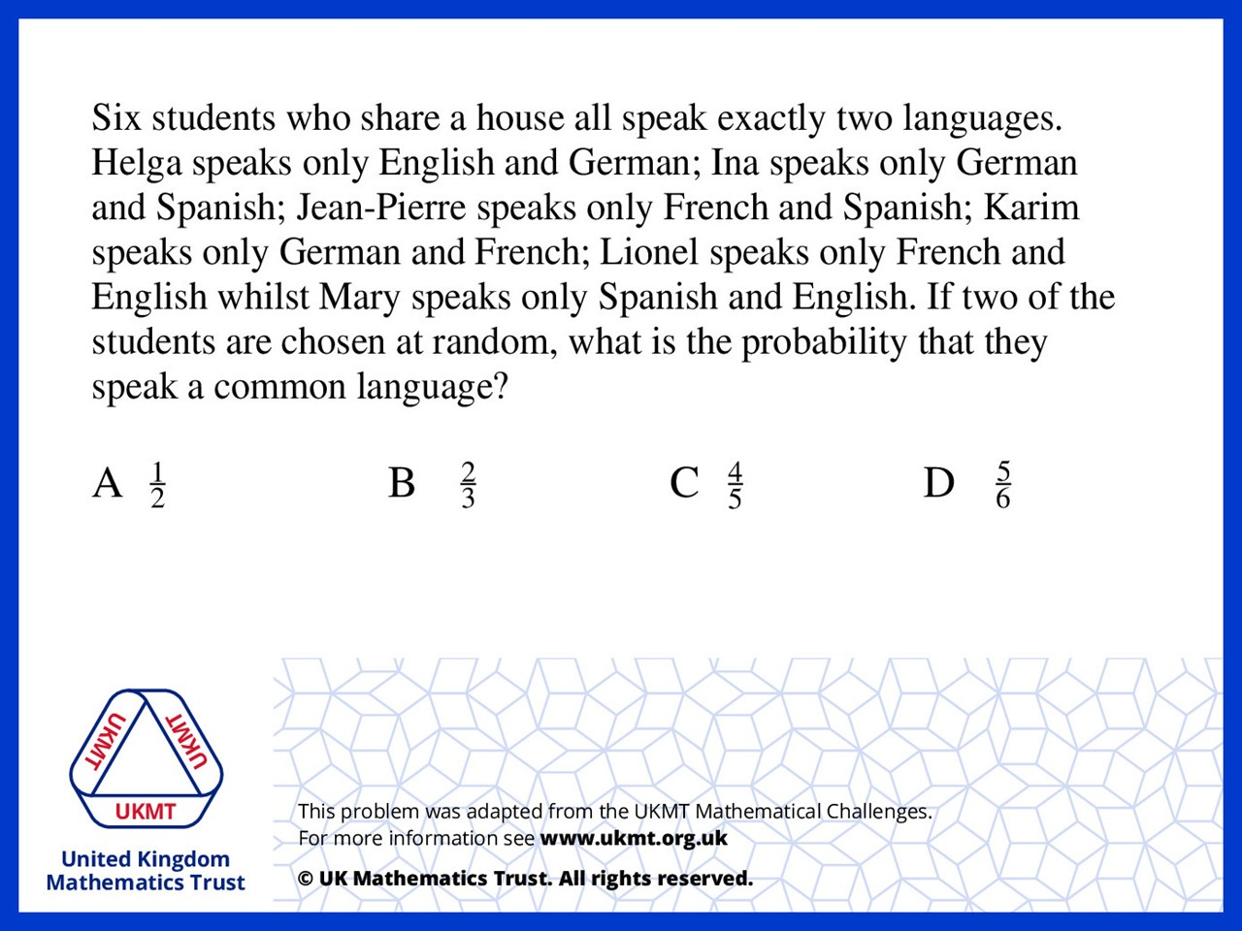
Q5.
As the probability of them speaking English is 3/6
and then for the 2nd student it is 2/5,
times these together and then times by 4 ,
as there are 4 languages spoken in the house

