Slide 1
LO: Capture, Tag and Release

Slide 2
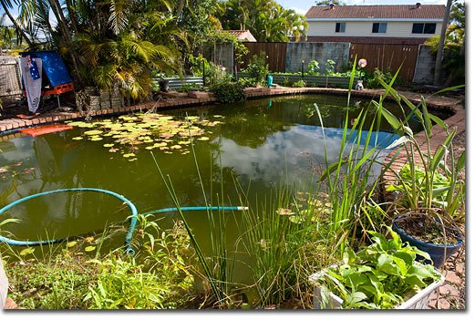
How can you estimate the number of fish in the pool?

Slide 3
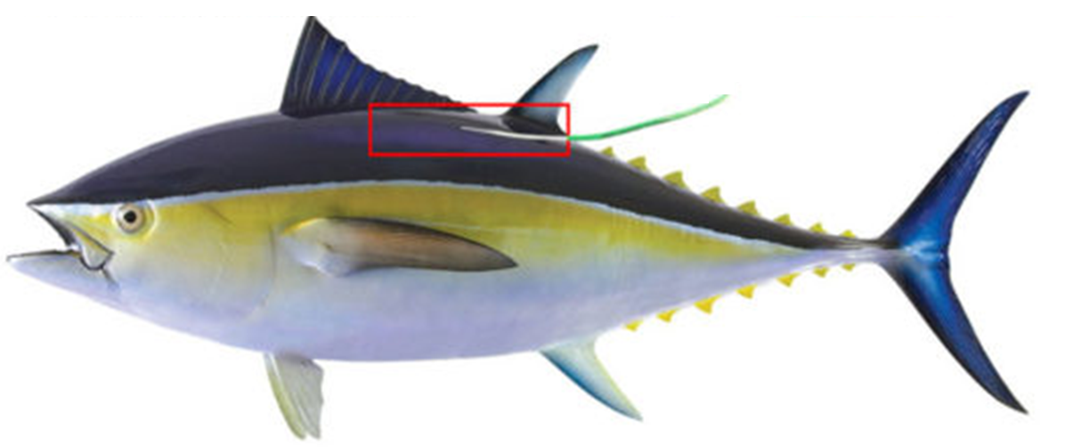
Considering proportions
can be used to
estimate animal populations.

Slide 4

Click to play the video

Slide 5
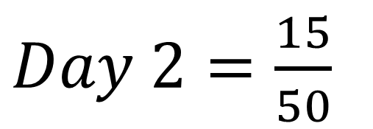
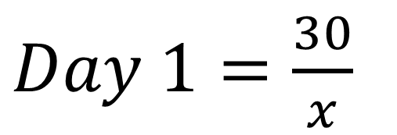
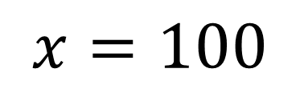
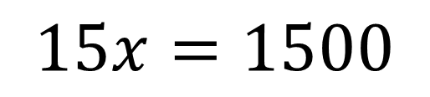
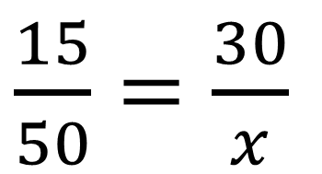
30 fish were captured from a pool,
tagged and released back into the pool.
The next day I capture 50 fish and of these,
15 of these have tags.
Estimate the number of fish in the pool.
$\frac{15}{50}=\frac{30}{x}$
$Day 1=\frac{30}{x}$
$$15x=1500$$
$Day 2=\frac{15}{50}$
$$x=100$$

Slide 6
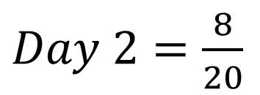
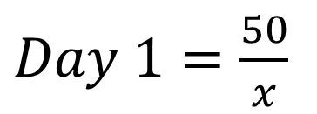


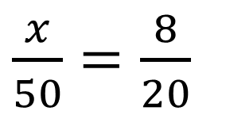
50 of the llamas in a field are captured, given an ear tag and then released. The following day, I capture 20 llamas, and 8 have an ear tag.
Estimate the total number of llamas in the field.
State any assumptions you have made in making your estimate.
a)
b)
We have assumed that there has been no change to the proportion of llamas that have been tagged,
e.g. no llamas have died or births.
$Day 1=\frac{50}{x}$
$\frac{x}{50}=\frac{8}{20}$
$Day 2=\frac{8}{20}$
$$8x=1000$$
$$x=125$$

Slide 7
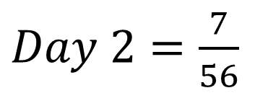
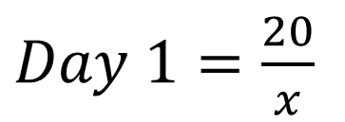


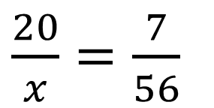
I want to estimate the population of dolphins in Ingall Bay.
I capture and tag 20 dolphins before releasing them.
I then capture 56 dolphins and 7 have tags.
Estimate how many dolphins are in the bay.
$Day 1=\frac{20}{x}$
$\frac{20}{x}=\frac{7}{56}$
$Day 2=\frac{7}{56}$
$$7x=1120$$
$$x=160$$

Slide 8
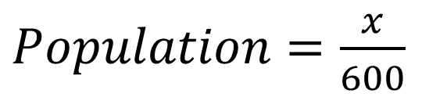
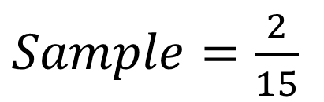


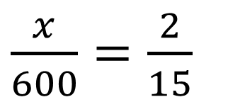
I want to estimate how many vegetarians to cater for at a large even of 600 people. I randomly ask 15 people and 2 are vegetarian.
$Sample=\frac{2}{15}$
$Population=\frac{x}{600}$
$\frac{x}{600}=\frac{2}{15}$
$$15x=1200$$
$$x=80$$

