Slide 1
Sequences and Series
Sum to Infinity
Chapter 3
(Part 5 of 8)

Slide 2
Divergent vs Convergent
Divergent
– the sum tends towards infinity.
Convergent
– the sum tends towards a number.

Slide 3
1 + 2 + 4 + 8 + 16 + ...
Divergent vs Convergent?
This is divergent –
the sum of the values tends towards infinity.

Slide 4
1 – 2 + 3 – 4 + 5 – 6 + …
Divergent vs Convergent?
This is divergent –
the running total alternates either side of 0, but gradually gets further away from 0.

Slide 5
1 + 0.5 + 0.25 + 0.125 + ...
Divergent vs Convergent?
This is convergent –
the sum of the values tends towards a fixed value, in this case 2.

Slide 6
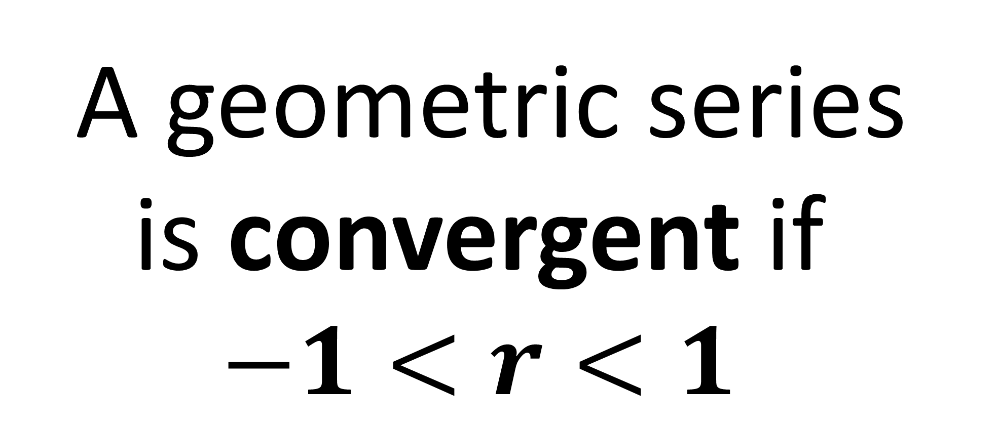
A geometric series is convergent if
$$−1<r<1$$

Slide 7
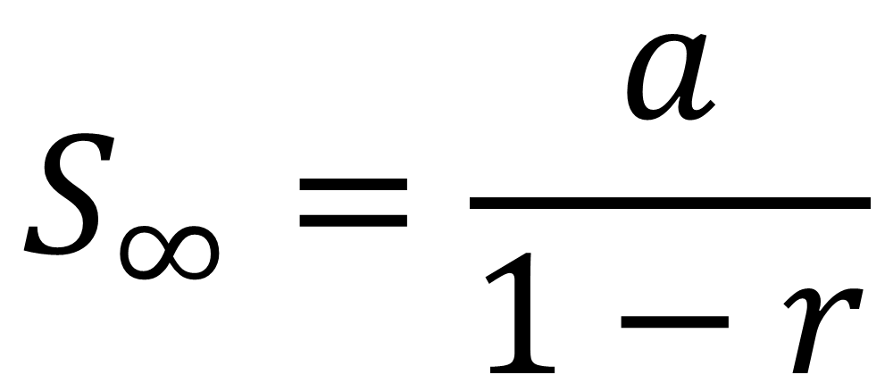
Sum to Infinity
For a convergent geometric series
$$S_{∞}=\frac{a}{1−r}$$
It is in the formula booklet.

Slide 8
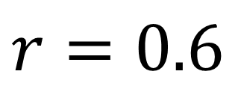
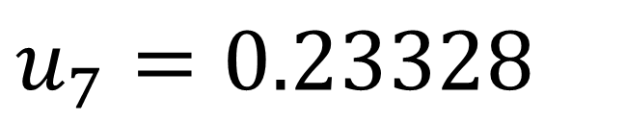

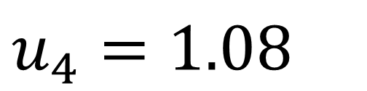
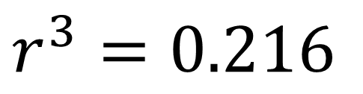
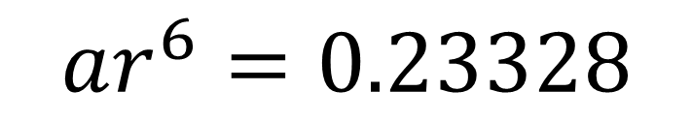
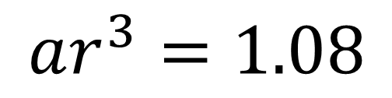
The fourth term of a geometric series is 1.08 and
the seventh term is 0.23328.
Show that this series is convergent.
Find the sum to infinity of this series.
$$u_{7}=0.23328$$
$$ar^{6}=0.23328$$
a)
$$u_{4}=1.08$$
$$ar^{3}=1.08$$
$$r^{3}=0.216$$
$$r=0.6$$
The series converges because $\left|0.6\right|<1$

Slide 9
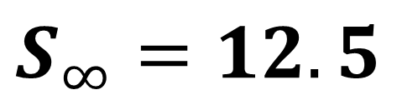
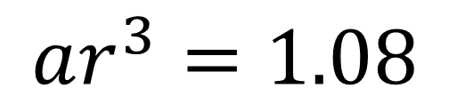
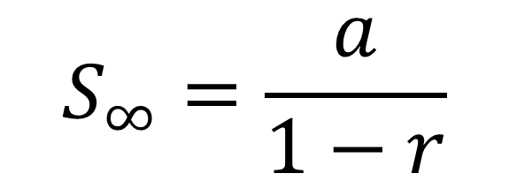
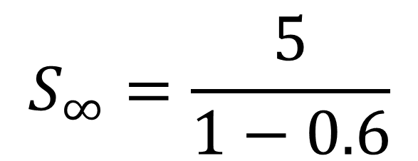
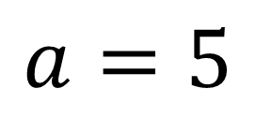
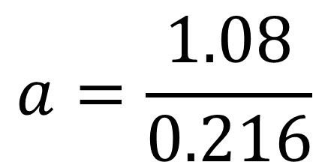
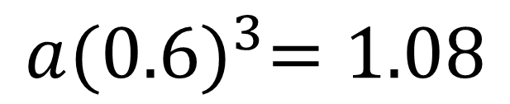
The fourth term of a geometric series is 1.08 and
the seventh term is 0.23328.
Show that this series is convergent.
Find the sum to infinity of this series.
$$ar^{3}=1.08$$
$$S_{∞}=\frac{a}{1−r}$$
b)
$$a{(0.6)}^{3}=1.08$$
$$S_{∞}=\frac{5}{1−0.6}$$
$$a=\frac{1.08}{0.216}$$
$$S_{∞}=12.5$$
$$a=5$$

Slide 10
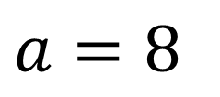
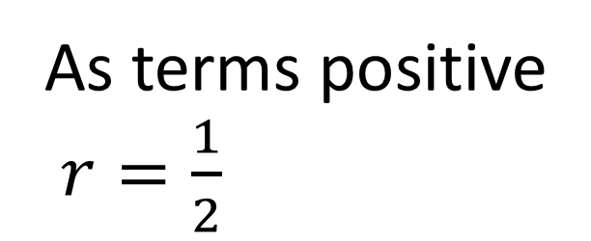
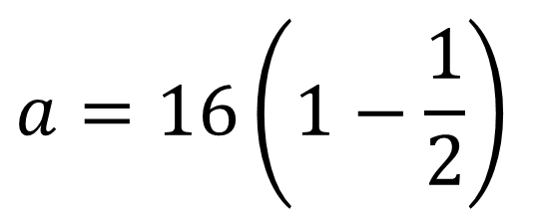
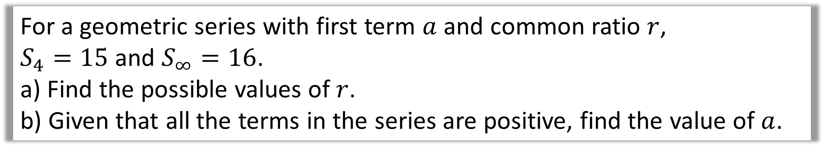
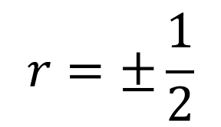
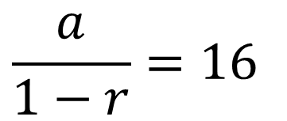
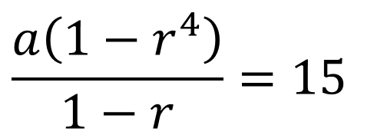
For a geometric series with first term $a$ and common ratio $r$,
$S_{4}=15$ and $S_{∞}=16$.
a) Find the possible values of $r$.
b) Given that all the terms in the series are positive, find the value of $a$.
a)
$$\frac{a\left(1−r^{4}\right)}{1−r}=15$$
As terms positive
$r=\frac{1}{2}$
b)
$$\frac{a}{1−r}=16$$
$$a=16\left(1−\frac{1}{2}\right)$$
Solve simultaneous equations
$$r=±\frac{1}{2}$$
$$a=8$$

Slide 11
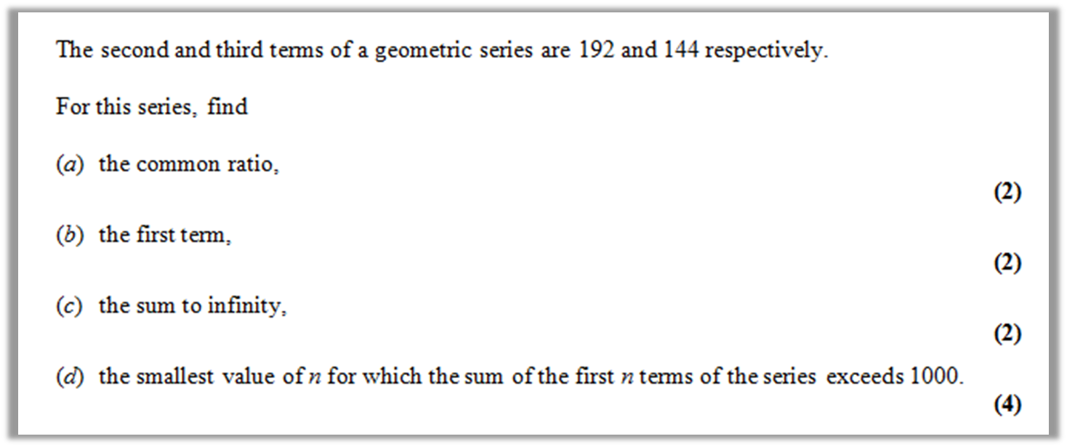
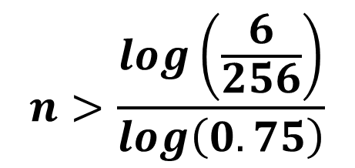

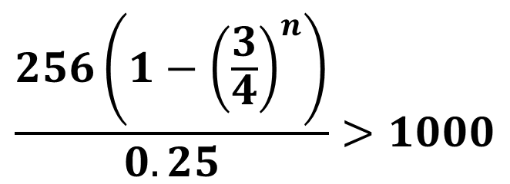
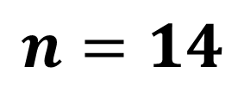


$$r=\frac{3}{4}$$
$$a=256$$
$$S_{∞}=1024$$
$$\frac{256\left(1−{\left(\frac{3}{4}\right)}^{n}\right)}{0.25}>1000$$
$$n>\frac{log\left(\frac{6}{256}\right)}{log\left(0.75\right)}$$
$$n=14$$

