Slide 1

You will be presented with six graphs graphing Olympic records over the years.
You task is to work out what those athletic events are.
Before you get started here are 3 great world records:
1) 100m world Record
http://www.youtube.com/watch?v=By1JQFxfLMM
2) Triple Jump World Record
http://www.youtube.com/watch?v=rgHYUDoG8_A
3) Javelin World Record
http://www.youtube.com/watch?v=NwfosNrFnwk

Slide 2
Event |  | Units
Men's 4 x 100 metres relay |  | points
Men's High Jump |  | metres
Men's Decathlon |  | seconds
Men's 100 metres |  | seconds
Men's Long Jump |  | metres
Men's Javelin |  | metres
Some questions you may want to ask yourself should be:
Can you determine what the units might be on the vertical axis for each graph?
Why do some graphs show a decreasing trend and some an increasing trend?
Are there any unusual features on any of the graphs?

Slide 3
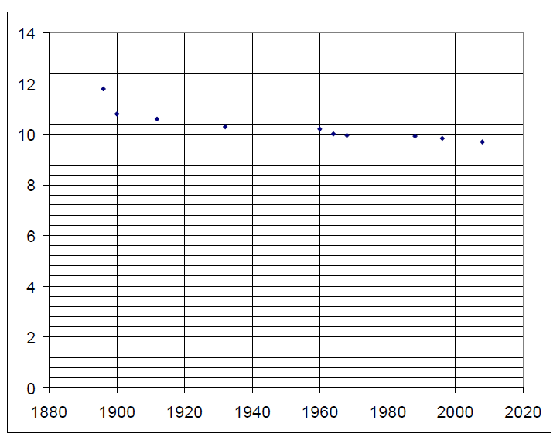
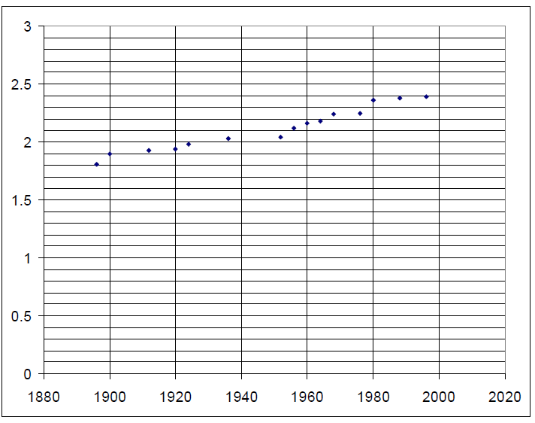
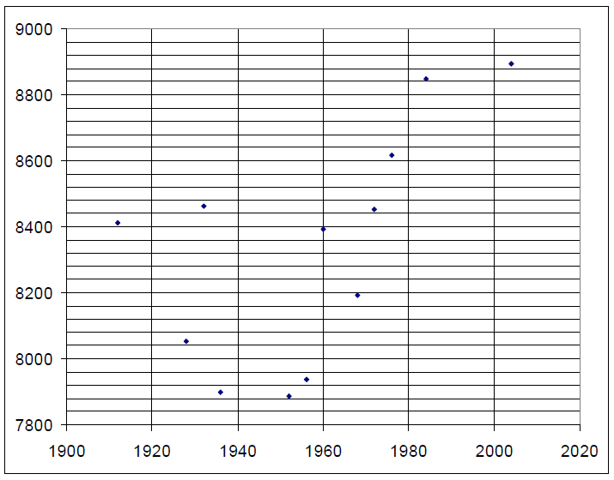
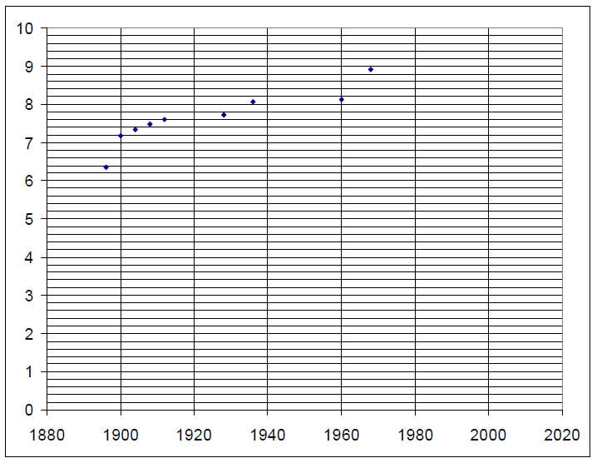
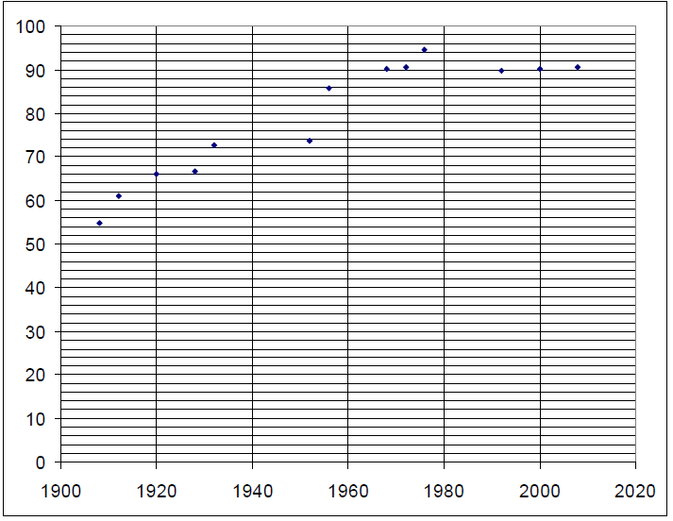
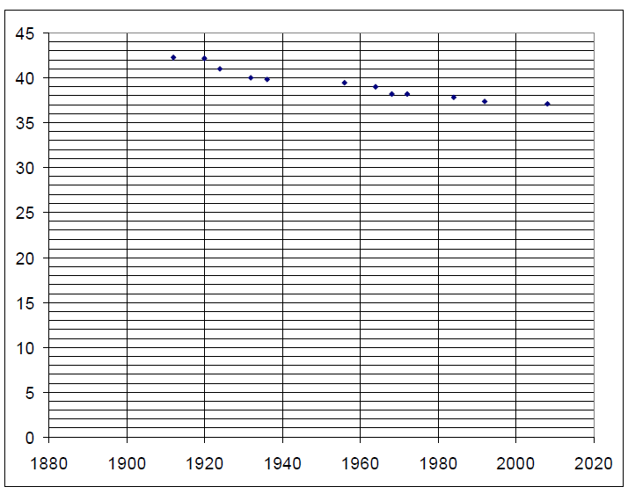
1
3
5
2
4
6

Slide 4
Answers

Slide 5
Graph | Event | Units
1 | Men's 100 metres | seconds
2 | Men's Long Jump | metres
3 | Men's High Jump | metres
4 | Men's Javelin | metres
5 | Men's Decathlon | points
6 | Men's 4 x 100 metres relay | seconds

