Slide 1
LO: Understating
Decimals

Slide 2
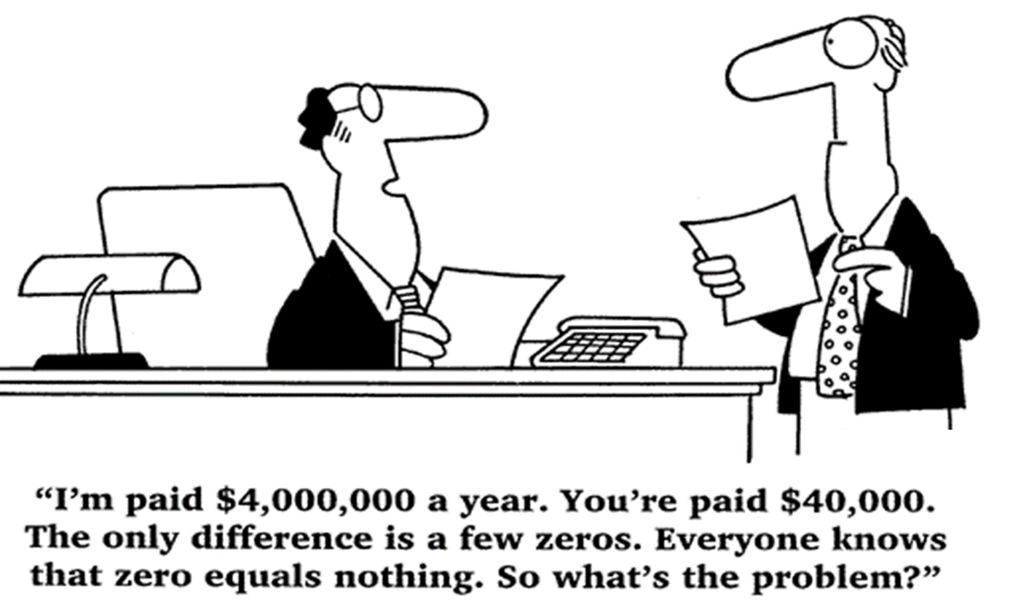

Slide 3
652.89 can be broken down
into 5 individual numbers.
600
50
2
0.8
0.09

Slide 4

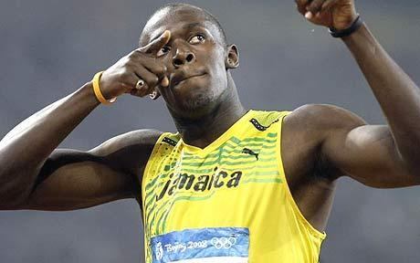
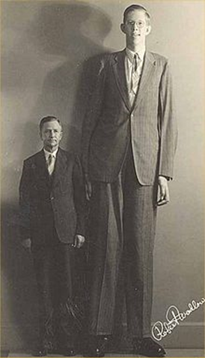
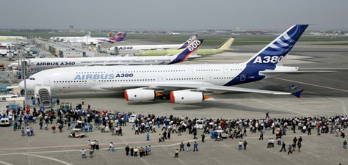
Why do we use decimal numbers?
Not everything comes in whole numbers.
Men’s 100m World Record
Bill Gates Bank Account!
World Tallest Person
9.58 seconds
61.3 million dollors
2.72 metres
Weight of Air Bus
276.8 Tonnes

Slide 5
Which number is bigger 1.72 or 1.702?
1 | . | 7 | 2
1 | . | 7 | 0 | 2

Slide 6
Which number is bigger 5.36 or 5.351?
5 | . | 3 | 6
5 | . | 3 | 5 | 1

Slide 7
What is the golden rule when adding or subtracting decimals?
Make sure the
decimal points are lined up.

Slide 8
2 | 3 | . | 5
+
 | 7 | . | 6
3 | 1 | . | 1

Slide 9
2 | 3 | . | 5
-
 | 7 | . | 6
1 | 5 | . | 9

Slide 10
+
3 | 7 | . | 2
9 | . | 4
3 | 7 | . | 2
+
 | 9 | . | 4
4 | 6 | . | 6

Slide 11
-
3 | 7 | . | 2
9 | . | 4
3 | 7 | . | 2
-
 | 9 | . | 4
2 | 7 | . | 8

