Slide 1
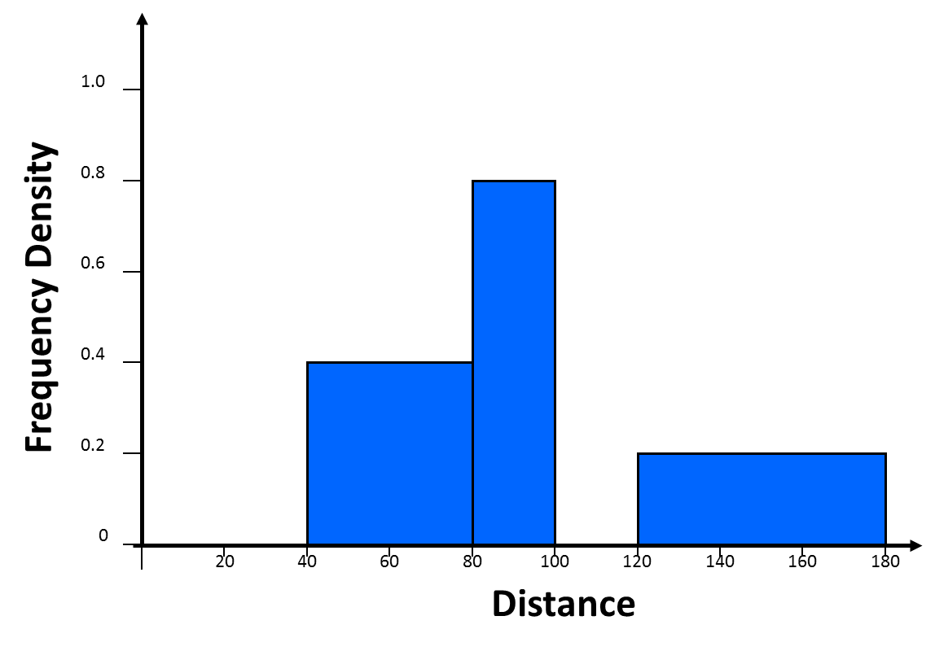
 | Complete the table
 | Length | Frequency
A | 0 < t < 40 | 4
B | 40 < t < 80
C | 80 < t < 100
D | 100 < t < 120 | 12
E | 120 < t < 180

Slide 2
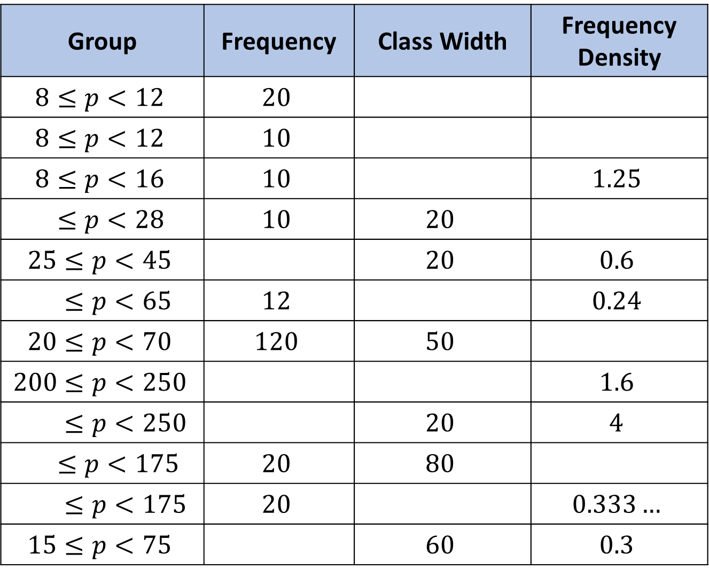
Group | Frequency | Class Width | Frequency Density
$$8≤p<12$$ | $$20$$ | $$4$$ | $$5$$
$$8≤p<12$$ | $$10$$
$$8≤p<16$$ | $$10$$ |  | $$1.25$$
$$8≤p<28$$ | $$10$$ | $$20$$
$$25≤p<45$$ |  | $$20$$ | $$0.6$$
$$15≤p<65$$ | $$12$$ |  | $$0.24$$
$$20≤p<70$$ | $$120$$ | $$50$$
$$200≤p<250$$ |  |  | $$1.6$$
$$230≤p<250$$ |  | $$20$$ | $$4$$
$$95≤p<175$$ | $$20$$ | $$80$$
$$115≤p<175$$ | $$20$$ |  | $$0.333…$$
$$15≤p<75$$ |  | $$60$$ | $$0.3$$
1)
2)
3)
4)
5)
6)
7)
8)
9)
10)
11)
12)

Slide 3
ANSWERS

Slide 4
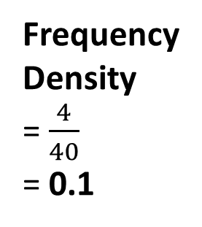
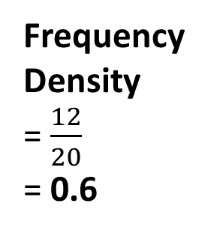
 | Complete the table
 | Length | Frequency
A | 0 < t < 40 | 4
B | 40 < t < 80
C | 80 < t < 100
D | 100 < t < 120 | 12
E | 120 < t < 180
C
B
0.4
Frequency
= 0.8 x 20
= 16
40
0.8
Frequency
= 0.4 x 40
= 16
20
Frequency
= 0.2 x 60
= 12
0.2
E
60
Frequency
Density
= $\frac{4}{40}$
= 0.1
Frequency
Density
= $\frac{12}{20}$
= 0.6
4
12
A
D
40
20

Slide 5

















Group | Frequency | Class Width | Frequency Density
$$8≤p<12$$ | $$20$$ | $$4$$ | $$5$$
$$8≤p<12$$ | $$10$$
$$8≤p<16$$ | $$10$$ |  | $$1.25$$
$$8≤p<28$$ | $$10$$ | $$20$$
$$25≤p<45$$ |  | $$20$$ | $$0.6$$
$$15≤p<65$$ | $$12$$ |  | $$0.24$$
$$20≤p<70$$ | $$120$$ | $$50$$
$$200≤p<250$$ |  |  | $$1.6$$
$$230≤p<250$$ |  | $$20$$ | $$4$$
$$95≤p<175$$ | $$20$$ | $$80$$
$$115≤p<175$$ | $$20$$ |  | $$0.333…$$
$$15≤p<75$$ |  | $$60$$ | $$0.3$$
1)
$$4$$ | $$5$$
2)
$$4$$ | $$2.5$$
3)
$$8$$
4)
$$8$$
$$0.5$$
5)
$$12$$
6)
$$15$$
$$50$$
7)
$$2.4$$
8)
$$80$$ | $$50$$
9)
$$230$$
$$80$$
10)
$$95$$
$$0.25$$
11)
$$115$$
$$60$$
12)
$$18$$

